Slide 1
2022 MASBO Budget Workshops
Mike Waterman
Executive Director of Business & Operations
Bozeman Public Schools
W: 406-522-6097
C: 406-589-4027
mike.waterman@bsd7.org
Denise Williams
Executive Director
MASBO
W: 406-461-3659
dwilliams@masbo.com

Slide 2
HB192 – Reksten
2021 Legislative Session
20-9-116. (Temporary) Resolution of intent to increase nonvoted levy -- notice.
(1) The trustees of a school district shall adopt a resolution no later than March 31 of each fiscal year and provide notice pursuant to subsection (2) whenever the trustees intend to impose an increase in a nonvoted levy in the ensuing school fiscal year for the purposes of funding any of the funds listed below:
  (a) the tuition fund under 20-5-324;
  (b) the adult education fund under 20-7-705;
  (c) the building reserve fund under 20-9-502 and 20-9-503;
  (d)(c) the transportation fund under 20-10-143 and 20-10-144;
  (e)(d) the bus depreciation reserve fund under 20-10-147; and
  (f)(e) the flexibility fund established in 20-9-543 for the purposes in 20-7-1602.
Notes:
HB192

Slide 3
HB192 – Reksten
2021 Legislative Session
20-9-116. (Temporary) Resolution of intent to increase nonvoted levy -- notice.
(2) The trustees shall provide notice of intent to impose an increase in a nonvoted levy for the ensuing school fiscal year by:
(a) adopting a resolution of intent to impose an increase in a nonvoted levy that includes, at a minimum, the estimated number of increased or decreased mills to be imposed and the estimated increased or decreased revenue to be raised compared to nonvoted levies under subsections (1)(a) through (1)(f) (1)(e) imposed in the current school fiscal year and, based on the district's taxable valuation most recently certified by the department of revenue under 15-10-202, the estimated impacts of the increase or decrease on a home valued at $100,000 and a home valued at $200,000; and
(b) publishing a copy of the resolution in a newspaper that will give notice to the largest number of people of the district as determined by the trustees and posting a copy of the resolution to the school district's website:
(i) the resolution under subsection (2)(a); and
(ii) the resolution under 20-9-502(3)(a)(i) if adopted by the trustees.
Notes:
HB192

Slide 4
20-9-502(3)(a)(i), MCA
Relevant Portion
To authorize and impose a levy under this subsection (3), the trustees shall:
following public notice requirements pursuant to 20-9-116, adopt no later than March 31 of each fiscal year a resolution:
  (A) identifying the anticipated improvements or projects for which the proceeds of the levy, the deposits and transfers authorized under subsection (3)(f) of this section, and anticipated state aid pursuant to 20-9-525(3) will be used; and
  (B) estimating a total dollar amount of money to be raised by the levy, the deposits and transfers authorized under subsection (3)(f) of this section, anticipated state aid pursuant to 20-9-525(3), and the resulting estimated number of mills to be levied using the district's taxable valuation most recently certified by the department of revenue under 15-10-202

Slide 5
Notice of Intent to Increase Nonvoted Levies
Annual notice requirements:
  Dollar and mill increases in nonvoted levies in:
    Transportation Fund
    Bus Depreciation Fund
    Tuition Fund
    Adult Ed Fund
    Flexibility
    Building Reserve Fund
  Using prior year taxable value
  Impact on $100K and $200K home
  Publish in newspaper by March 31
  Nonbinding

Slide 6
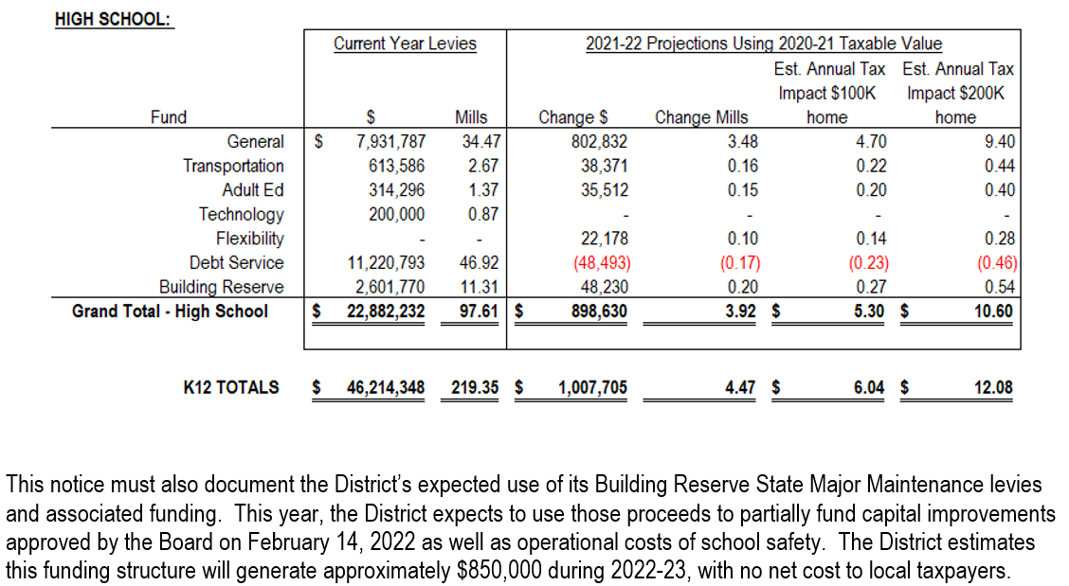
Notice of Intent to Increase Nonvoted Levies
Sample notice:

Slide 7
Notice of Intent to Increase Nonvoted Levies
Recommended Steps to Completion
  Determine desired outcome
  Complete budget projections
  Finalize the notice

Slide 8
Notice of Intent to Increase Nonvoted Levies
Step 1: Determine Desired Outcome
Ready
FIRE!
Aim

Slide 9
Notice of Intent to Increase Nonvoted Levies
Step 1: Determine Desired Outcome
Questions to consider:
What is transparency?
When your constituents read the notice, what message(s) do you want them to hear?
In the end, would you prefer this notice to err on the high or low side with regard to tax impact?
What is your strategy for managing the repercussions?

Slide 10
What is Transparency?
Questions:
Is transparency THE goal?
If not, what is?
How does transparency fit in that goal?

Slide 11
Notice of Intent to Increase Nonvoted Levies
Step 1: Determine Desired Outcome
Budgeted Fund | Permissive Levy? | Voted Levy?
General Fund (01) | Y | Y
Transportation Fund (10) | Y | N
Bus Depreciation Fund (11) | Y | N
Tuition Fund (13) | Y | N
Retirement Fund (14) | N/A | N
Adult Ed Fund (17) | Y | N
Technology Fund (28) | N | Y
Flexibility Fund (29) | Y | N
Debt Service Fund (50) | Y | Y
Building Reserve Fund (61) | Y | Y
Levies with tax impact;
notice not required
Notice required per 20-9-116, MCA

Slide 12
Notice of Intent to Increase Nonvoted Levies
Step 1: Determine Desired Outcome

Slide 13
Notice of Intent to Increase Nonvoted Levies
Step 1: Determine Desired Outcome

Slide 14
Notice of Intent to Increase Nonvoted Levies
Step 1: Determine Desired Outcome
Notice required per 20-9-116, MCA

Slide 15
Notice of Intent to Increase Nonvoted Levies
Recommended Steps to Completion
  Determine desired outcome
  Complete budget projections
  Finalize the notice

Slide 16
Calculating Mills
Don’t overcomplicate it!
  A mill is 1/1,000 of taxable value (TV/1000)
  Levied mills: Amount needed to raise / mill value
  Tax impact on a property: levied mills x property’s taxable value / 1000

Slide 17
Calculating Mills
Don’t overcomplicate it!
Taxable Value | Mill Value 1/1000 of TV | Amount to Raise | Mills Needed | Tax Impact on $100K home
$ 1,000,000 | $ 1,000 | $ 20,000 | 20.00 | $ 27.00
$ 25,000,000 | $ 25,000 | $ 50,000 | 2.00 | $ 2.70
$ 20,000,000 | $ 20,000 | $ 25,000 | 1.25 | $ 1.69
$ 24,000,000 | $ 24,000 | $ 36,000 | 1.50 | $ 2.03
$ 12,000,000 | $ 12,000 | $ 52,000 | 4.33 | $ 5.85
$ 41,357,866 | $ 41,358 | $ 20,000 | 0.48 | $ 0.65

Slide 18
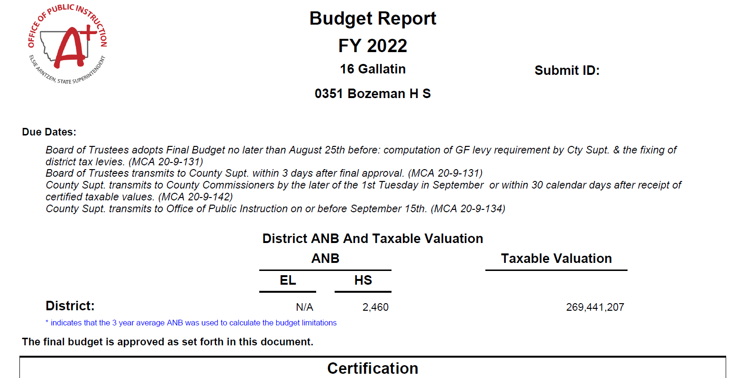
Calculating Mills
Taxable Value is basis for mill calculation:

Slide 19
Projecting Taxable Value

Slide 20
The Budgeting Process
Funding Sources
=
Funding Uses
Fund Balance Reappropriated (money carried forward from prior year)
New revenue
Expenditure Budget

Slide 21
The Budgeting Process

Slide 22
Fund balance reappropriated
+ New money
Spending authority (adopted budget)

Slide 23
Financing Sources for Budgeted Funds
Two types of budgeted funds:
Funding Sources Determine Spending Authority (Budget) | Spending Authority (Budget) Determines Funding Sources
General (01) | Transportation (10)
Bus Depreciation (11) | Tuition (13)
Technology (28) | Retirement (14)
Flexibility (29) | Adult Ed (17)
Building Reserve (61) | Debt Service (50)

Slide 24
Financing Sources for Budgeted Funds
Two types of budgeted funds:
Funding Sources Determine Spending Authority (Budget) | Spending Authority (Budget) Determines Funding Sources
General (01) | Transportation (10)
Bus Depreciation (11) | Tuition (13)
Technology (28) | Retirement (14)
Flexibility (29) | Adult Ed (17)
Building Reserve (61) | Debt Service (50)
Notice required per 20-9-116, MCA

Slide 25
Financing Sources for Budgeted Funds
Two types of budgeted funds:
YOUR JOB: Determine how much you need/want to spend and arrange funding sources to match.
Funding Sources Determine Spending Authority (Budget) | Spending Authority (Budget) Determines Funding Sources
General (01) | Transportation (10)
Bus Depreciation (11) | Tuition (13)
Technology (28) | Retirement (14)
Flexibility (29) | Adult Ed (17)
Building Reserve (61) | Debt Service (50)

Slide 26
Financing Sources for Budgeted Funds
Funding Sources Determine Spending Authority (Budget)
Step 1
Step 3
Step 2

Slide 27
Financing Sources for Budgeted Funds
Two types of budgeted funds:
YOUR JOB: Determine how much money you have available and develop a spending plan to fit that amount.
Funding Sources Determine Spending Authority (Budget) | Spending Authority (Budget) Determines Funding Sources
General (01) | Transportation (10)
Bus Depreciation (11) | Tuition (13)
Technology (28) | Retirement (14)
Flexibility (29) | Adult Ed (17)
Building Reserve (61) | Debt Service (50)

Slide 28
Financing Sources for Budgeted Funds
Funding Sources Determine Spending Authority (Budget)
Step 3
Step 2
Step 1

Slide 29
Financing Sources for Budgeted Funds
Funding Sources Determine Spending Authority (Budget)
YOUR JOB: Determine how much money you have available and develop a spending plan to fit that amount.
Fund Balance Reappropriated
+ New Money
Total Funds Available (Adopted Budget)
Funding Sources Determine Spending Authority (Budget) | Spending Authority (Budget) Determines Funding Sources
General (01) | Transportation (10)
Bus Depreciation (11) | Tuition (13)
Technology (28) | Retirement (14)
Flexibility (29) | Adult Ed (17)
Building Reserve (61) | Debt Service (50)

Slide 30
Financing Sources for Budgeted Funds
Funding Sources Determine Spending Authority (Budget)
YOUR JOB: Determine how much money you have available and develop a spending plan to fit that amount.
Fund Balance Reappropriated
+ New Money
Total Funds Available (Adopted Budget)
Funding Sources Determine Spending Authority (Budget) | Spending Authority (Budget) Determines Funding Sources
General (01) | Transportation (10)
Bus Depreciation (11) | Tuition (13)
Technology (28) | Retirement (14)
Flexibility (29) | Adult Ed (17)
Building Reserve (61) | Debt Service (50)
Step 1
Step 2
Step 3

Slide 31
Funding Sources Determine Spending Authority
Step 1: Fund Balance Reappropriated
What the heck is Fund Balance Reappropriated??

Slide 32
Funding Sources Determine Spending Authority
Step 1: Fund Balance Reappropriated
What the heck is Fund Balance Reappropriated??
Beginning Fund Balance
+ Revenue
- Expenditures
Ending Fund Balance
Reserves
(NOT used to fund ensuing year budget;
limited as a % of ensuing year budget)
Fund Balance Reappropriated:
(Ending fund balance used to fund ensuing year budget;
all non-reserved ending fund balance)

Slide 33
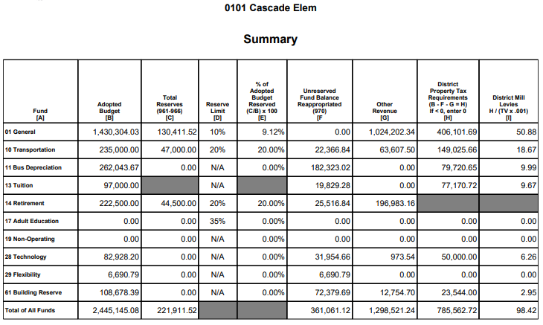
Funding Sources Determine Spending Authority
Step 1: Fund Balance Reappropriated

Slide 34
Funding Sources Determine Spending Authority
Step 1: Fund Balance Reappropriated
Reserves (C)
+ Fund Balance Reappropriated (F)
Beginning Fund Balance

Slide 35
Funding Sources Determine Spending Authority
Step 1: Fund Balance Reappropriated
Methods for estimating Fund Balance Reappropriated:
Averaging/trend analysis

Slide 36
Funding Sources Determine Spending Authority
Step 1: Fund Balance Reappropriated
Example: Technology Fund:
$ 500 Less: Budgeted interest
$ 7,500 Less: Budgeted course fees
$ 51,000 Permissive tax levy
 | Year 1 | Year 2 | Year 3 | Year 4 (Budget Year)
Fund Balance Reappropriated | $20,000 | $17,500 | $15,000
Budgeted Interest | $ 1,000 | $ 1,000 | $ 1,000
Local Levy | $50,000 | $50,000 | $50,000
Total Budget | $71,000 | $68,500 | $66,000

Slide 37
Funding Sources Determine Spending Authority
Step 1: Fund Balance Reappropriated
Methods for estimating Fund Balance Reappropriated:
Averaging/trend analysis
Actual/calculated

Slide 38
Funding Sources Determine Spending Authority
Step 1: Fund Balance Reappropriated
Methods for estimating Fund Balance Reappropriated:
Averaging/trend analysis
Actual/calculated:
    Beginning Fund Balance
    + Current Year Receipts
    - Current Year Expenditures
    Ending Fund Balance
    - Reserves
    Fund Balance Reappropriated
Generally zero
for these funds

Slide 39
The Importance of Fund Balance Reappropriated
Transportation Fund Example
 | Budget | Projected Actual
Beginning Fund Balance | $ 862,914 | $ 862,914
+ Revenues | $ 1,922,342 | $ 1,794,130
- Expenditures | $ 2,321,047 | $ 1,865,892
Ending Fund Balance | $ 464,209 | $ 791,152

Slide 40
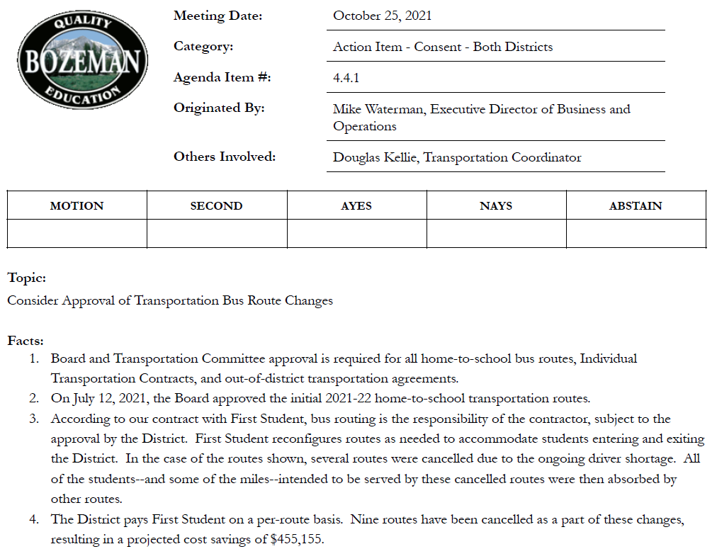

Slide 41
The Importance of Fund Balance Reappropriated
Transportation Fund Example
 | Budget | Projected Actual
Beginning Fund Balance | $ 862,914 | $ 862,914
+ Revenues | $ 1,922,342 | $ 1,794,130
- Expenditures | $ 2,321,047 | $ 1,865,892
Ending Fund Balance | $ 464,209 | $ 791,152
Expected end result:
Higher ending fund balance;
Higher fund balance reappropriated, lower taxes in ensuring year

Slide 42
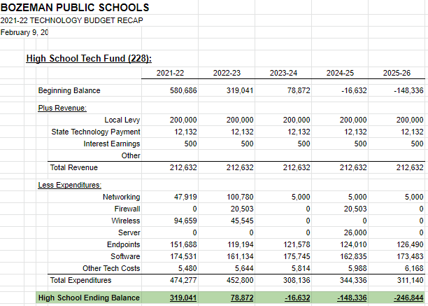
The Importance of Fund Balance Reappropriated
Technology Fund Example

Slide 43
The Importance of Fund Balance Reappropriated
Technology Fund Example

Slide 44
Funding Sources Determine Spending Authority
Step 1: Fund Balance Reappropriated
Methods for estimating Fund Balance Reappropriated:
Averaging/trend analysis
Actual/calculated:
    Beginning Fund Balance
    + Current Year Receipts
    - Current Year Expenditures
    Ending Fund Balance
    - Reserves
    Fund Balance Reappropriated
Being conservative? Recommend estimating low

Slide 45
Financing Sources for Budgeted Funds
Funding Sources Determine Spending Authority (Budget)
YOUR JOB: Determine how much money you have available and develop a spending plan to fit that amount.
Fund Balance Reappropriated
+ New Money
Total Funds Available (Adopted Budget)
Funding Sources Determine Spending Authority (Budget) | Spending Authority (Budget) Determines Funding Sources
General (01) | Transportation (10)
Bus Depreciation (11) | Tuition (13)
Technology (28) | Retirement (14)
Flexibility (29) | Adult Ed (17)
Building Reserve (61) | Debt Service (50)
Step 1
Step 2
Step 3

Slide 46
Funding Sources Determine Spending Authority
Step 2: Estimating New Money
Common (but not exhaustive) list of budgeted revenue sources:
Fund | Interest | Permissive Levy | Voted Levy | State Funding
General (01) | Y | Y | Y | Y
Bus Depreciation (11) | Y | Y
Technology (28) | Y |  | Y | Y
Flexibility (29) | Y | Y |  | Y
Building Reserve (61) | Y | Y | Y | Y

Slide 47
Funding Sources Determine Spending Authority
Step 2: Estimating New Money
Methods for estimating New Money:
Tax levies
  Voted levied: use voted amount
  Permissive levies: start with prior year amounts, adjust levies and/or budgets as necessary
Non-levy revenue:
  Internal: analyze actual trends
  State payments: start with prior year amounts
  Recommend estimating low
General Fund:
  Preliminary Budget Data Sheets
  OPI’s General Fund Spreadsheet (best)
Transportation Fund: OPI Transportation Fund Worksheet

Slide 48
Funding Sources Determine Spending Authority
Step 3: Adopted Budget
Add ‘em up!
Fund Balance Reappropriated
+ New Money
Total Funds Available (Adopted Budget)
Step 1
Step 2
Step 3

Slide 49
Funding Sources Determine Spending Authority
Step 3: Adopted Budget
Revenue (G+H)
+ Fund Balance Reappropriated (F)
Budget (Funding Uses) (B)
Funding
Sources

Slide 50
Funding Sources Determine Spending Authority
Example 1: Bus Depreciation Fund:
$ 125,000 Fund Balance Reappropriated
$ 1,000 Budgeted Interest
$ 74,000 Permissive local levy
$ Total adopted budget

Slide 51
Funding Sources Determine Spending Authority
Example 1: Bus Depreciation Fund:
  Step 1: Fund Balance Reappropriated:
  Beginning Fund Balance
  + Current Year Receipts
  - Current Year Expenditures
  Ending Fund Balance

Slide 52
Funding Sources Determine Spending Authority
Example 1: Bus Depreciation Fund:
2021-22 Beginning Balance (from FY22 Budget) $ 50,000
Plus: FY22 Budgeted Revenue (from FY22 Budget) $ 75,000
Interest $ 5,000
Local Tax Levy $ 70,000
Less: 2021-22 Estimated Expenditures (Internal) $ - 0 –
Projected 2021-22 Ending Fund Balance $ ???

Slide 53
Funding Sources Determine Spending Authority
Example 1: Bus Depreciation Fund
  Step 1: Fund Balance Reappropriated
  Step 2: New Money

Slide 54
Funding Sources Determine Spending Authority
Example 1: Bus Depreciation Fund:
$ 125,000 Fund Balance Reappropriated
$ 5,000 Budgeted Interest
$ 70,000 Permissive local levy
$ ??? Total adopted budget

Slide 55
Funding Sources Determine Spending Authority
Example 1: FY22 Bus Depreciation Fund Budget:
$ 125,000 Fund Balance Reappropriated
$ 1,000 Budgeted Interest
$ 74,000 Permissive local levy
$ Total adopted budget
Step 1 FY22 Fund Balance Reappropriated: $187,351.64*
Step 2 New Money: $ 20,000.00
Step 3 FY23 Total Adopted Budget: $207,351.64
* Assumes no buses purchased in FY22

Slide 56
Funding Sources Determine Spending Authority
Step 3: Adopted Budget
Example: Technology Fund:
$ 500 Less: Budgeted interest
$ 7,500 Less: Budgeted course fees
$ 51,000 Permissive tax levy
 | Year 1 | Year 2 | Year 3 | Year 4 (Budget Year)
Fund Balance Reappropriated | $20,000 | $17,500 | $15,000 | $ 12,500
Budgeted Interest | $ 1,000 | $ 1,000 | $ 1,000 | $ 1,000
Local Levy | $50,000 | $50,000 | $50,000 | $ 50,000
Total Budget | $71,000 | $68,500 | $66,000 | $ 63,500

Slide 57
Funding Sources Determine Spending Authority
Additional Considerations: Building Reserve Fund
  Structure:
  UPDATED permissive levy for school facility maintenance, improvements to school and student safety (20-9-502, MCA)
  Max annual contribution amount from ALL sources
      $15,000 + (budget limit ANB x $110)
Examples:
ANB | Max Annual Contribution
100 | $ 26,000 (100 x $110 + $15,000)
500 | $ 70,000 (500 x $110 + $15,000)
750 | $ 97,500 (750 x $110 + $15,000)

Slide 58
Funding Sources Determine Spending Authority
Additional Considerations: Building Reserve Fund
  Structure:
  Max annual contribution amount from ALL sources
      $15,000 + (budget limit ANB x $110)
  Requires use of Project Reporter Codes (“Subfunds) in Building Reserve Fund
    Balance sheet accounts (including cash and fund balance), revenues, and expenditures all tracked separately
    Reconcile PRCs monthly! Recommend using OPI Fund 15 spreadsheet

Slide 59
Funding Sources Determine Spending Authority
Additional Considerations: Building Reserve Fund
  Allowable Uses [20-9-525(2), MCA]:
    improvements to school and student safety and security as described in 20-9-236(1)
      planning for improvements to and maintenance of school and student safety, including but not limited to the cost of staffing for or services provided by architects, engineers, school resource officers, counselors, and other staff or consultants assisting the district with improvements to school and student safety and security;
      programs to support school and student safety and security, including but not limited to active shooter training, threat assessments, and restorative justice;
      installing or updating locking mechanisms and ingress and egress systems at public school access points, including but not limited to systems for exterior egress doors and interior passageways and rooms, using contemporary technologies;
      installing or updating bullet-resistant windows and barriers; and
      installing or updating emergency response systems using contemporary technologies;
      and
    projects designed to produce operational efficiencies such as utility savings, reduced future maintenance costs, improved utilization of staff, and enhanced learning environments for students, including but not limited to projects addressing:
      roofing systems;
      heating, air-conditioning, and ventilation systems;
      energy-efficient window and door systems and insulation;
      plumbing systems;
      electrical systems and lighting systems;
      information technology infrastructure, including internet connectivity both within and to the school facility; and
      other critical repairs to an existing school facility or facilities.

Slide 60
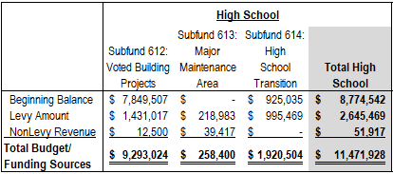
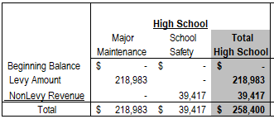
Funding Sources Determine Spending Authority
Additional Considerations: Building Reserve Fund
Funding Sources by Subfund:
Subfund 613 Sources and Uses:

Slide 61
Funding Sources Determine Spending Authority
Additional Considerations: Building Reserve Fund
20-9-502(3)(a)(i), MCA:
To authorize and impose a levy under this subsection (3), the trustees shall:
following public notice requirements pursuant to 20-9-116, adopt no later than March 31 of each fiscal year a resolution:
  (A) identifying the anticipated improvements or projects for which the proceeds of the levy, the deposits and transfers authorized under subsection (3)(f) of this section, and anticipated state aid pursuant to 20-9-525(3) will be used; and
  (B) estimating a total dollar amount of money to be raised by the levy, the deposits and transfers authorized under subsection (3)(f) of this section, anticipated state aid pursuant to 20-9-525(3), and the resulting estimated number of mills to be levied using the district's taxable valuation most recently certified by the department of revenue under 15-10-202

Slide 62
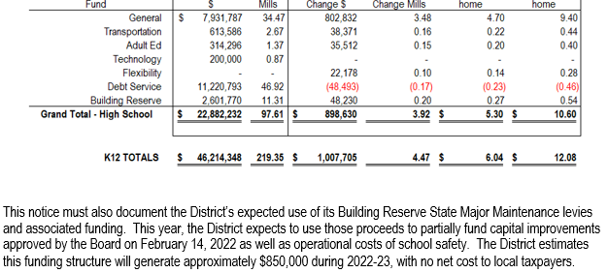
Funding Sources Determine Spending Authority
Additional Considerations: Building Reserve Fund

Slide 63
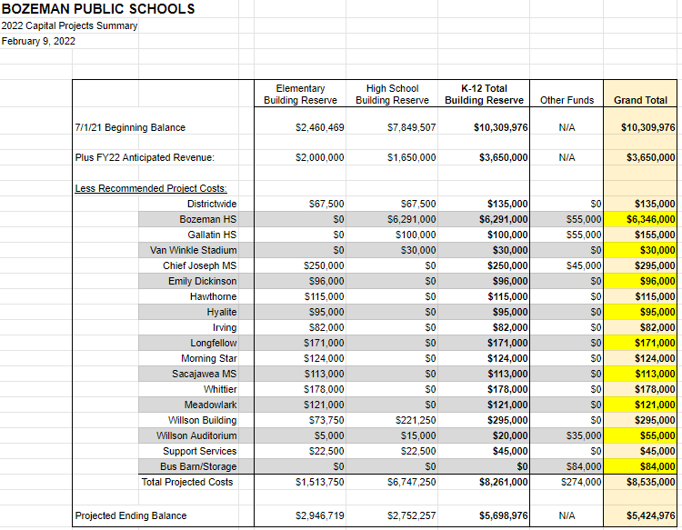
Funding Sources Determine Spending Authority
Additional Considerations: Building Reserve Fund

Slide 64
Financing Sources for Budgeted Funds
Funding Sources Determine Spending Authority
YOUR JOB: Determine how much money you have available and develop a spending plan to fit that amount.
To the Spreadsheet!
Work on the BLUE tabs!
Funding Sources Determine Spending Authority (Budget) | Spending Authority (Budget) Determines Funding Sources
General (01) | Transportation (10)
Bus Depreciation (11) | Tuition (13)
Technology (28) | Retirement (14)
Flexibility (29) | Adult Ed (17)
Building Reserve (61) | Debt Service (50)

Slide 65
Financing Sources for Budgeted Funds
YOUR JOB: Determine how much you need/want to spend and arrange funding sources to match.
Funding Sources Determine Spending Authority (Budget) | Spending Authority (Budget) Determines Funding Sources
General (01) | Transportation (10)
Bus Depreciation (11) | Tuition (13)
Technology (28) | Retirement (14)
Flexibility (29) | Adult Ed (17)
Building Reserve (61) | Debt Service (50)
Fund Balance Reappropriated
+ New Money
Total Funds Available (Adopted Budget)

Slide 66
Financing Sources for Budgeted Funds
YOUR JOB: Determine how much you need/want to spend and arrange funding sources to match.
Funding Sources Determine Spending Authority (Budget) | Spending Authority (Budget) Determines Funding Sources
General (01) | Transportation (10)
Bus Depreciation (11) | Tuition (13)
Technology (28) | Retirement (14)
Flexibility (29) | Adult Ed (17)
Building Reserve (61) | Debt Service (50)
Fund Balance Reappropriated
+ New Money
Total Funds Available (Adopted Budget)
Step 2
Step 3
Step 1

Slide 67
Spending Authority Determines Funding Sources
Step 1: Determine Expenditure Budget
Fund | Expenditure Budget Needed
Transportation (10) | Amount to finance home-to-school transportation
Tuition (13) | Amount to finance: Private non-sectarian day treatment programs Tuition for resident students placed in county or regional detention facilities Tuition for resident students attending another public school at the expense of the resident district The cost of a free and appropriate education for resident students with an Individualized Education Plan (IEP)
Retirement (14) | Amount to finance FICA, TRS, PERS, unemployment for employees paid from state/local funds
Adult Ed (17) | Amount to finance Adult Ed Program
Debt Service (50) | Amount to finance bonds and SID payments

Slide 68
Spending Authority Determines Funding Sources
Step 2: Fund Balance Reappropriated
YOUR JOB: Determine how much you need/want to spend and arrange funding sources to match.
Funding Sources Determine Spending Authority (Budget) | Spending Authority (Budget) Determines Funding Sources
General (01) | Transportation (10)
Bus Depreciation (11) | Tuition (13)
Technology (28) | Retirement (14)
Flexibility (29) | Adult Ed (17)
Building Reserve (61) | Debt Service (50)
Fund Balance Reappropriated
+ New Money
Total Funds Available (Adopted Budget)
Step 2
Step 3
Step 1

Slide 69
Spending Authority Determines Funding Sources
Step 3: Estimating New Money
YOUR JOB: Determine how much you need/want to spend and arrange funding sources to match.
Funding Sources Determine Spending Authority (Budget) | Spending Authority (Budget) Determines Funding Sources
General (01) | Transportation (10)
Bus Depreciation (11) | Tuition (13)
Technology (28) | Retirement (14)
Flexibility (29) | Adult Ed (17)
Building Reserve (61) | Debt Service (50)
Fund Balance Reappropriated
+ New Money
Total Funds Available (Adopted Budget)
Step 2
Step 3
Step 1

Slide 70
Spending Authority Determines Funding Sources
Step 3: Estimating New Money
Funds left over from last year (fund balance reappropriated)
+ New Money
Total funds available (i.e., your adopted budget)
Total funds available (i.e., your adopted budget)
- Funds left over from last year (fund balance reappropriated)
New Money

Slide 71
Spending Authority Determines Funding Sources
Step 3: Estimating New Money
Example 1: Retirement Fund:
$ 500,000 Adopted budget (funds needed)
$ 5,000 Less: fund balance reappropriated
$ 1,000 Less: budgeted interest
$ New money (county retirement
distribution = taxes)

Slide 72
Spending Authority Determines Funding Sources
Example 2: Adult Education Fund:
$ 500 Less: Budgeted interest
$ 7,500 Less: Budgeted course fees
$ 51,000 Permissive tax levy
 | Year 1 | Year 2 | Year 3 | Year 4 (Budget Year)
Fund Balance Reappropriated | $1,500 | $2,500 | $2,000
Budgeted Interest | $500 | $500 | $500
Course Fees | $7,750 | $7,500 | $7,250
Local Levy | $50,250 | $49,500 | $50,250
Total Budget | $60,000 | $60,000 | $60,000

Slide 73
Spending Authority Determines Funding Sources
Step 1: Determine
Expenditure Budget

Slide 74
Spending Authority Determines Funding Sources
Step 2: Fund Balance
Reappropriated

Slide 75
Spending Authority Determines Funding Sources
Step 3: New Money

Slide 76
Spending Authority Determines Funding Sources
Step 3: Estimating New Money
Common (but not exhaustive) list of budgeted revenue sources:
Fund | Interest | User Fees | Permissive Levy | Voted Levy | State Funding | County Funding
Transportation (10) | Y |  | Y |  | Y | Y
Tuition (13) | Y |  | Y
Retirement (14) | Y |  |  |  |  | Y
Adult Ed (17) | Y | Y | Y |  | Y
Debt Service (50) | Y |  | Y | Y | Y

Slide 77
Spending Authority Determines Funding Sources
Funding Sources Determine Spending Authority (Budget) | Spending Authority (Budget) Determines Funding Sources
General (01) | Transportation (10)
Bus Depreciation (11) | Tuition (13)
Technology (28) | Retirement (14)
Flexibility (29) | Adult Ed (17)
Building Reserve (61) | Debt Service (50)
YOUR JOB: Determine how much you need/want to spend and arrange funding sources to match.
To The Spreadsheet!!
This time, use the RED tabs

Slide 78
Notice of Intent to Increase NonVoted Levies
Recommended Steps to Completion
  Determine desired outcome
  Complete budget projections
  Finalize the notice

Slide 79
Finalizing the Notice
Next steps:
Decide what to include in notice
Develop notice language…
Refine numbers
Make year-end spending decisions with ending fund balance, ensuing year taxes in mind

Slide 80
Notice of Intent to Increase Permissive Levies
Step 1: Determine Desired Outcome
Questions to consider:
What is transparency?
When your constituents read the notice, what message(s) do you want them to hear?
In the end, would you prefer this notice to err on the high or low side with regard to tax impact?
What is your strategy for managing the repercussions?

Slide 81
Finalizing the Notice
Next steps:
Decide what to include in notice
Develop notice language
Get Board approval, post notice as required
Refine numbers
Make year-end spending decisions with ending fund balance, ensuing year taxes in mind

Slide 82
THANK YOU FOR COMING!!
Mike Waterman
Executive Director of Business & Operations
Bozeman Public Schools
W: 406-522-6097
C: 406-589-4027
mike.waterman@bsd7.org
Denise Williams
Executive Director
MASBO
W: 406-461-3659
dwilliams@masbo.com

