Slide 1

Playground safety
Presented by:
Brodie Loushin
Commercial Insurance Risk Control Specialist

Slide 2
Agenda
Common playground injury statistics
Common playground hazards and types of injuries
Parts of the playground and how they should be maintained
General considerations

Slide 3
Playground Injury Statistics
Each year, Emergency Departments treat about 200,000 children 15 years old and younger for playground related injuries.
The American Academy of Orthopedic Surgeons estimates 527,000 children are treated in hospitals, emergency departments, doctors offices, and ambulatory surgery centers.
45 percent of the playground injuries that take place are severe: fractures, concussions and dislocations.

Slide 4
Playground Injury Statistics
75 percent of non-fatal injuries take place on public playgrounds like those in schools and parks.
70 percent of the deaths that take place on playgrounds happen on home playgrounds

Slide 5
The Playground Injury Problem
Falls to the surface cause 70 percent of the injuries on playgrounds.
Entanglement of clothing, strings and ropes are the number one cause of death on playgrounds
Other dangers include:
  Head entrapment in equipment openings
  Impact of moving swings
  Tripping on loose equipment

Slide 6
Playground Injuries Are Preventable

Slide 7
Follow the SAFE Model
Supervision and Survey
Age appropriate and design
Fall Surface Cushioning
Equipment Maintenance

Slide 8
S-Supervision
To properly supervise children they need to be seen
They need to be visible in crawl spaces
Playground rules should be posted

Slide 9
S- Survey
Before children are allowed to play in playgrounds:
Look for safety hazards
  Look for broken glass, litter, pieces of metal and other sharp objects
  In summer, check metal equipment to make sure it is not hot

Slide 10
S-Survey
Make sure there are no tripping hazards like:
  Tree stumps
  Exposed concrete
  Missing rubber tiles
  Pot holes

Slide 11
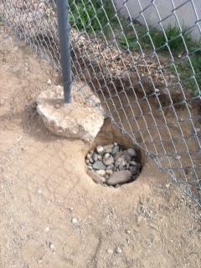
S-Survey
Some common tripping hazards found in playgrounds

Slide 12
A= Age Appropriate Equipment and Design
Children develop different skills at different ages.
Equipment designed for children 5-12 is too big for children ages 2-5.
Platforms elevated more than 20 inches above the ground need guardrails or protective barriers for ages 2-5year olds and those higher than 3-inches need barriers for 5-12 years olds.

Slide 13
F= Fall to Safe Surfaces
Surfacing must be provided under all equipment, and there must be at least a 6 foot fall zone around all equipment.
For swings the length of the fall zone should be twice the height of the beam from which the swing hangs

Slide 15
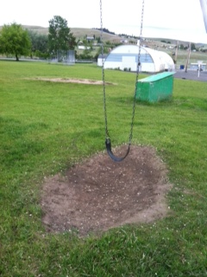
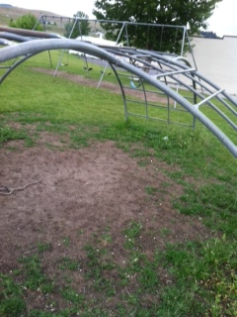
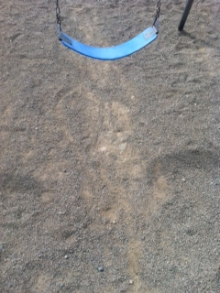
Fill material needed under
playground equipment

Slide 16
E= Equipment Maintenance
Check to make sure that equipment is:
  Anchored safety into the ground
  Well maintained
  Free of broken parts
  Has no noticeable gaps less than 3 ½ inches or more than 9 inches

Slide 17
E= Equipment Maintenance
Check to make sure that the equipment is free of:
    Dangerous hardware like protruding bolts and improperly closed s-hooks
    Sharp points or edges
    Splinters
    Cracks or holes
    (Make sure your child’s clothes are tucked in; items that may get caught in the equipment can be strangulation risk (hoodies, scarves, loose hanging strings, jewelry, hooks, cords, and helmets)

Slide 18
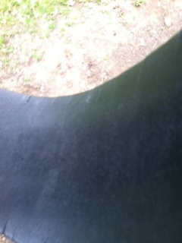
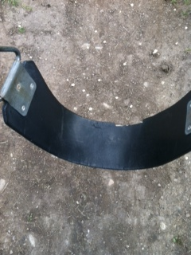
E= Equipment Maintenance
Swings that are old and cracked can be very dangerous and are in need of replacement
There should also be only a maximum of two swing per bay

Slide 19
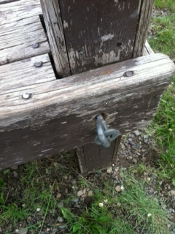
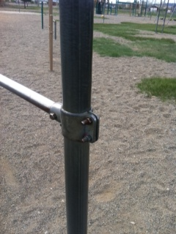
E= Equipment Maintenance
Projections on playground equipment should not able to entangle children’s clothing nor should they be large enough to impale. Bolts should not expose more than two threads beyond the end of the nut.

Slide 20
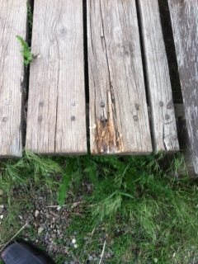
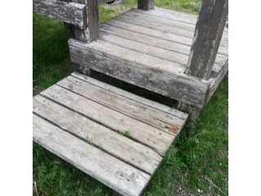
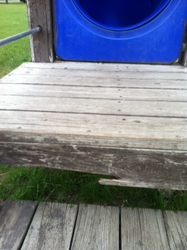
E= Equipment Maintenance
Make sure that that all damaged or weathered wood on a playground equipment
is replaced. Wood that is damaged can cause children to be injured by splinters.
Rotted wood need to be replaced immediately because it becomes very brittle and
can break easily.

Slide 21
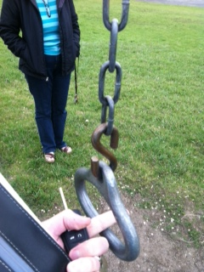
E= Equipment Maintenance
All hooks, such as C-hooks and S-hooks, should be closed. A hook is considered closed if there is not a gap or space greater than .04 inches, about the thickness of a dime. Also make sure that the hooks are not rusting and wearing down. Some hooks may be closed, but still may need to be replaced because of wear and tear.

Slide 22
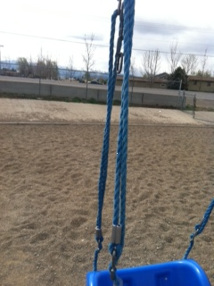
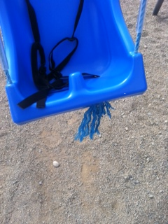
E= Equipment Maintenance
According to the Consumer Product Safety Commission fiber ropes are not recommended as a means of suspending swings since they may degrade over time.

Slide 23
General Playground Considerations

Slide 24
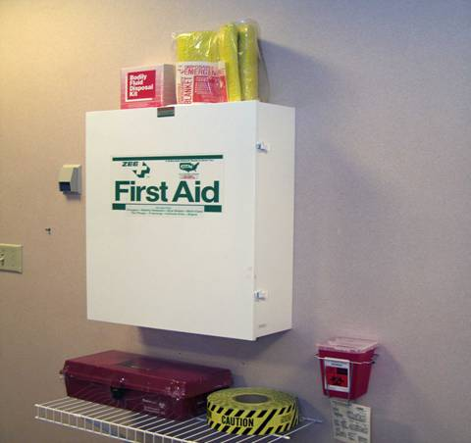
First Aid

Slide 25
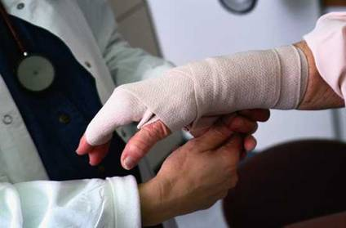
First aid intervention
Bandaging
Splinting
  Only if help will be delayed use a splint to keep the area mobilized
Moving and
rescuing victims
4a

Slide 26
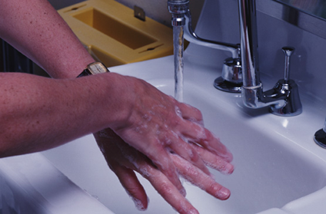
Universal precautions
Definition of universal precautions
Value of universal precautions
OSHA standard for occupational exposure to blood borne pathogens
5a

Slide 27
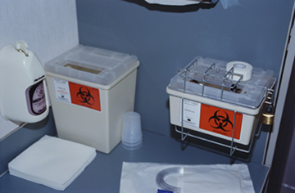
Universal precautions
Personal protective equipment
Tagging and disposing of sharp items
5c

Slide 28
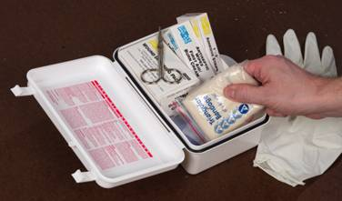
First aid supplies
Type of supplies
Amount of supplies
Maintenance of supplies
Storage of supplies
6a

Slide 29
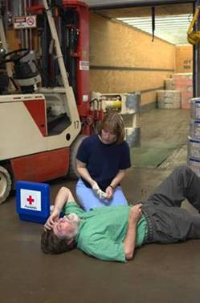
Program elements: type of injury
Shock
  Shock due to injury
  Shock due to allergic reactions
  Treating fainting victims
7a

Slide 30
Signs and Symptoms of Shock
Anxiety, confusion, agitation, or restlessness
Dizziness, light-headiness
Cool, clammy, or sweating skin that is pale, bluish, or ashen in color
Rapid, shallow breathing
Thirst
Nausea, vomiting
Changing responsiveness
If someone is going into shock get medical help as soon as possible

Slide 31
First Aid for Shock
Check for normal breathing and for injuries.
Call 911
Have victim lie on back and raise legs 8-12 inches if possible (spinal injury). Loosen tight clothing.
Prepare for possible vomiting turn the victim’s head to the side
Try to maintain victim body temperature- Cover with a blanket
Do not let a shock victim eat or drink anything
Stay with the victim and offer reassurance and comfort
Put an unresponsive victim ( if no suspected spinal injury) in the recovery position.

Slide 32
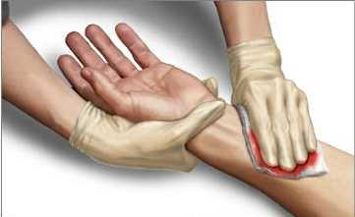
Program elements: type of injury
Controlling bleeding
  Direct pressure
  Pressure points
  Elevation
  Pressure bandaging
7c

Slide 33
Cold Emergencies
Hypothermia
Make sure students are dressed properly for weather conditions
  Signs and symptoms- uncontrollable shivering, irrational behavior, clumsy movements, pale skin, slow breathing
  First Aid
    Call 911
    Get out of the cold, remove wet clothing
    Warm victim with blanks or clothing
    Don’t warm person too fast or it can cause heart problems i.e.- putting into a hot bath or using direct heat
    Do not rub the skin of victim-Handle with care
    Give hot drinks to victim- No caffeine or alcohol
Frost Bite
  First Aid
    Move the victim out of the cold
    Remove constricting items
    Protect between fingers with dry gauze and fluffy cloth
    Seek medical as soon as possible
    Warm with lukewarm water only if help is delayed
    Protect and elevate the area

Slide 34
Warm Emergencies
Heat Exhaustion
  Signs and symptoms-
    Heavy sweating, thirst, fatigue, heat cramps
    Later headache, dizziness, nausea, or vomiting-May develop into heatstroke
  First Aid
    Move victim out of heat and rest in a cool place, loosen restrictive clothing
    Give water
    Raise legs 8-12 inches
    Cool victim with water
Heat Stroke
  Signs and symptoms-fast breathing, sweating may have stopped, fast breathing, headache, confusion, convulsions or unresponsiveness
  First Aid
    Call 911
    Move victim to cool place
    Cool victim as quickly possible
    Do not give victim drinks with alcohol or caffeine- If mental status is diminished do not give fluids
    Monitor breathing and give CPR if necessary

Slide 35
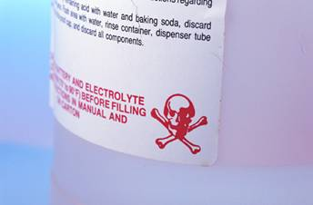
Program elements: type of injury
Poisoning
  Alkali
  Acid
  Systemic
  Topical
  Drug abuse
  Poison control center
  Chemical emergency information (MSDSs)
7e

Slide 36
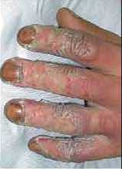
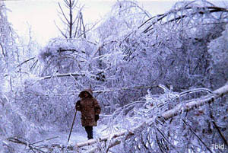
Program elements: type of injury
Burns
  First degree
  Second degree
    Skin is swollen and red
    Blisters with clear fluid
    Pain
  Third degree
    Skin damage, charred skin, white or leathery skin
    Damages nerve endings- not as painful
    (Make sure that kids are careful of metal slides on hot days which can cause 2nd and 3rd degree burns on the skin
First Aid for Burns
  Stop the heat source
  Cool the area, but no more than 20% of the area
  Call 911
  Treat for shock
  Carefully cover with a no-stick dressing
7f

Slide 37
Program elements: type of injury
Bites and stings
  Human and animal
  Insects
  Call 911 for any poisonous bites or stings
7h

Slide 38
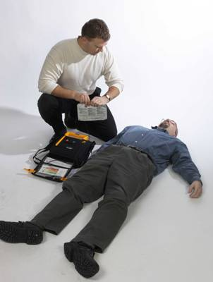
Program elements: type of injury
Medical emergencies
  Heart attacks
  Asthma attacks
  Diabetic emergencies
  Seizures
  Stroke
7i

Slide 39
Heart Attack
Signs and symptoms
  Persistent Chest Pain that last longer than 3 to 5 minutes and or goes away and comes back
  Chest Pain spreading to the shoulders, neck, jaw, stomach or arms
  Shortness of breathe, dizziness, nausea or vomiting and fainting, pale skin, sweating, and denial of signs and symptoms
First Aid
  Call 911
  Rest victim in comfortable position. Loosen constricting clothing.
  Ask the victim if he or she is taking heart medication, and help obtain the medication for the victim
  If at home, allow the victim to take or chew one aspirin unless he or she is allergic
  Be assuring to the victim to keep them calm- Do not let victim eat or drink anything

Slide 40
Asthma Attacks
Signs and symptoms
  Wheezing and difficulty breathing and speaking
  Dry, persistent cough
  Fear, anxiety
  Gray-blue skin
  Changing levels of responsiveness
First Aid
  Call 911 if the victim is not known to have asthma or if the person condition get worse
  Help the victim use his or her medication
  Help the victim rest and sit in a position for easiest breathing.

Slide 41
Diabetic Hypoglycemia
Hypoglycemia
  Not enough sugar
  Sudden dizziness, shakiness, mood change , headache, confusion, pale skin, sweating and hunger
Hyperglycemia
  Too much insulin
    Frequent urination, drowsiness, dry mouth, thirst, shortness of breath, rapid breathing, nausea/ vomiting, fruity smelling breath

Slide 42
Diabetic Hypoglycemia
Give sugar to a victim experiencing either low or high blood sugar
Call 911 if the victim becomes unresponsive or continues to have significant signs and symptoms
Remember to ask:
  Ask the person if they are diabetic
  Look for a medical alert bracelet
  Look for sugar to give the victim

Slide 43
Seizures
Protect a person having seizure by:
  Removing near by objects that could injure the victim
  Placing a thin cushion under the victim’s head to protect it
  Roll victim on side so that body fluids can drain out of the mouth if needed
After Seizure
  Check to see if victim was injured
  Be reassuring and comforting
  Stay until help arrives

Slide 44
Slips Trips and Falls
General Tips
Maintain adequate lighting in parking areas, on sidewalks, and in stairways. This can make it easier for pedestrians to see any possible impediments.
Gutters should not drain water from the roof onto walkways or into parking areas. Water and puddles can easily lead to slips, and if the temperature is below freezing, ice will form.
Reported spills should be cleaned up quickly.
Repair or replace torn carpets, rugs, loose or missing floor tiles, or any other flooring materials.
Consider a removal plan for snow and ice on sidewalks, stairs, parking areas, and around dumpsters.
Always repair potholes or uneven surfaces in driveways and parking lots. ( Make sure that students are also wearing proper shoes for weather conditions-proper tread)

Slide 45
Slips Trips and Falls
Stairways, Steps, And Ramps
Install handrails on stairways and ramps in accordance with local building code requirements.
Handrails should be stable and securely fastened.
Consider using nonslip surfaces, like carpet on stairs.
Walkways And Lawn Areas
Repair uneven surfaces, large cracks, or bumps in the sidewalk.
Remove obstructions from walkways, such as ladders and other maintenance equipment.
If there is a lawn sprinkler system, remember to turn it off and drain the system when the temperature nears freezing. If you don’t, the pipes could freeze, leading to leaks and an unplanned ice rink.

Slide 46
Cell Phones
Do not use cell phones while watching kids on the playground. This creates a distraction which could be very serious if an emergency situation should occur.

Slide 47
Schools and Bullying
Tips for Teachers and Staff to Address Bullying
Providing safe classroom environments is an important part of the mission to reduce bullying. Students need to see and recognize that teachers and staff are in control and that they care about their students.
Creating a Safe Classroom Environment
Develop, post, and discuss rules and sanctions related to bullying.
Treat students and each other with warmth and respect. Demonstrate positive interest and involvement in your students.
Establish yourself as a clear and visible authority with responsibility for making the school experience safe and positive.
Reward students for positive, inclusive behavior.
Take immediate action when bullying is observed and consistently use nonphysical, non-hostile negative consequences when rules are broken.
Listen to parents and students who report bullying in your classroom. Quickly and effectively resolve the issue to avoid perpetuation of bullying behaviors.
Notify parents of all involved students when a bullying incident occurs, and resolve the problem expeditiously, according to discipline plans at school.
Refer students affected by bullying to school counseling or mental health staff, if needed.
Protect students who are bullied with a safety plan.
Hold class meetings during which students can talk about bullying and peer relations.
Provide information to parents about bullying behaviors and encourage their involvement and support in addressing bullying issues.

Slide 48
Schools and Bullying
Advocate for Bullying Prevention Efforts in Your School
There are several steps you can take as a teacher or staff member to create lasting change when it comes to preventing bullying. In addition to working to create a safe classroom and being watchful of bullying behavior, you can advocate for a comprehensive program that takes a systems-change approach to preventing bullying in schools.
If you have the commitment and desire to see positive change happen, these tips will help you advocate for prevention efforts to address bullying in schools:
Help demonstrate that bullying behavior in your school is a problem by documenting bullying incidents that you observe or that are reported to you.
Garner the support of parents whose children are experiencing problems with bullying or who are simply concerned that bullying is occurring.
Schedule meetings with school administrators who might be open to the idea of implementing a prevention program to address bullying in schools.

Slide 49
Other Playground Safety Tips
Play responsibly; no pushing or roughhousing.
  Take turns; one person at a time on a swing, slide, monkey bars.
  Remind children to sit down while swinging, slow down before getting off, and not walk close to someone swinging.
  Climbing up the front of a slide is not acceptable.
  Look before you jump or slide; make sure no one is below you.

Slide 50
Other Considerations
Natural Play areas may not meet current playground guidelines depending on materials used
Parent and Teachers Association (PTA)
  At times will install equipment that does not meet current playground regulations
    Build own equipment
Please check with MSPLIP Program before installing new equipment!

Slide 51
Thanks!
Any Questions?

Slide 52
References
Consumer Product Safety Commission Guidelines for Playgrounds
National Safety Council- First Aid/CPR

