Slide 1
MAEFAIRS UPDATES 2021
School Finance Division
Presented by Renee Richter
OPI Financial Specialist
June 15, 2021

Slide 2
LET’S GET STARTED
Navigate to the webpage:
http://opi.mt.gov/Leadership/Finance-Grants/School-Finance
(from the OPI site navigate to Leadership/School Finance)
TFS Instructions (Accounting tab) – step by step instructions to complete the TFS
Budget Instructions (Budget tab) – step by step instructions to complete the Budget
Preliminary Budget Data Sheets (Budget tab) – published in March (pre-session) and again in May (post-session). Post-session should be used for Budget.
FY 2022 General Fund Budget Spreadsheet (Budget tab) – comprehensive budgeting spreadsheet

Slide 3
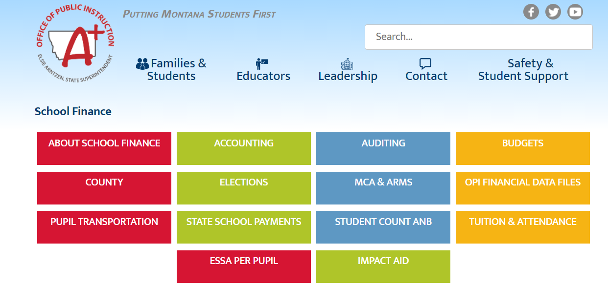
www.opi.mt.gov

Slide 4
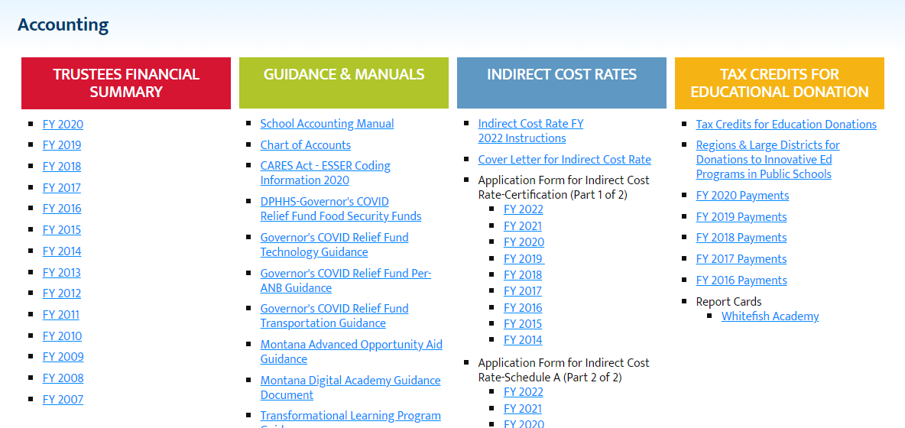

Slide 5
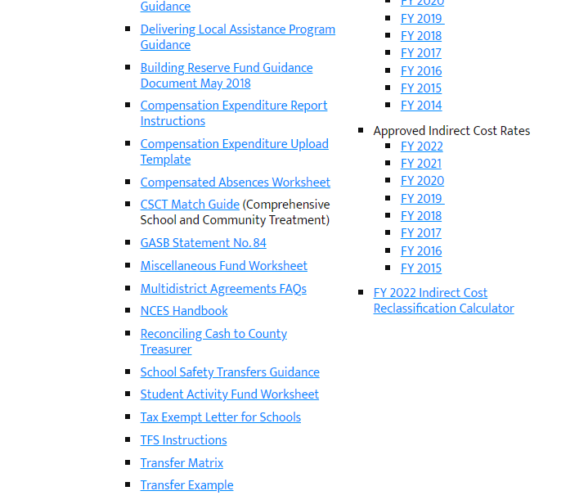

Slide 7
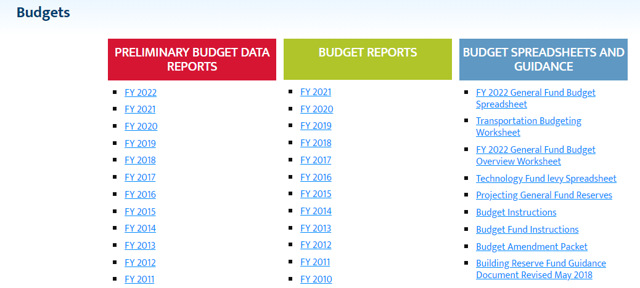

Slide 9
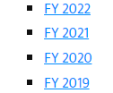
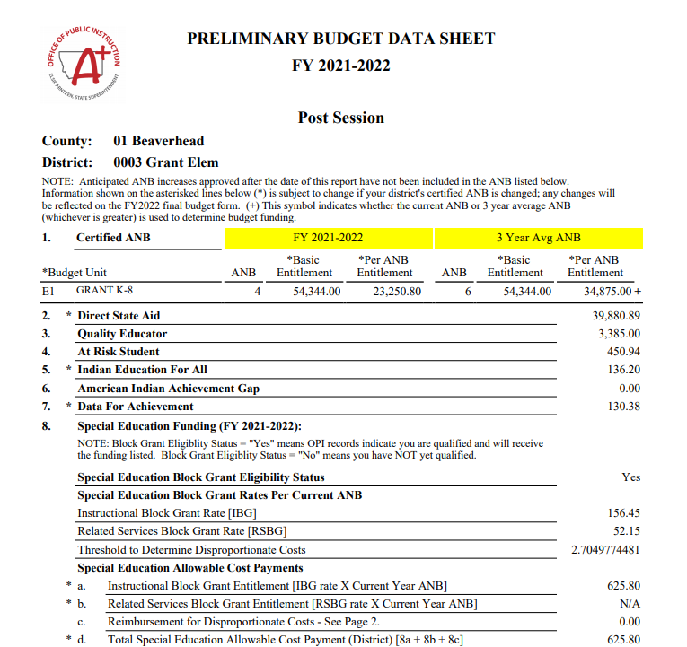

Slide 10
The difference between the Pre and Post Session amounts are:
With the passage of HB46,the Special Education Instructional Block Grant Rate (IBG) increased from 152.96% to 156.45% and the Related Services Block Grant Rate (RSBG) increased from 50.98% to 52.15%.
These changes increased your special education allowable cost payment in FY2022.
In the case of statewide enrollment increases in FY2023, your allowable cost payment may decrease.
HB46 Revises special education funding laws, including the special education allowable cost payment in the definition of “BASE aid”; establishes a method of calculating the total special education allocation.

Slide 11
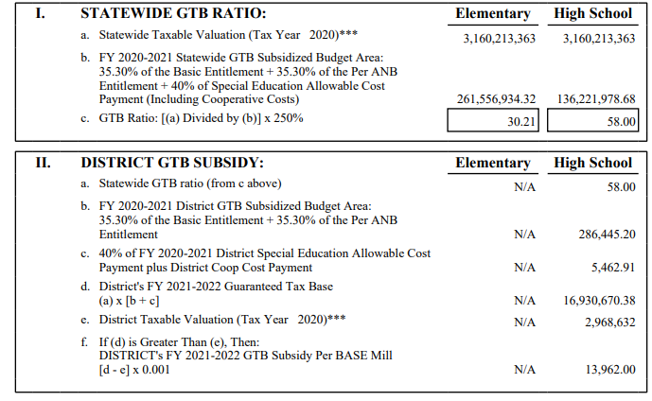
School district general fund GTB is a property tax supplement to a district’s general fund for lower taxable wealth districts by equalizing the number of mills necessary to fund the school district base budget.
The result of inflating the multiplier (234% to 250% in FY2022) will result in qualifying additional districts to receive GTB and increase the amount of GTB to districts.
The Pre-session Statewide GTB ratio was 28.03 for Elem and 53.82 for High School.
The Post-session Statewide GTB ratio is now 30.21 for Elem and 58.00 for High School

Slide 12
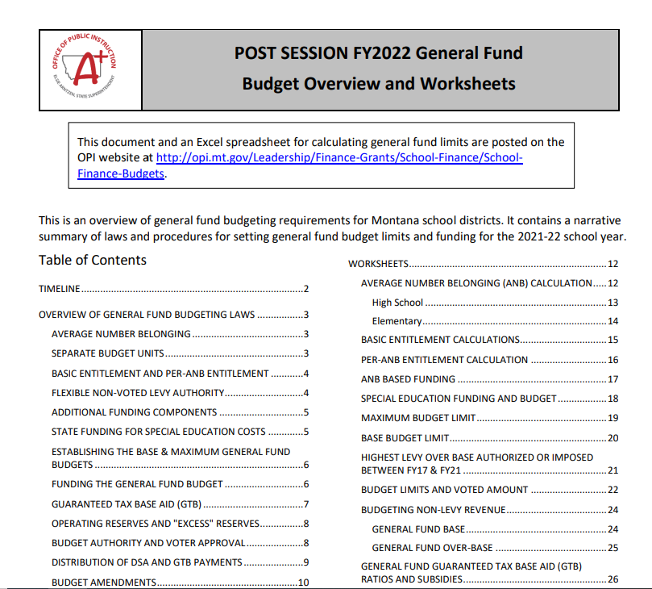

Slide 13
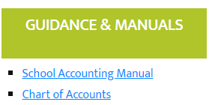
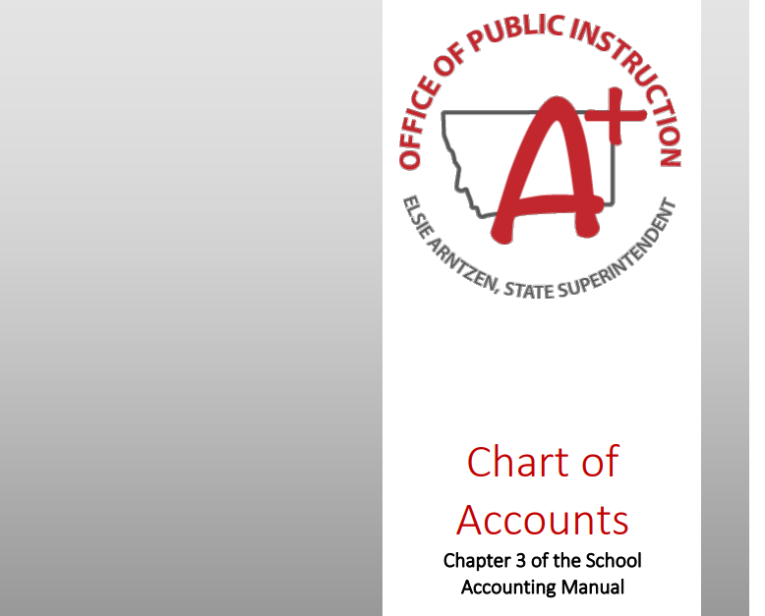

Slide 14
MAEFAIRS UPDATE BY FUND– GENERAL FUND (01)
HB 2 General Appropriations Act –appropriates money to various state agencies for the biennium ending June 30, 2023.
HB 15 applied inflationary adjustments to school funding formula components. This provided a 1.5% increase for FY2022 and 2.57% increase for FY2023.
HB 32 eliminates the implementation of the ending fund balance limit of 300% of the General Fund maximum budget.

Slide 15
MAEFAIRS UPDATE BY FUND – GENERAL FUND (01)
HB 2 and HB 46 Revises special education funding laws, including the special education allowable cost payment in the definition of “BASE aid”; establishes a method of calculating the total special education allocation; applies the inflation factor.
HB 303 & HB 663 increased the GTB multiplier for FY2022. This increased the FY2022 multiplier to 250%.

Slide 16
MAEFAIRS UPDATE BY FUND – TUITION FUND (13)
HB206 establishes a tuition per-ANB amount that reflects updates to the school funding formula; requires the district of residence to contribute a portion of the tuition costs for pupils placed in group homes or foster care and for a portion of the educational costs of eligible children in in-state children’s psychiatric hospitals and in-state residential treatment facilities
This is NOT for FY 21; it will start in FY 22 (if the district pays the obligation from existing funds) for some districts and FY 23 for all districts (if they permissively levy the tuition fund to pay the obligation).
There will be a new object code 564 - Educational Fees to In-State Treatment Facilities. This information will need to be entered in Step 8 Detailed Expenditures on the TFS.
For more information see the Tuition and Attendance Guidance on the OPI website
Please attend Nicole’s Tuition Fund training this week for more detailed information

Slide 17
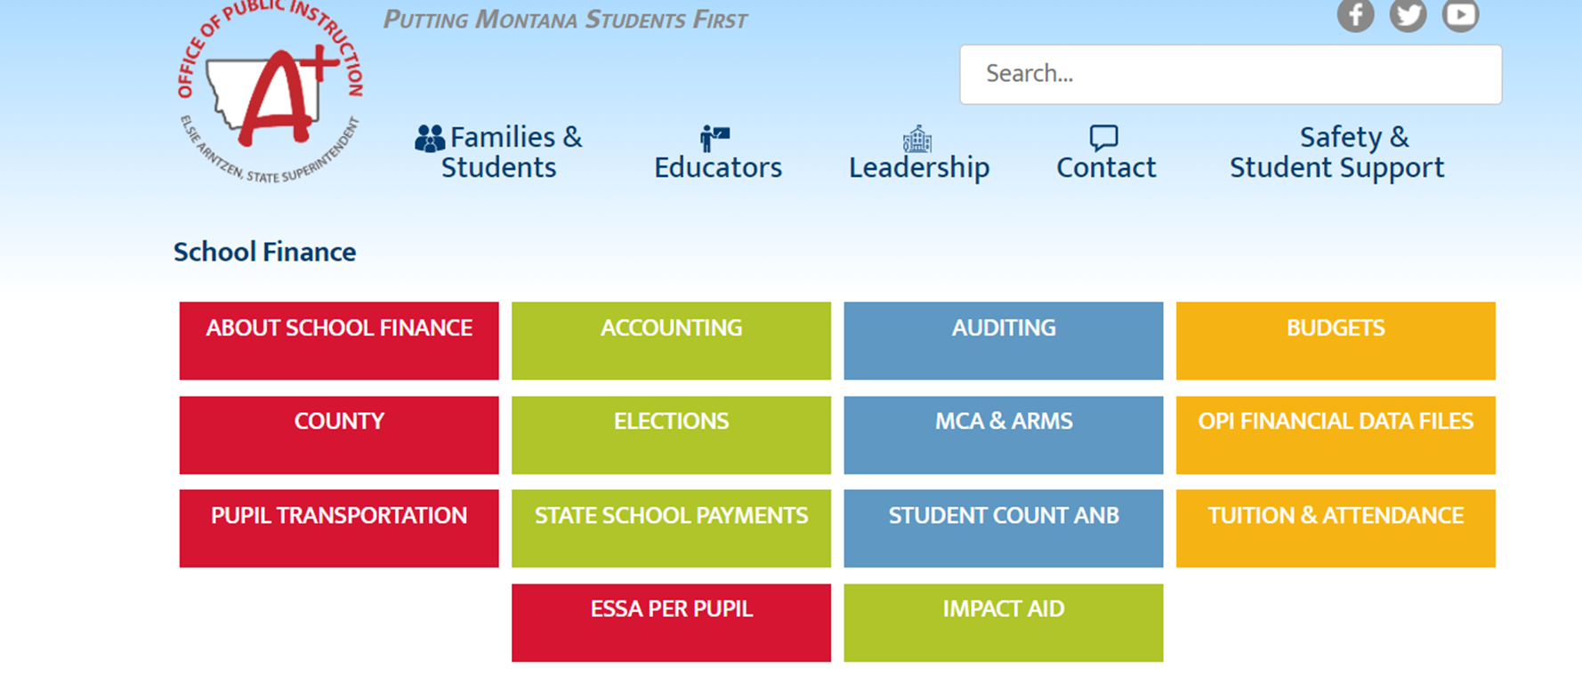
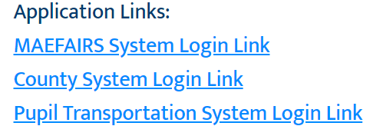

Slide 18
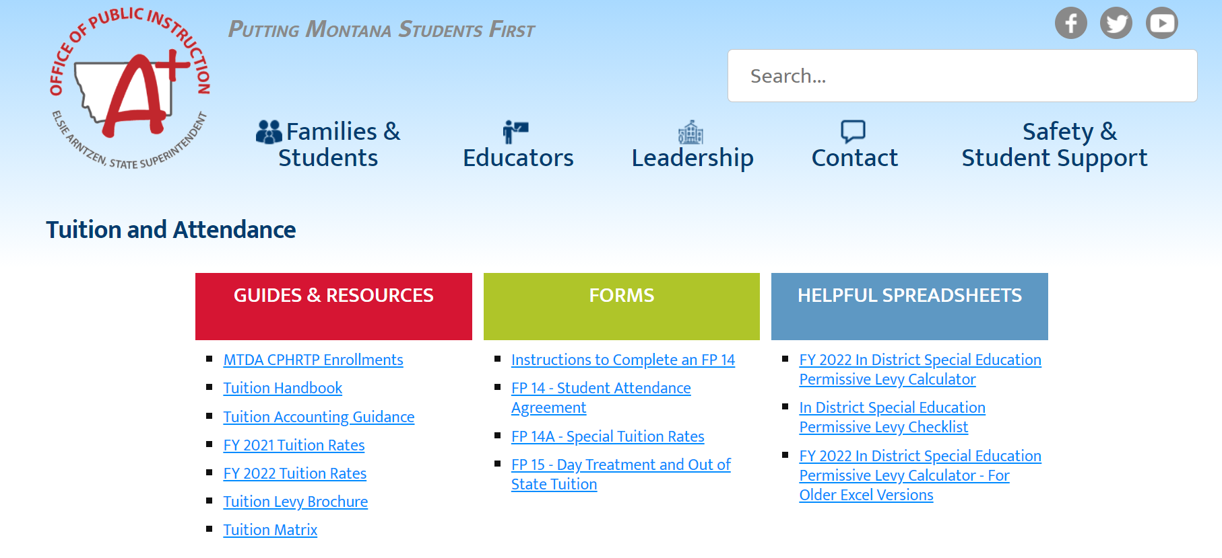

Slide 19
MAEFAIRS UPDATE BY FUND – MISCELLANEOUS PROGRAMS FUND (15)
HB 630 and HB 632 appropriated federal funds for Covid-19 relief. These funds are deposited to the Miscellaneous Programs Fund 15. Within these appropriations are different “programs”. ESSER I, II and III program codes are loaded into Maefairs on the drop down in Fund 15. Make sure you are also using a unique project reporter code for each of these program codes within the same revenue.
The Chart of Accounts was updated last year, it had been quite a while since it had an “overhaul”. The OPI is hoping to maintain this document to keep up with new coding guidelines.
You will find all the new ESSER revenue and program codes in the updated Chart of Accounts.

Slide 20
MAEFAIRS UPDATE BY FUND – NON-OPERATING FUND (19)
SB 24 allows Non-Operating districts to retain Oil and Gas Revenue
MAEFAIRS UPDATE BY FUND – TECHNOLOGY FUND (28)
HB 181 – temporarily redirects and statutorily appropriates technology funding. The TECH payment in FY2022 is $750,000. This is down from $1,000,000. The remaining $250,000 was directed to the e-rate broadband program. This payment is a pre-fill on the preliminary budget data sheets, using revenue code 3281 (State technology aid). These funds are based on general fund BASE budgets.
Begins July 1, 2021.

Slide 21
MAEFAIRS UPDATES BY FUND – FLEXIBILITY FUND (29)
SB 23 relates to the STATE special revenue school flexibility account. It eliminates the STATE special revenue school flexibility account. There has not been a distribution to schools from this account since 2003. This was a “clean up” bill.
This does not take away a SCHOOL district’s flexibility fund.
HB 32 Eliminates the implementation of ending fund balance limits by repealing 20-9-323, MCA. This currently only applies to a small number of LEAs.

Slide 22
ADULT EDUCATION FUND(17) & FLEXIBILITY FUND (29) Advanced Opportunities Grant
Beginning in FY2021, applications received by the Board of Public Education (BPE) were reviewed, approved, and retained in the order in which they were received. Approvals would continue until the total amount of appropriated funds available for the fiscal year are exhausted. Qualifying applications received past this point would be held in the order received, until the ensuing fiscal year when the applications would be considered “first received” in the next fiscal year, when there is an appropriation.
These grant funds will be deposited into the Flexibility Fund (29) Revenue code 3770. You may want to use a unique project reporter code to keep track of year-to-year funds.
A district qualified for funding under Section 4(3) of HB 387 may supplement state funding of advanced opportunity aid with matched expenditures from its adopted adult education budget, not to exceed 25% of the district’s advanced opportunity aid payment. These funds must be used in the same manner the advanced opportunity aid payment is expended. These expenditures from the Adult Education fund will be coded to X17-XXXX-377-XXXX-XXX. Again, you may want to use a unique PRC to keep track of each year’s expenditures
THIS IS NOT NEW LEGISLATION; IT WAS PASSED IN 2019

Slide 23
FLEXIBILITY FUND (29) Transformational Learning program
House Bill 89 - This applies to new applications and requests for funding increases received on or after January 1, 2022. (FY2023) This will now have a lottery system that shall assign every first-time application or request for expansion of a previously approved plan, a number that will be placed into a lottery system draw that will be done by a third party. The applications will be assigned a position in the order in which the numbers are drawn. The drawing will continue until all districts on the qualification list for the current year funding or deferred for consideration in a subsequent year. These funds will use Revenue code 3760 and Expenditure Program code 376.
This has changed from a “first come” “by date received”.
A district may levy up to 100% of the state Transformation Learning Aid in Fund 29.
Transfers can come from any state or local revenue from any budgeted or non-budgeted fund, other than the debt service or retirement fund, to the district’s flexibility fund. Revenue code 5304 has been created for the transfer code.
Remember: Any transfers that are not expended for the purposes of implementing the district's approved transformational learning plan within 2 full school fiscal years after the funds are transferred must be transferred back to the originating fund from which the revenue was transferred.

Slide 24
BUILDING RESERVE FUND (61)
Subfund X61-611 – Safety Transfers subfund
Transfers from other funds for school and student safety and security and/or voted levy for school and student safety and security.
Safety transfers must be spent within two fiscal years after the funds are transferred. Any remaining money must be transferred back to the originating fund from which the revenue was transferred. Transfers from other funds require revenue code 5301. Safety and security expenditures require the use of program code 190.
A unique PRC is recommended for each transfer and related expenditure from each transferring fund
Subfund X61-612- Voted Levy subfund
Voter approved levy for the purpose stated on the ballot (future construction, equipping,
enlarging of school buildings or for purchasing land needed for school purposes.
Subfund X61-613- Permissive Levy subfund
Permissive levy for major maintenance projects or school and student safety and security
Subfund X61-614- Transition Levy subfund
Voter approved levy for transformational costs must be spend on the purposes stated on the ballot (transitional costs of opening/closing schools, replacing school buildings or consolidating/annexing
A district should be verifying that the tax levies are being recorded in the proper subfunds. Make sure to split up the property taxes (protested, delinquent, and interest) by subfund.

Slide 25
Building Reserve Fund (61)
House Bill 192 (2021 Legislature)
(This act) applies to notice requirements, school budgets, property tax levies, and state major maintenance aid calculations related to school fiscal years beginning on or after July 1, 2022.
HB 192 increases the school major maintenance amount and the multiplier used to calculate state major maintenance aid (from 171% to 187%)
This bill references a certified school safety or emergency operations plan.
It is a requirement that all districts have a plan. A district self-reports this in TEAMS, through Accreditation, a district must select a box certifying that they have an Emergency Operations Plan. A district reports “yes or no” in TEAMS. All accredited schools reported having this policy in place already.
Current Montana law regarding emergency planning in schools is located here: 20-1-401, MCA.
More information will be coming in FY2023 for this bill.

Slide 26
Building Reserve Fund (61) – subfund 613
Revenue 3283: State Major Maintenance Aid (SMMA) 20-9-635, MCA
This is included in the Estimated Funding Sources section on the Pre-filled Verification Sheet
$10 million in fiscal year 2022, $10 million in fiscal year 2023,
with each fiscal year's appropriation reduced by the amount of projected earnings from the school facilities fund pursuant to 17-5-703, MCA for that fiscal year.
The district may permissively levy up to $15,000 per district ($30,000 for a K-12 district) plus the product of $100 multiplied by the district’s budgeted ANB for the prior fiscal year.
The permissive levy may not exceed 10 mills (20 for a K-12 district).
Non-levy revenues cannot be used in the permissive fund unless the district has levied the full 10.00 or 20.00 (K-12) mills.
Beginning FY2023, the multiplier will be $110

Slide 28
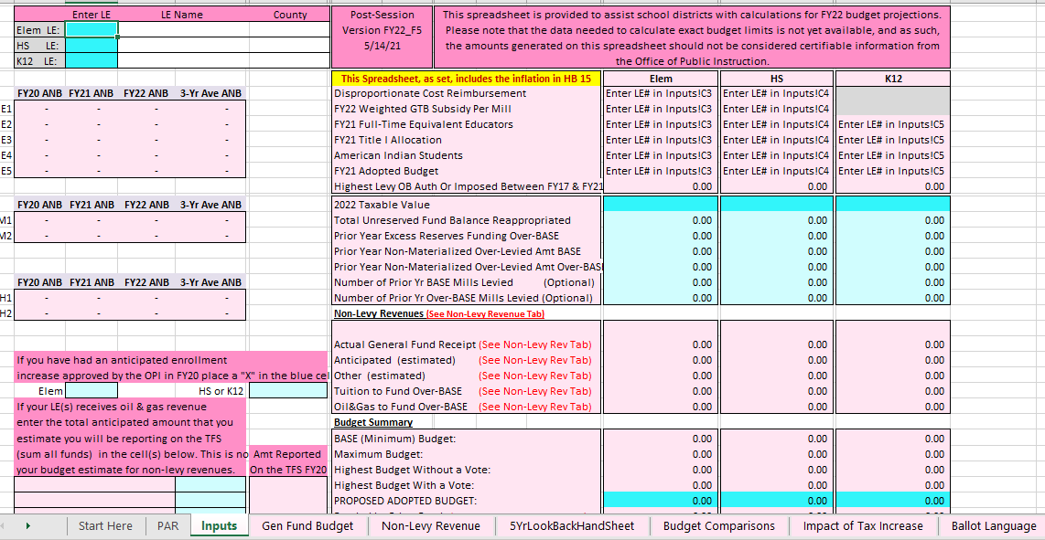

Slide 29
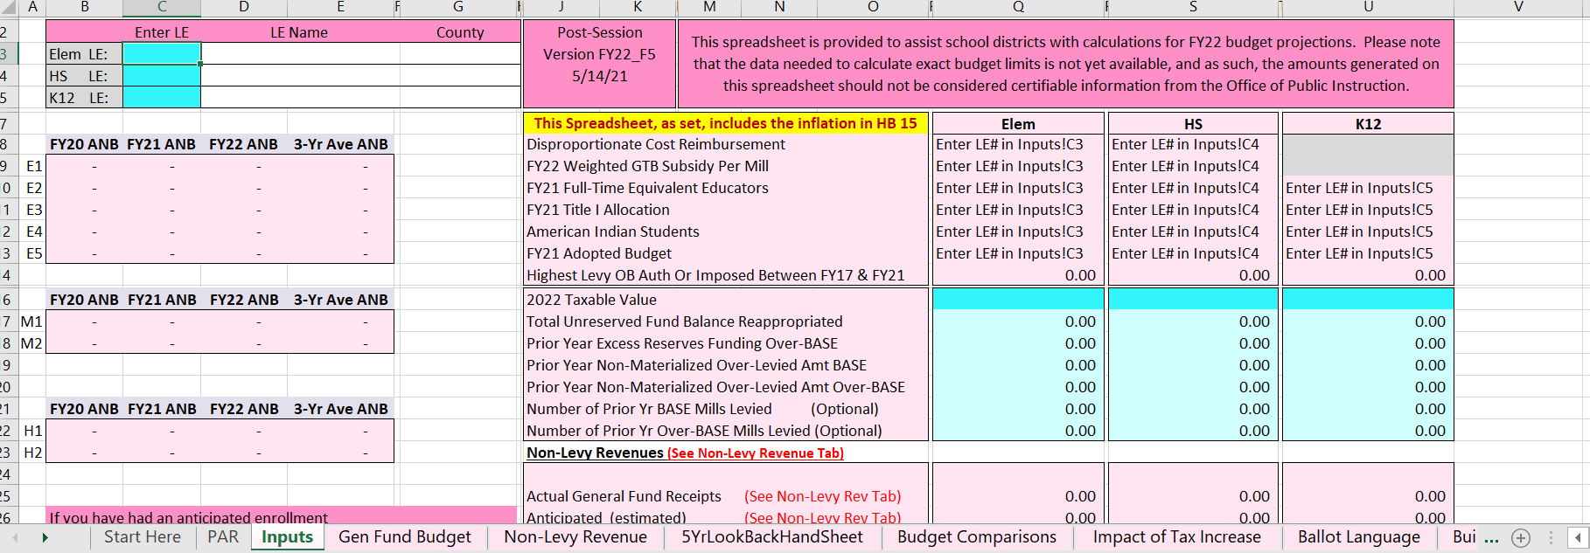
Building Reserve Fund (61) - subfund 613
OPI website – Leadership – School Finance – Budgets - General Fund Budgeting Spreadsheet FY2022_v5. Save a copy of this spreadsheet to your desktop. Enter your LE number and last year’s taxable value in the blue boxes. This will start populating areas of your budget

Slide 30
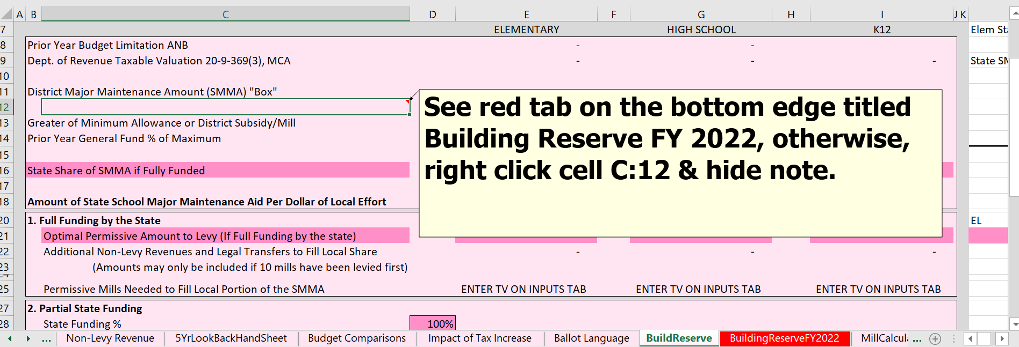
Building Reserve Fund (61) - subfund 613
The OPI has added a tab to this spreadsheet to make it easier for districts to know what their SMMA payment from the state will be and what they will need to permissive levy to fill their “SMMA Box”.

Slide 31
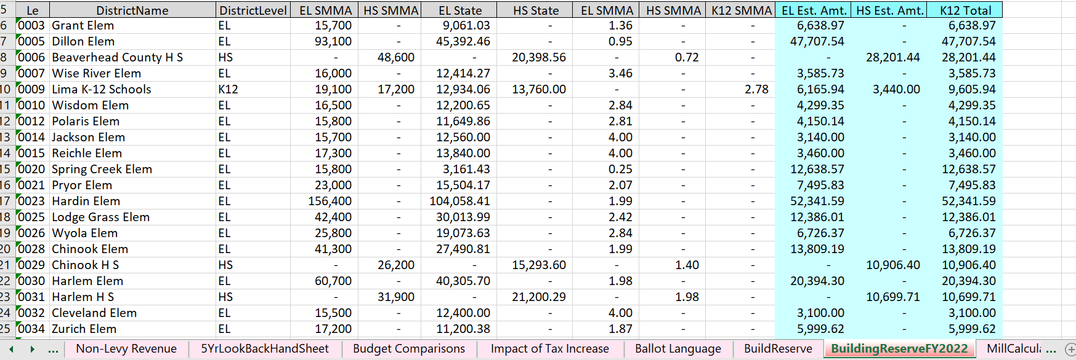
Building Reserve Fund (61) – subfund 613

Slide 34
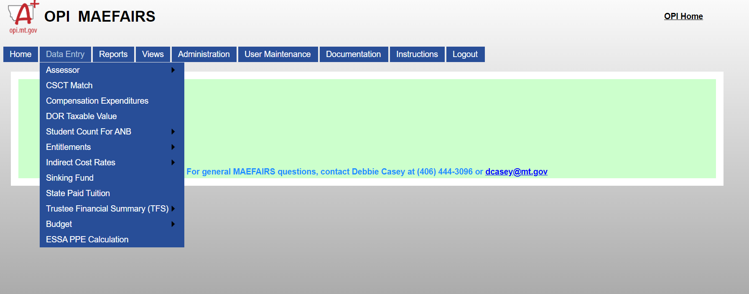

Slide 35
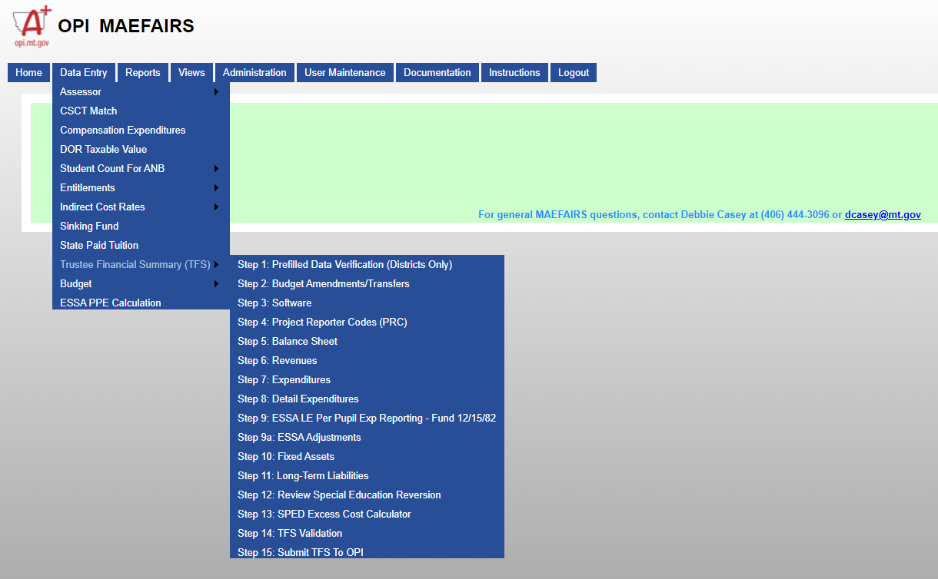

Slide 36
TRUSTEES FINANCIAL SUMMARY (TFS)
Step 6: Revenues
May enter manually or upload
Districts can manually enter or use a data upload to enter revenue information.
Most accounting software can create the required upload file(s).
Districts have two upload options:
Upload by fund – one file per fund (select fund before uploading file).
Upload all funds in one file (leave fund field blank).
If the district uploads a file for a specific fund, uploading all fund files (leaving fund field blank) will overwrite the first upload. If the district uploads all funds, and then uploads a specific fund (selecting a fund before uploading the file), the selected fund will be over-written, but all other funds will not.
Note: Only expenditures are entered by SC, not revenues

Slide 37
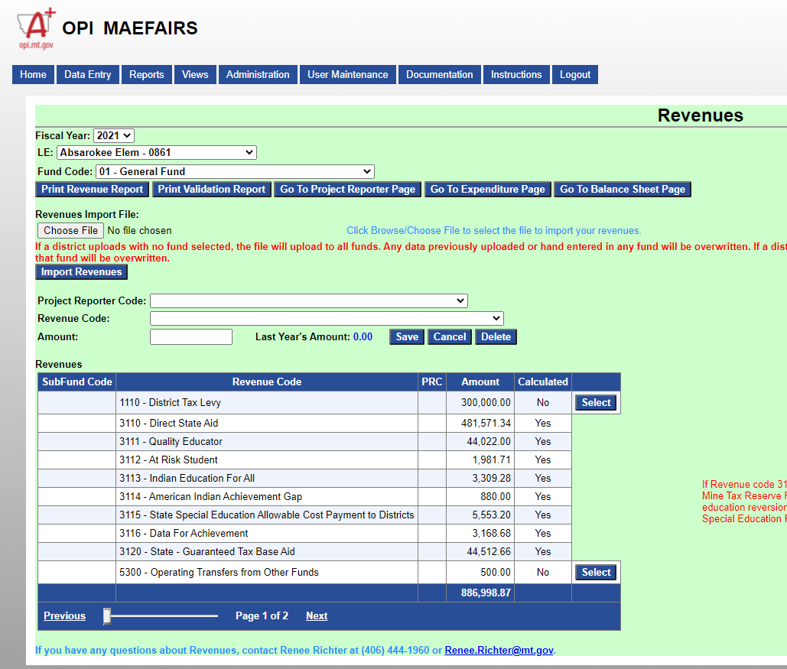

Slide 39
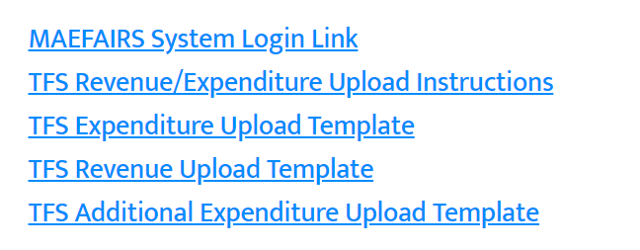
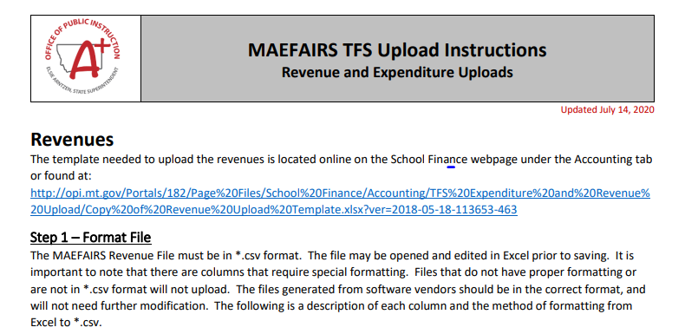

Slide 40
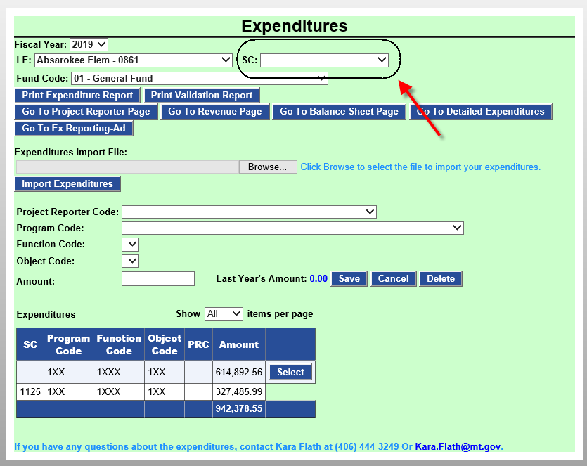
TRUSTEES FINANCIAL SUMMARY (TFS)
Step 7: Expenditures
ESSA Per-Pupil Requirements
LE’s with multiple school codes, must report expenditures by school.
Select LE and SC
Must enter Program Code, Function Code, Object Code and Amount.
PRC is required for Fund 15.
If a school code (SC) is selected the user will only see expenditures for that selected school code. If no school is selected the user will see expenditures for all schools (and district-wide).

Slide 41
TRUSTEES FINANCIAL SUMMARY (TFS)
Step 7: Expenditures Upload
Templates available on the School Finance Webpage:
http://opi.mt.gov/Leadership/Finance-Grants/School-Finance/School-Finance-Accounting
Upload in *.csv format
Districts will now have two options:
Upload by fund – one file per fund (select fund before uploading file)
Upload all funds in one file (leave fund field blank)
** If the district uploads a file by fund, uploading another file with fund un-selected will overwrite the first upload. If the district uploads all funds, then re-uploads a selected fund, the other funds will not be over-written.

Slide 42
TRUSTEES FINANCIAL SUMMARY (TFS)
Step 9: LE Per Pupil Ex Reporting – Additional 12/15/82
Added for districts to record expenditures from the Food Service Fund, Miscellaneous Programs Fund (15) and the Interlocal Agreement Fund (82) made on behalf of another district or entity.
This applies to all districts who report expenditures in Fund 12, Fund 15 or Fund 82 that are reported for another district. For example, Title I funds are run entirely from EL district but include the HS district expenditures.
Amounts entered in this step will be subtracted from the district’s expenditures for the purposes of calculating the ESSA per pupil expenditure amount.
Data may be manually entered or uploaded.

Slide 43
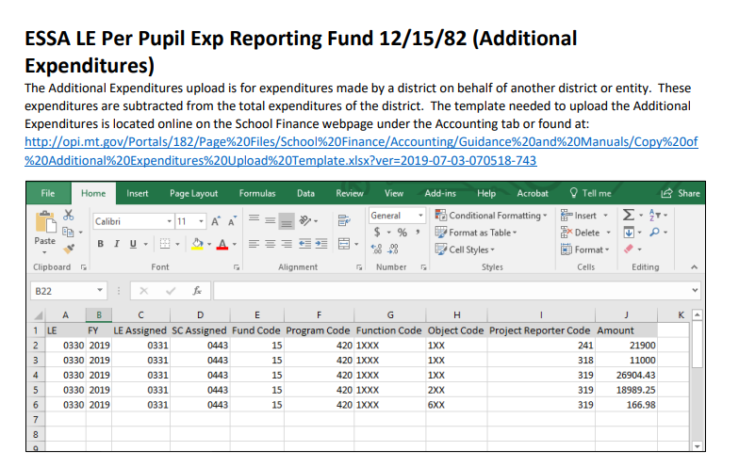

Slide 44
TRUSTEES FINANCIAL SUMMARY (TFS) HB 192 allowed for the change to remove this collection requirement
Step 14: Certification of Facilities Condition Inventory Report
Districts must select one of the three options for updating the Facilities Condition Inventory report as required in 20-9-525, MCA.
Even if a district did not permissively levy in FY 2019, one of the three options must be selected before the TFS may be submitted.
DELETED!!

Slide 45
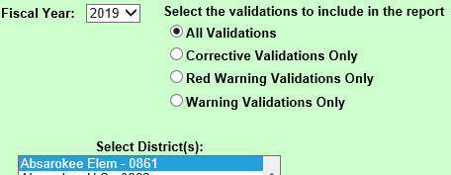
TRUSTEES FINANCIAL SUMMARY (TFS)
Step 15: TFS Validation
Select a validation and district.
All: Both Corrective and Red Warning/Warning below
Corrective: Must be fixed before the district is allowed to submit
Red Warning/Warning: Alert the user to possible errors (may submit with warning errors)
Users are responsible for understanding all warning validations – call if you do not understand the warning validations

Slide 46
TRUSTEES’ FINANCIAL SUMMARY (TFS)
Step 15: Submit TFS to the OPI
MAEFAIRS requires districts with budget submissions to submit the TFS and budget report together. A school district cannot submit the TFS at this time.
The submission will be after the Budget is completed and ready for submission.
ONLY SPECIAL EDUCATION COOPERATIVES SUBMIT THE TFS REPORT TO THE OPI AT THIS TIME, AS SPECIAL ED COOPERATIVES DO NOT SUBMIT BUDGETS.

Slide 47
ADDITIONAL GUIDANCE DOCUMENT
The following document is currently being updated. Denise Williams is the author of this document and does a great job of keeping it updated for the schools. I have some hi lights and have updated some of the guidance on my own, this is not an “official MASBO document”.
I wanted to show it to you, as it is a “staple” on my desk for coding and allowable expenditures from the different school funds. I use this document at the OPI, and I also had it on my desk at CJI.
The updated guidance document will be posted on the MASBO website.
This is a copy of the Budgeted Funds guidance, there is also a Non-Budgeted Funds document located on the MASBO website. Give Denise a little while to get them updated and reposted, she is BUSY.

Slide 48
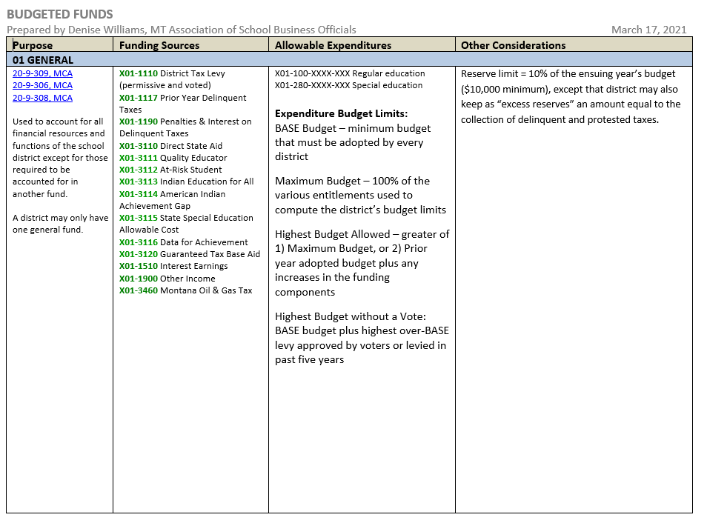
DRAFT

Slide 49
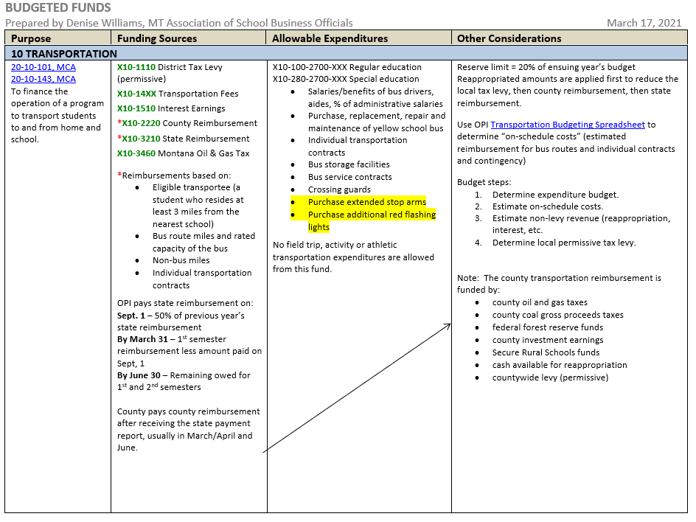
DRAFT

Slide 50
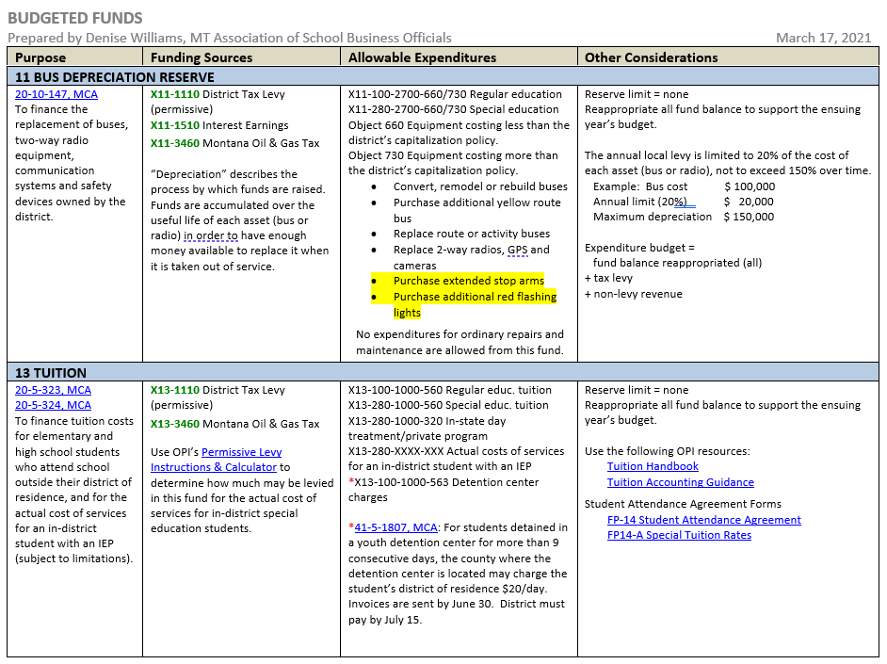
DRAFT

Slide 51
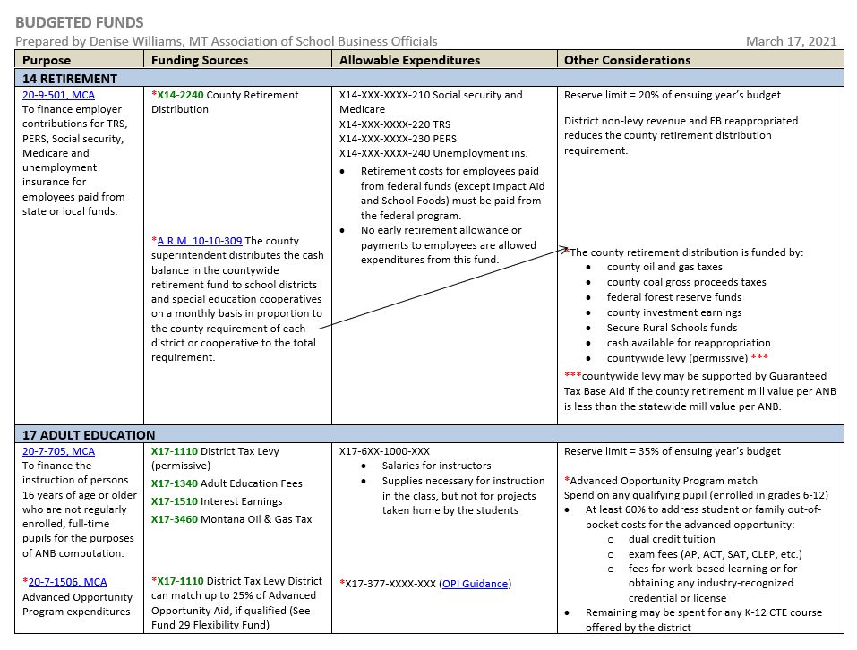
DRAFT

Slide 52
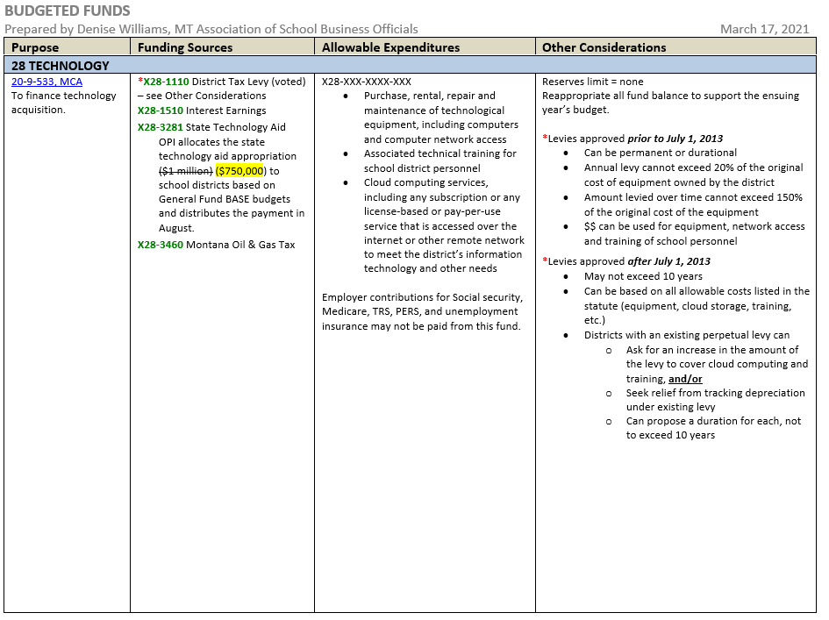
DRAFT

Slide 53
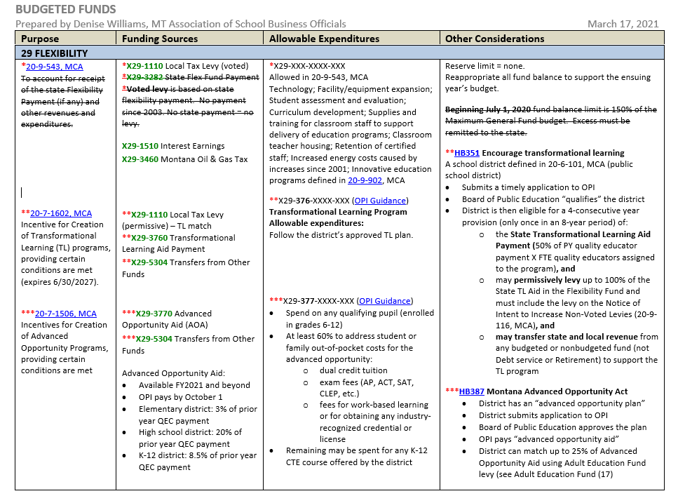
DRAFT

Slide 54
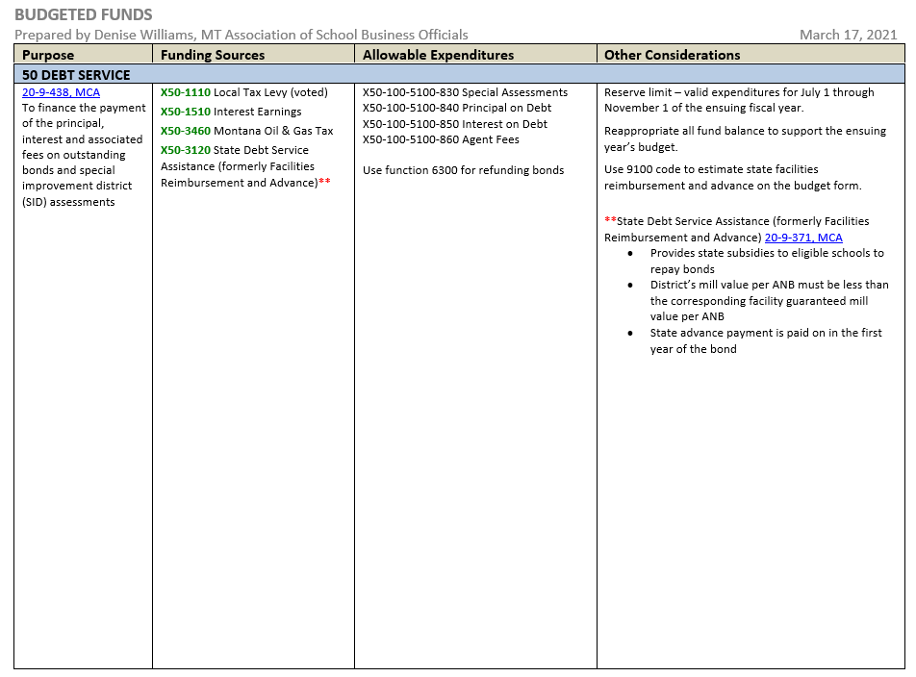
DRAFT

Slide 55
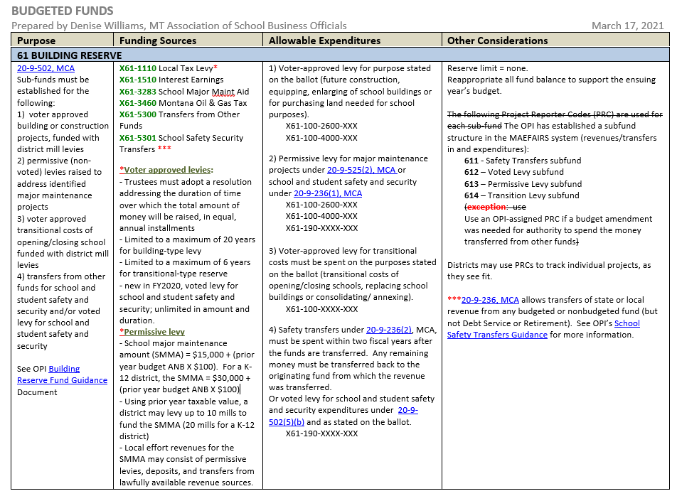
DRAFT

Slide 57
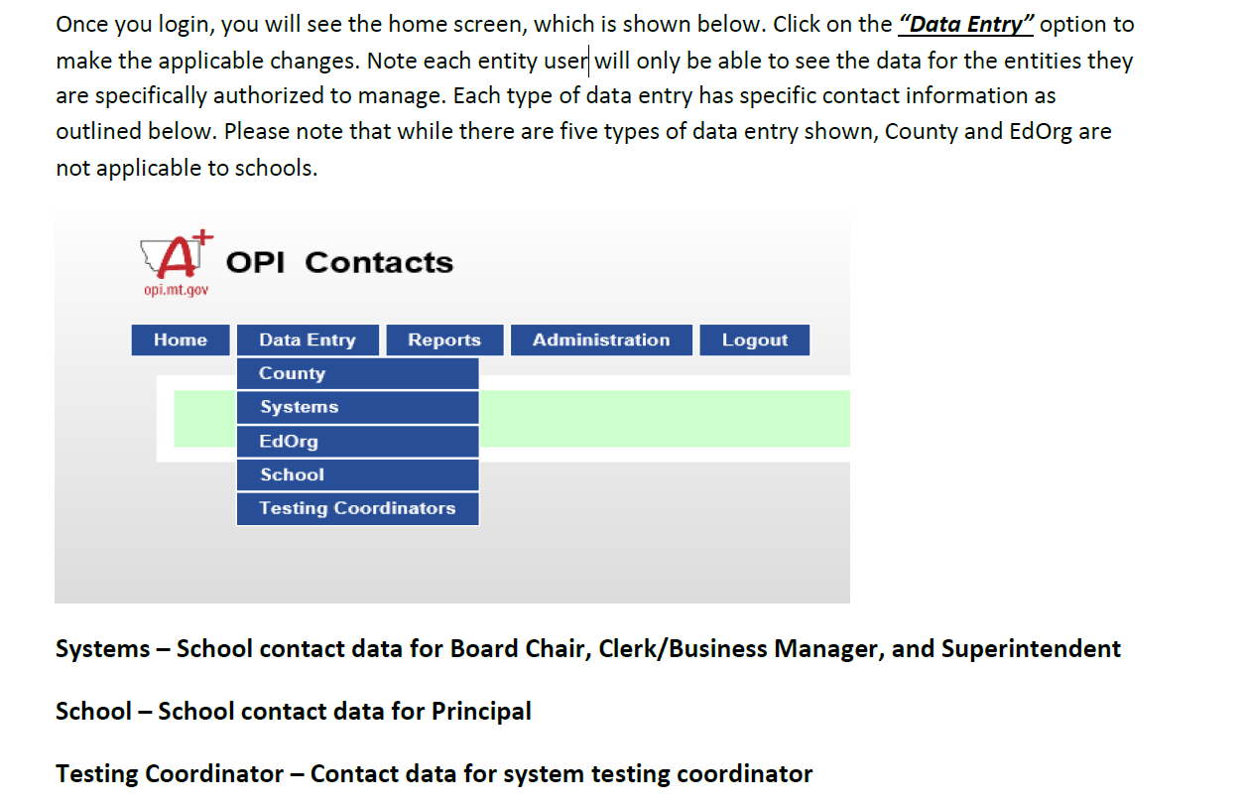

Slide 58
To verify or make a change to existing data, from “Data Entry” option, select the applicable option: “System,” “School,” or “Testing Coordinator.” Please note: Most Schools will have to make changes to both Systems and Schools. Systems relates to Board Chair, Superintendent, and Clerk. School is for Principal data.

Slide 59
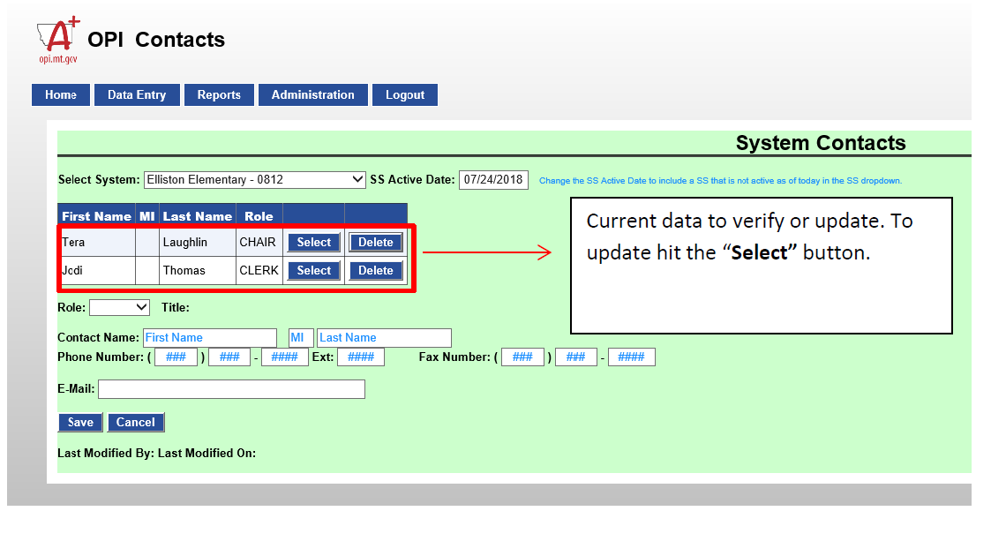

Slide 60
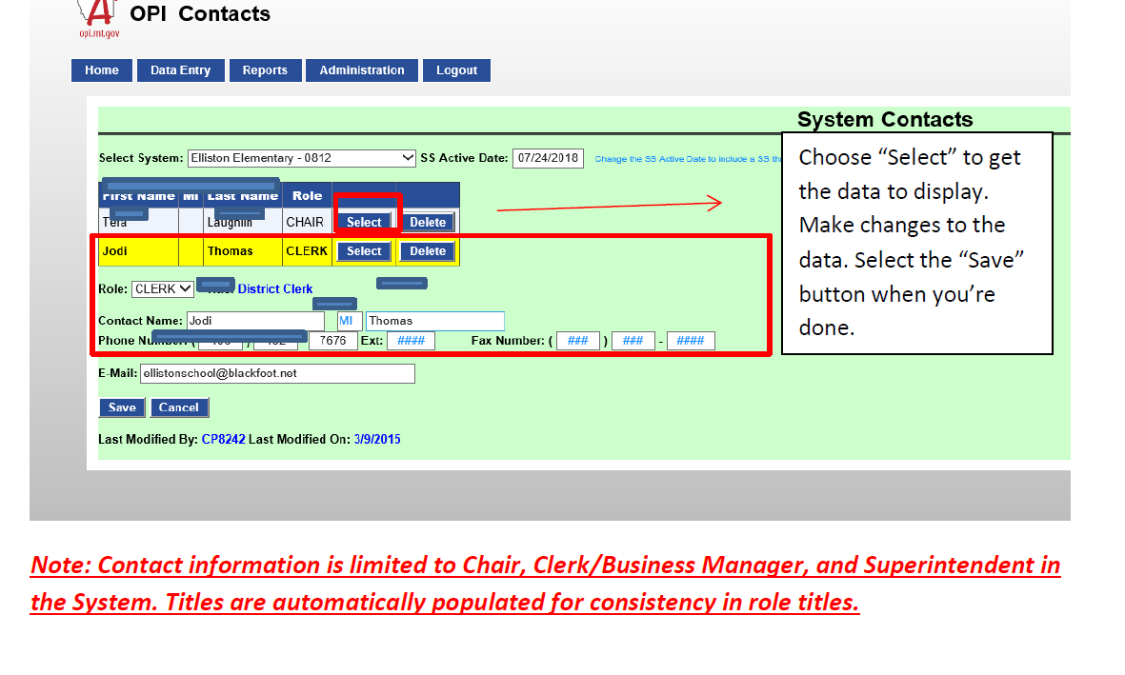

Slide 61
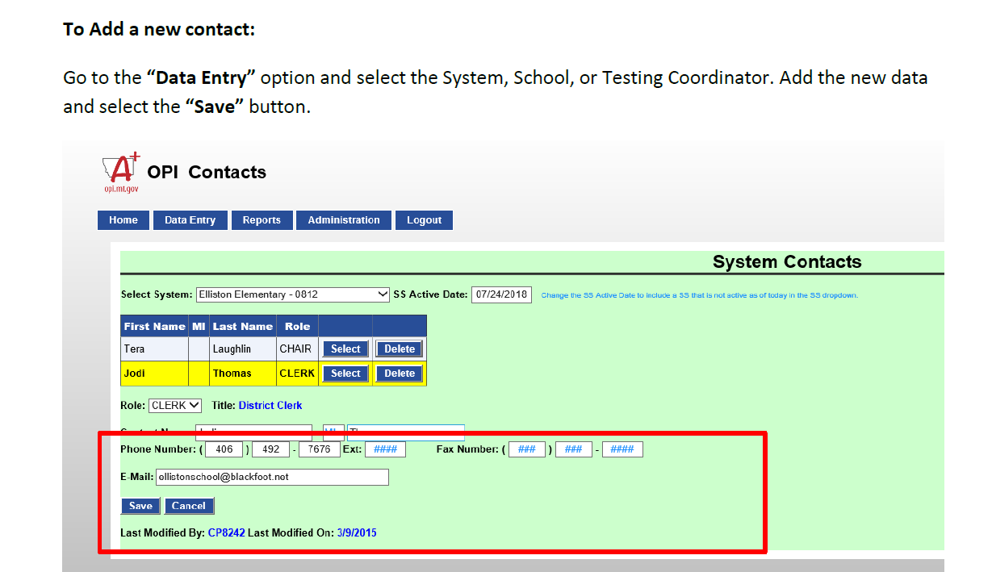
Once the Save button has been selected, you will see the new entry.
If you have questions or issues in the system, please contact the OPI at CentralUpdates@mt.gov
Note: Contact Information is limited to Chair, Clerk/Business Manager, and Superintendent in the System and Principal in the School location.

Slide 62
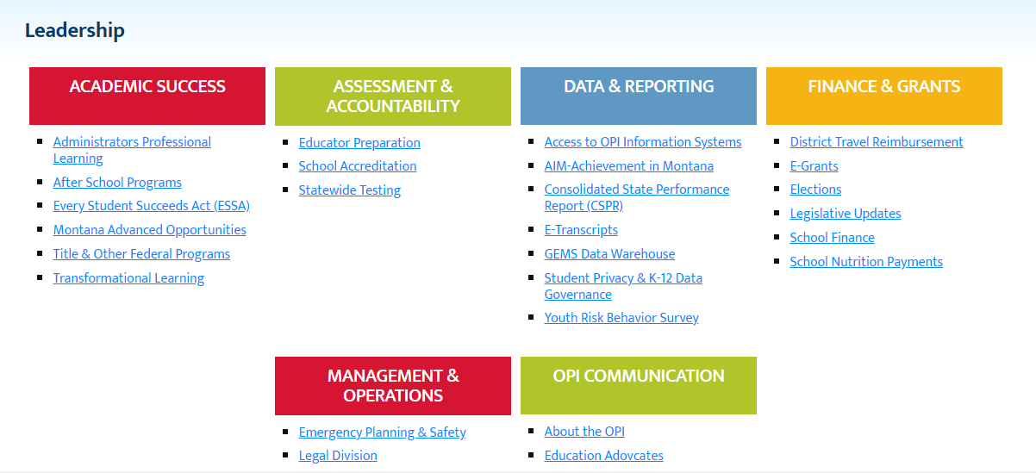
If you don’t have a Maefairs log in – you will go to the OPI website

Slide 63
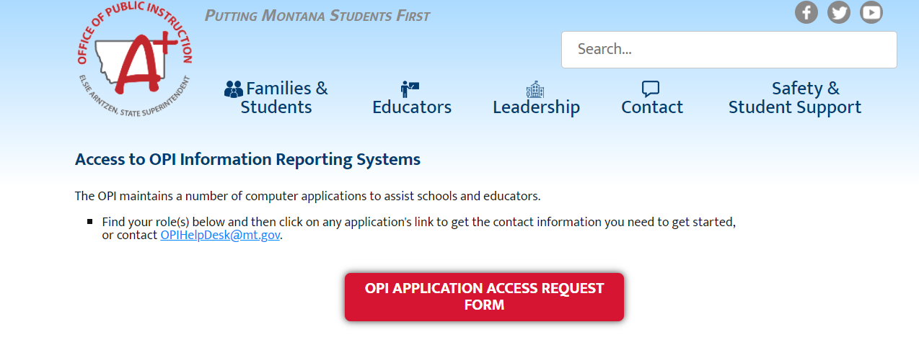
http://opi.mt.gov/Leadership/Data-Reporting/OPI-Application-Access-Form

Slide 64
Questions? Always call if you are unsure!

Slide 65
School finance staff
Debbie Casey, Computer Support Specialist, dcasey@mt.gov or 444-3096 - *Assistance with access to MAEFAIRS, Pupil Transportation, County, access problems, general questions
Dan Moody, Auditor, Dan.Moody@mt.gov or 444-0701 *Assistance with audit responses and assistance
Donell Rosenthal, Director of Pupil Transportation, drosenthal@mt.gov or 444-3024 *Assistance with pupil transportation questions, questions or problems with transportation and bus depreciation funds
Mari Haefka, Financial Specialist, mari.haefka2@mt.gov or 444-9852 *Assistance with GTB, debt service, FP 6, FP 10a, questions or problems with debt service, building reserve, and retirement
Nica Merala, Financial Specialist, nmerala@mt.gov or 444-4401 *Assistance with structure changes, budget amendments, enrollment, and FP 9, questions or problems with non-op, flex, or adult education funds
Nicole Thuotte, Financial Specialist, nthuotte@mt.gov or 444-4524 *Assistance with elections, Impact Aid, tuition agreements, questions or problems with technology or tuition fund
Paul Taylor, Budget Analyst, ptaylor2@mt.gov or 444-1257 *Assistance with data requests, and general fund questions
Renee Richter, Financial Specialist, renee.richter@mt.gov or 444-1960 *Assistance with TFS and budget, questions or problems with general fund
Barb Quinn, Administrator, Barbara.Quinn@mt.gov or 444-3249 *Assistance with all topics
Jeffrey Kirksey, ESSER Program Manager, Jeffrey.Kirksey@mt.gov or 444-0783
Janey Salomon, EANS Program Manager, Janey.Salomon@mt.gov

