Slide 1
WHAT’S NEW FOR SCHOOL NUTRITION PROGRAMS IN SY2021-22
Erin Turner, School Nutrition Programs Specialist
Kim Lloyd, Summer Meals Manager
Notes:
Erin

Slide 2
AGENDA
Introduction
Priorities for SY 2021-22
Overview of SNP New & Extended Waivers available to opt into
Administrative Reviews
FFVP Reminder
Free & Reduced Applications
Information on the AfterSchool Snack Program waiver
Information on the new NSLP SSO option
Questions
List of Schools on Administrative Review SY 2021-22
Notes:
Erin

Slide 3
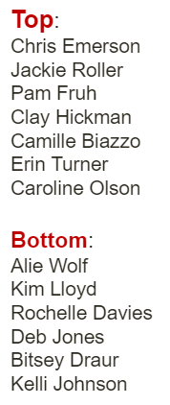
OPI SCHOOL NUTRITION PROGRAMS TEAM
Notes:
Erin

Slide 4
SPECIALIST REGIONAL MODEL
Notes:
Erin

Slide 5
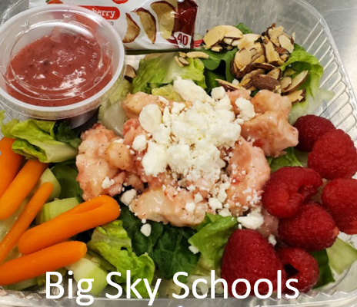
PRIORITIES FOR SY2021-2022
Support the reopening of schools and institutions
Ensure program access for children
Increase funding for program operators
Promote nutritious meals
Provide operational flexibility
Monforton School Meal SY20-21
Notes:
Erin
The US Department of Agriculture recently announced new and extended school nutrition waivers for the 2021-2022 school year for schools participating in the OPI School Nutrition Programs. These waivers continue to offer flexibility in feeding children and meeting local needs with a focus on promoting nutritious meals. We want to ensure meal access for children and assist program operators in their operational efforts by providing flexibility in the program. So the priorities for next school year are to:

Slide 6
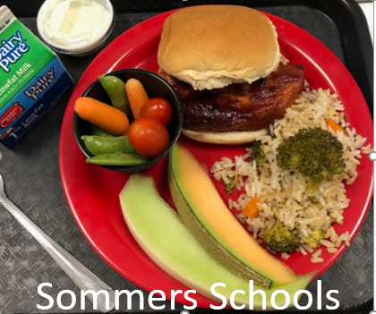
SCHOOL NUTRITION PROGRAMS WAIVERS FOR 2021-22 SCHOOL YEAR
New- Allow NSLP Seamless Summer Option
New- Allow Summer Food Service Program Reimbursement Rates
New- Area Eligibility in the Afterschool Snack Program
Non-Congregate Meal Service
Meal-Time Requirements
Allow Parents and Guardians to Pick Up Meals
Allow Offer Versus Serve Flexibility for Senior High Schools
Onsite Monitoring Requirements
Nationwide Waiver to Allow Specific School Meal Pattern Flexibility*
This waiver requires schools to request and justify their specific need for the waiver
**NOT EXTENDED**
School Year SFSP – Ends when school starts
These waivers expire June 30, 2022, unless otherwise noted
Notes:
Erin
Many of these flexibilities are extensions of existing waivers. For example, schools can continue to offer grab and go meals if needed, parents or guardians can pick up meals to take home to their children, and schools can establish meal service times that support streamlined access to nutritious meals. Additionally, specific meal pattern flexibilities have been extended, allowing for increased food choices to support alternative meal service options.
just by completing the MAPS application to operate the SSO or ASP programs utilizes these waivers.
SFA’s will need to complete a Google Forms survey to opt into or request to use all the other waivers listed here. *Available soon
Schools have the choice of operating normal NSLP/SBP or SSO. Whether Schools choose to operate NSLP or SSO, the meal flexibility waivers are available regardless of program being operated.
Go thru each waiver.

Slide 7
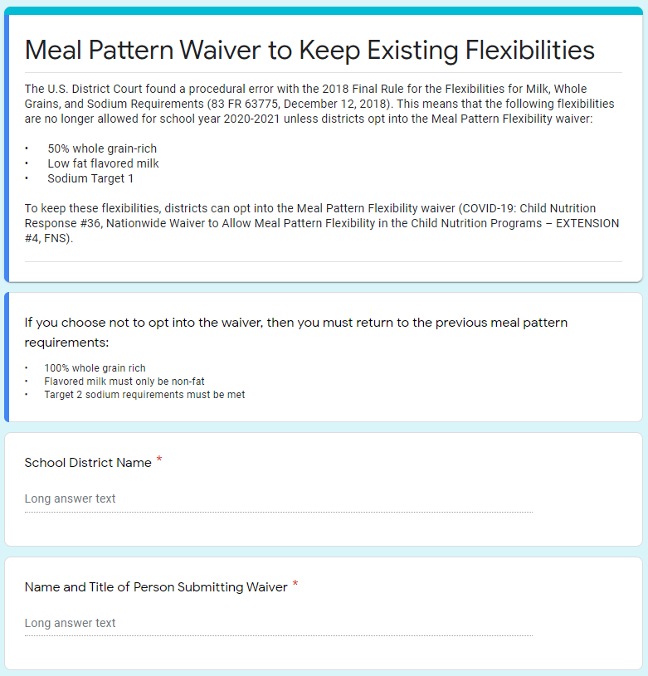
MEAL PATTERN FLEXIBILITY WAIVER
The U.S. District Court found a procedural error with the 2018 Final Rule for the Flexibilities for Milk, Whole Grains, and Sodium Requirements (83 FR 63775, December 12, 2018). This means that the following flexibilities are no longer allowed for school year 2020-2021 or 2021-2022 unless districts opt into the Meal Pattern Flexibility waiver:
• 50% whole grain-rich
• Low fat flavored milk
• Sodium Target 1
To keep these flexibilities, districts can opt into the Meal Pattern Flexibility waiver:
Nationwide Waiver to Allow Specific School Meal Pattern Flexibility for School Year 2021-2022
Notes:
Erin
Just a little background on the Flexibilities for Milk, Whole Grains, and Sodium Requirements 2018 Final Rule that these flexibility are no longer allowed in SY2020-21 or 2021-22 unless districts opt into the Meal Pattern Flexibility waiver that OPI will provide a waiver form to complete and submit requesting these or any other meal pattern flexibility.

Slide 8
MEAL PATTERN FLEXIBILITY WAIVER
Sodium Target 2
Whole Grains 100%
Fat-Free Flavored Milk
Vegetable Subgroups
Milk Variety (Two varieties)
Age/Grade Group
Sodium Target 1 –Just opt in
Whole Grains 50% - Justify need
Low-Fat (1%) Flavored Milk –Justify need
Vegetable Subgroups –Justify need
Milk Variety –Justify need
Age/Grade Group –Justify need
All other meal pattern requirements remain in effect.
Notes:
Erin
The School Meal Pattern Flexibility waiver for SY2021-22:
Schools can apply for this waiver due to Food Safety, Supply Chain, Financial Hardship, or Logistical Challenges. Meal Pattern requirements may be waived if the State agency determines that the waivers are necessary in order for the SFA to provide access to student meals in a safe and consistent manner.
These meal pattern flexibilities are offered to support a successful reopening of schools in school year 2021-2022. To ensure the safety of students, families, and school food service professionals, schools may continue to use alternative meal service models to support social distancing in the new school year. We recognize that meeting the meal pattern requirements can be challenging when serving meals outside the cafeteria. However, we also appreciate the importance of offering age-appropriate meals and meeting other meal pattern requirements, and expect that operators look to other alternatives prior to utilizing these flexibilities.
We are committed to supporting schools in serving the most nutritious meals possible as you transition back to normal school meal program operations during the upcoming school year. We expect that the flexibilities provided for this school year will only be utilized as needed, and that schools will seek to meet the meal pattern requirements to the greatest extent possible.
In order to participate under the flexibilities for sodium, whole grains, vegetable subgroups, milk variety, low-fat flavored milk, and the age/grade groups, schools must contact the state agency (via a Google Form Survey) for approval to use this waiver and provide the state agency any justification of need for the waiver. The state agency must consider approval of this waiver for whole grains, vegetable subgroups, milk variety, low-fat flavored milk, and the age/grade groups on a case-by-case basis. For sodium, state agencies will allow all local program operators to implement sodium flexibilities because, due to COVID–19 safety concerns, many schools are relying on grab-and-go or shelf-stable foods that are pre-packaged, many which are higher in sodium than the foods that were typically used by schools prior to COVID–19.

Slide 9
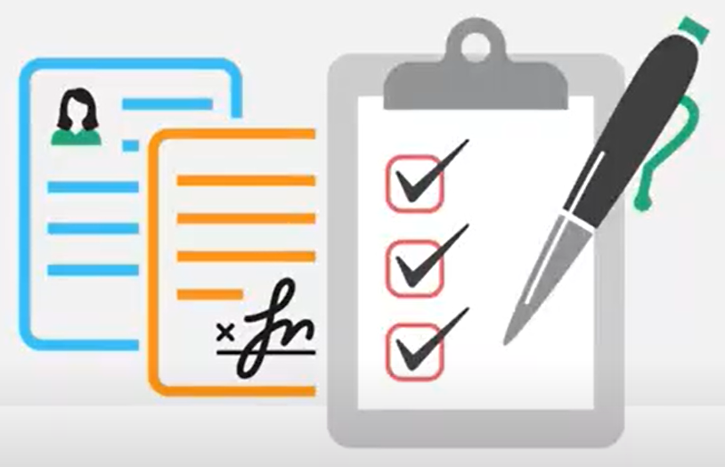
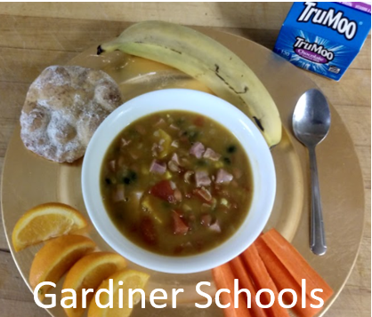
HOW TO OPT INTO WAIVERS
Google Forms (survey) available soon from OPI for schools to opt in and state the specific justification for the waiver.
Examples of justification for the waiver:
For the 1% flavored milk flexibility, maybe “fat-free chocolate milk is unavailable from the distributor” or “need certainty to plan meals” as justification – schools would need to check with their vendors.
For the two Milk Variety requirement, maybe “need certainty to plan for grab and go meals” but for cafeteria meals it may not be an issue.
For the 50% Whole Grain flexibility, maybe “School needs flexibility from the 100% WGR requirement due to lack of distributor options for WGR items.” – schools may need to check with their vendors.
Notes:
Erin

Slide 10
Administrative Reviews & Procurement Reviews
Will be conducted during SY2021-22
Will be notified of the review and scheduled at least 30 days in advance
Hope to conduct On-site
Pre-arrival (off-site questions) to be completed in MAPS
Refer to the Administrative Update (available after July 1st)
Refer to the School Year SNP Checklist and Procurement Checklist
Notes:
Erin

Slide 11
FFVP, Fresh Fruit & Vegetable Program
Get claims in for June by July 10
Sponsors will still be able to participate in FFVP if they opt into the Summer Seamless Option during the school year.
All elementary schools with a F/R percentage of 37% or more (based on 18-19 data) have been invited in Maps.
Be sure to complete the SFSP application for next SY 2021-22 in MAPS
Notes:
Erin

Slide 12
Free & Reduced Applications
Please Opt into using the online F/R application via DCA
If operating SSO, schools do not need to collect applications but families may still choose to submit them (for PEBT).
Complete the Verification process by November 15th.
Complete the Verification Report in MAPS by November 20th.
Continue to check the DCA list at least 3 times per year.
Notes:
Please Opt into using the online F/R application via DCA even if you don’t receive any applications this year. This will provide your families with a direct link to your schools F/R application and allow you to process it via DCA.
If operating SSO, schools do not need to collect applications but families may still choose to submit them (for PEBT).
If schools receive any F/R applications, school must complete verification by the normal November 15th deadline based on applications they received by October 1st.
Verification report must still be completed in MAPS by November 20th to report on any applications received (whether or not school received any applications).
Continue to check the DCA list at least 3 times per year.

Slide 13
AFTERSCHOOL SNACK PROGRAM
Nationwide Waiver of Area Eligibility in the Afterschool Programs in School Year 2021-2022
Area Eligibility Waived – will be tied to your application in MAPS to reimburse all approved ASP snacks to be reimbursed at the ‘free’ snack rate.
All Enrolled Students in the Afterschool eligible for Free snack.
Schools will count and claim ASP snacks at the ‘Free’ reimbursement rate.
If operating SSO, remember only 2 meals are allowed (most schools will do breakfast and lunch) therefore cannot operate or claim After School Snack ASP along with 2 other meals with SSO.
Notes:
Erin

Slide 14
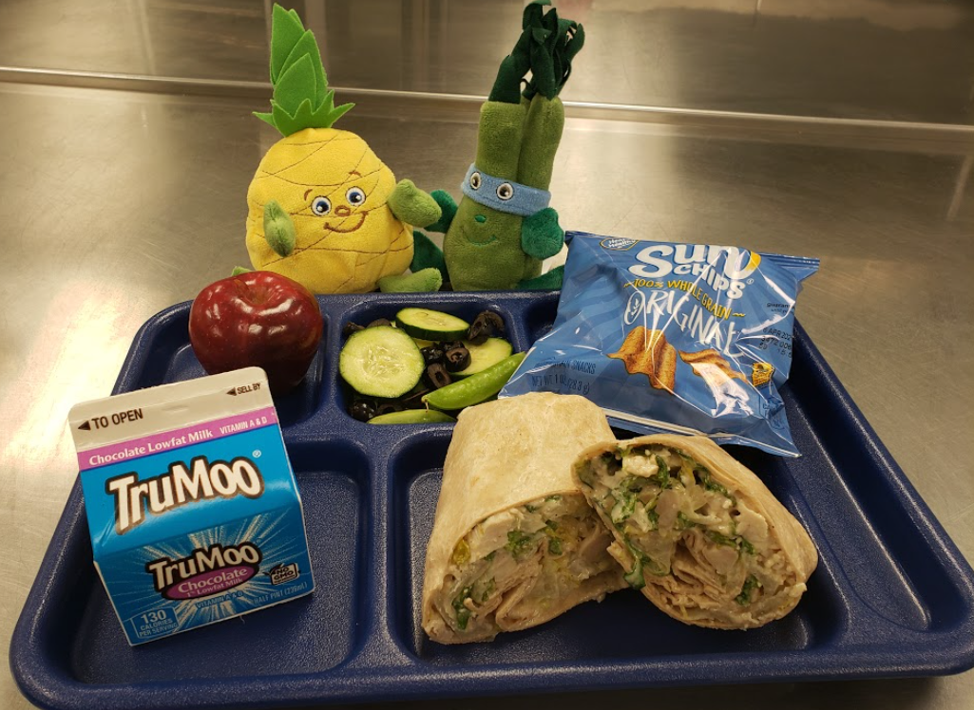
SEAMLESS SUMMER OPTION
Monforton School Meal SY20-21
Summer Food Service Program waivers end June 30, 2021
The NSLP Seamless Summer Option (SSO) combines features of:
National School Lunch Program (NSLP)
School Breakfast Program (SBP)
Summer Food Service Program (SFSP)
Notes:
Kim
Since March 2020, schools have had the option to run the Summer Food Service Program while school was in session. This waiver will expire on June 30, 2021. After the end of this month, schools can no longer operate the Summer Food Service Program while school is in session - this includes summer school.
Instead, the USDA is now offering the option for schools to operate either the National School Lunch Program Seamless Summer Option (SSO) or switch back to the National School Lunch Program. Much like the SFSP, the Seamless Summer Option is normally only available in the summer. The USDA has now extended this program into the 2021-2022 School Year. The SSO combines features of the NSLP, the SBP, and the SFSP and we will cover more information in the following slides. Schools are required to follow the NSLP/SBP meal patterns when operating the SSO.
Normally the reimbursement rates for SSO are tied to the NSLP free reimbursement rate, but there is a waiver for SY21-22 to allow the higher SFSP reimbursement rate (like the SFSP offered). (Reimbursement rate should be around $4.3175 lunch/$2.46 breakfast SFSP reimbursement rate. NSLP ‘free’ reimbursement rate was about $3.53 lunch and $2.26 breakfast depending on ‘severe need’ or not ($1.89))
National School Lunch Program (NSLP) (meal pattern)
School Breakfast Program (SBP) (meal pattern)
Summer Food Service Program (SFSP) (All kids or just Students? eat for free and schools receive higher reimbursement rate, and SFSP/SSO operates October through September with reimbursement rate updates in January*)
SSO is available to all schools in SY2021-22 but SFA’s must submit SSO site application in MAPS to operate.
Nationwide Waiver to Allow the Seamless Summer Option through School Year 2021-2022
Nationwide Waiver to Allow Summer Food Service Program Reimbursement Rates in School Year 2021-2022

Slide 15
SSO HIGHLIGHTS SY 21-22
Allows schools to serve meals for free and provides the higher Summer Food Service Program Reimbursement rate
Available through June 30, 2022
Schools may choose between SSO or NSLP
Available to all schools regardless of eligibility or in-person learning status
Notes:
Kim
The SSO allows schools to continue serving meals for free and also provides the same higher Summer Food Service PRogram reimbursement rate
This waiver is available through June 30, 2022
Schools may choose to operate the SSO - or decide to stick with the National School Lunch Program
The SSO is available to all schools across the state regardless of eligibility or in-person learning status. If you are a school that is back to all in-person learning and even if you have a low free/reduced rate - your school still is able to operate the SSO.

Slide 16
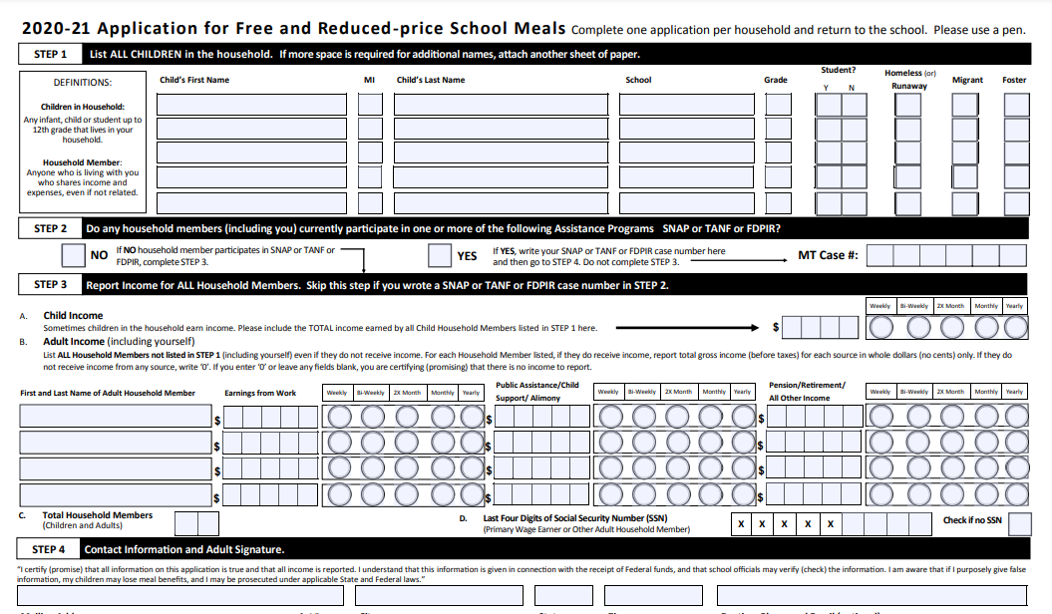
SSO HIGHLIGHTS FOR SY 21-22
No Eligibility Applications
All children eat for free
Title I Questions
opi.mt.gov/School-Nutrition
Jack O’Connor (406) 444-3083
Notes:
Kim
The SSO is available to help reduce the amount of paperwork and the administrative burden. There are no eligibility applications required. Free and Reduced Price applications still need to be available if a family wants to fill them out, but you do not have to distribute them. All children eat for free.
Like Erin mentioned, verification will still need to be completed this year even if no applications are received. Applications also still need to be processed if they are received.
Additionally, the USDA is aware that some schools may be concerned about their Title Program funding if they do not collect eligibility information. They have made a fact sheet and this is posted on the OPI school nutrition website opi.mt.gov/schoo-nutrition Jack OConnor 444-3083 JOConnor2@mt.gov

Slide 17
Meal Service Requirements
Two meals
Breakfast and Lunch
CACFP At-Risk Afterschool Meals (snack and supper)
NSLP and SBP Meal Pattern Requirements
Notes:
A maximum of two meals per day may be claimed under the SSO - recommended to do Breakfast and Lunch - but may do snack if not offering breakfast
If schools want to offer snack along with the breakfast and lunch, it is recommended to consider participating in CACFP at-risk afterschool meals program. The Afterschool Snack Program will not be allowed in addition to the SSO.
Seamless Summer Option positions schools to serve nutritious meals by requiring to follow the NSLP/SBP meal pattern.
Targeted Meal Pattern waiver available
Offer vs. Serve (OVS) is allowed with SSO

Slide 18
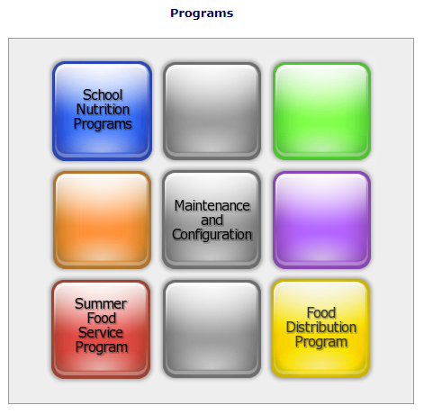
SSO OVERVIEW
Coming Soon: Apply for SSO here
SFA must submit application in MAPS to operate SSO sites (under the SNP icon)
SSO runs from October through September
SFA’s will need to complete SY20-21 application in MAPS to operate SSO when school starts through September 2021.
SFA’s will need to complete SY21-22 application in MAPS to operate SSO October 2021 through end of SY or June 30th at the latest.
Notes:
Kim
OPI is currently working on administrative and technology changes to existing systems to accommodate the new Seamless Summer Option. These changes will allow school districts to sign up and apply for this option. We hope to have the application available tentatively the week of July 1st so schools can then start applying.
SSO runs from October through September so SFA’s will need to complete the application in MAPS for SY20-21 (for operating SSO in August or September whenever your school starts) and then complete application for October 2021 through end of your school year (usually May or June 30th at the latest). The SSO option will be under the SNP icon in MAPS and will be an option under site applications.

Slide 19
REIMBURSEMENT RATES - SSO
TYPE OF MEAL
Breakfast | $2.4625
Lunch | $4.3175
Snack | $1.0200
Notes:
The SSO will follow the Summer Food Service Program reimbursement rates for School Year SSO 2021-2022. Normally, the SSO provides the NSLP free rate. These SFSP rates follow the Consumer Price index and will be updated again on January 1, 2022. Schools will submit meal claims at the end of each month, just like usual, and will receive this amount for each meal claimed - again regardless of a child’s eligibility.
These rates are higher than the NSLP free reimbursement rates - $3.60 for free lunch at 60% eligibility in 2020-2021

Slide 20
MONITORING
Limited Administrative Review for SFAs due for an NSLP review
SFAs are required to complete monitoring of all schools and sites
Counting, claiming, meal pattern compliance
Notes:
This year, we will also be going back to conducting Administrative Reviews. If your school is operating the SSO and due for an Administrative Review, there will be a few less areas to review. School districts will also be responsible for conducting some self-monitoring at the beginning of the school year to ensure schools are complying with the counting, claiming and meal pattern regulations. This can be done off-site via the monitoring waiver via a desk audit - so a phone call or asking for records to be scanned or faxed instead of observing a meal service in person.

Slide 21
PUBLIC ANNOUNCEMENT
For SY 2021-2022, schools participating in SSO should provide the public release that all meals will be offered free through SSO.
OPI will provide a template for schools to use to meet this requirement.
Notes:
Finally, whether operating the SSO or NSLP, schools will be required to distribute a public announcement. This has been done by OPI for the past couple of years. But, since we have two different programs this year, OPI will be asking schools to submit the public announcement to their Local paper, newsletter, facebook, etc. However they let families know things. OPI will be providing a template for schools to meet this requirement

Slide 22
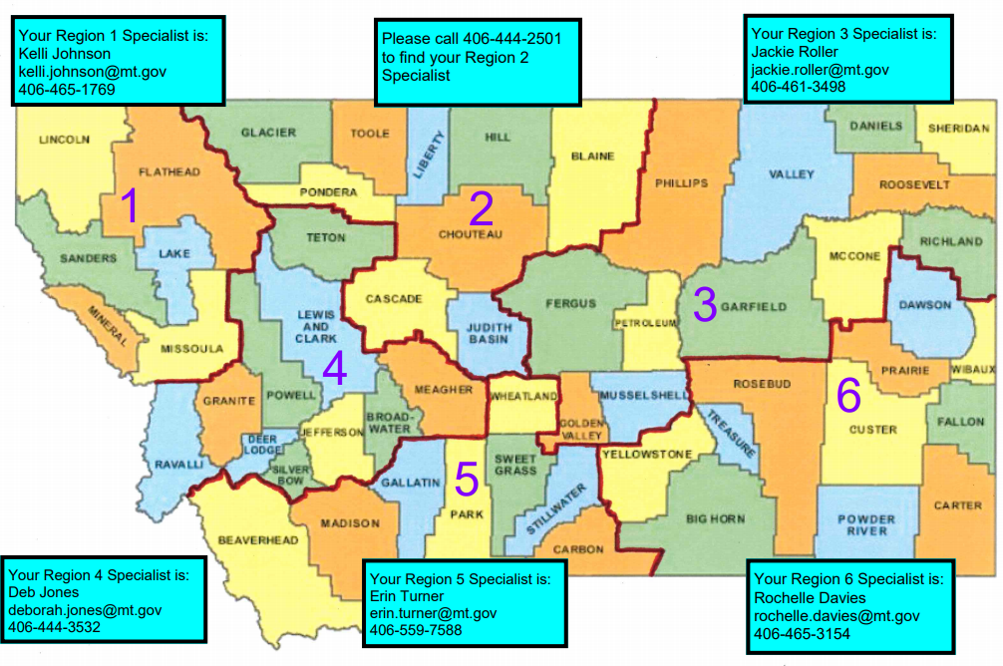
Questions?
Kim Lloyd,
Summer Food Program Manager,
kim.lloyd@mt.gov 406-475-0101

Slide 23
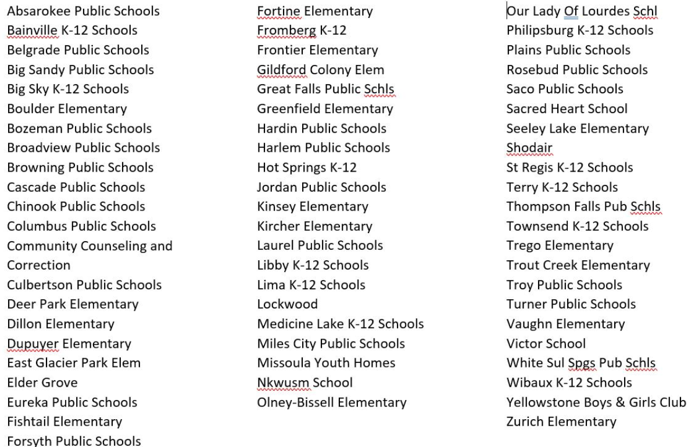
SY2021-21 Schools on Administrative Review

