Slide 1
School Nutrition Resource Management
MASBO 2021

Slide 2
THANK YOU!

Slide 3
agenda
Introduction
What to Expect
SY21-22
Non-Profit School Food Service Account
Questions?
Free/Reduced Applications + DCA
Counting & Claiming

Slide 4
Introduction

Slide 5
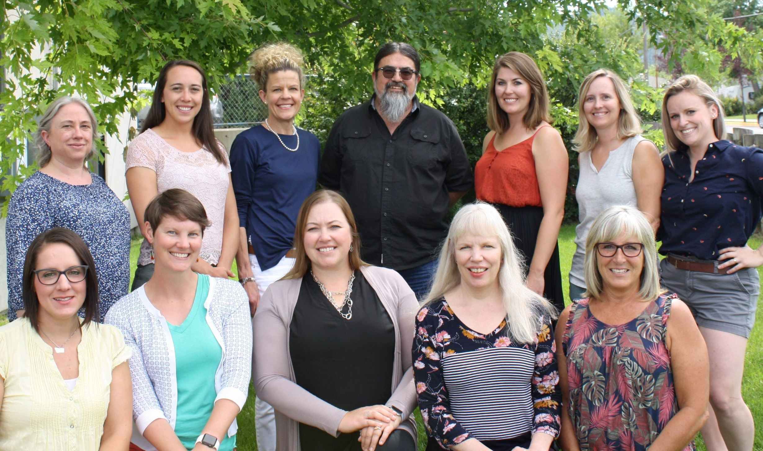
School Nutrition programs team
Top:
Chris Emerson
Jackie Roller
Pam Fruh
Clay Hickman
Camille Biazzo
Erin Turner
Caroline Olson
Bottom:
Alie Wolf
Kim Lloyd
Rochelle Davies
Deb Jones
Bitsey Draur
Kelli Johnson
Notes:
MAPS Off-Site Questions
Procurement- Find the review form Applications < Download Forms < Procurement. Upload completed procurement review form and required documents to Compliance < Review Attachments
Onsite Visit
Menu Review Materials
Corrective Actions – if any findings throughout the process.
We visit to help your district improve the school meal program and make your job easier. We always look forward to coming and visiting you.

Slide 6
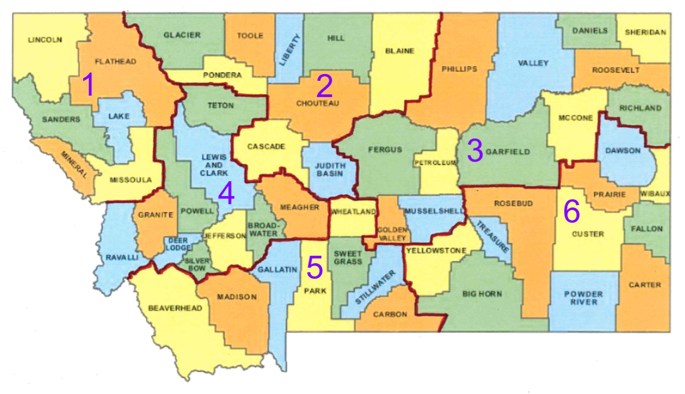
Specialist regional model
Region 1: Kelli Johnson
Region 2: Caroline Olson
Region 3: Jackie Roller
Region 4: Deb Jones
Region 5: Erin Turner
Region 6: Rochelle Davies
Notes:
MAPS Off-Site Questions
Procurement- Find the review form Applications < Download Forms < Procurement. Upload completed procurement review form and required documents to Compliance < Review Attachments
Onsite Visit
Menu Review Materials
Corrective Actions – if any findings throughout the process.
We visit to help your district improve the school meal program and make your job easier. We always look forward to coming and visiting you.

Slide 7
Specialist regional model

Slide 8
What to Expect SY21-22

Slide 9
NSLP or SSO
National School Lunch Program
Seamless Summer Option
Priorities of USDA
Supporting the reopening of schools and institutions
Ensuring program access for children
Increasing funding for program operators
Providing additional flexibility
Promoting nutritious meals

Slide 10
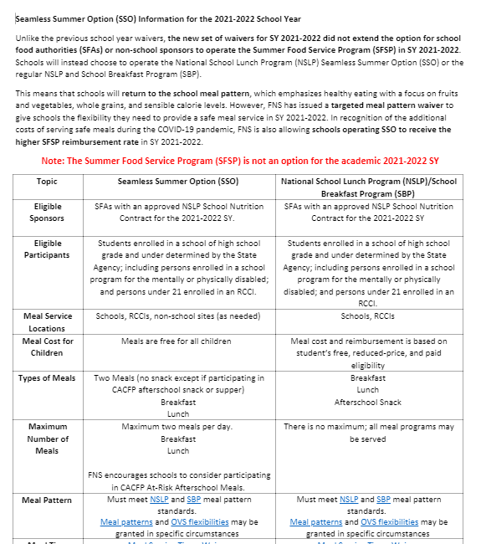
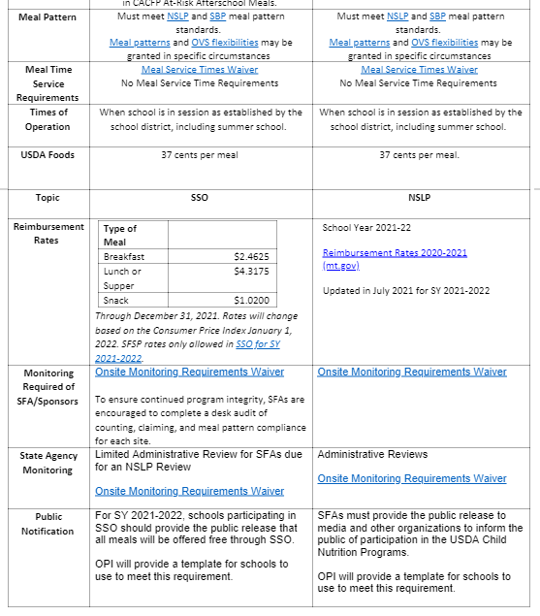
NSLP/SBP vs SSO Comparison

Slide 11
NSLP vs SSO
National School Lunch Program
Seamless Summer Option
Meals allowed per day
Waivers available
Reimbursement

Slide 12
NSLP or SSO?
School District
Choose a program
Complete the MAPS application
Apply for waivers
Both programs can still operate FFVP!

Slide 13
Administrative Reviews?
Yes
Timeline
September/October: Email Notification of MAPS Off-Site Questions/Procurement Review
30 Days Prior to Review: Notification Paper Letter & Menu Review Folder
Day of Review: Onsite Visit
After Onsite Review: Corrective Actions (CADs) in MAPS

Slide 14
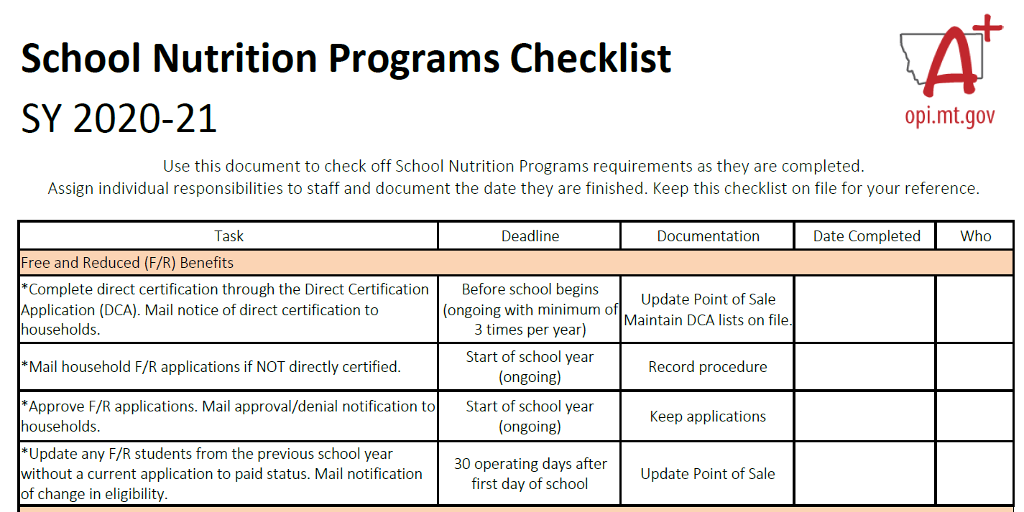
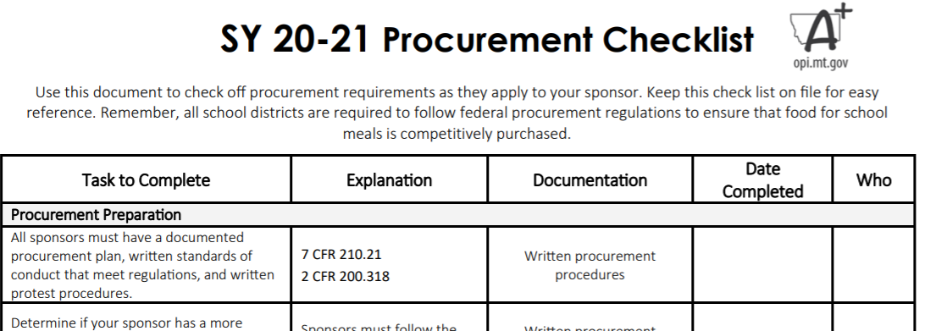
Administrative Reviews
Use the checklists!

Slide 15
Free/Reduced Applications + DCA

Slide 16
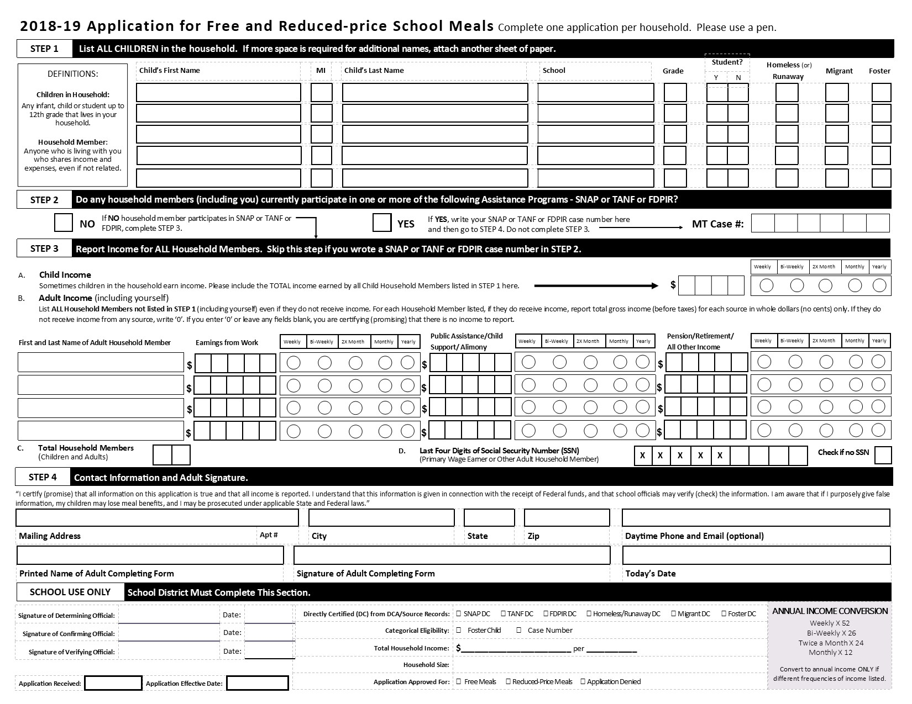
Application highlights
Timeframe
Zero Income
Edits to Application
Error Prone
Signatures
30 Day Drop
Notes:
Timeframe – USDA requires that applications are processed within 10 days
Zero Income – OK! $0 or nothing written
Edits to Application – Make these with a different color ink and initial/date on application itself
Error Prone – within $100 of income guidelines
Error prone applications must be used during verification if less than 80% of HH responded during verification the previous school year – it’s a good practice to note an “error prone application” when you come across them so you don’t have to go back and figure that out twice. OPI SNP will let you know if you need to use error prone applications.
Signatures – required, plain and simple
SSN – required, call and get this information
30 Day Drop – don’t forget after 30 days of the school year, any student with a Free or Reduced status from the previous school year must be moved back to Paid status if a current application is not received by the district. Students that were approved for free meals through DCA but are no longer on the direct cert list must also be moved to Paid status if a current application is not received or they do not show up on the DCA list. Run 30 day report to see which students these are.

Slide 17
Applications with SSO?
Disseminate?
Online F/R App
Process?

Slide 18
Application organization
Free – Categorical
Free – Income
Reduced – Income
Denied
Directly Certified - DO NOT PROCESS (must keep on file)
Notes:
Maintain Records in the Following Way:
Free – Categorical – SNAP number, household marked: foster, homeless, runaway at the top but no source of secondary proof. Student receives Free benefit but the application is in the verification pool.
Free – Income – Processed as such
Reduced – Income – Processed as such
Denied

Slide 19
F/R process overview
Conduct Direct Certification
Send Direct Cert Notifications
Send Applications
Process Applications
Send Notifications
Repeat – Ongoing

Slide 20
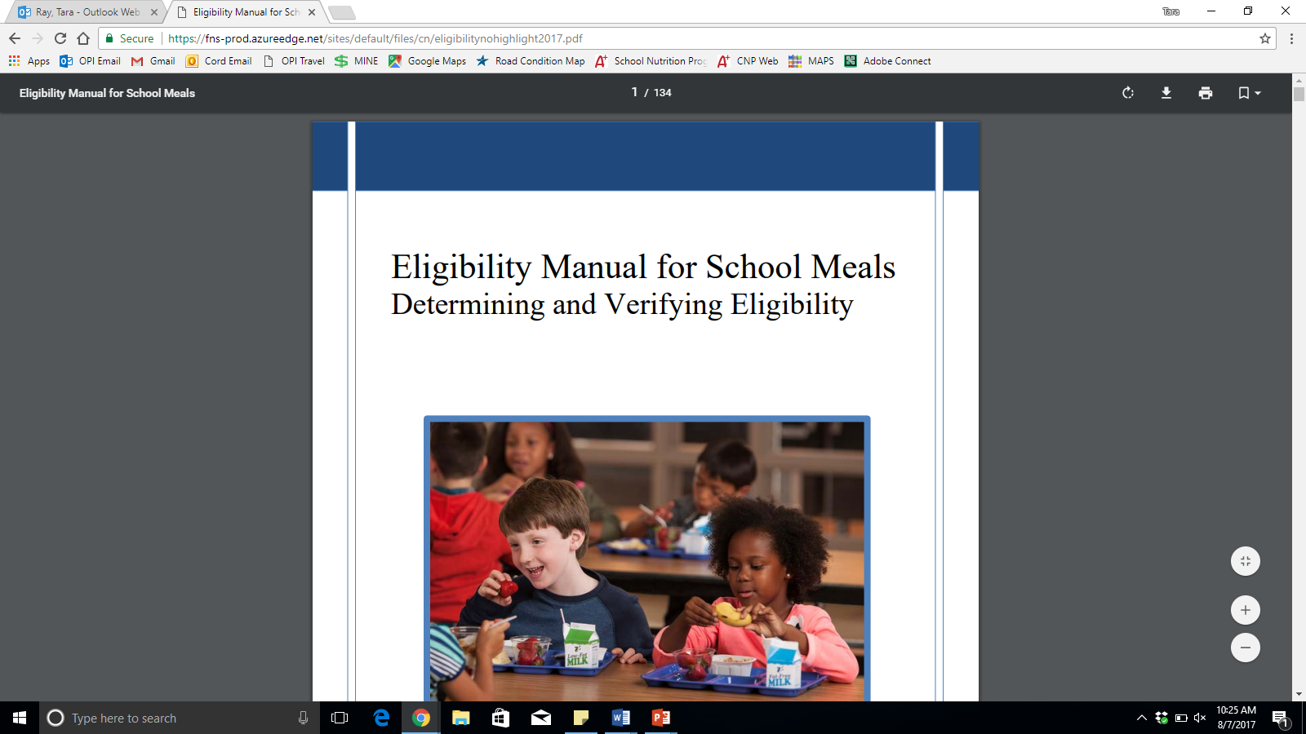
Questions? Eligibility manual for school meals

Slide 21
Verification?
Yes

Slide 22
What is verification?
Process of validating information received from households.
Notes:
School meal program integrity.
Reported to USDA.
All districts must verify 3% of applications.
(round up)

Slide 23
All districts fall into one of the following two categories:
3% Random
At least 80% response rate from households in the previous year.
Applications for verification chosen at random from entire pool subject to verification.
3% Error Prone
Less than an 80% response rate from households in the previous year.
Applications for verification chosen at random from error prone applications.
Notes:
Random
Equal to or greater than an 80% response rate from households in the previous year.
Applications for verification chosen at random from entire pool subject to verification.
Error Prone
Less than an 80% response rate from households in the previous year.
Applications for verification chosen at random from error prone applications.

Slide 24
Between October 1 and 31
Select applications for verification (REMEMBER: 3% - round up!)
Conduct confirmation review (double check)
Attempt Direct Verification
Send household notification of selection
Collect information from households…follow up…multiple ways (call, email, mail, etc.)
Review documentation returned from household
Send household notification of results, update POS if needed

Slide 25
November 15
Deadline to submit Verification Report in MAPS
If 1 or more applications are submitted: complete verification process and submit report in MAPS
If 0 applications are processed: submit report in MAPS
Notes:
GO THROUGH FORM

Slide 26
Direct Certification Application (DCA)
*If operating SSO you must still check at least 3 times per year!

Slide 27
Counting & Claiming

Slide 28
Counting
NSLP:
POS/SIS
Rosters
SSO:
Check-Off Sheets
Rosters
POS/SIS
*Count at Point of Service – meals in the classroom?
*Make sure no one is double counted

Slide 29
Claims
Submit claims by the 10th of the month
Original Claim submissions after 60 days from the claim month cannot be paid without approval of a one-time exception
Revised Claim submissions after 90 days from the claim month cannot be paid without approval of a one-time exception
Upward revisions can be completed up to 90 days past the claim month
Downward revisions can be completed at any time
Revisions resulting in no changes in reimbursement can be completed at any time
One-time exception requests require a corrective action plan
Sponsors allowed one exception every 36 months
Exceptions are counted separately for the Summer Food Service Program
One time exceptions for payment can only be made for one month.

Slide 30
Non-Profit School Food Service Account

Slide 31
Meal Charge Policy
It’s required. Define process for delinquent and bad debt.
Communicate in writing.
Montana School Board Association Policy Template
Unpaid Meal Charges: Guidance Q&A
Notes:
Meal Charge Policy:
Must develop and implement an SFA-level policy.
Policy must be provided in writing to all household at the start of each school year and to transfer students.
Work with families. Do not punish the child. Alternate meals may single children out with unpaid meal charges.
Charge all available reimbursable meals to the child’s account
Charge a limited number or type of meals to the child’s account
Receive an alternate meal
Neither charge a meal nor receive an alternate meal (p 11 of overcoming doc)
Policies must include process SFA follows for delinquent and bad debt (uncollectable).
“Delinquent”- when payment is overdue as defined by local policy. It is considered delinquent as long as it is considered collectable and efforts are being made to collect it. Must make reasonable effort to collect. Cost of collect efforts is an allowable us of NSFSA funds. A debt owed to the NSFSA remains on accounting docs until it is either collected or is determined uncollectable and written off. Can be carried over to next school year.
“Bad” Debt: When further collection for delinquent debt are useless or too costly, the debt must be re-classified as “bad” debt. Once considered “bad” debt, it must be written off as an operating loss. NSFSA resources may not be used to cover costs related to the bad debt, such as continued legal and collection costs. MUST BE RESORED using NON-FEDERAL funds- General fund, local contributions from community orgs, revenue from catering or contracting services that operate using an account other than the NSFSA.
If child has $ to buy meal but has outstanding meal charge debt, the SFA cannot require payment and refuse to provide the child a meal.
Good Practices- pre-payment, payment plans, online payment, online applications.
Resources
MTSBA policy Overcoming the Unpaid Meal Challenge

Slide 32
Paid Lunch Prices
Paid Lunch Equity Tool not required unless nonprofit school foodservice account is negative
Annual USDA Memo
$3.12
Free reimbursement $3.58 – paid reimbursement $0.40 = $3.12
Notes:
Ensure sufficient funds are provided to the nonprofit school food service account for meals served to students not eligible for F/R. Two ways to do this- either though price charged for “paid” meals or through other non-Federal sources provided to the NSFSA.

Slide 33
Adult meal Prices
It’s Required!
Adult Meal Price Memo
2020-21
Breakfast $1.89
Lunch $3.84
Factor in serving size
Notes:
Adult Meal Prices
Revenue from NSLP and SBP cannot be used to subsidize adult meals. If SFA decide to subsidize meals for teachers, admin, custodians and other adults, the subsidy should be identified as an employee benefit and as a source of revenue in the School food Service budget.
$3.55 lunch; $1.79 breakfast [lunch = free reimbursement, value of commodities ($.23?), state match (.002)

Slide 34
A la carte sales
Minimum
Track a la carte milks and second entrees.
Best Practice
Charge for a la carte items.

Slide 35
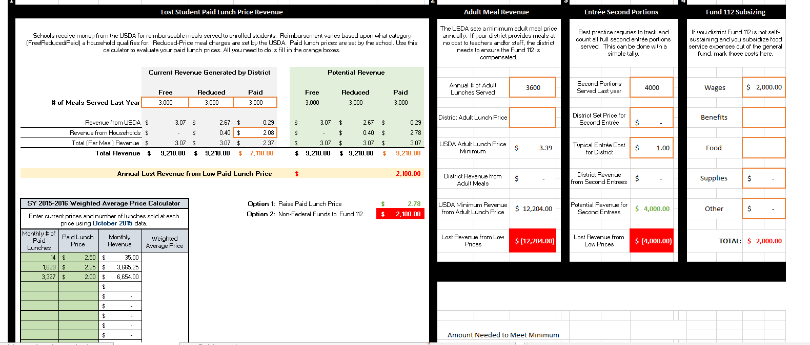
Lost Revenue Calculator
Notes:
Open tool- do example

Slide 36
Questions?

