Slide 1
ESSER I, II, III and so much more….
Mindi Federman Askelson
Mindi.Askelson@mt.gov
(406) 444 0768
This Photo by Unknown Author is licensed under CC BY-SA
Notes:
Introduce myself
Been here 6 months
Working with Egrants and Managing ESSER funds until a new person is hired
Have over 20 year of experience in federal grants in education

Slide 2
Today we will cover:
ESSER Resources
Equitable Share
ESSER 1 - Allowable Expenditures
ESSER 2 - Allowable Expenditures
ESSER 3- Allowable Expenditures
ESSER Rules and Laws
OPI Monitoring
Notes:
Please feel free to ask questions

Slide 3
I hope to make this presentation as painless as possible, and maybe even a little enjoyable!

Slide 4
Esser Resources
Grant Manager – Ken Bailey
Program Analyst – Mindi Askelson
OPI Website – Search for “ESSER” or http://opi.mt.gov/COVID-19-Information/ESSER
Office of Elementary & Secondary Education
https://oese.ed.gov/offices/education-stabilization-fund/elementary-secondary-school-emergency-relief-fund/
Notes:
Many of you know Ken Bailey, who will retire this June
Bring in another program manager and accountant to work with ESSER

Slide 5
Additional information about ESSER and EANS can be found on the OPI Website
Notes:
OPI website has detailed, up to date information about ESSER and another program I am going to talk about EANS. Direct links from landing page.

Slide 6
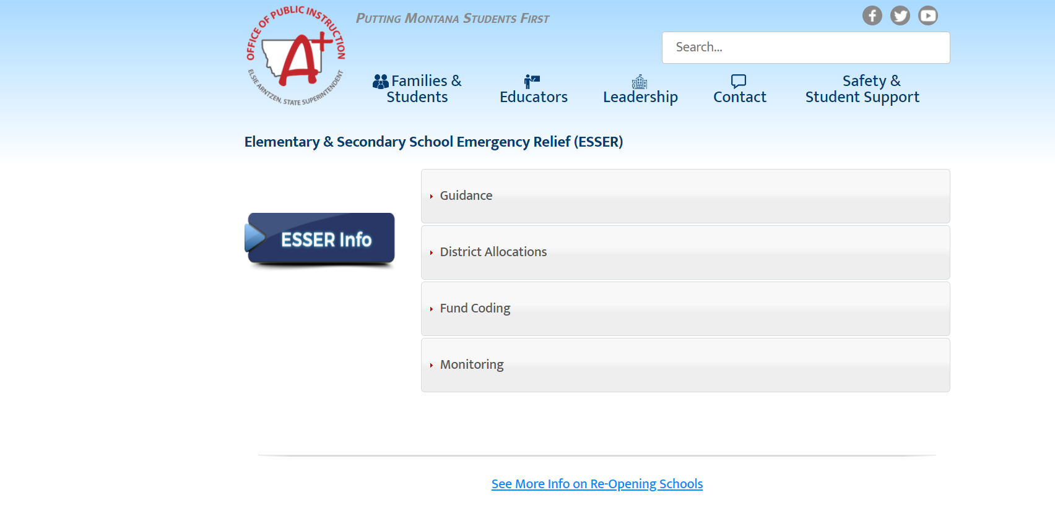
OPI ESSER Web page
http://opi.mt.gov/COVID-19-Information/ESSER
Notes:
Let’s take a look around at all the fun things found on this page
Allocation tables is found under district allocations

Slide 7
CARES, ESSER II, ESSER III
PREVENT
PREPARE FOR
AND
RESPOND TO COVID
Notes:
You will see me repeat this slide and phrase over and over. These are the overarching reasons that you can use ESSER funds. As long as you can comfortabley defend your purchase to an auditor that it meets one of these category.

Slide 8
Supplement Not Supplant
Neither the ESSER Fund nor the ESSER II fund contains a supplanting prohibition
At the LEA level, ESSER funds may take the place of State or local funds for allowable activities
However, the ESSER grant does not change the maintenance of effort requirements of other federal grants
Notes:
No supplanting issues however it still needs to fall under the Prevent, Prepare, and Response guidelines
Here is an example:
Used another federal grant for providing swimming lessons

Slide 9
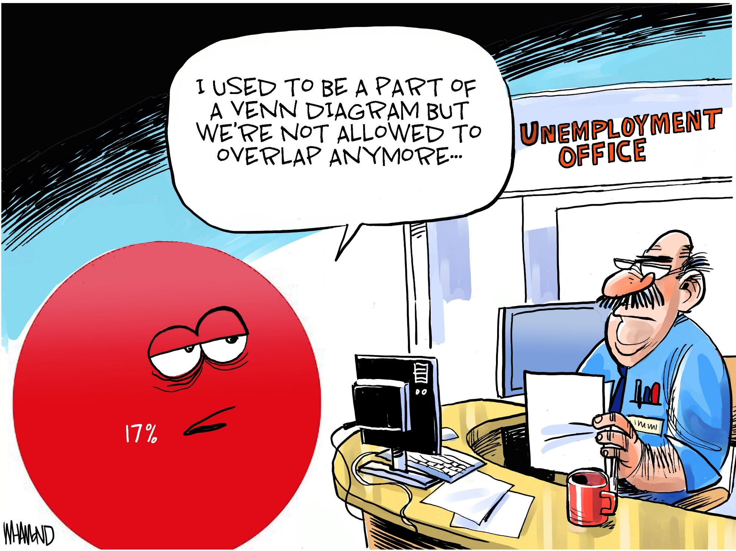
Notes:
Isn’t this how we all feel right now?

Slide 10
Equitable Share aka…. Emergency assistance to Non-public schools
ESSER I-funds were handled by the LEA’s
ESSER II and III (EANS) - handled by OPI
ESSER II-reimbursement is allowed by the
OPI
ESSER III-no reimbursement allowed
Notes:
No more of the complicated spreadsheets after finished with ESSER 1 funds

Slide 11
Notes:
If you get calls from Home Schools regarding the EANS found send to the website or me

Slide 12
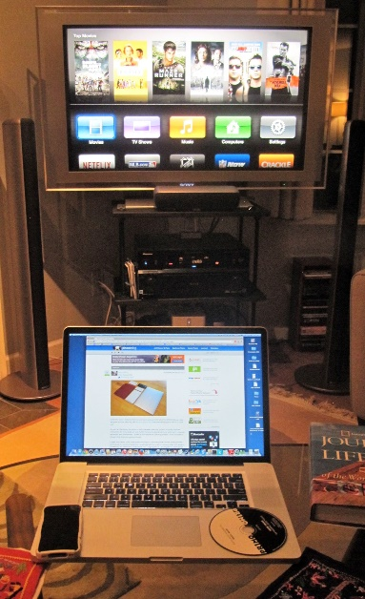
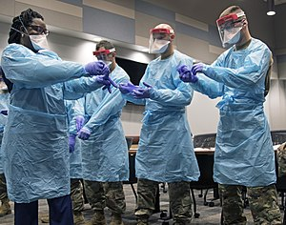
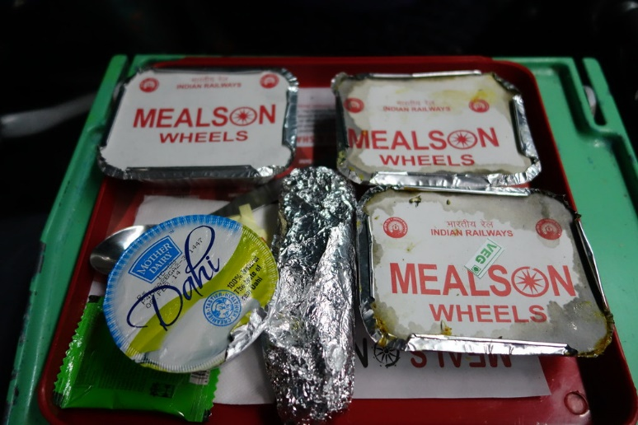
Allowable activities in esser i
Not just cleaning supplies …
Notes:
I want to reinforce that ESSER is not just for cleaning supplies as you can see from the slide

Slide 13
PREVENT
PREPARE FOR
AND
RESPOND TO COVID
Notes:
Again all items and services purchased with ESSER funds need to

Slide 14
Any activities authorized under ESEA, IDEA, Perkins, Family Literacy and McKinney-Vento Act
Coordination of preparedness and response efforts of LEAs
Providing resources for school leaders
Activities to address unique needs of at-risk students
Developing and implementing procedures and system to improve readiness
Training and professional development
Purchasing supplies for sanitation
Notes:
Activities linked to …. Need to pass a two step process….. Would it be acceptable under both federal grants. Example about title 2 monies and how it didn’t match
Addressing the needs of at-risk students will become more prominent in ESSER II and III
I have seen some great trainings being offered for student, teachers and parents

Slide 15
Continued ……
Planning and coordination during long term closures (including meals)
Purchasing educational technology
Providing Mental Health services
Planning and implementing summer/supplemental learning activities
Other activities necessary to maintain the operation and continuation of services in LEAs - deleted from ESSER III
Notes:
Most schools are covering meals for students experiencing food insecurity
I am not seeing a lot of Mental Health services, but this maybe the time for you to move to a full time counselor, or title teacher

Slide 16
Indirect costs
Nothing in the grant what permits or prohibits claiming indirect costs
OPI (Paul Taylor) approves the indirect cost rate
Rate is loaded into EGrants
Notes:
Here is another topic we are getting a lot of questions about. This is at the bottom of the Budget Detail page.

Slide 17
This is not an acceptable means for preventing, preparing, and responding to COVID

Slide 18
Using esser funds for staff
3 REASONS:
Maintain pay for pre-COVID staffing
Additional staff or staff time caused by COVID (this includes substitutes for COVID leave)
Pay existing budgeted staff if there is a change of duties and you have the system to keep track of time spent on new duties
“… to prevent, prepare for, and respond to coronavirus …”
Notes:
Get a lot of questions about using funds for staff
There is no hazard pay, bonuses, stipends……… must document

Slide 19
before Using ESSER Funds for Staff
To the greatest extent practicable, continue to compensate its employees and contractors during the period of any disruptions or closures related to COVID-19
Each entity that accepts funds will continue to pay employees and contractors to the greatest extent practicable
Not be used for bonuses, merit pay, or similar expenditures, unless related to disruptions or closures resulting from COVID-19
Document how duty change is related to coronavirus
Establish timekeeping system to record hours expended on new duties

Slide 20
What the real covid classroom looks like

Slide 21
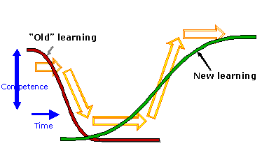
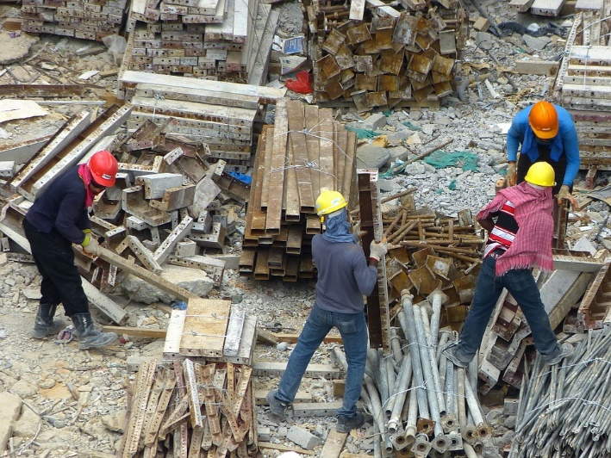
New allowable uses in esser ii
Think bigger
Notes:
Have to start thinking on a larger scale instead of the biggies in ESSER II is Learning Loss, HVAC, Construction/Deferred maintainance

Slide 22
Addressing learning loss
Administering high quality reliable assessments
Implementing evidence-based activities
Providing information and assistance to parents and families to support students
Tracking student performance and engagement in distance learning
Notes:
There will be a section in the ESSER application where you will have to discuss how and what you measured
And then what you did or are doing about it
They are really pushing measure distance learning

Slide 24
HVAC SYSTEMS
School facility repairs and improvements to enable operation of schools to reduce risk of virus transmission and exposure to environmental health hazards, and to support student health needs.
Inspection
Testing maintenance
Repair
Replacement
Upgrade projects
Mechanical and non-mechanical heating ventilation and air conditioning systems
Filtering, purification and other air cleaning, fans, control systems
Window and door repair replacement

Slide 25
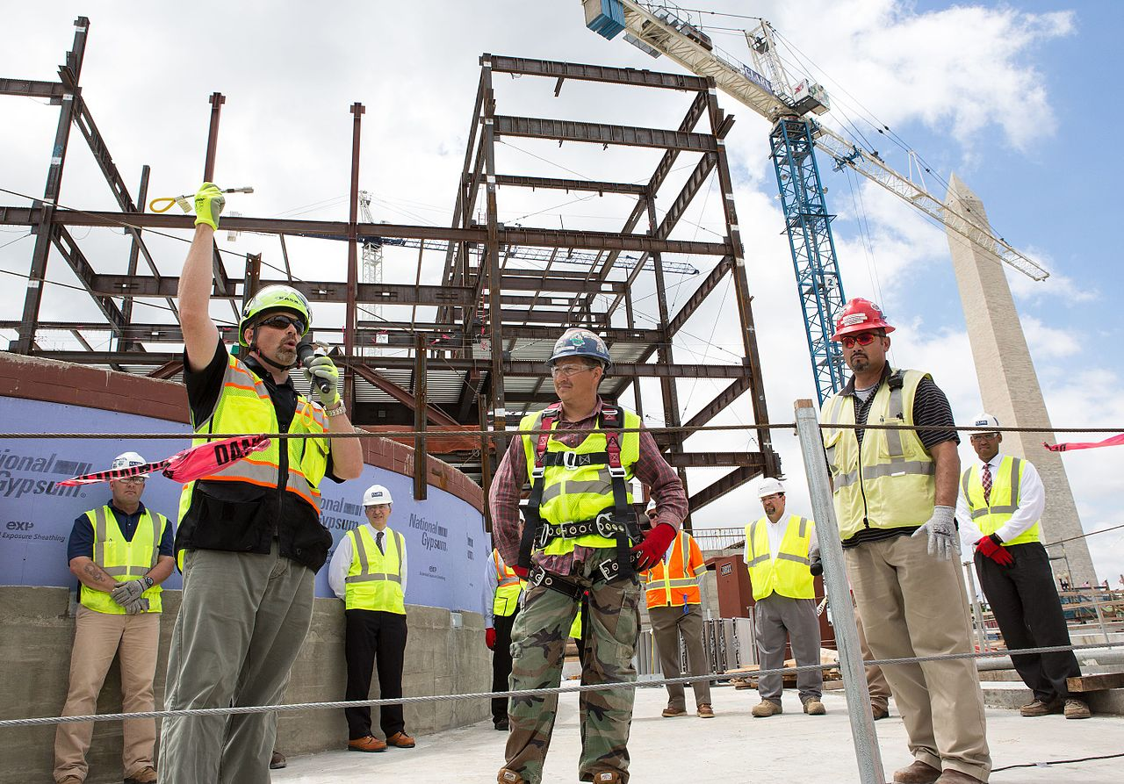
Facilities repairs, & Improvements
Facilities and repairs and improvements to enable operation of schools to reduce risk of virus transmission and exposure to environmental health hazards and support student health needs
This Photo by Unknown Author is licensed under CC BY-SA

Slide 26
When purchasing assets and construction
2 CFR §200.313 Equipment Procurement Standard
2 CFR §200.318 General Procurement Standards
2 CFR §200.319 Competition
2 CFR §200.320 Methods of procurement to be followed
2 CFR §200.321 Contracting with small and minority businesses
2 CFR §200.322 Domestic preference for procurement
2 CFR §200.323 Procurement of recovered materials
2 CFR §200.324 Contract cost and price
Notes:
Here is the reason you need OPIs approval of projects and equipment over $5,000 but wait………..

Slide 27
2 CFR §200.325 Federal or state review
2 CFR §200.326 Bonding
2 CFR §200.327 Contract provisions
20 U.S.C. 1232 Labor Standards
34 CFR § 76.600 Construction standards
Davis-Bacon Prevailing wage requirements
Notes:
There is more!

Slide 28
In summary…..
Maintain records that include a description of the property, a serial number or other identification number, the source of funding for the property (including the FAIN), who holds title, the acquisition date, and cost of the property, percentage of Federal participation in the project costs for the Federal award under which the property was acquired, the location, use and condition of the property, and any ultimate disposition data including the date of disposal and sale price of the property
A physical inventory of the property must be taken, and the results reconciled with the property records at least once every two years
A control system must be developed to ensure adequate safeguards to prevent loss, damage, or theft of the property. Any loss, damage, or theft must be investigated
Notes:
The main points of these acts
A word about physical inventory…..

Slide 29
Adequate maintenance procedures must be developed to keep the property in good condition
If the non-Federal entity is authorized or required to sell the property, proper sales procedures must be established to ensure the highest possible return
For assets that have a residual value of $5,000 or more at the end of the grant period you can sell the asset and give the money back to the feds, assign the asset to other ongoing federal projects, or petition to retain the asset.

Slide 30
Don’t ruin a great project by overlooking federal rules

Slide 31
Projects & Equipment over $5,000 for ESSER 1
Send an email to Ken Bailey that contains:
The amount of money needed for the project
How the project relates to COVID
A request to retain the asset at the end of the grant
Ken will send back a note approving the plan.
Notes:
Take a minute to talk about how to get permission from OPI to do the projects. For Esser I….

Slide 32
Projects & Equipment over $5,000 for ESSER ii & III
Notes:
No longer need Ken’s signature….. You will attest to knowing and following all the rules and laws in final assurances
This means an item that costs over not adds up to

Slide 33
Equipment under $5,000
Notes:
New information – for items under $5,000 computers, chrome books, software, hot spots……. Need to be labled and kept track of

Slide 34
Auditors are required to follow federal compliance supplements for end of year audits.

Slide 35
New in esser iii
Our new normal?
Notes:
Which includes back to in person education and maintenance of Equity

Slide 36
Notes:
Biggest change in ESSER III is the preparedness of the schools to return to in person classes.

Slide 37
Return to In-Person Instruction
(1) IN GENERAL.—A local educational agency receiving funds under this section shall develop and make publicly available on the local educational agency’s website, not later than 30 days after receiving the allocation of funds described in paragraph (d)(1), a plan for the safe return to in-person instruction and continuity of services.
(2) COMMENT PERIOD.—Before making the plan described in paragraph (1) publicly available, the local educational agency shall seek public comment on the plan and take such comments into account in the development of the plan.
(3) PREVIOUS PLANS.—If a local educational agency has developed a plan for the safe return to in-person instruction before the date of enactment of this Act that meets the requirements described in paragraphs (1) and (2), such plan shall be deemed to satisfy the requirements under this subsection.

Slide 38
Maintenance of equity
As a condition of receiving ESSER funds the school district shall not, in fiscal year 2022 or 2023:
Reduce per pupil funding for any high-poverty school
Reduce per pupil, full-time equivalent staff in any high-poverty school

Slide 39
Reports and monitoring
Notes:
There are also A LOT of reports and monitoring requirements with these funds

Slide 40
OPI Monitoring
Monitoring will change slightly with the new consolidated upload
Like other grants, ESSER requires OPI to monitor use of funds by school districts
Monitoring will be “desk” monitoring only
Form for monitoring session will be posted on our website

Slide 41
http://opi.mt.gov/COVID-19-Information/ESSER#9922711276-monitoring

Slide 42
Annual Reporting for esser ii & iii
If the reporting requirements remain the same, this information will be pulled from the application in EGRANTS

Slide 43
Finally…..
We are still waiting on legislative action to determine the use of state level funds including BASE Aid for enrollment increases and Maintenance of Effort requirements for LEAs.

Slide 44
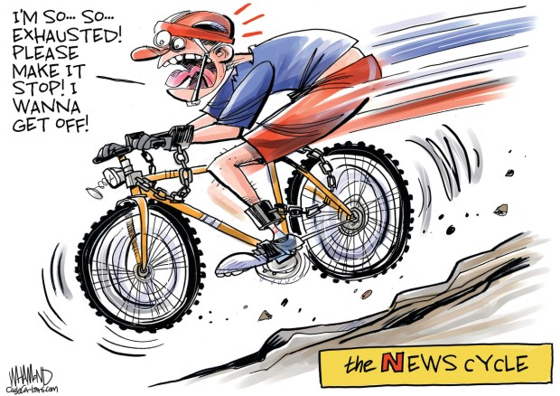

Slide 45
Thank you for your time
QUESTIONS???

