Slide 1
Indirect Cost Rate
Denise Williams, Executive Director
MASBO Region 1 Spring Workshop
April 19, 2021 - Kalispell

Slide 2
Indirect Cost Rate
What is it?
How is it calculated?
How can I get one?
How do I use it?
Sources: OPI School Finance – Accounting – Indirect Costs
Indirect Cost Rate FY2022 Instructions
Cover Letter for Indirect Cost Rate

Slide 3
Indirect Cost Rate – What is it?
Indirect Costs – not readily identifiable with the activities of the grant but incurred for the joint benefit of those activities and other activities of the organization
Uniform Grants Guidance, 2 CFR 200:
“Incurred for a common or joint purpose benefiting more than one cost objective; and
Not readily assignable to the cost objectives specifically benefited, without effort disproportionate to the results achieved”
Common examples: procurement, payroll, personnel functions, maintenance and operations of space, data processing, accounting, auditing, budgeting

Slide 4
Indirect Cost Rate – What is it?
Indirect Cost Rate - the percentage of allowable general administrative expense that each Federal grant should bear
ratio of total indirect costs to total direct and unallowable costs
excludes extraordinary or distorting expenditures, such as capital outlay, debt service, costs already charged to other programs, etc. (see OPI cover letter)
determined by OPI based on Trustees Financial Summary data
FY2020 TFS used to calculate FY2022 IDC rates
OPI negotiates the process with the U.S. Dept. of Education every 5 years

Slide 5
Indirect Cost Rate – What is it?
Classification of Local Education Agencies (LEAs)
Independent Elementary School | Single LEA serving a range in grades PK – 8
Independent County High School | Single LEA serving a range in grades 9 - 12
Joint Board District | 2 LEAs – an elementary and a high school governed by a joint board of trustees
K-12 District | Single LEA serving grades K - 12

Slide 6
Indirect Cost Rate – How is it calculated?
Preliminary rate
Calculated by OPI using TFS data
See Schedule A – preliminary rate highlighted in yellow on last page
See IDC Instructions for fund, expenditure and object codes used
Adjusted rate
Expenditures reported on TFS are “rolled up”
Provide additional detail to OPI to reclassify expenditures from direct to indirect
May result in a higher rate

Slide 7
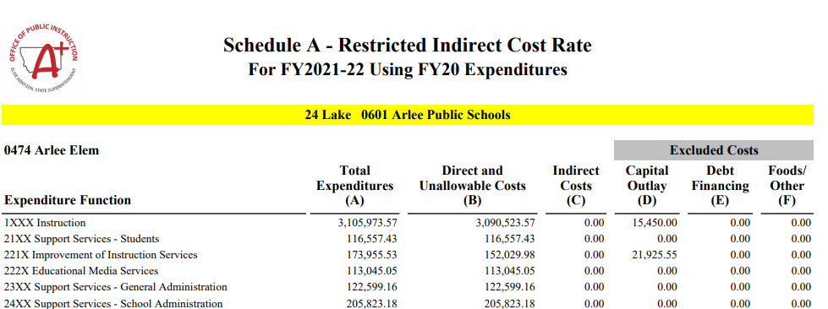

Slide 8
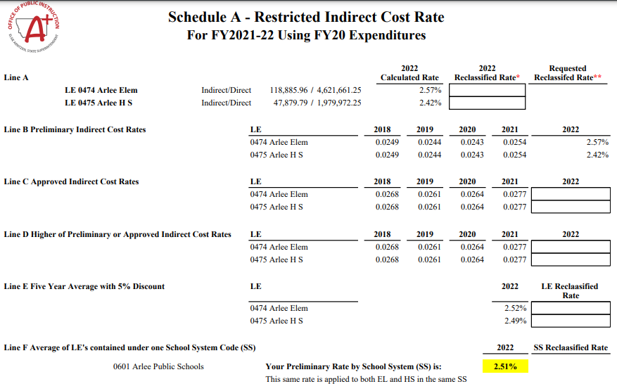

Slide 9
Indirect Cost Rate – How can I get one?
Two Options
Preliminary rate
Review Schedule A provided by OPI
Get approval from district superintendent or board chair
Submit certification form to OPI
Adjusted rate
Reclassify costs from direct to indirect (see instructions)
Use reclassification calculator to determine adjusted rate
Get approval from district superintendent or board chair
Submit certification form to OPI

Slide 10
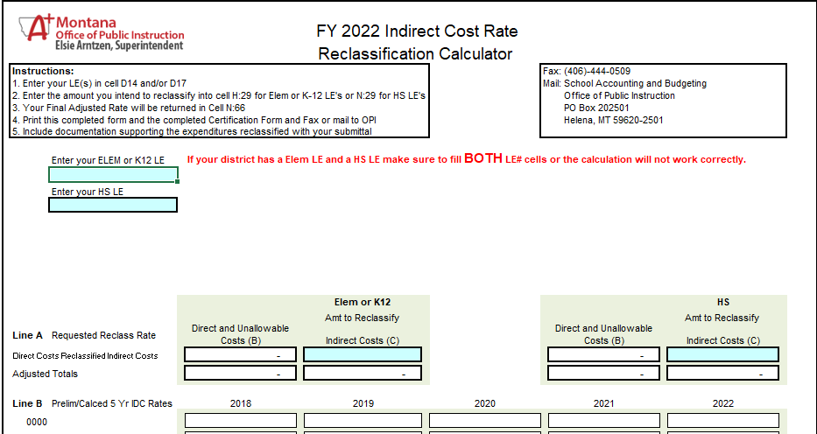

Slide 11
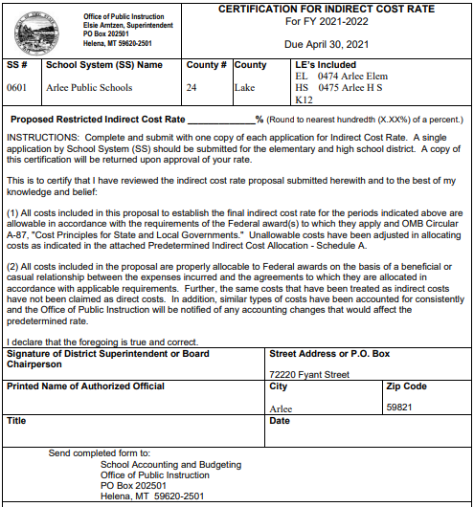
Enter preliminary or adjusted rate here
Get supt. or board chair signature

Slide 12
Indirect Cost Rate – How do I use it?
Approved rate is valid from July 1 through June 30 of the applicable fiscal year of approval or the term of the grant award
Apply the indirect cost rate in effect for a given fiscal year or the term of the grant award to the direct expenditures less capital outlay
An indirect cost rate approved during the middle of a grant period may only be applied to grant expenditures made after the approval date.
The rate may not be applied retroactively

Slide 13
Indirect Cost Rate – How do I use it?
Applying for an approved IDC rate is voluntary
Can apply in one fiscal year, but not in others
Using an approved IDC is voluntary
Can use only on some grants but not others
Within a grant, can apply on some grant expenditures requests, but not others
Can apply up to the approved rate
Can apply to state and federal grants, including ESSER grants, even grants administered by other agencies

Slide 14
Indirect Cost Rate – How do I use it?
It’s all done in E-Grants
For compatibility with the e-grants system the closing date for applying for an Indirect Cost Rate is April 30.
. . . however . . .
You can apply for an IDC at any time; just remember:
An indirect cost rate approved during the middle of a grant period may only be applied to grant expenditures made after the approval date.
The rate may not be applied retroactively

Slide 15
Indirect Cost Rate – How do I use it?
Use Miscellaneous Programs Fund (X15) – 20-9-507, MCA
Each grant has a unique Project Reporter Code (PRC)
Set up an Indirect Cost Pool using a unique PRC
Revenue: 4930 – Federal Indirect Cost Recoveries/Aggregate of Reimbursements
Expenditures:
Used appropriately, this money is intended to pay for costs of administration and operations which cannot be reasonably allocated directly to one particular program or grant (i.e., indirect costs)
However, there is no legal restriction addressing what it can be used for
Balance can carry forward to the next year

Slide 16
Indirect Cost Rate – How do I use it?
Claim IDC recoveries when you submit a grant cash request
Payment from OPI includes the cash request amount + IDC
Receipt the full payment to grant revenue
Transfer the IDC portion to the Indirect Cost Pool
Example: Title I payment from OPI = 10,300.00 (IDC = $300)
Debit/ Credit | Account codes | Account Title | Amount
Debit | X15-101 | Cash | $10,300.00
Credit | X15-4200-123 | Title I revenue (PRC 123) | $10,300.00
Debit | X15-420-6200-940-123 | Resource Transfer Out | $300.00
Credit | X15-4930-777 | Indirect Cost Recovery (PRC 777) | $300.00

Slide 17
Indirect Cost Rate
Advice:
Read the OPI Instructions and Cover Letter
Apply for an IDC by April 30 if you can
Remember: it’s voluntary to apply for and to use it
Remember that an IDC does not increase the amount of the grant

