Slide 1
MASBO BUDGET WORKSHOPS 2021
Mike Waterman, Director of Business Services
Bozeman Public Schools
mike.waterman@bsd7.org
W: 406-522-6097 C: 406-589-4027
Denise Williams, Executive Director
Montana Association of School Business Officials
dwilliams@masbo.com
W: 911 C: 406-461-3659

Slide 2
Agenda
Budgeting Steps
LC2554
Budgeting in the Age of ESSER Grants

Slide 3
Budgeting Steps
Conventional:
  Complete enrollment counts
  Wait for OPI to release preliminary budget data sheets, budget spreadsheet

Slide 4
Sample School District
Historical Enrollment Count

Slide 5
Sample School District
Historical Enrollment Count
These students drive the funding…
(funding source)

Slide 6
Sample School District
Historical Enrollment Count
…that will be used to
serve these students
(funding use)
These students drive the funding…
(funding source)

Slide 7
Sample School District
Historical Enrollment Count
Our job: Identify these students in order to:
Know what you need to serve them
Possibly obtain additional resources for your District
???

Slide 8
Budgeting Steps
X
Conventional:
  Complete enrollment counts
  Wait for OPI to release preliminary budget data sheets, budget spreadsheet
Recommended:
  Complete enrollment counts
  Project enrollment for ensuing October
  Determine eligibility for anticipated unusual enrollment increase
  Calculate budget, tax impacts
  Seek Board approval, submit projections to OPI
  Monitor projections vs actual in ensuing October

Slide 9
Projecting Enrollment
Grade | Student Count Current Year | Student Count Next Year
K
1
2 | 30
3 |  | ???
4
5
6
7
8
9
10
11
12
Total K-12
The “Eyeball” Method:
Extension Exercise

Slide 10
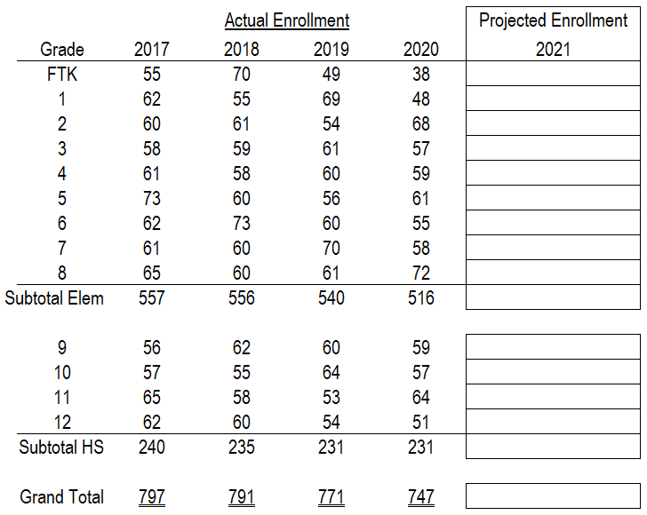
Sample School District
Historical Enrollment Count

Slide 11
Sample School District
Historical Enrollment Count

Slide 12
Sample School District
Historical Enrollment Count
Recommended order for developing enrollment projections:
  Classes for which you have full history
  Classes for which you have partial history
  Project Kindergarten last
    Historical average
    Other methods
  Classes for which you have partial history
  Project Kindergarten last
    Historical average
    Other methods

Slide 13
Sample School District
Historical Enrollment Count
Recommended order for developing enrollment projections:
  Classes for which you have full history
  Classes for which you have partial history
  Project Kindergarten last
    Historical average
    Other methods
  Classes for which you have partial history
  Project Kindergarten last
    Historical average
    Other methods

Slide 14
Sample School District
Historical Enrollment Count
Recommended order for developing enrollment projections:
  Classes for which you have full history
  Classes for which you have partial history
  Project Kindergarten last
    Historical average
    Other methods
  Classes for which you have partial history
  Project Kindergarten last
    Historical average
    Other methods

Slide 15
Sample School District
Historical Enrollment Count
Recommended order for developing enrollment projections:
  Classes for which you have full history
  Classes for which you have partial history
  Project Kindergarten last
    Historical average
    Other methods
  Classes for which you have partial history
  Project Kindergarten last
    Historical average
    Other methods

Slide 16
Sample School District
Historical Enrollment Count
Observations/takeaways:
  Enrollment increases possible even in districts with falling enrollment
  Keep an eye on bubble classes
  Anticipate changes to budget limits
Grades | FY21 Per-ANB Entitlement
K-6 (E) | $5,727
7-8 (M) | $7,333
9-12 (H) | $7,333

Slide 17
Heads Up!
HB329 - "Students with Special Needs Equal Opportunity Act“:
  Resident public school district contributes General Fund amount for non-enrolled special ed student’s use via OPI. Amount is lesser of:
    District’s average General Fund budget per pupil
    Statewide average General Fund budget per pupil
  District counts students for ANB funding

Slide 18
Projecting Enrollment During COVID
Possible sources of info
  County Superintendent
  Private Schools
  Call them and ask!

Slide 19
Your toolbox…
Spreadsheet on MASBO website

Slide 20
Projecting Enrollment
Use Enrollment Projections tab to summarize your October enrollment history and develop projections for next year

Slide 21
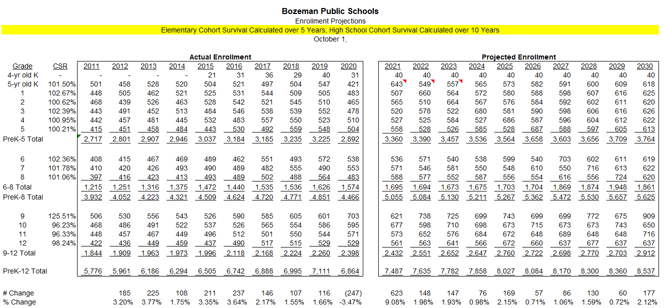
Bozeman Public Schools
Enrollment History and Projections

Slide 22
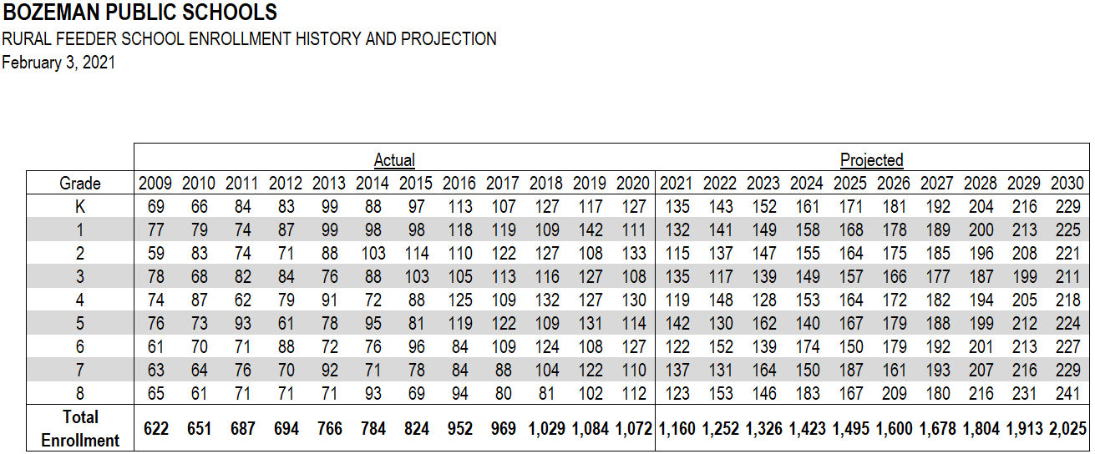
And not just YOUR enrollment…

Slide 23
And not just YOUR enrollment…

Slide 24
Yeah…but does it work?

Slide 25
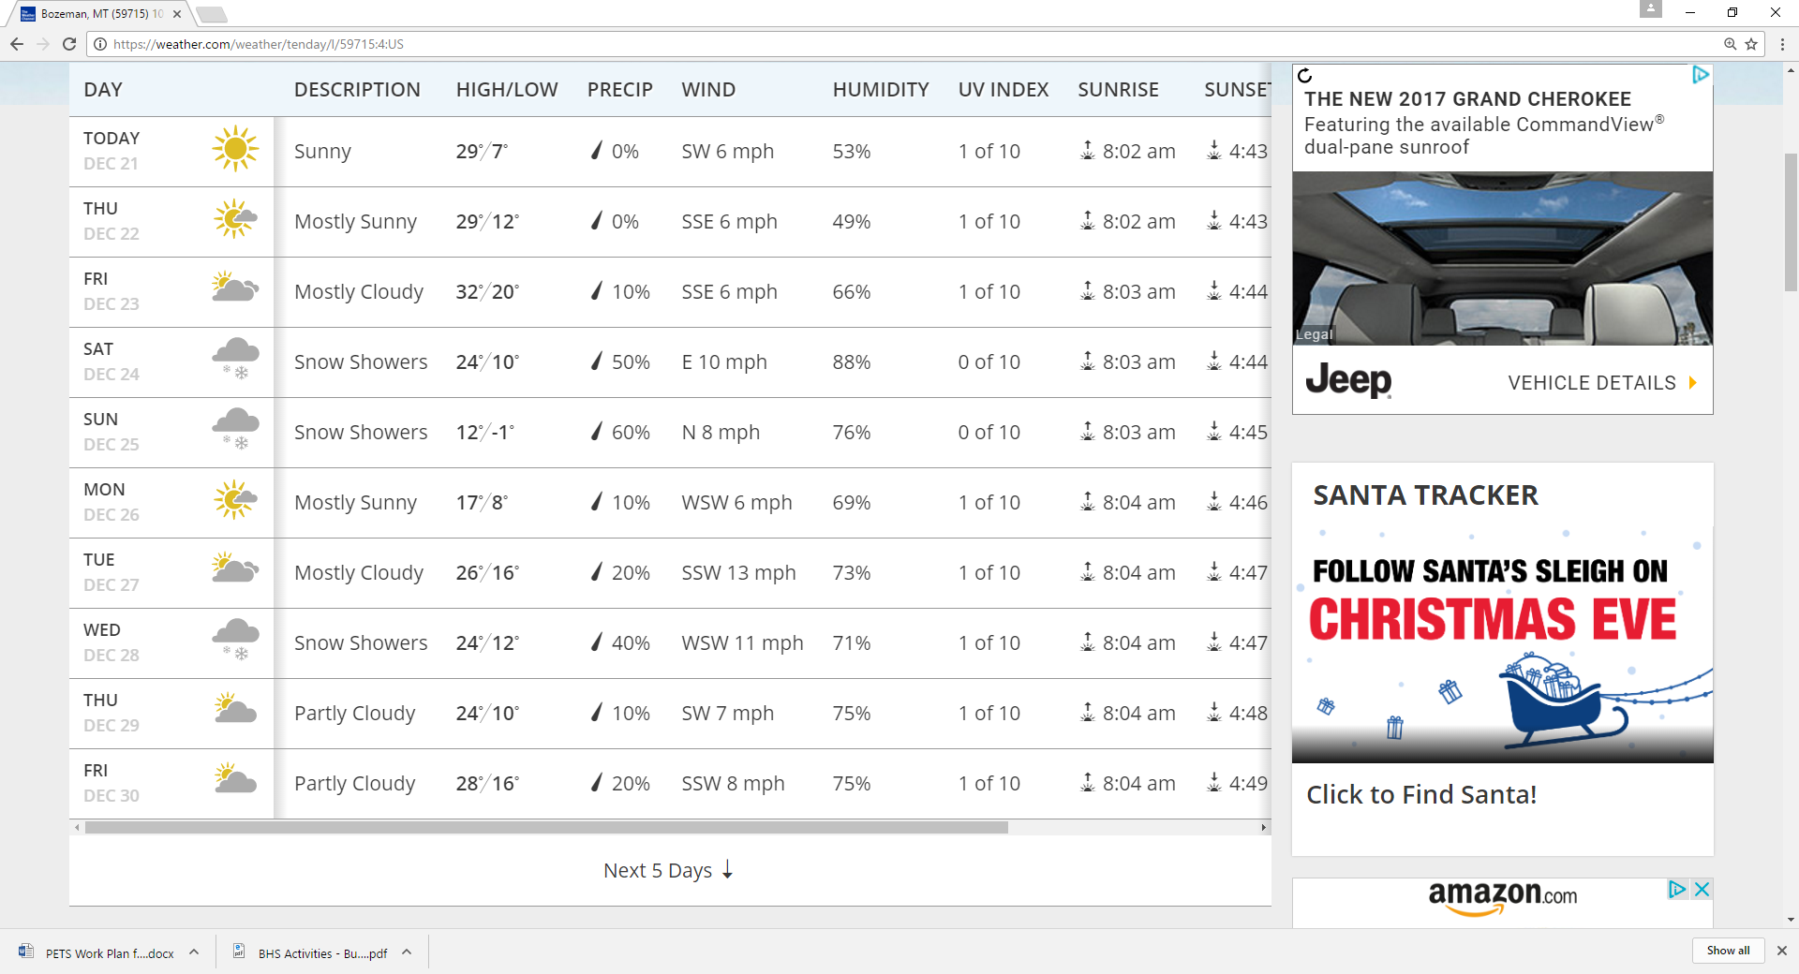
The *
The importance of “I’ll believe it when I see it”

Slide 26
Bozeman Public Schools
Enrollment History and Projections
Actual
Projected

Slide 27
Bozeman Public Schools
Enrollment vs. Building Capacity

Slide 28
Budgeting Steps
Recommended:
  Complete enrollment counts
  Project enrollment for ensuing October
  Determine eligibility for anticipated unusual enrollment increase
  Calculate budget, tax impacts
  Seek Board approval, submit projections to OPI
  Monitor projections vs actual in ensuing October

Slide 29
Anticipated Enrollment Increases
Calendar of Events
Event | Timeline
Fall Enrollment Count | First Monday in October
Spring Enrollment Count | First Monday in February
Deadline for Calling for a May election | February 23 (70 days before)
Preliminary Budget Data Sheets released by OPI | March 1
Deadline for finalizing ballot language | April 2 (30 days before)
90th day of Legislative Session | May 1
Deadline for submitting Application for Additional ANB to OPI | June 1
Final Preliminary Budget Data Sheet available | Fourth Monday in June

Slide 30
Anticipated Enrollment Increases
Understanding ANB (Average Number Belonging)
Generally:
Adjusted Fall enrollment + Adjusted Spring Enrollment
2
…rounded up to nearest integer
X 187/180

Slide 31
Anticipated Enrollment Increases
Understanding ANB (Average Number Belonging)
Exercise: calculate your ANB

Slide 32
Anticipated Enrollment Increases
How does the funding work?
Anticipated enrollment in Oct of budget year
Remainder of enrollment increase
Lesser or 4% or 40 students
(not funded!)
Students
Prior year average enrollment
(Oct enrollment + Feb enrollment)
2
State Funding
Local Taxes

Slide 33
Anticipated Enrollment Increases
Understanding ANB (Average Number Belonging)
Grade | Oct 2020 Actual Enrollment | Oct 2021 Projected Enrollment | Change
Grade 9 | 703 | 621
Grade 10 | 595 | 677
Grade 11 | 571 | 573
Grade 12 | 529 | 561
High School Total | 2,398 | 2,432 | 34
Is Bozeman High School
eligible for an anticipated
unusual enrollment increase?

Slide 34
Anticipated Enrollment Increases
Understanding ANB (Average Number Belonging)
Grade | Oct 2020 Actual Enrollment | Feb 2021 Actual Enrollment | 2020-21 Average Enrollment | Oct 2021 Projected Enrollment | Change
Grade 9 | 703 | 704 |  | 621
Grade 10 | 595 | 590 |  | 677
Grade 11 | 571 | 557 |  | 573
Grade 12 | 529 | 486 |  | 561
High School Total | 2,398 | 2,337 | 2368 | 2,432 | 34 64

Slide 35
Budgeting Steps
Recommended:
  Complete enrollment counts
  Project enrollment for ensuing October
  Determine eligibility for anticipated unusual enrollment increase
  Calculate budget, tax impacts
  Seek Board approval, submit projections to OPI
  Monitor projections vs actual in ensuing October

Slide 36
General Fund Comparisons
Use OPI General Fund spreadsheet and Funding Comparsions tab to:
Summarize funding sources
Determine funding available from AEI, UEI budget amendment
Determine LC1310 impact on your district
Students
State Funding
Local Taxes

Slide 37
Budgeting Steps
Recommended:
  Complete enrollment counts
  Project enrollment for ensuing October
  Determine eligibility for anticipated unusual enrollment increase
  Calculate budget, tax impacts
  Seek Board approval, submit projections to OPI
  Monitor projections vs actual in ensuing October

Slide 38
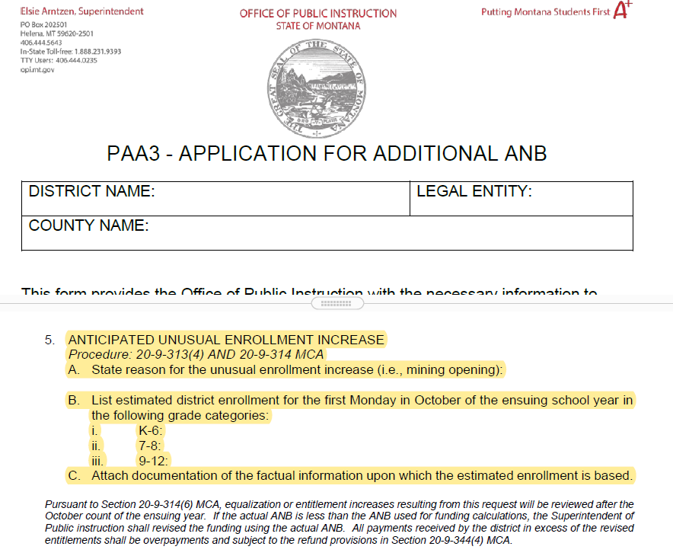
Anticipated Enrollment Increases
Approval Process
PAA3 – Application for Additional Enrollment
  Due to OPI June 1
  Requires Board approval, county supt signature
  OPI Resource: Nica Merala 444-4401

Slide 39
Anticipated Enrollment Increases
Approval Process
Understanding the implications
  All General Fund funding sources will likely increase if enrollment increase is anticipated
    State Funding
    Permissive BASE levy
    Vote-able OverBASE levy
    Reserve cap
  Funds are at risk until enrollment increase is confirmed in October (i.e., don’t spend it all!!)

Slide 40
Budgeting Steps
Recommended:
  Complete enrollment counts
  Project enrollment for ensuing October
  Determine eligibility for anticipated unusual enrollment increase
  Calculate budget, tax impacts
  Seek Board approval, submit projections to OPI
  Monitor projections vs actual in ensuing October

Slide 41
Budgeting Steps
Recommended:
  Complete enrollment counts
  Project enrollment for ensuing October
  Determine eligibility for anticipated unusual enrollment increase
  Calculate budget, tax impacts
  Seek Board approval, submit projections to OPI
  Monitor projections vs actual in ensuing October
    AEI? Determine if projection materialized. If so, all funding stays. If not, expect a letter with reductions from OPI
    Everyone: Determine eligibility for budget amendment due to unanticipated enrollment increase

Slide 42
Anticipated Enrollment Increases
How does the funding work?
Anticipated enrollment in Oct of budget year
Remainder of enrollment increase
Lesser or 4% or 40 students
(not funded!)
Students
Prior year actual average enrollment
(Oct enrollment + Feb enrollment)
2
State Funding
Local Taxes

Slide 43
Anticipated Enrollment Increases
How does the funding work?
Anticipated enrollment in Oct of budget year
Actual enrollment in Oct of budget year
Students
State Funding
Local Taxes

Slide 44
Anticipated Enrollment Increases
How does the funding work?
Anticipated enrollment in Oct of budget year
Students
Actual enrollment in Oct of budget year
State Funding
Local Taxes

Slide 45
Anticipated Enrollment Increases
How does the funding work?
Anticipated enrollment in Oct of budget year
Students
Minimum funding (based on PY average actual enrollment)
Actual enrollment in Oct of budget year
State Funding
Local Taxes

Slide 46
Anticipated Enrollment Increases
How does the funding work?
Anticipated enrollment in Oct of budget year
Students
Minimum funding (based on PY average actual enrollment)
Actual enrollment in Oct of budget year
State Funding
Local Taxes

Slide 47
Anticipated Enrollment Increases
How does the funding work?
Actual enrollment in Oct of budget year
Anticipated enrollment in Oct of budget year
Students
State Funding
Local Taxes
Reserves

Slide 48
Anticipated Enrollment Increases
How does the funding work?
Actual enrollment in Oct of budget year
Anticipated enrollment in Oct of budget year
Students
State Funding
Local Taxes
Reserves

Slide 49
Anticipated Enrollment Increases
How does the funding work?
Actual enrollment in Oct of budget year
Anticipated enrollment in Oct of budget year
Unanticipated enrollment increase
Students
State Funding
Local Taxes
Reserves

Slide 50
Enrollment Increases
Anticipated vs Unanticipated
 | Anticipated | Unanticipated (budget amendment)
Timing | Submit PAA-3 by June 1 in prior year | Submit petition by May 31 of budget year
Subject to ‘claw back’ | Yes | No
Funding: State funding Local property taxes | Yes Yes | Yes No, but can use reserves

Slide 51
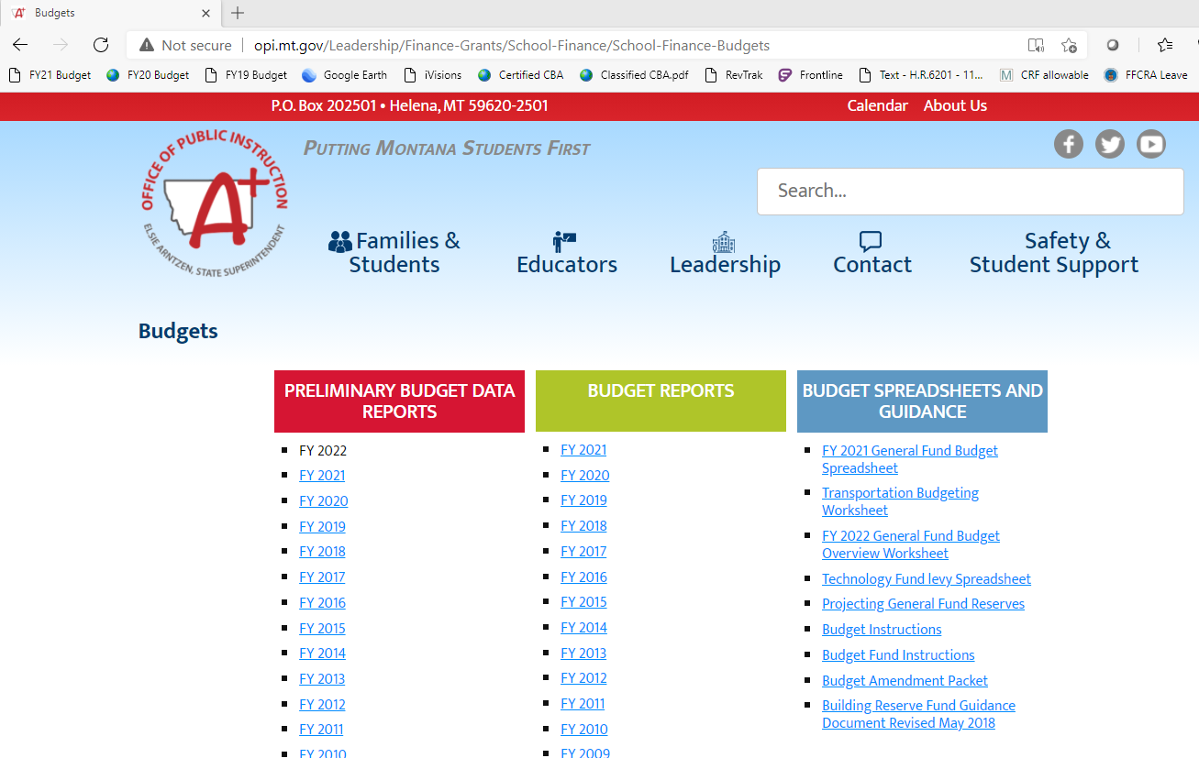
Budget Amendment Process
20-9-161 thru 20-9-166, MCA

Slide 52
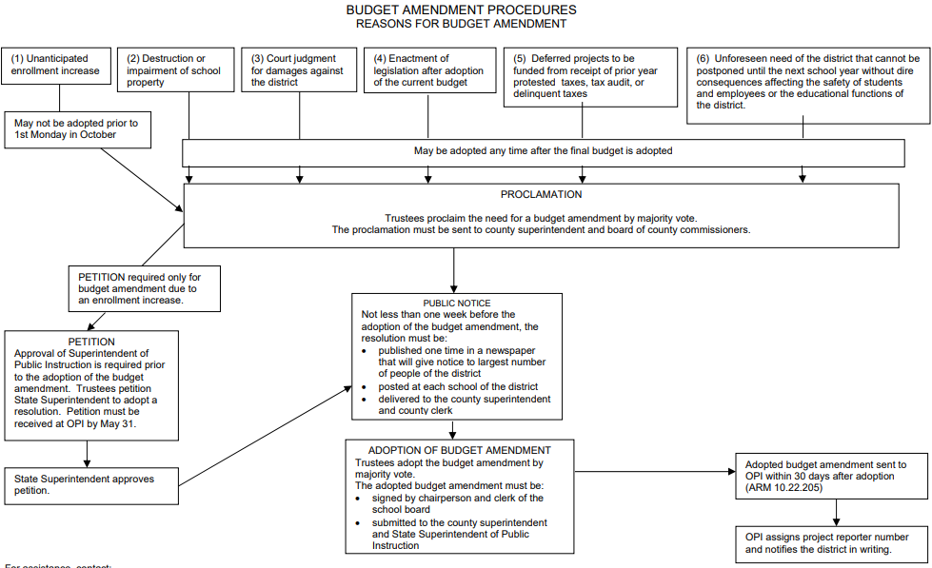
Budget Amendment Process
20-9-161 thru 20-9-166, MCA

Slide 53
Agenda
Budgeting Steps
LC2554
Budgeting in the Age of ESSER Grants

Slide 54
LC2554
Basic Provisions:
  NOT A DONE DEAL!
  FY22 & FY23 only
  No anticipated enrollment increases
  Changes to budget amendments for unanticipated enrollment increases:
    No funding for additional General Fund spending authority
    Access to ‘additional financial support’ (state ESSER)
      4%/40 student threshold eliminated
      OPI calculates after Oct 2021, 2022 enrollment counts
      Includes all BASE funding components
      Reduced by 10% of ESSER II, subsequent grants
      Deposited to fund 15
      Spending deadline TBD

Slide 55
Budgeting Steps
FY22 and FY23 only (LC2554)
Recommended:
  Complete enrollment counts
  Project enrollment for ensuing October
  Determine eligibility for anticipated unusual enrollment increase
  Calculate budget, tax impacts
  Seek Board approval, submit projections to OPI
  Monitor projections vs actual in ensuing October
    AEI? Determine if projection materialized. If so, all funding stays. If not, expect a letter with reductions from OPI
    Everyone: Determine eligibility for budget amendment due to unanticipated enrollment increase

Slide 56
Agenda
Budgeting Steps
LC2554
Budgeting in the Age of ESSER Grants

Slide 57
ESSER Grants
Select Allowable Uses:
To prevent, prepare for, and respond to coronavirus” and:
  Provide principals and others school leaders with the resources necessary to address the needs of their individual schools
  Other activities that are necessary to maintain the operation of and continuity of services in LEAs and continuing to employ existing staff of the LEA.
Supplanting allowed
Indirect costs allowed

Slide 58
ESSER Grants
Strategic considerations:
Spending deadlines
  ESSER I (CARES): 9/30/22
  ESSER II: 9/30/23
Beware of:
  Financing ongoing cost structures based on non-recurring funding sources
  Accounting, disposal requirements for capital assets purchased with federal funds…
ESSER grants are federal funds; must support payroll costs of employees paid

Slide 59
ESSER Grants
Purchasing fixed assets (2 CFR 200.313):
Must be pre-approved by OPI
Options for assets with residual value of $5,000 or more at the end of the grant period:
  Sell the asset and return the funds to the feds
  Assign the asset to other ongoing federal projects
  Petition to retain the asset.
ESSER grants are federal funds; must support payroll costs of employees paid

Slide 60
ESSER Grants
Strategic considerations:
Spending deadlines
  ESSER I (CARES): 9/30/22
  ESSER II: 9/30/23
Beware of:
  Financing ongoing cost structures based on non-recurring funding sources
  Accounting, disposal requirements for capital assets purchased with federal funds
ESSER grants are federal funds; must support payroll costs of employees paid

Slide 61
ESSER Grants
Strategic considerations:
The importance of margin

Slide 62
Employer Contributions to Social Security, State Retirement, and Unemployment Systems
Retirement Fund purpose (20-9-501, MCA):
Used to finance benefit costs of employees paid from state and local funds. Allowable expenditures:
  Retirement (TRS, PERS)
  Federal social security
  Medicare
  Unemployment insurance
  NOT work comp; life, accident, health insurance
Employees paid with federal funds: funding source that pays employee salary must pay benefit costs

Slide 63
Employer Contributions to Social Security, State Retirement, and Unemployment Systems
Retirement Fund financing (20-9-501, MCA):
Unlimited budget
20% max reserves
Retirement fund financing sources:
  Fund balance reappropriated
  County Retirement Distribution. Nonlevy revenue funded by:
    Countywide levy
    State GTB

Slide 64
Leveraging Your Costs
Paying staff with General Fund vs Federal Grants
Assume each staff member makes $50,000 per year (salary) and retirement benefits total 15%. In order to hire 2.0 FTE of this position:
What General and Retirement Fund budgets would you need?
  General Fund: $100,000 ($50,000/FTE x 2 FTE)
  Retirement Fund: $30,000 ($50,000/FTE x 2 FTE x 15%)
What federal grant would you need?
  $130,000 (salary: $50,000/FTE x 2 FTE + benefits $50,000/FTE x 2 FTE x 15%)

Slide 65
Leveraging Your Costs
Paying staff with General Fund vs Federal Grants
Assume each staff member makes $50,000 per year (salary) and retirement benefits total 15%. In order to hire 2.0 FTE of this position:
What General and Retirement Fund budgets would you need?
  General Fund: $100,000 ($50,000/FTE x 2 FTE)
  Retirement Fund: $30,000 ($50,000/FTE x 2 FTE x 15%)
What federal grant award would you need?
  $130,000 [salary ($50,000/FTE x 2 FTE) + benefits ($50,000/FTE x 2 FTE x 15%)]

Slide 66
ESSER Grants
Budgeting Strategies
Using ESSER grants, how do you:
Hire additional staff
Increase compensation for existing staff
Save for the future
  Build reserves
  Interlocal Agreement fund
  Special Revenue funds
Reduce taxes

Slide 67
THANK YOU for coming!
Mike Waterman, Director of Business Services
Bozeman Public Schools
mike.waterman@bsd7.org
W: 406-522-6097 C: 406-589-4027
Denise Williams, Executive Director
Montana Association of School Business Officials
dwilliams@masbo.com
W: 911 C: 406-461-3659

