Slide 1
CARES – ESSER Funding
MASBO Summer Regional Meetings – June 2020
Denise Williams, MASBO Executive Director
dwilliams@masbo.com 406.461.3659

Slide 2
CARES Act – Education Stabilization
CARES = Coronavirus Aid, Relief and Economic Security Act
March 27, 2020
$2 trillion total
$30.75 billion for an Education Stabilization Fund
$13.2 billion Emergency Elementary and Secondary School Emergency Relief Fund (ESSER)
$3 billion Governors Emergency Education Relief Fund (GEERF)
1% to Education Stabilization Fund Discretionary Grants
$12.5 billion Higher Education Emergency Relief Fund
.5% Formula Grants to the Outlying Areas

Slide 3
AGENDA
CARES – ESSER Funding
How will your school district spend these $$?
Governors Emergency Education Relief (GEER) Fund

Slide 4
CARES ESSER Funding
ESSER = Emergency Elementary and Secondary School Emergency Relief Fund
Montana’s allocation: $41,295,230
$37,165,707 (90%) minimum distribution to LEAs based on FY2020 Title I allocations
$4,129,523 (10%) maximum state set aside

Slide 5
CARES ESSER Funding
ESSER = Emergency Elementary and Secondary School Emergency Relief Fund
Montana’s allocation: $41,295,230
$37,165,707 (90%) minimum distribution to LEAs based on Title I allocations in FY2020
$613,992 adjustment to ensure schools receive at least $10,000
$3 million for special education
Schools that run their own program
School participating in special education cooperatives – pass thru to co-op
$206,476 OPI administrative costs
$309,055 OPI Covid-19 Emergency Needs

Slide 6
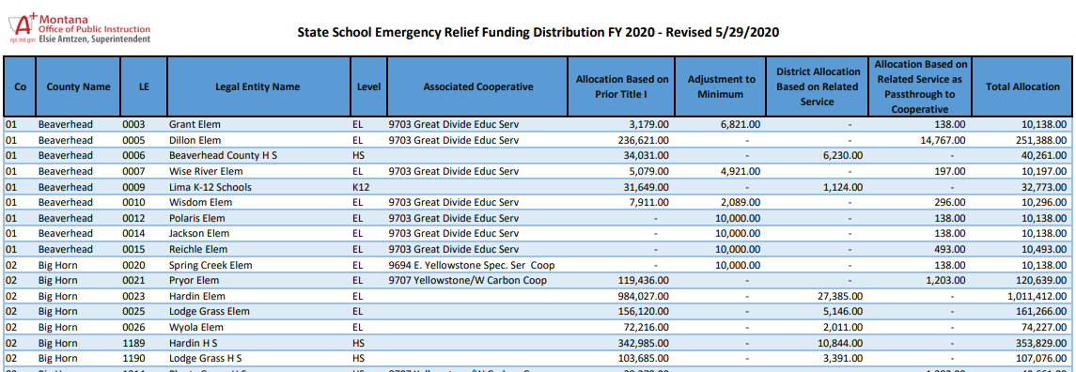

Slide 7
CARES – ESSER FUNDING OPI E-Grants Timeline – JUNE 2020
Sunday | Monday | Tuesday | Wednesday | Thursday | Friday | Saturday
 | 1 Applications open | 2 | 3 | 4 | 5 | 6
7 | 8 | 9 | 10 | 11 | 12 | 13
14 | 15 | 16 | 17 | 18 | 19 | 20
21 | 22 Cash Requests Open | 23 | 24 First Cash Request Submission Close | 25 | 26 First Cash Request Payment | 27
28 | 29 | 30 Applications Close | Special Education applications extended to July 16
September 1, 2020 - Last day to submit amendments Cash requests due to 25th of each month for payments on 10th of the following months (no payments in July) September 30, 2022 – Final date to obligate funds; October 31, 2022 Final date to liquidate funds November 10, 2022 – Final expenditure report due

Slide 8
CARES ESSER Funding
Grant period
Pre-Award Costs – LEA can reimburse itself for expenditures made on or after March 13, 2020
September 30, 2022 – Final date to obligate funds
October 31, 2022 Final date to liquidate funds

Slide 9
CARES ESSER Funding
Allowable Expenditures
CARES Act: all grants must be used “to prevent, prepare for, and respond to coronavirus”
Any purposes listed in section 18003(d)of the CARES Act; includes any activity authorized by
ESSA 2015
IDEA
Adult Education & Family Literacy Act (AEFLA)
CTE
McKinney-Vento Homeless Assistance Act – subtitle B of Title VII

Slide 10
CARES ESSER Funding
Allowable Expenditures
Other uses (12) – see page 2 & 3 of OPI guidance
Other activities that are necessary to maintain the operation of an continuity of services in LEAS and continuing to employee existing staff of the LEA
Students with special needs; training, technology, mental health services, summer learning, etc.
Cannot be spent on:
Executive salaries and benefits of individuals who are not employees of the SEA or LEAs
State or local teacher or faculty unions or associations

Slide 11
CARES ESSER Funding
Allowable Expenditures
Assurances
Section 442 of the General Provisions Act (GEPA)
LEA’s procedures to permit students, teachers, etc. to overcome barriers that impede equal access to/participation in the program
Continue to pay employees and contractors during the period of any disruptions or closures related to coronavirus – to the greatest extent practicable
Document time and effort of employees paid in whole or part by funds

Slide 12
CARES ESSER Funding
Equitable Services to Non-Public Schools
Same process as Title I, Part A
Non-public schools are invited to participate in the services and assistance that will be supported by the ESSER funds
Value of services and assistance to non-publics are calculated on a per-student basis
No money is passed on to the non-public schools
Control of funds and title to materials/equipment, contract for services lies with the public agency

Slide 13
CARES ESSER Funding
Quarterly Reporting – OPI has to do it ☺
E-Grants budget and cash requests tied to 8 cost categories:
Remote Learning Technology
Professional Development
Facility
Wellness
Community Collaboration
Meals
At Risk Children and Children with Disabilities
Other

Slide 14
CARES ESSER Funding
What are you doing in your district?

Slide 15
CARES Act – Education Stabilization
CARES = Coronavirus Aid, Relief and Economic Security Act
March 27, 2020
$2 trillion total
$30.75 billion for an Education Stabilization Fund
$13.2 billion Emergency Elementary and Secondary School Emergency Relief Fund (ESSER)
$3 billion Governors Emergency Education Relief Fund (GEERF)
1% to Education Stabilization Fund Discretionary Grants
$12.5 billion Higher Education Emergency Relief Fund
.5% Formula Grants to the Outlying Areas

Slide 16
Governors Emergency Education Relief (GEER) Fund
Purpose - to serve as an emergency fund and authorization to address student needs arising from the COVID-19 related disruption of the current academic year
Allocations to States
60% based on each State’s relative population of individuals aged 5 through 24
40% based on children counted for the purposes of making Title I, Part A formula grants to LEAs
Montana: $8,764,495
Application deadline: June 1, 2020; extended to June 8, 2020

Slide 17
RESOURCES
Office of Public Instruction webpages
Re-opening Schools
Elementary & Secondary School Emergency Relief (ESSER)
State of Montana COVID-19 webpage
MT Dept. of Commerce COVID-19 Coronavirus Relief
U.S. Department of Education
ESSER
Governors Emergency Education Relief Fund (GEER)

