Slide 1
What IS a P-Card?

Slide 2

Speaker Today
Holly Wallace, Senior Programs Coordinator, Illinois Association of School Business Officials

Slide 3

WHY WOULD I WANT A CREDIT CARD!

Slide 4

Credit Cards can create efficiencies
Cut down on paper pushing
Cut down on paper produced
One check for the month
Less Bank Statement reconciliation

Slide 5
What are the Experts Saying?
“The average cost of processing a purchase order manually is between $75 - $200.”
“Automating procurement reduces that cost to between $10 - $40... The Return-On-Investment (ROI) is amazing.” Deloitte Consulting
Accenture US Bank Fifth/Third Bank American Express

Slide 6

Credit Cards Also Benefit Suppliers

Slide 7
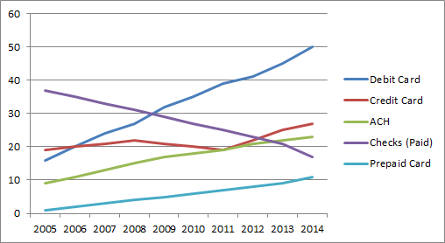
Growth of Credit Card Use

Slide 8
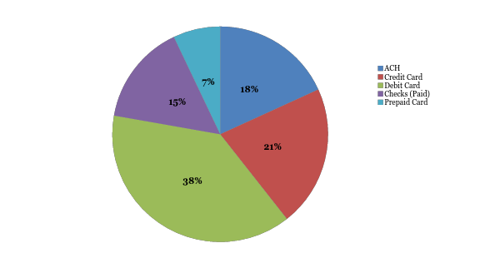
Distributions of Non Cash Payments

Slide 9

Recommends use of purchasing cards to improve efficiency
Need to maintain appropriate controls
Controls to include written policies and procedures for cardholders

Slide 10
What does the “P” stand for??
Procurement
Purchasing
Payment

Slide 11
A p-Card is an OPTION
Because in good times school districts spend money
And in
Bad economic times school districts spend money
What we need are OPTIONS and CONTROLS

Slide 12

A p-Card is an OPTION with CONTROLS
Different then a “normal” credit card
Based on School District finances not an individual’s ss number
No access to corporate limit
Individual parameters and credit limit
More Controls: transaction limits/transaction number in cycle
MCC blocking

Slide 13

Credit Cards Use Should…..
ENHANCE
your current best practices –
Not replace

Slide 14
All p-Card programs are
NOT alike!

Slide 15

Advantages of an Association Sponsored Program
Single Contract
Creates a user group/support network
Negotiation clout
Due diligence costs eliminated
No Costs
No Fees
Access to new products
REBATE! Potential Average Spend Bonus
IL. ASBO/BMO Team/Spend Dynamics

Slide 16
Only 3 Possible costs to participating district
Late fee
ATM Charge – IF cash advance option is selected
Interest owed on any cash advance

Slide 17

Types of p-Cards
Personalized Card
Department Card
Ghost Card

Slide 18

Partnership with BMO Harris

Slide 19
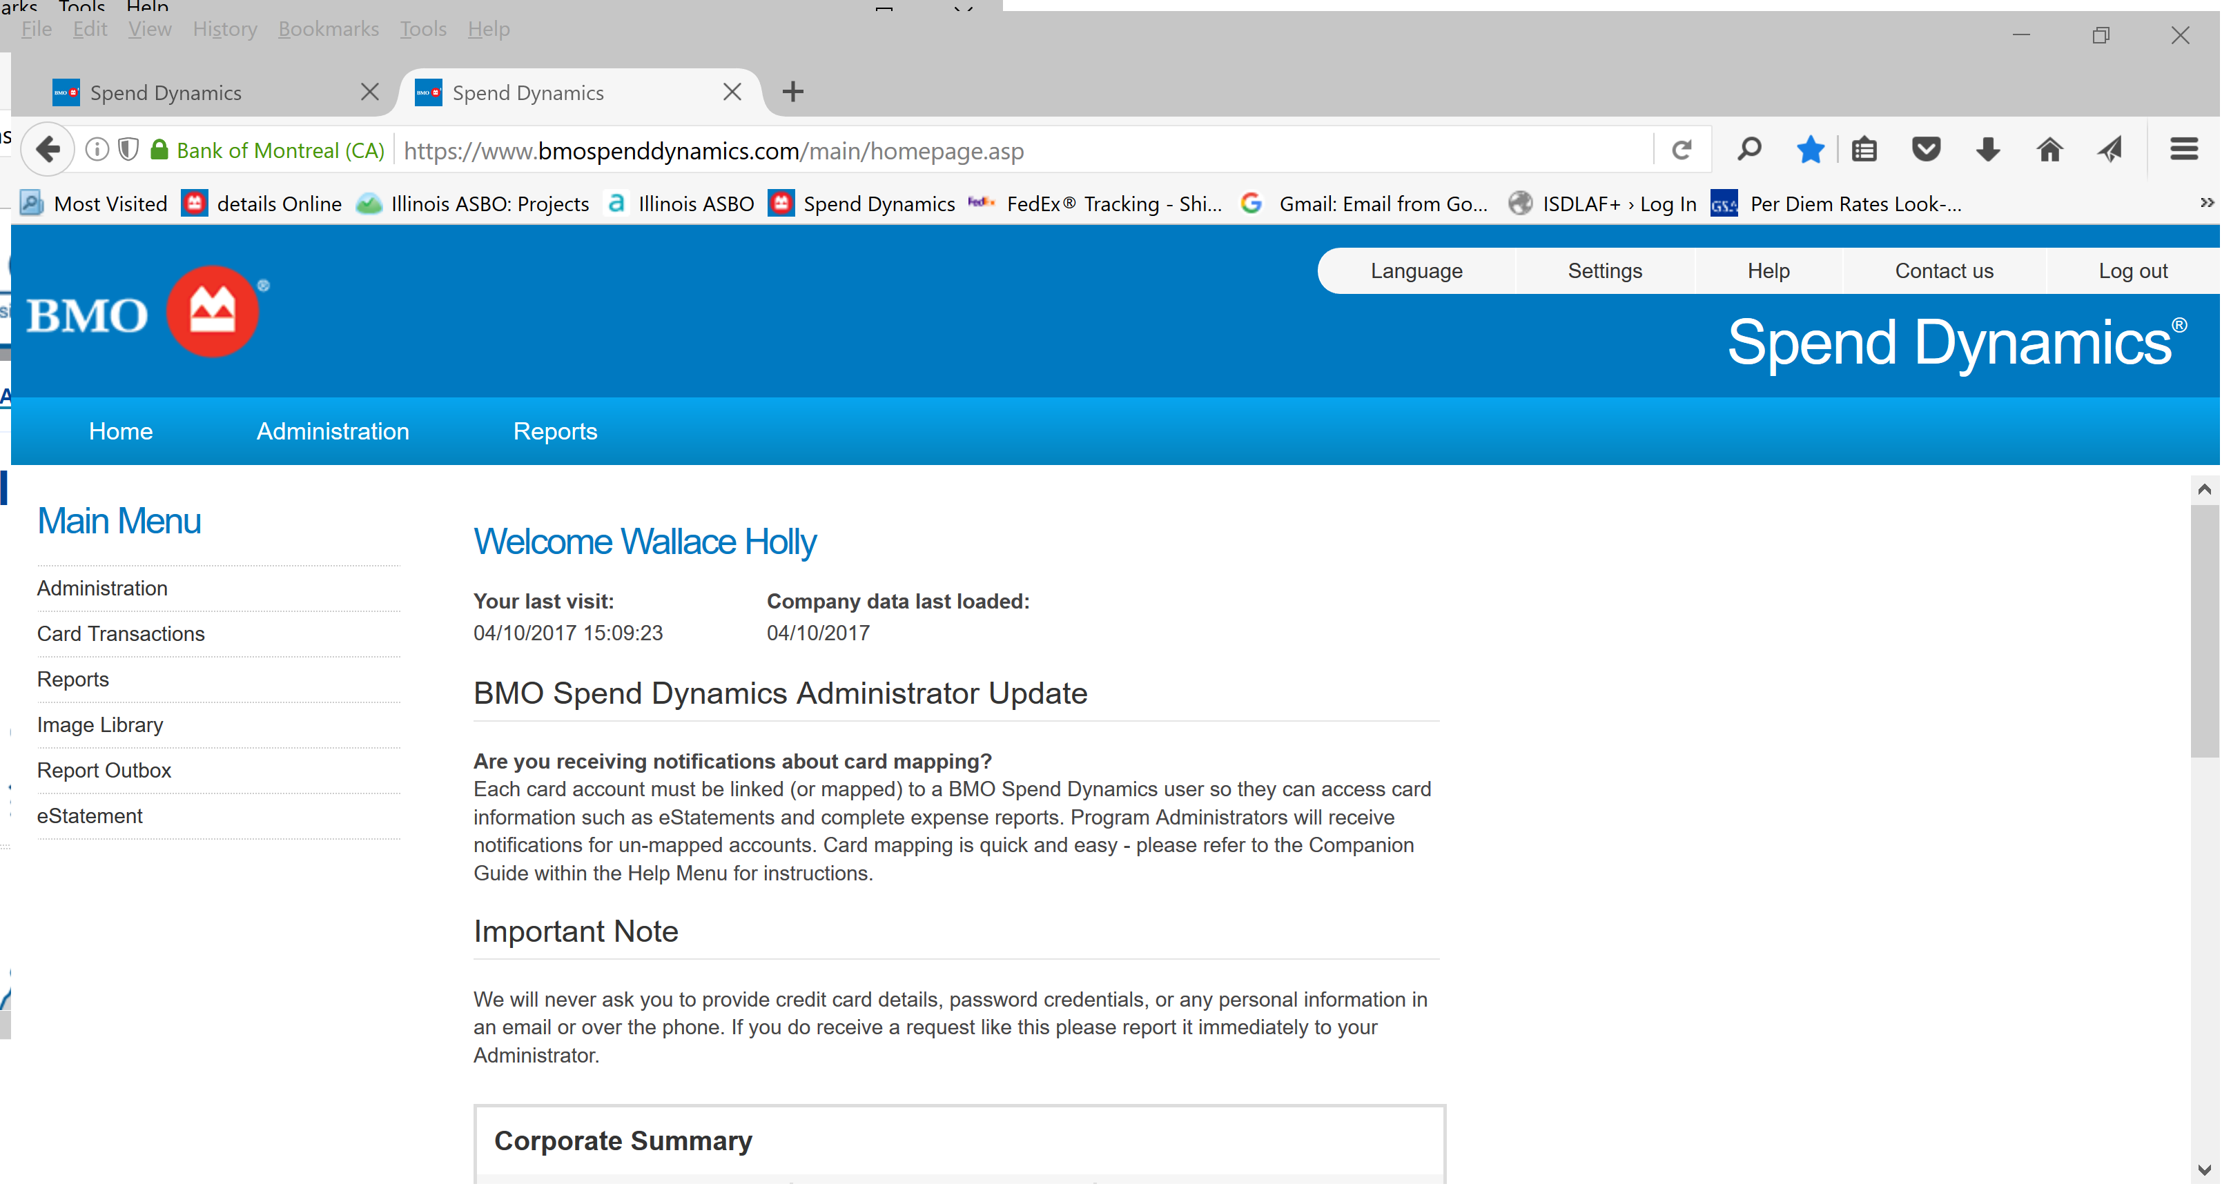
Online Management

Slide 20

Billing Cycle Requirements
District may choose a billing cycle cut-off of the 5th or the 20th.
Payment is due within chosen grace (7,14,21 or 27) days of billing cycle cut-off.

Slide 21

Customized Card design can display:
Card holder name
Department/District/Building name
Tax ID
2 Lines of text per card
24 Characters (including spaces) per line

Slide 22
Specific card use parameters can be established for each card
  Transaction limits per charge
  Monthly limits
  Preferred Supplier Restriction

Slide 23
Billing and Payment
Monthly Billing Statements
  Available online
Payment Methods
  Automated Clearing House
  Check

Slide 24
Check List To Start A Program
Discussion with Superintendent/Board/Bus. Office
Research available programs
Develop Procedure Manual
Present to Board for Approval
Application/Implementation

Slide 25

BOE Expectations
Compliance with Law
Cost to Run Program
Controls Available
Checks and Balances in Place
Policy and Procedural Manuals
Reporting
Ease of Use
BOE approval to enter into contract

Slide 26
Policy and Procedure Manual
Policies and procedures for use
Policies and procedures for MISuse
Parts can be individualized
Samples of paperwork
Tutorials

Slide 27

Questions??
Concerns??
Comments??

Slide 28

More Information
For information, application documents, tutorials, sample manuals and other tools, please visit:
www.illinois-pcard.com
Holly Wallace
hwallace@iasbo.org

