Slide 1
TOE/Compensation Expenditure Reporting
Shanna Flores, Havre School District
floress@blueponyk12.com

Slide 2
Acronyms, acronyms, and more acronyms
TOE – Terms of Employment
TEAMS – Terms of Employment Accreditation Master Schedule
CRP – Compensation Expenditure Report – unofficial acronym
SEID – State/School Employee Identification Number
LE - Legal Entity
MAEFAIRS – Montana Automated Education Finance and Information Reporting System

Slide 3
Dates to keep in mind
Terms Of Employment (TOE)
2018-2019 Teams Current Year available through August 30, 2019
The 2019-2020 TEAMS screens will open September 1, 2019 and close November 1, 2019.
Compensation Expenditures Report (CRP unofficially)
FY19 available when Maefairs opens late July 2019
Due December 10, 2019

Slide 4
Which Reports Are Clerks responsible for?

Slide 5
Tongue Twister: TOE TIEs to TFS
Through the Compensation Expenditures Report
(like a check/balance)
Salary Expenses reported on it may receive a
Validation Warning
if 10% difference from Salary Expenses reported on TFS
You will still be able to submit your Compensation Expenditures Report with this warning, but if you receive this warning please contact Keri Ludwig from OPI keri.ludwig@mt.gov to identify the reasons why the two reports don’t match more closely.

Slide 6
TOE-Terms Of Employment
TOE must be completed prior to TEAMS- Terms of Employment Accreditation Master Schedule TEAMS is usually completed by Supt. or Bldg. Admin.
TOE may need adjustments as TEAMS information is entered.
Attend TEAMS workshop along with your Supt/Bldg Admin to correct issues as they come up
Possible Issues:
coded Mr. Smith to Elementary LE and he coached a high school sport
Librarian is split between all schools and FTE adds up to 1.25
Hired a sub teacher assigned a TOE record at one LE they worked at the other LE

Slide 7
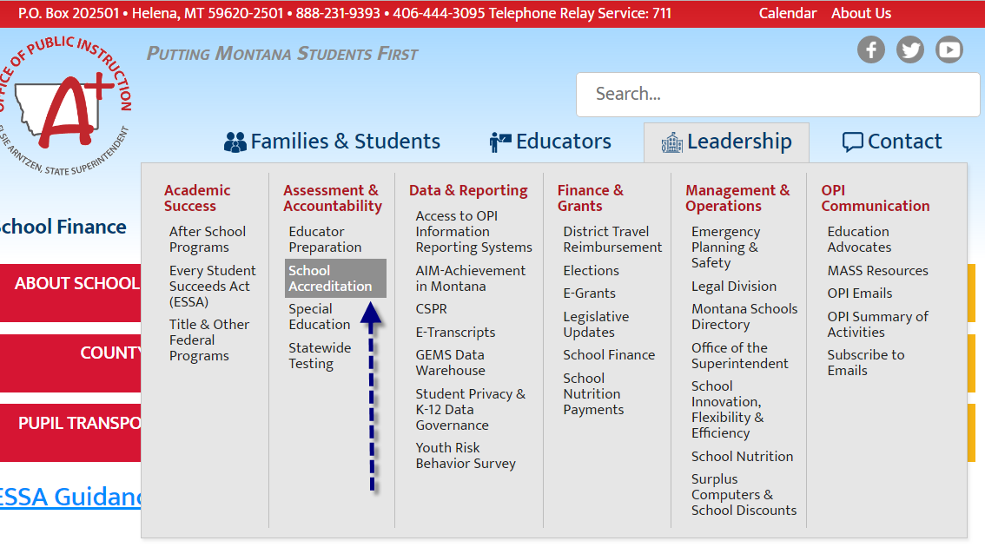
TOE – Terms of Employment OPI Website>Leadership>Assessment & Accountability>School Accreditation>TEAMS> TEAMS Login or https://apps3.opi.mt.gov/SSO/login/login.aspx?ReturnUrl=%2fSSO%2fNormalPages%2fSummary.aspx

Slide 9
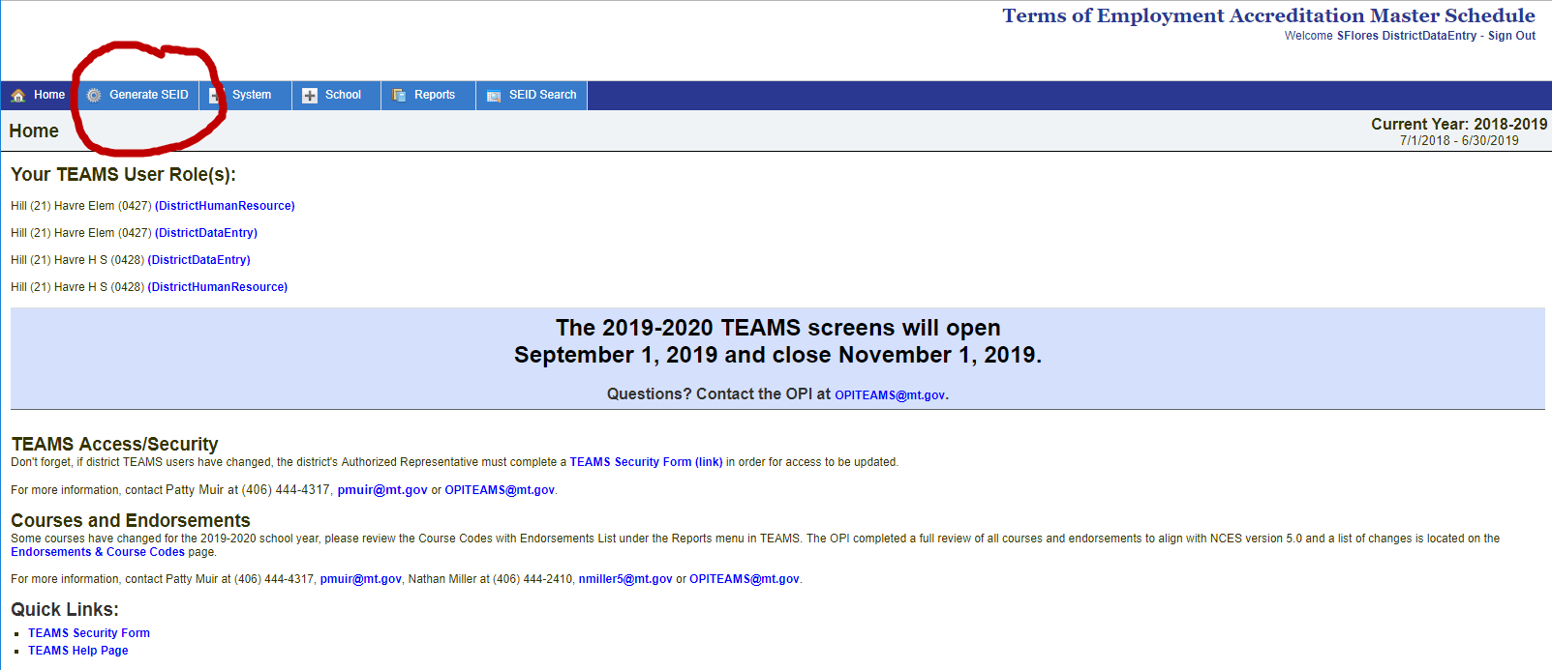
SEID – State/School Employee Identification Number
Any Employee receiving compensation in a fiscal year period 07/01 to 6/30 requires an SEID assigned in TEAMS

Slide 10
Now is the time to
Generate SEID 2018-2019 last minute hires and 2019-2020 new hires such as:
New Spring Coach
Last Minute Sub
Summer Help beginning before June 30
Make sure you have the correct LE selected ie Havre Elem
Click SEID Search
Enter information ie: highlighted
Click Search
Click Select

Slide 11
If you are ahead of the game (I don’t like you)
Generate SEID throughout the year as you hire employees
Add Toe Record shown in following slide
Load them into your software system ie BMS, C&C, Tyler
Assign LE
Assign School Codes (if applicable)
Assign FTE (if applicable)
Assign Job Code list of job codes can be found
http://opi.mt.gov/Leadership/Assessment-Accountability/School-Accreditation/TEAMS
Load them into you school data base ie Infinite Campus, Schoolmaster
Assign same as 3.a-d above

Slide 12
When the System opens September 1, you’re ready to add TOE Records for 2019-2020

Slide 13
Notice 2018-2019 year is grayed out, you can’t add anything now.
Current Year (19-20) Options available:
File Upload from Payroll
Roll forward from Previous Year

Slide 14
After you have SEID assigned – Add TOE Record
*I am not ahead of the game and find it easier to wait to update TOE during validation process of Compensation Expenditure reporting.

Slide 15
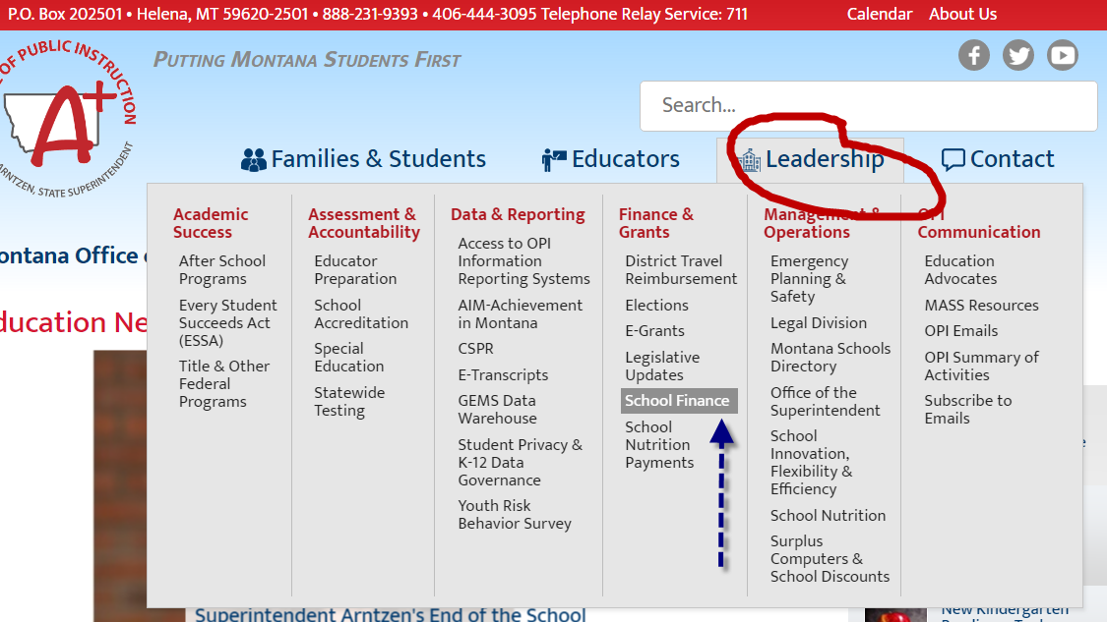
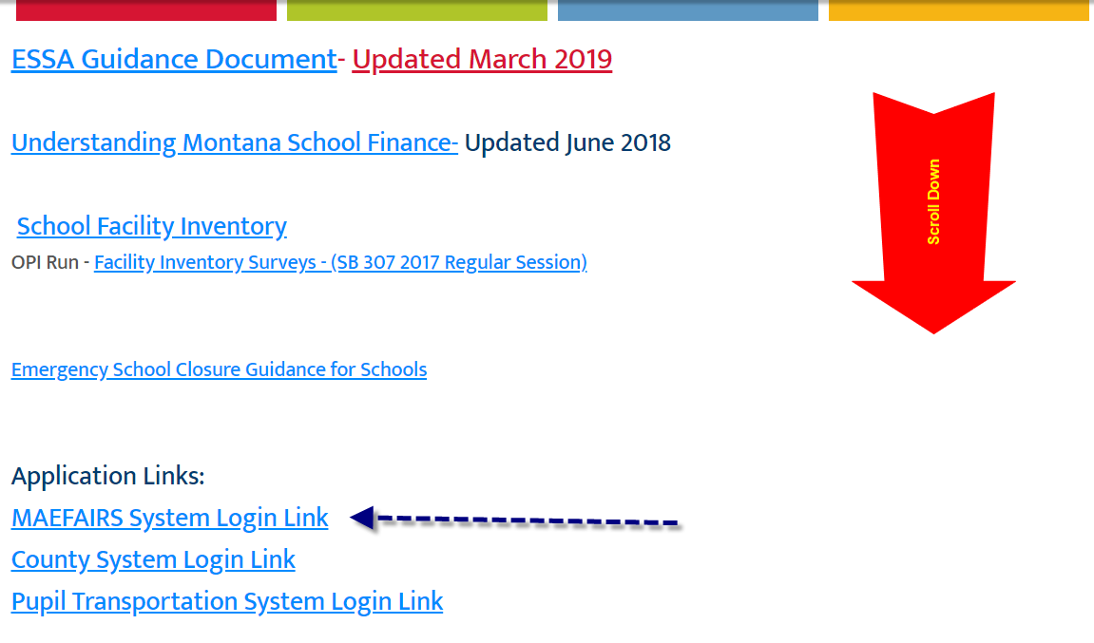
CRP unofficially –Compensation Expenditure Report OPI Website>Leadership>Assessment & Accountability>School Accreditation>TEAMS> TEAMS Login or https://apps.opi.mt.gov/Maefairs/frmLogin.aspx?ReturnUrl=/Maefairs/frmDefault.aspx

Slide 17
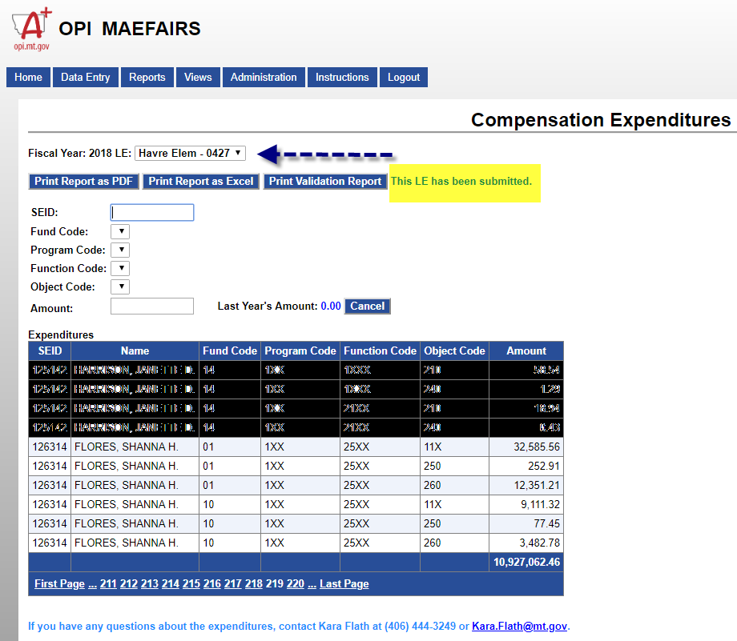
Opens late July

Slide 18
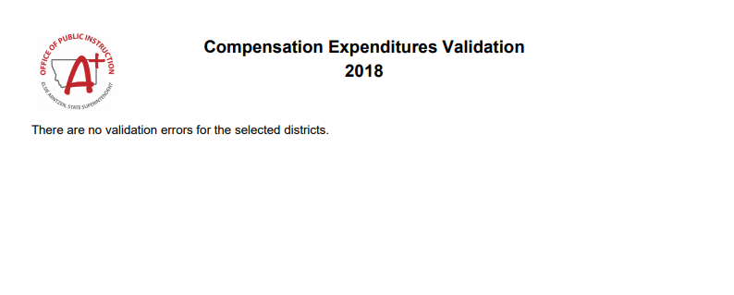
Current Year (18-19) Check Validation:
Validate
If you have warnings contact Keri Ludwig from OPI at Keri.Ludwig@mt.gov

Slide 19
New Year (19-20) Options available:
File Upload from Payroll
Roll forward from Previous Year
Validate
Submit

Slide 20
Questions…..

Slide 21
Compensation Expenditure Reports Black Mountain Software Specific
Black Mountain Payroll>OPI Compensation Survey>Expenditure File>Saves to c:drive bms files folder OPIEXP_0427 and OPIEXP_0428.
Total $ Column and write down the amount, this is the amount you should have when you finish making all changes.
Open saved files and sort by SEID remove 999999 (work comp)
Sort by fund, program, function, object, amount any negatives subtract from coinciding positives
Delete all rows with 0 amounts.
Change LE Column type to text, retype 0427 (0428) copy and paste down the entire column.
Total $ Column and write down the amount, this is the amount you should have when you finish making all changes.
Save, Yes-NO 2nd prompt

