Slide 1
TECHNOLOGY BEST PRACTICES
Summer Conference 2019

Slide 2
A little about me
Colleen Drury – Business Manager and Technology Director at Scobey School since 2011
Road to where I am now:
Computer Lines in Bozeman
DSFCU
Scobey School

Slide 4
TECHNOLOGY BEST PRACTICES
Topics for Discussion
Backups
Paying for Technology
What to do with all this “STUFF”
Board Packets
Scanning documents
Compliance on your website
In-house vs Outsourced
Other Ideas

Slide 5
BACKUPS
What are the top 5 files or folders you use?
If your computer or server died, would you be able to recreate them?
How often do you backup your computer?
How often does your IT person backup the server?
Does your district have a computer management policy that includes backup of data?

Slide 6
BACKUPS
3-2-1 Backup Rules
Have at least 3 copies of your data
Original on your computer or laptop
One copy on an external hard drive
One copy off-site (cloud or hard drive kept away from the office or home)
Backup to the cloud
Google Drive/Google File Stream
Drop Box

Slide 7
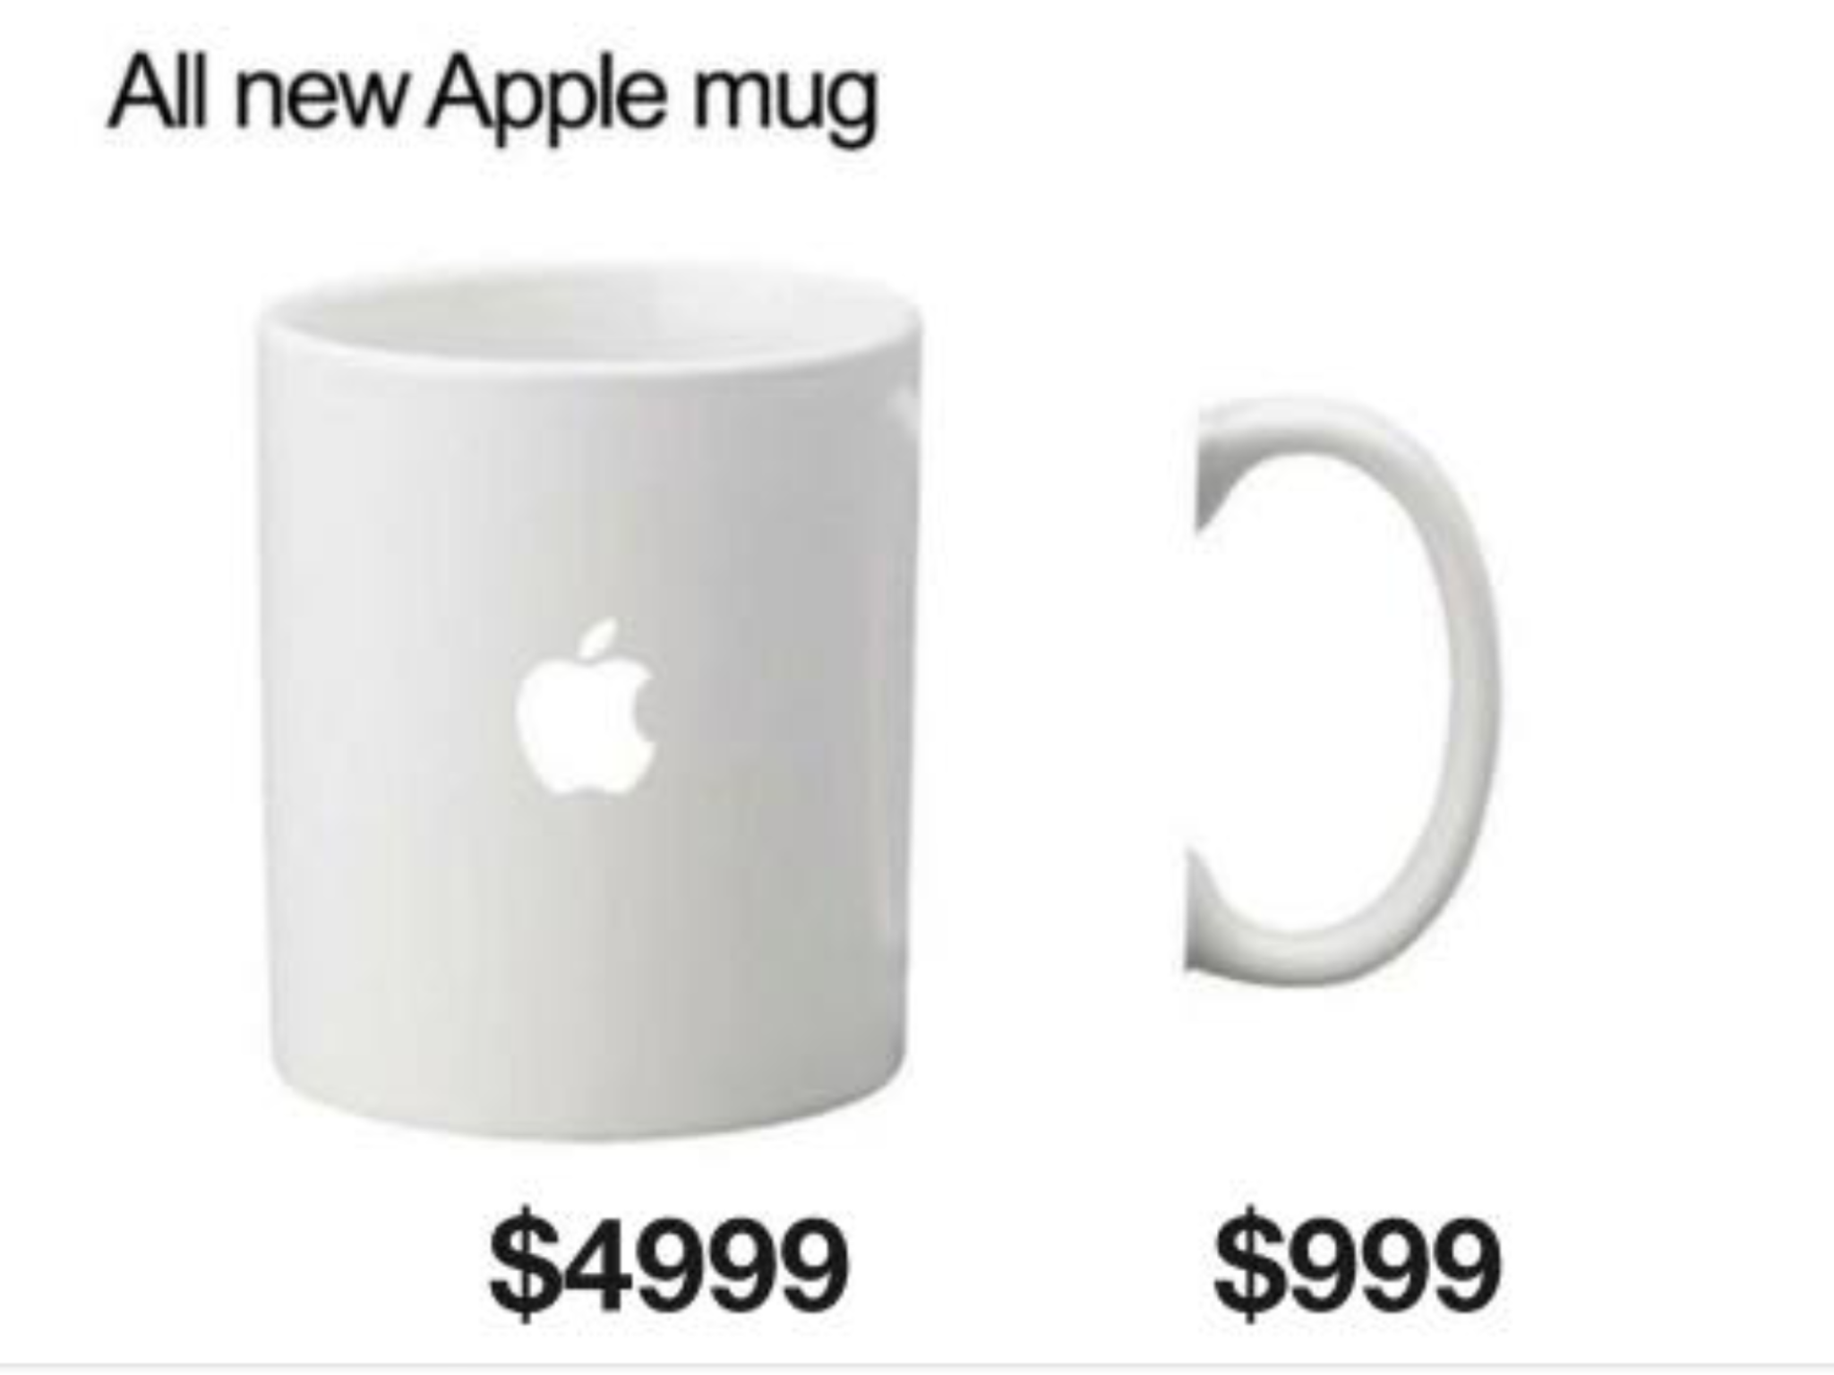
Paying for technology

Slide 8
PAYING FOR TECHNOLOGY
Funding Sources
General Fund
Technology Fund
Misc. Programs (grants and/or donations)
Multi-district agreements (Fund 82)
Fees & Fines
Others?

Slide 9
PAYING FOR TECHNOLOGY
General Fund
How much can be spent here
Fund 28 – Technology Fund
Determine your funding sources
Perpetual Levy vs Voted Levy
Where will you be in 10 years?
State technology payment (suspended FY18/ FY19)
Fees and charges for damaged equipment

Slide 10
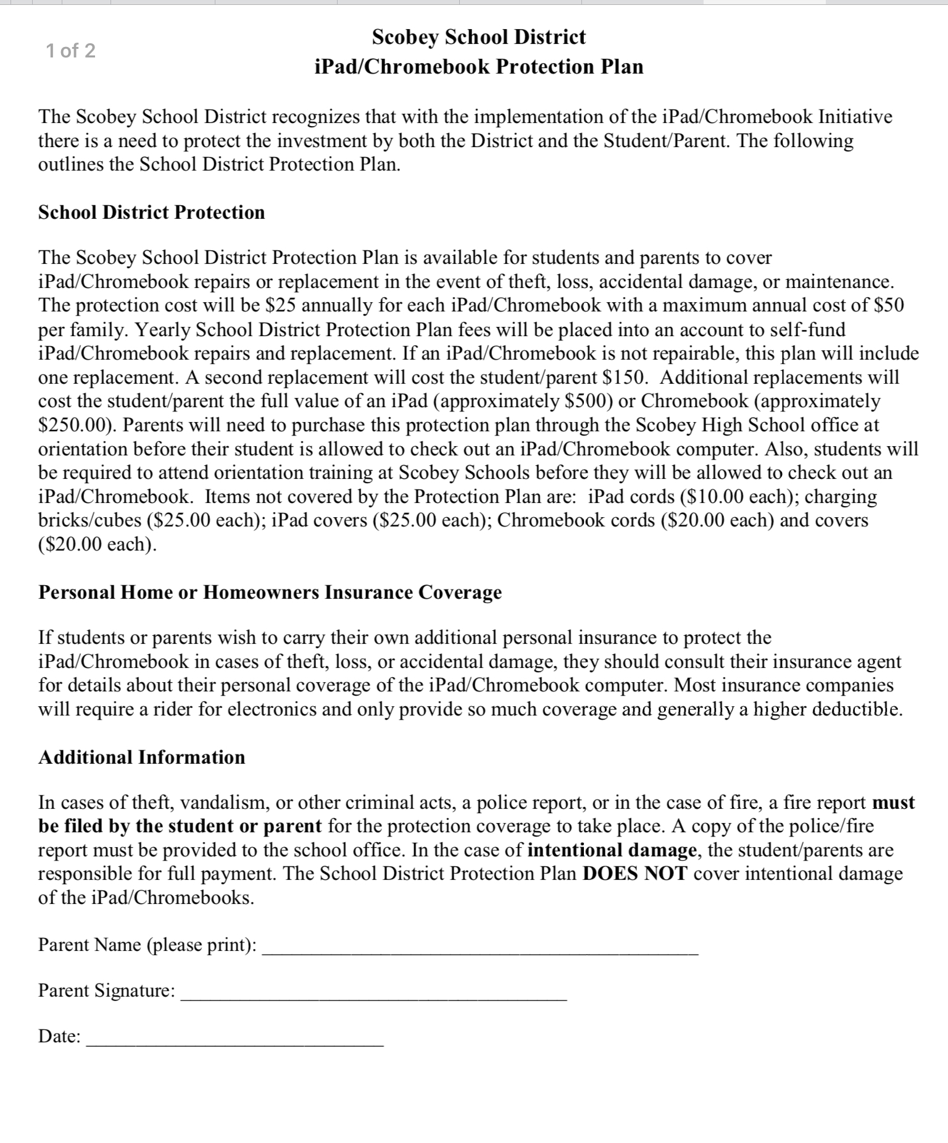

Slide 11
Have some funds in reserve to meet unexpected expenses or requests
Spend out of other funds first (Carl Perkins, CTE, GF)
Recode expenditures to Fund 28 at year-end, if needed

Slide 12
PRIORITIZE TECHNOLOGY SPENDING
SAFETY
Cameras and Other Security Devices
Network & Wireless Security
Cybersecurity
Other?

Slide 13
STUDENTS
What Technology is most appropriate for each age group?
What is the useful life of these devices?
What is the plan to replace/upgrade as needed?

Slide 14
STAFF
Wish/Want/Need
How will you incorporate this into your classroom and lessons?
Do you know how to use the technology?

Slide 15
LICENSES
** have a clear/concise list of all licenses
When they renew
How many licenses you have compared to needs
How often are they used? Can you cancel if only one teacher using once per year?
Estimated amount of how much the cost of a license will increase at renewal.

Slide 16
REPLACING EQUIPMENT

Slide 17
REPLACING EQUIPMENT
Make an inventory & check it annually
Printers, projectors, document cameras (e.g. elmos) last about 5 years
Replace on a rotational basis
Budget for replacing at least 2-3 every year
New proposals from teachers and tech staff:
Does it work with existing infrastructure?
Are any upgrades needed?

Slide 18
Vendors
Where do you get the hardware?
CDW-G will also give MCS discount if member
MCS National Vendors
Scott Buswell – OPI website-
Leadership/Management & Operations/Surplus Computers
Apple

Slide 19
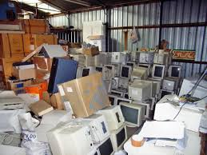
What to do with all this “stuff”

Slide 20
Scobey Schools’ Procedures
Abandon Property Notice in the Paper
Resolution - Board Approval – we have 2 readings
Prep to get rid of the stuff
Remove hard drives from PC’s
Remove Inventory tags
Update Master Inventory List
Then what:
Yellowstone E-Waste-http://www.yellowstoneewaste.com
Garage Sale
Local Dump

Slide 21
BOARD PACKETS
“Electronic” board meetings
Provide each board member with an iPad (can also use Chromebooks)
Email board packet to them
Attach other documents for reference
Cuts down on paper for them and for you

Slide 22
SCANNING DOCUMENTS
Scanning documents during the year
Board meeting minutes
Claims and payroll
Useful at audit time
give electronic copies to auditors
don’t have to pull paper copies during audit fieldwork
Make CD or hard drive copy of the fiscal year and store it off-site

Slide 23
Website compliance
Who puts documents on the website
ADA Compliant?

Slide 24
In house VS OUTSOURCED
Cost of in-house employee vs Company
Which will offer best services to your students & staff
Options to “share” employee with other school?

Slide 25
OTHER topics or GOOD IDEAS?

Slide 26
