Slide 1
Student Records
Montana Association of School Business Officials
Summer Conference 2019
June 13, 2019
Heritage Inn - Canadian Room

Slide 2
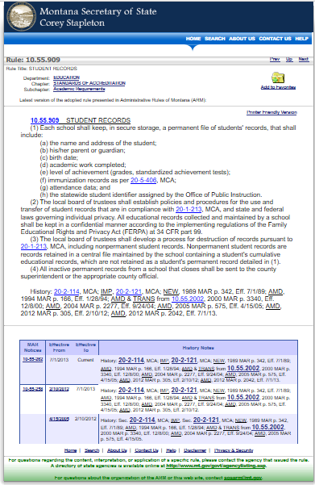
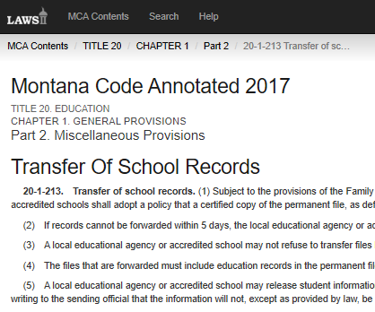
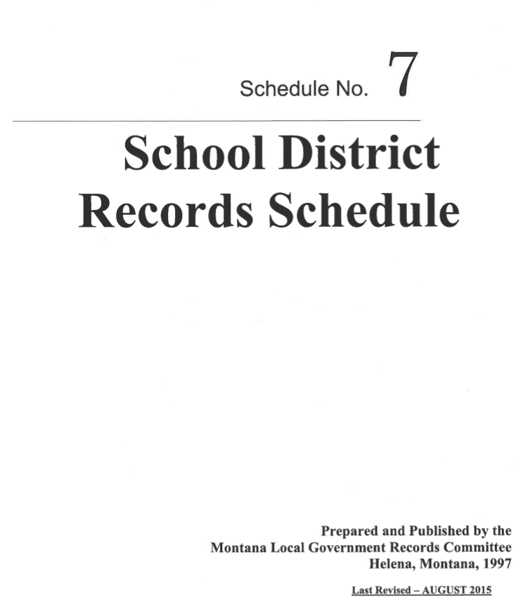
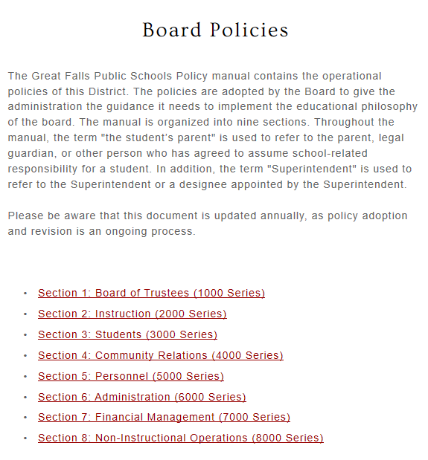
Where do I start?
School Board Policy
Policy # 3606

Slide 3
Montana Law - 20-1-213
FERPA
IDEA
Montana Youth Challenge Academy Reporting
Release of Records to Justice Department
Reciprocal Agreements

Slide 4
Montana State Law 20-1-213
Transfer Of School Records
20-1-213. Transfer of school records. (1) Subject to the provisions of the Family Educational Rights and Privacy Act of 1974, 20 U.S.C. 1232g, as amended, and its implementing regulations at 34 CFR, part 99, and to the provisions of the Individuals With Disabilities Education Act, 20 U.S.C. 1411 through 1420, and its implementing regulations at 34 CFR, part 300, local educational agencies and accredited schools shall adopt a policy that a certified copy of the permanent file, as defined by the board of public education, and the file containing special education records of a student will be forwarded by mail or electronically to a local educational agency or accredited school in which the student seeks or intends to enroll within 5 working days after a receipt of a written or electronic request.

Slide 5
(2) If records cannot be forwarded within 5 days, the local educational agency or accredited school shall notify the requestor in writing or electronically providing the reasons why the local educational agency or accredited school is unable to comply within the 5-day timeframe and the local educational agency or accredited school shall provide the date by which the requested records will be transferred.
(3) A local educational agency or accredited school may not refuse to transfer files because a student owes fines or fees.
(4) The files that are forwarded must include education records in the permanent file, special education records, and any disciplinary actions taken against the student that are educationally related.

Slide 6
Montana State Law 20-1-213
(5) A local educational agency or accredited school may release student information to the juvenile justice system to assist the system's ability to effectively serve, prior to adjudication, the student whose records are released under provisions of 20 U.S.C. 1232g(B)(1)(E) of the Family Educational Rights and Privacy Act of 1974, as amended. The official to whom the records are disclosed shall certify in writing to the sending official that the information will not, except as provided by law, be disclosed to any other party without prior written consent of the parent of the student.
(6) The superintendent of public instruction is encouraged to contact other states or provinces and may enter into reciprocal records transfer agreements with the superintendent of public instruction or a department of education of any state or province. The superintendent of public instruction shall supply a copy of any reciprocal records transfer agreement that is executed to the county superintendent of each county that may be affected by the agreement.

Slide 7
(7) Upon request, the local educational agency or accredited school shall transfer by mail or electronically a copy of the permanent file to a nonpublic school or facility.
(8) (a) By November 1 and March 1 of each school fiscal year, a local educational agency shall prepare a report to be provided to the director of the Montana youth challenge program subject to subsections (8)(b) and (8)(c) containing the name, last-known address, and dates of attendance of a student who:
(i) is at least 16 years of age but less than 19 years of age;
(ii) was enrolled but is no longer enrolled in a school in the district;
(iii) has not provided school transfer or graduation information to a school in the district; and
(iv) has not received a high school diploma or a high school equivalency diploma.

Slide 8
(b) After preparing the report in accordance with subsection (8)(a), a local educational agency shall provide written notice to the parent or guardian of the student or to the student if the student is at least 18 years of age or is under 18 years of age and emancipated that the agency intends to provide the report to the director of the Montana youth challenge program. The parent or guardian or the student must be given the opportunity to object to the planned disclosure of the information. If the parent or guardian or the student fails to respond to the notice within 30 days, the local educational agency shall forward the report to the director of the Montana youth challenge program.
(c) The report provided by the local educational agency may not include a student who:
(i) is receiving medical care or treatment that prohibits school attendance;
(ii) is enrolled in a foreign exchange program;
(iii) is enrolled in an early admissions college program;
(iv) is participating in a job corps program, an adult basic education program, or an accredited apprenticeship program; or
(v) is excused from school for a reason determined acceptable by the local educational agency.
(d) The official to whom the information in subsection (8)(a) is provided shall certify in writing to the local educational agency that is providing the information that the information will not be disclosed to any other party except as necessary to recruit and retain students.

Slide 9
(9) As used in this section, "local educational agency" means a public school district or a state-funded school.
History: En. Sec. 1, Ch. 157, L. 1997; amd. Sec. 1, Ch. 15, L. 2011; amd. Sec. 14, Ch. 55, L. 2015.

Slide 10
Montana Law Highlights
Schools shall adopt a policy that a certified copy of the permanent file and the file containing special education records will be . . . . .
Forwarded by mail or electronically to a local educational agency or accredited school within 5 days – if it can’t comply it must inform as to the reason why
School may not refuse to transfer files because a student owes fines or fees
Must include education records in the permanent file, special education records, and any disciplinary actions taken against the student that are educationally related
School may release student information to the juvenile justice system
Superintendent of Public Instruction is encouraged to contact other states or provinces and may enter into reciprocal records transfer agreements
Prepare a report to be provided to the Director of the Montana Youth Challenge program

Slide 11
Montana Youth Challenge
By November 1 and March 1 of each school fiscal year
Create a report containing the name, last-known address, and dates of attendance of a student who
is at least 16 years of age but less than 19 years of age;
was enrolled but is no longer enrolled in a school in the district;
has not provided school transfer or graduation information to a school in the district; and
has not received a high school diploma or a high school equivalency diploma. shall provide written notice to the parent or guardian must be given the opportunity to object to the planned disclosure of the information.
Report provided by the local educational agency may not include a student who:
is receiving medical care or treatment that prohibits school attendance;
is enrolled in a foreign exchange program;
is enrolled in an early admissions college program;
is participating in a Job Corps program, an adult basic education program, or an accredited apprenticeship program; or
is excused from school for a reason determined acceptable by the local educational agency.

Slide 12
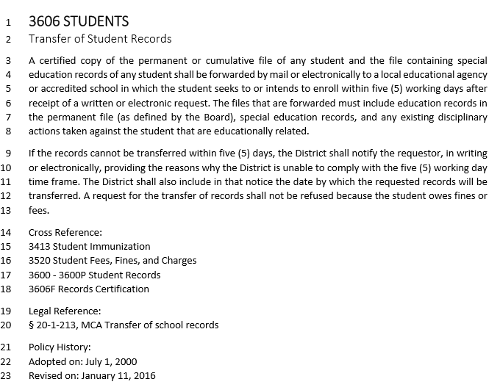
School Board Policy

Slide 13
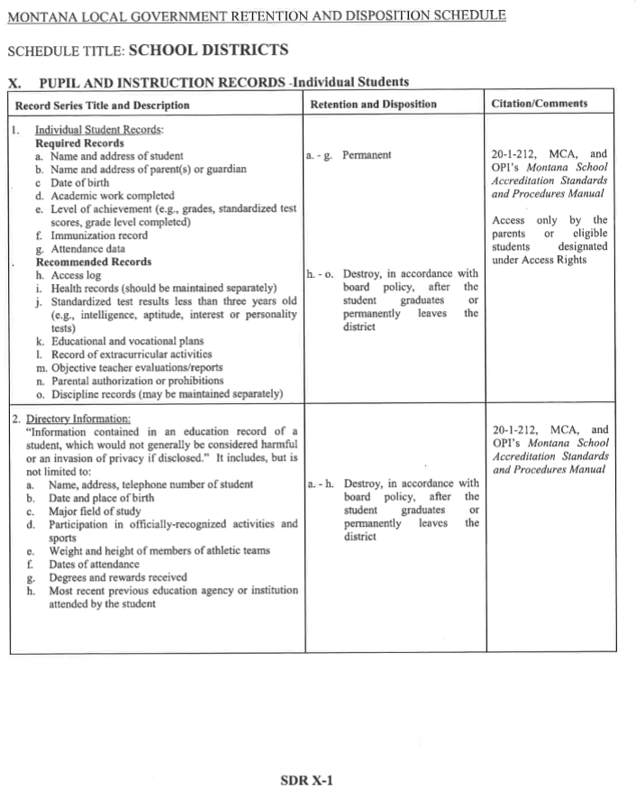

Slide 14
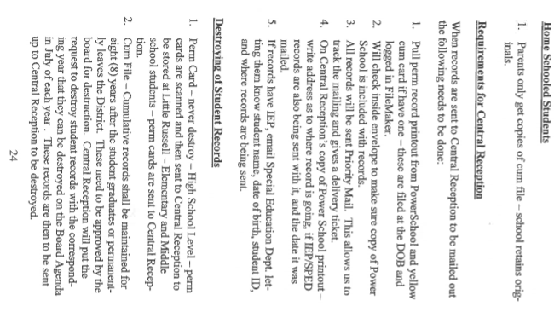
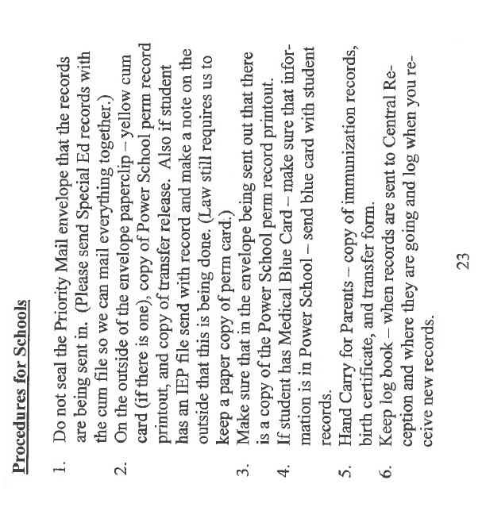
Great Falls Public Schools Process

Slide 15
The Great Falls Public Schools process for handling records are some what unique to our District due to the military connected students.
When military families are re-locating to another military facility outside the country they will request their students records to be “hand-carried”.
When preparing student records to be hand-carried the following:
The school principal should review the contents of the cumulative folder to make sure it is complete and accurate.
The behavioral/discipline records are generally not included unless information is attached to an IEP or principal determines that this information be included.
Check list of records included in packet for office use to stay on file at the school.
Original records are enclosed in a sealed envelope with the following information printed on the envelope.
Envelope should be sealed with packing tape with a sticker over flap:
“Enclosed are confidential school records that are to be hand carried to the overseas school. If the seal is broken, documents are no longer considered official.”
A copy of the PowerSchool perm transcript is sent to Central Reception for logging of the transfer of the student records tracker program.
Transfer out information is noted in PowerSchool when the student is exited from school.

Slide 17
Questions????

