Slide 1
Cheri’ Nygard, Wolf Point Schools Kevin Patrick, Anaconda Schools
POINT OF SALE SYSTEM - WWW.SHOPKEEP.COM

Slide 2
WHAT IS SHOPKEEP?
https://youtu.be/QwehJleUwaw

Slide 3
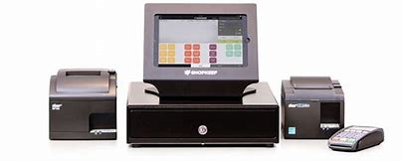
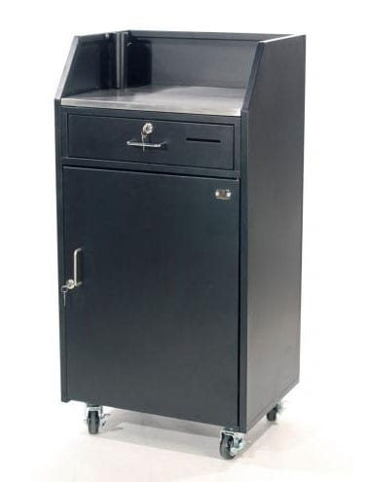
What you need to get started:
iPad - $499.00
iPad Enclosure - $129.00
Receipt Printer - $269
Cash Drawer - $109
Valet Stand - $449.95
Sign Stand - $83.99
www.shop.shopkeep.com

Slide 4
SHOPKEEP BACKOFFICE
WWW.SHOPKEEPAPP.COM
Set up Staff/Users
Set up Sale Items & iPad Layout
Add registers
Print Reports

Slide 5
SHOPKEEP POCKET APP

Slide 6
QUESTIONS
Thank you all for coming!

