Slide 1
BEING A SMART SHOPPER
2019 MASBO CONFERENCE • GREAT FALLS, MONTANA

Slide 2
TOPICS
Preventive Services
Advantages of Preventive Health vs Reactive Treatment
Preventive RX
Generic vs Name Brand Prescriptions
Care Options
“
Education is the most
POWERFUL
weapon which you can use to change
—Nelson Mandela
the world.

Slide 3
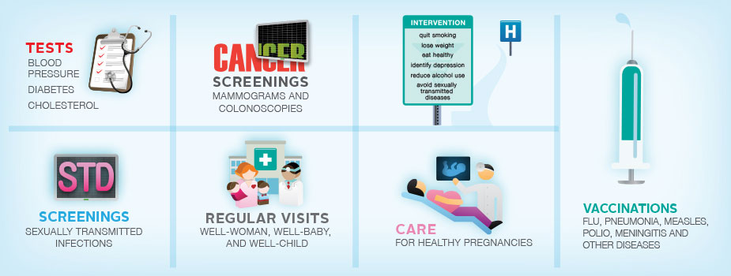
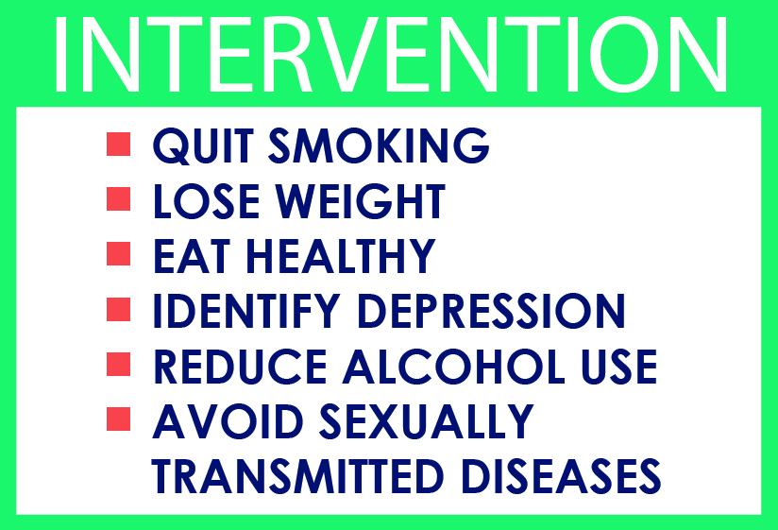
PREVENTIVE HEALTH

Slide 4
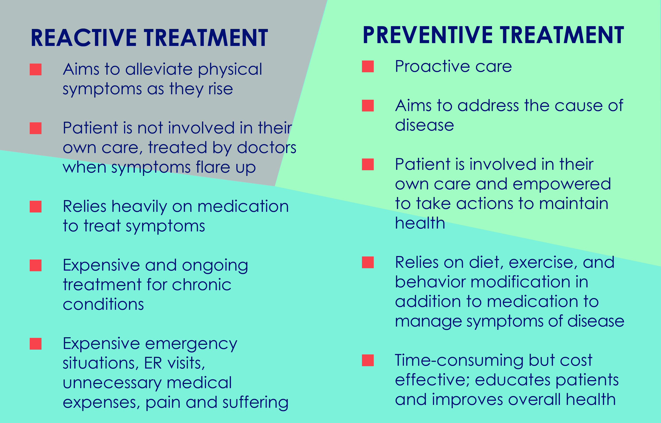
REACTIVE TREATMENT VS PREVENTIVE HEALTH

Slide 5
Chronic diseases are responsible for 7 of every 10 deaths in the US.
Many chronic diseases are either largely preventable or easily managed if patients prioritize preventive care and work closely with their providers.
REACTIVE TREATMENT VS PREVENTIVE HEALTH
In 2018, U.S. healthcare spend reached over $3.67 trillion, accounting for 19.5% of gross domestic product (GDP).
From a quality perspective, technologies such as the electronic health record (EHR) have helped providers enhance the quality of care by improving diagnoses and treatments with fewer errors.
over 99% of hospitals in the U.S. use EHR systems
as a single tool, the EHR does not solve all the problems in the “cost, quality, and access” continuum
The U.S. has made many attempts to improve patients’ access to healthcare, which have helped improve access to some extent, but also increased costs.
  a key objective of the Affordable Care Act (ACA) was to open up access to healthcare services and better manage costs by addressing the insurance part of the access equation
  continuing discussion regarding the outcomes and impacts of the ACA

Slide 6
NO-COST PREVENTIVE RX
MEDICATION COVERED AT $0 TO YOU
Call the Customer Service number listed on your member ID card to find out what drugs are covered at no cost share under your plan
Your health plan may include certain prescription and over-the-counter (OTC) preventive medicines, as a benefit of membership, at no cost to you when you use a pharmacy or doctor in your health plan's network.
There is no co-pay, deductible or coinsurance, even if your deductible or out-of-pocket maximum has not been met.
Coverage for these medicines can vary according to the type of plan you are enrolled in.
Age limits, restrictions and other requirements may apply.

Slide 7
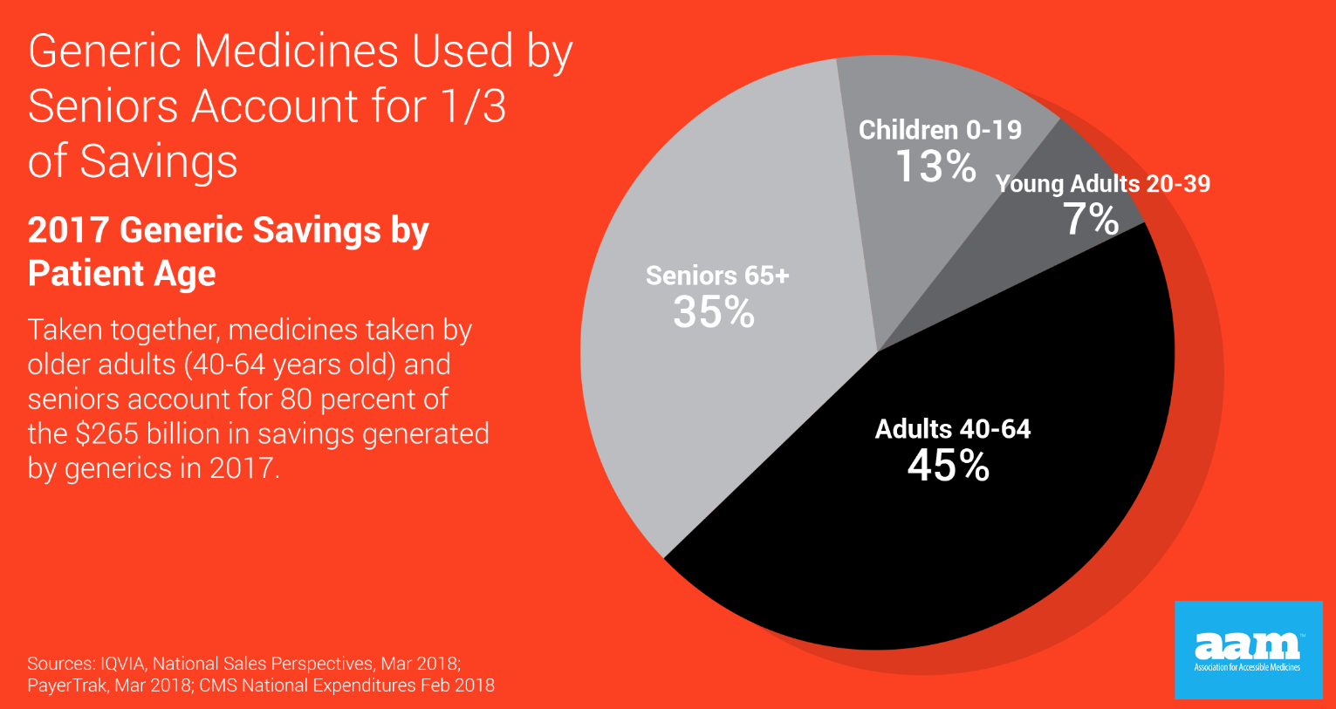

NAME BRAND VS GENERIC PRESCRIPTIONS

Slide 8
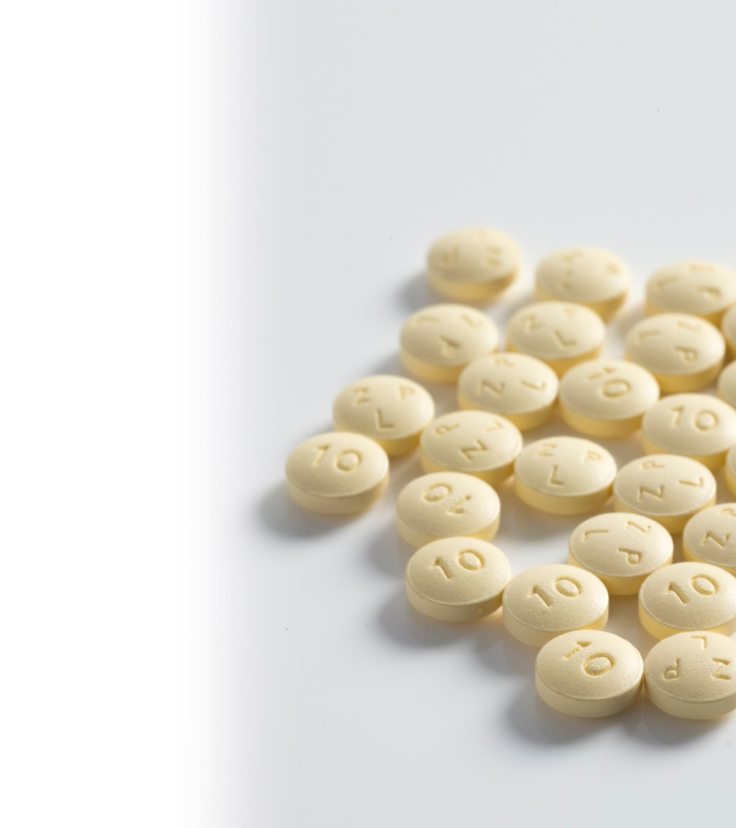
NAME BRAND VS GENERIC PRESCRIPTIONS
Generic drugs are less expensive because generic manufacturers don’t have the investment costs of the developer of a new drug. New drugs are developed under patent protection.
Q: What are generic drugs?
  A: A generic drug is a copy that is the same as a brand-name drug in dosage, safety, and strength, how it is taken, quality, performance, and intended use.
Q: Are generic drugs as safe as brand-name drugs?
  A: Yes. The FDA requires that all drugs be safe and effective. Since generics use the same active ingredients and are shown to work the same way in the body, they have the same risks and benefits as their brand-name counterparts.
Q: Does every brand-name drug have a generic counterpart?
  A: No. Brand-name drugs are generally given patent protection for 20 years from the date of submission of the patent.
Q: What is the best source of information about generic drugs?
  A: Contact your physician, pharmacist, or insurance company for information on your generic drugs. Also, visit the FDA website at fda.gov/cder/ogd/.

Slide 9

NAME BRAND VS GENERIC PRESCRIPTIONS
  QUESTIONS TO ASK YOUR DOCTOR OR PHARMACIST
Why are you suggesting this dosage?
  Prescriptions with a higher dose of the same drug could end up costing hundreds of dollars more, depending on where you shop. Pay especially close attention if you’re visiting a dispensing doctor who gives you the drug directly instead of having it filled by a pharmacist.
Can I use a lower-cost generic?
  Generic drugs have the same active ingredients, strength, quality, and safety as their name-brand counterparts, but they can cost hundreds of dollars less. A low-cost alternative is bound to hit the market eventually.
Is there an OTC alternative?
  Over-the-counter (OTC) drugs won’t usually put more than a $20 dent in your wallet, so it’s worth asking if you really need a prescription for treatments like nasal sprays. Pharmacist might know even more about specific OTC medications than your doctor does.
Or would a prescription be cheaper than this over-the-counter product?
  Sometimes, a prescription medication actually costs less than a similar OTC option.
Can I get free samples?
  If your physician writes an expensive prescription, it’s worth asking if you can get samples. Drug companies hand out around $18 billion worth of samples a year.
  For a list of covered prescriptions on the MUST health plan, visit:
  mustbenefits.org/explore-plans/pharmacy
Source: www.rd.com

Slide 10

CARE OPTIONS
CAREHERE HEALTH CENTERS—alternate ways to access care
LOCATIONS
Chronic Disease Management
Health Coaching Services
Care for Infections & Colds
Flu & Allergy Treatments
Well-Child Checkup
School Physicals
Sports Physicals
Annual Health Screenings
Stress Management
Tobacco Cessation
Routine Blood Work
Skin Checks
Immunizations
Minor Stitches
Wellness Programs
Annual Exams
MRI & Diagnostic Referrals
Zero cost for traditional plan (Basic, CM and RM Plans) members
$55 office charge HDHP members*
CAREHERE SERVICES
ANACONDA—1102 Commercial St
Tues-Wed • 7am-6pm
BUTTE—3703 Harrison Ave, Ste B
Mon-Wed • 7am-6pm
Thurs • 7am-5pm
Friday • 7am-6pm
Sat • 8am-1pm
BILLINGS—1501 14th St W, Ste 230
Mon-Thurs • 7am-6pm
Friday • 8am-5pm
HELENA—405 Saddle Dr
Mon-Friday • 7am-6pm
Sat • 8am-12pm
MISSOULA—1211 S Reserve, Ste 202
Mon-Thurs • 7am-6pm
Friday • 9am-6pm
Convenient Scheduling
CareHere.com | CareHere App
or by phone 877.423.1330
*until deductible is met
All MUST members have access!

Slide 11

CARE OPTIONS
VIRTUAL VISITS (powered by MDLive)—alternate ways to access care
VIRTUAL VISITS (telehealth)
Doctor is available 24 hours a day/seven days a week via phone, computer or tablet
Speak to a doctor immediately or schedule an appointment. This can be a better alternative to the emergency room or urgent care.
On average, a virtual visit is $44
  $85 less than an in-person PCP visit
  $250 less than an urgent care visit
  $950 less than an ER visit
General Health
Allergies
Asthma
Joint aches
Sinus infections
Just some of the conditions virtual visit doctors can help treat and prescribed needed medication
Pediatric Care
Cold/flu
Ear infections
Pink eye

Slide 12

Why Virtual Visits?
CARE OPTIONS
VIRTUAL VISITS (powered by MDLive)—alternate ways to access care
Simple, non-emergency medical conditions can be addressed via telephone, online video or mobile app.
Digital prescriptions can be sent to the member’s pharmacy of choice.
You and your employees save

Slide 13

CARE OPTIONS
24/7 NURSELINE -The Right Care at the Right Time
Use eligibility information to guide members to primary care physician, urgent care, emergency room or other care as necessary – to improve health quality and lower costs
Answers general health questions
Staffed by registered nurses
Can direct members to audio library of 1,000+ health topics

Slide 14

!

