Slide 1

2019 HEALTHCARE TRENDS
MASBO CONFERENCE • GREAT FALLS, MONTANA

Slide 2
TOPICS
Wellness
Value-Based Care vs Fee-For-Service
Consolidation
Consumerism
Telehealth
Artificial Intelligence & Machine Learning
Wearables
“
Education is the most
POWERFUL
weapon which you can use to change
—Nelson Mandela
the world.

Slide 3
WELLNESS IN THE WORKPLACE
STEPS FOR SUCCESS
Putting the Exercise at Your Desk program into action
Working Americans spend about 2,000 hours a year in the workplace. So it’s no surprise that all those hours can take a toll on your eyes, back, arms and neck. Exposure to adverse working conditions can result in short-term pain or possibly long-term injury.
Fortunately, a careful approach to ergonomics in the workplace can help prevent injuries and even help increase productivity and efficiency.
^{Is your workplace in a slump?}
The Exercise at Your Desk program can provide you with straight answers about overcoming ergonomic challenges in the workplace. Following an easy-to-use program, employees learn how to perform a series of eight simple stretches divided into two groups, morning and afternoon, lasting about five minutes each.

Slide 4
WELLNESS IN THE WORKPLACE
TIPS FOR EMPLOYEES
Writing out your plan is a very important step to achieving your goal. Lives are so busy that finding time, energy and motivation is a challenge.
Think about which days work best for you, what type of exercise you like, and the most convenient place to work out.
There are many ways to enhance fitness no matter your current fitness level. There are many pathways you can take to reach your fitness goal.
Make this plan your own and don’t be afraid to aim high.
When stretching, move just to the point of tension, stop, and hold that position. Stretching shouldn’t be painful—it should make you feel relaxed and refreshed
Relax and continue breathing while you stretch
Dedicate time each day in the morning and afternoon for stretching breaks
Make it meaningful. Getting support—actual participation and encouragement—from the administration-level can make all the difference! When employees see a healthier workforce is a priority for the whole school and that they are also participating, employees may see an additional value to join in.

Slide 5
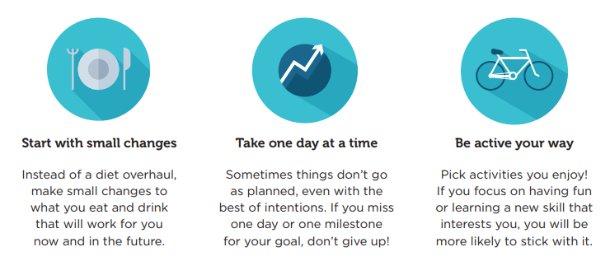
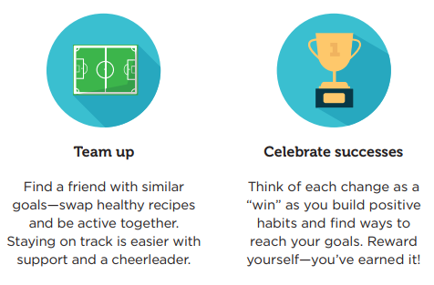
WELLNESS IN THE WORKPLACE
TIPS FOR EMPLOYEES

Slide 6
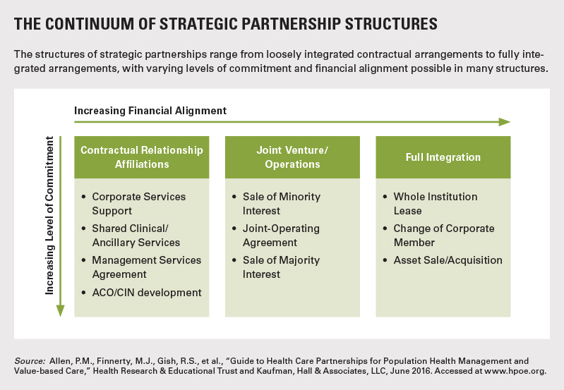
CONSOLIDATION
SHIFTS AS HEALTHCARE CONTINUES MOVING TO VALUE-BASED CARE
The shift from volume- to value-based care, exploration of ways to manage population health, and the increasing influence of consumerism have challenged healthcare stakeholders to improve care delivery by reducing clinical variation while increasing access to capital. As a result, consolidation has become a defining factor in healthcare business models.

Slide 7
VALUE-BASED-CARE AND
FEE-FOR SERVICE
What is Value-Based-Care?
Value-based care is a philosophy of healthcare realized when clinicians intentionally consider the quality of care provided, and the overall outcomes of that care, in relation to cost-efficiency. In the value-based care model doctors and specialists consider “best practices” when treating patients, since they are reimbursed for the quality and efficiency of care they provide. Value-based care models encourage a “holistic,” team approach to care, requiring coordination and communication between physicians across specialties. When successful, physician entity groups receive incentive payments for providing better care for individuals at a lower cost.
What is Fee-For-Service?
Fee-for service (FFS) is healthcare’s most traditional payment model where physicians and healthcare providers are reimbursed by insurance companies and government agencies (third-party payers) based on the number of services they provide, or the number of procedures they order. Payments are unbundled and paid for separately, so every time patients have a doctor’s appointment, a surgical consultation, or a hospital stay, these third-party payers are billed for each visit, test, procedure, and treatment provided, even though some of these may not be needed, or supported by evidence-based data.

Slide 8
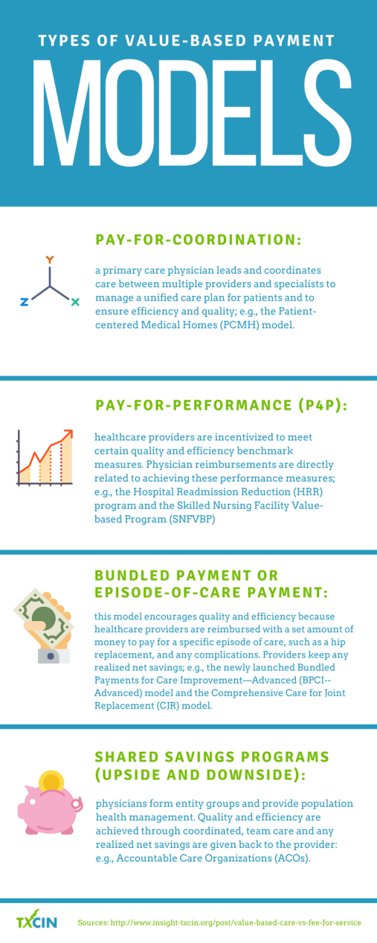
VALUE-BASED-CARE
The value-based model of healthcare shifts the emphasis of care from simply reimbursing clinicians on tests and services ordered to rewarding physicians for providing appropriate, coordinated care that keeps patient populations healthy.
Value-based care programs are designed to drive down healthcare costs and to improve patient care and population health, by financially rewarding healthcare providers for considering overall patient care, cost- efficiency, and patient outcomes.
Healthcare professionals are encouraged to engage with patients, to provide care appropriate to each individual’s circumstances, to invest in new technology, to evaluate processes, performance, and data, and to align their efforts with multiple providers, taking a team approach to healthcare.

Slide 9
CONSUMERISM
HEALTHCARE CONSUMERISM TODAY IS FRUGAL, TECHNOLOGY SAVVY, & SEEKING CONVENIENCE
Cost: 65 percent of commercial insurance respondents selected cost as a top factor when choosing where to seek care.
Technology-driven: Patients are increasingly looking at online reviews, transparent pricing, and satisfaction ratings for local providers to determine where they will go to get their treatments.
Convenience: Consumers who report using retail clinics have climbed from 9 percent to 24 percent in younger generations.
PERSONLIZATION IS BECOMING VERY IMPORTANT
There’s no longer a “one-size-fits-all” care model in place, and we see this in the reduction of the number of people that see a primary care provider.
Patients don’t just want excellent care. They want excellent service, too, which means care delivered with more ease, convenience, and choice.

Slide 10

TELEHEALTH
TELEHEALTH
Refers to instances of healthcare via the use of modern technology
Encompasses clinician-to-clinician, clinician-to-patient, and patient-to-patient interaction
Montanans serving Montana’s public education community for over 30 years with no competing priorities
Trusted resource for schools across the state regardless of enrollment in health trust
According to Definitive Healthcare’s 2017 Inpatient Telemedicine Study, over 70% of consumers would rather use video than visit their primary care provider in person. Telehealth is already growing rapidly, accounting for almost $22B in 2017. It is expected to reach $93.45B by 2026.

Slide 11

MOBILE HEALTH
mHEALTH
Refers to the concept of mobile self-care—consumer technologies like smartphone and tablet apps that enable consumers to capture their own health data, without a clinician’s assistance or interpretation. Limited to patient-to-patient interaction (or patient self-interaction)

Slide 12
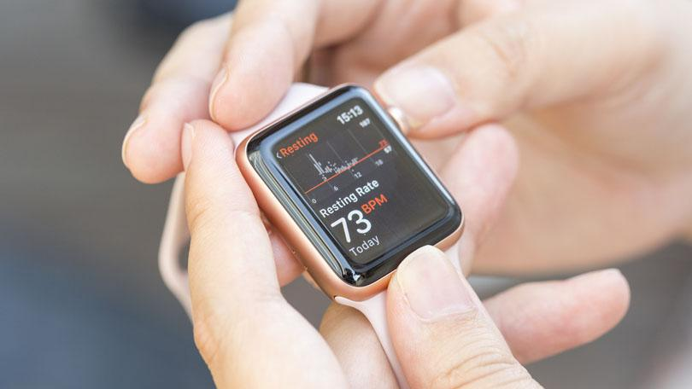
WEARABLES
WEARABLES
The wearable and remote patient monitoring market has just started to take off. This trend is still in its early stages, with only 1,800 hospitals using mobile applications (less than 25 percent of all U.S. hospitals). The wearable market is projected to reach $12.1B by 2021 and the remote monitoring market is projected to grow to $31.3B by 2023—almost double where it is today.
The Apple watch can now detect irregular heart rhythms and diabetics can monitor their blood sugar levels with digital glucose monitors.

Slide 13
ARTIFICIAL INTELLIGENCE
UNIFYING MIND AND MACHINE THROUGH BRAIN-COMPUTER INTERFACES
Artificial intelligence could help mitigate the impacts of this severe deficit of qualified clinical staff by taking over some of the diagnostic duties typically allocated to humans.
AI offers a number of advantages over traditional analytics and clinical decision-making techniques. Learning algorithms can become more precise and accurate as they interact with training data, allowing humans to gain unprecedented insights into diagnostics, care processes, treatment variability, and patient outcomes.

Slide 14

STRONG PARTNERS
VIRTUAL VISITS (powered by MDLive)—alternate ways to access care
VIRTUAL VISITS (telehealth)
Doctor is available 24 hours a day/seven days a week via phone, computer or tablet
Speak to a doctor immediately or schedule an appointment This can be a better alternative to the emergency room or urgent care
On average, a virtual visit is $44
  $85 less than an in-person PCP visit
  $250 less than an urgent care visit
  $950 less than an ER visit
General Health
Allergies
Asthma
Joint aches
Sinus infections
Just some of the conditions virtual visit doctors can help treat and prescribed needed medication
Pediatric Care
Cold/flu
Ear infections
Pink eye

Slide 15

Why Virtual Visits powered by MDLive?
STRONG PARTNERS
VIRTUAL VISITS (powered by MDLive)—alternate ways to access care
Simple, non-emergency medical and behavioral health conditions can be addressed via telephone, online video or mobile app.*
Digital prescriptions
can be sent to the member’s pharmacy of choice.
You and your employees save.

Slide 16

24/7 NURSELINE
The Right Care at the Right Time
Use eligibility information to guide members to primary care physician, urgent care, emergency room or other care as necessary – to improve health quality and lower costs
Answers general health questions
Staffed by registered nurses
Can direct members to audio library of 1,000+ health topics

Slide 17
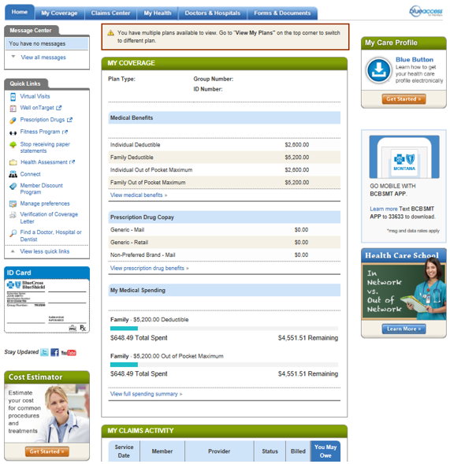
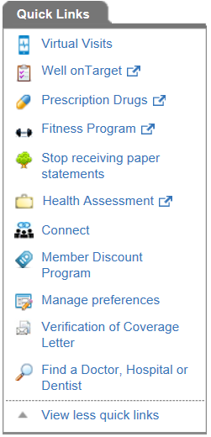
STRONG PARTNERS
BLUE ACCESS FOR MEMBERS (BAM); Provider Finder; Transparency Cost Estimator Tool
►

Slide 18

STRONG PARTNERS
CAREHERE HEALTH CENTERS—alternate ways to access care
LOCATIONS
Chronic Disease Management
Health Coaching Services
Care for Infections & Colds
Flu & Allergy Treatments
Well-Child Checkup
School Physicals
Sports Physicals
Annual Health Screenings
Stress Management
Tobacco Cessation
Routine Blood Work
Skin Checks
Immunizations
Minor Stitches
Wellness Programs
Annual Exams
MRI & Diagnostic Referrals
Zero cost for traditional plan (Basic, CM and RM Plans) members
$55 office charge HDHP members*
CAREHERE SERVICES
ANACONDA—1102 Commercial St
Tues-Wed • 7am-6pm
BUTTE—3703 Harrison Ave, Ste B
Mon-Wed • 7am-6pm
Thurs • 7am-5pm
Friday • 7am-6pm
Sat • 8am-1pm
BILLINGS—1501 14th St W, Ste 230
Mon-Thurs • 7am-6pm
Friday • 8am-5pm
HELENA—405 Saddle Dr
Mon-Friday • 7am-6pm
Sat • 8am-12pm
MISSOULA—1211 S Reserve, Ste 202
Mon-Thurs • 7am-6pm
Friday • 9am-6pm
Convenient Scheduling
CareHere.com | CareHere App
or by phone 877.423.1330
*until deductible is met
All MUST members have access!

Slide 19

!

