Slide 1



TRS Training for New Clerks
Nolan Brilz, TRS Accounting and Fiscal Manager
MASBO Summer Conference and New Clerk Academy  June 2019

Slide 2
TODAY’S AGENDA
Overview of TRS − and your responsibilities as a TRS Employer
Membership eligibility
      TRS-reportable positions
      Eligibility for new hires
      Monthly wage and contribution reporting for all members
      Requirements for retiring members
Monthly reporting: Overview of TRS systems
Q & A
trs.mt.gov

Slide 3
What is TRS?
In 1937, Montana law established the Teachers’ Retirement System
TRS is a Defined Benefit (DB) Pension Plan
  DB =The retiree receives a monthly benefit for life
  Benefit amount depends on member’s average final salary and years of service
Approx. $4 billion in assets, managed by Montana Board of Investments
FY 2018:
  Over 19,000 active, contributing members
  Paid over $352 million to 16,313 retirees and other benefit recipients

Slide 4
Who are “TRS employers”?
Per §19-20-101(9), MCA, these are identified as TRS Employers:
  The State of Montana
  Public school districts
  Office of Public Instruction
  Board of Public Education
  Education cooperatives
  MT School for Deaf & Blind
  MT Youth Challenge Program
  Montana University System
  Community Colleges
  Any other agency, political subdivision (e.g., county) or instrumentality (e.g., CSPD, RESA) of the state that employs a person who meets TRS membership criteria

Slide 5
TRS Employer Responsibilities
Duties and Liability of Employer (Paraphrased from §19-20-208, MCA)
  Pick up contributions of each employed member and submit to TRS
  Each month, report the name, SSN, hours worked and gross earnings of each member working in a position reportable to TRS
    NEW: This is required even if no wages were paid.
  Inform a person required to be a member of their rights and responsibilities related to TRS
  Notify TRS of employment of a person eligible for membership and forward their membership application
Continued…

Slide 6

TRS Employer Responsibilities (Continued)
Duties and Liability of Employer (Paraphrased from §19-20-208, MCA)
  When employing a retired member in a position reportable to TRS:
  Must report all hours worked and gross earnings
    Failure to comply may mean employer and retiree
    must repay, with interest, all retirement benefits
    that the member was not eligible to receive.
See TRS memos on 2019 Legislative changes
  Distributed by regular mail and/or email
  Available at trs.mt.gov under “Communication Archive”
Be sure you and the retiree understand
all requirements and consequences!
Read TRS Fact Sheets and
call with any questions.

Slide 7
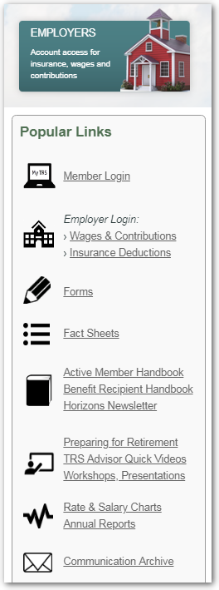
TRS Employer
Responsibilities (Continued)
Refer to the TRS website (trs.mt.gov) for…
  Past employer bulletins and memos
  Latest versions of forms
  Fact Sheets, such as:
    Substitute Teaching
    Volunteer Service
    150-Day Break in Service Requirement
    Terminating Employment and Retiring with TRS
    Working After Retirement
Forms,
Fact Sheets
and more at
trs.mt.gov

Slide 8


MEMBERSHIP and CONTRIBUTIONS
trs.mt.gov

Slide 9
Who is required to be a TRS member?
  Teachers, Principals, Superintendents
  Dean of Students
  Speech-language Therapists
  School Psychologists, School Nurses, Guidance Counselors
  Librarians
  Coaches, Athletic Directors
  PE instructors
  Study hall monitors
  Substitute teachers
  Teachers’ aides and paraprofessionals
Anyone who provides educational or instructional services
  Determined by duties, not by position title
  See TRS Fact Sheet, Which Positions are Reportable to TRS? (trs.mt.gov)
  If in doubt, contact TRS
More on these later

Slide 10
Who is excluded from TRS membership?
Those who perform non-instructional duties, such as:
  School District Clerks
  Non-instructional Informational Technology staff
  Bus drivers
  Cafeteria staff
  Custodial staff
  Hall monitors
  Playground monitors
  Ticket takers
Always contact TRS with any questions!

Slide 11
Eligibility: 30-Day work requirement
A person who is not already a member of TRS must become a member when they have worked 30 days (210 hours) in a single fiscal year
  This is a threshold, not a waiting period
  Once a member, the requirement is not reapplied each year
If a new employee is expected to meet the requirement, report them to TRS from the first date of employment
  e.g., contracted F/T or P/T teachers, or those paid hourly (no contract)
If new employee is not expected to meet the requirement, do not report until they reach 210 hours (…but see exception on next slide)

Slide 12
Eligibility: Substitute teachers, part-time teachers’ aides & paraprofessionals
Per state law, new substitute teachers and part-time teachers’ aides/ paraprofessionals may elect to enroll and pay contributions from day one − thus earning service credit for every hour worked
If they are not already active or inactive members of TRS, give them TRS Form 106, Membership Election on their first day of work
Remember, if these employees reach the 210-hour threshold, they must participate in TRS
  Encourage them to enroll from day one if it is likely they will work 210 hours in the school year

Slide 13

New Hires: TRS Form 107 (and 146 if working retiree)
New employees working in TRS-reportable positions must
complete TRS Form 107, New Hire Questionnaire
  Employees who are Active or Inactive TRS members must
  identify their previous TRS employer(s) on the form
  RETAIN FORM 107 for your records − DO NOT submit to TRS
Retired TRS member: Within 30 days, employer and retiree
also must notify TRS via Notice of Postretirement Employment (TRS Form 146)
TIAA-CREF member: If concurrently employed in positions reportable to both
TIAA-CREF and TRS, the employee cannot be an active TRS member

Slide 14
New hire who is new to TRS (Form 102)
TRS Record for Membership (Form 102) is required –
unless the member is already an active or inactive member of TRS
Before you report wages, log into TRS Wage & Contribution Reporting System, access Member Search/Edit, and look up the employee by SSN
If TRS membership record exists, Form 102 is not required
Notice the employee’s TRS member status
  Active, Terminated (inactive), Retired, etc.
  This will be discussed later
New feature!

Slide 15
New Hires: Beneficiary Designations
All new TRS members must designate at least one beneficiary
New hires may designate beneficiaries online…
… as long as wages have been reported to TRS
  Employee then can create a login for “My TRS” (online member portal) and access Online Beneficiary Designation (OBD) process
TRS strongly recommends the online process for speed and accuracy
  Active members who prefer using a paper form may do so, but they must use the latest version of TRS Form 123 (8 pages, revised November 2018)
  Do not use older versions! Download the current version from trs.mt.gov
New feature!

Slide 16
Reportable earned compensation
Per §19-20-101(8), MCA, earned compensation means:
  Remuneration paid for the service of a member out of funds controlled by an employer before any pretax deductions allowed under the Internal Revenue Code are deducted.
  i.e., gross pay
Earned compensation does not include:
  Direct premium payments by employer for health, dental, or other insurance
  Payments or reimbursements for professional membership dues; housing; maintenance; day care; auto, travel, lodging, entertainment, or any other expenses

Slide 17
Employer contributions to TRS
TRS Employer rates for FY 2020 (7/1/2019 thru 6/30/2020):
  For Active members: 9.07% of total earned compensation
  For Working Retirees: 11.45%
Rates will increase by 0.1% through FY 2024
TRS posts the updated employer rates on the website in late March
  See “Rate & Salary Charts” under Popular Links

Slide 18
Member contributions to TRS
May depend on employee’s membership tier
  Tier 1 = became a member of TRS before July 1, 2013
  Tier 2 = became a member of TRS on or after July 1, 2013
    Note: Tier 1 members who terminate employment and withdraw TRS membership (cash out contributions) will be Tier 2 members if rehired in a TRS-reportable position
Employer remits to TRS 8.15% of total earned compensation paid to or on behalf of each active member
  Same rate for Tier 1 and Tier 2 members currently – This could change in the future
Working retirees do not pay member contributions (employer pays working retiree rate)

Slide 19


TRS Employer Portal
trs.mt.gov

Slide 20
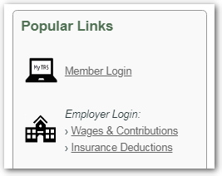
Obtaining access to TRS reporting systems
NEVER log in with a User ID and password that belongs to someone else.
  It is easy to set up your own User ID and password – and it is a requirement
  TRS does not create User IDs and passwords – you create your own user account
To create your user account:
Click the link for the system you want to access
Then click the “Employer Login” button and follow New User steps.
Click the Online Manual link on the account setup screen for help.
Problems? Call (406) 444-9293

Slide 21
TRS Form 141: Hierarchy of roles
TRS Form 141 Employer Designation of Administrator for Employer Reporting Systems:
  Employer Representative: “An administrative officer, trustee, or other representative who has general authority to direct the employees of the employer or who has authority to enter into legally binding agreements on behalf of the employer”
  Online Administrator: The person designated by the Employer Representative as the primary user of the system. (For wage and contribution reporting, this will be TRS’s Payroll contact person)
Optional: The Online Administrator can, in turn, grant access to additional users if other employees will log in and perform TRS reporting duties
  Form 141 is not required for additional users

Slide 22
Granting Access: Who is who? Who does what?
The Employer Representative (ER) may designate one Online Administrator (OA) for both Wage & Contribution and Insurance Deduction systems – or the ER can designate a separate OA for each TRS reporting system
  Depends on who is primarily responsible for those reporting duties
Steps for granting access:
  OA creates own User ID & password and writes the User ID (not password!) on Form 141
  ER and OA both sign Form 141 and mail the original to TRS
  TRS IT staff person activates the new OA’s account and inactivates any prior OA’s account
  To give access to another employee (optional):
    Employee creates own user account and tells the OA their User ID (not their password!)
    OA goes to “Additional Users” menu option in reporting system to grant access

Slide 23
Using the TRS Employer Reporting Systems
Insurance Deduction Reporting System
Wage & Contribution Reporting System
trs.mt.gov

Slide 24
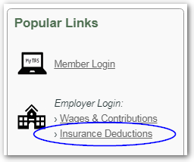
Insurance Deduction Reporting System
TRS retirees who remain covered on your group health
insurance plan may choose to have their premiums
deducted from their monthly TRS benefit.
  To sign up, the employer and retiree must sign and submit TRS Form 117, Authorization for Deduction of Health Insurance
The Online Administrator or authorized “additional user” logs into the TRS Insurance Deduction Reporting System to record the amount of each participating retiree’s monthly insurance premium.
  When premium amounts change: Update by the 16th of the month to have the new amounts deducted from TRS benefits paid at the end of that month
  Use the system’s Online Manual for guidance

Slide 25
Insurance Deduction Reporting System (continued)
After TRS payroll runs at the end of each month, TRS sends the withheld funds to the employer, who pays the insurer per their contract with them.
  Funds withheld by TRS are intended for paying next month’s insurance premiums
Remind your retirees to contact you (the employer) – not TRS – with questions related to insurance premiums.
For assistance, contact a TRS Retired Benefit specialist:
  Sherry Smith (406) 444-2912 (primary contact)
  Chris Fish (406) 444-3185

Slide 26
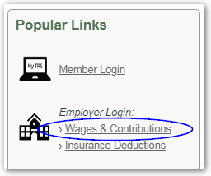
Wage & Contribution Reporting System
The Online Administrator or authorized “additional user”
logs in each month to report members’ wages and
to pay required contributions.
  NEW: TRS requires a contribution report for all 12 months of the year – even in summer months if no wages are paid (we’ll review this process later)
Each month’s contribution report and payment is due by the 15th of the following month
  TRS cannot post contributions to member accounts or update their creditable service until your report is submitted and payment is posted
  TRS strongly encourages payment by EFT – rather than by check

Slide 27
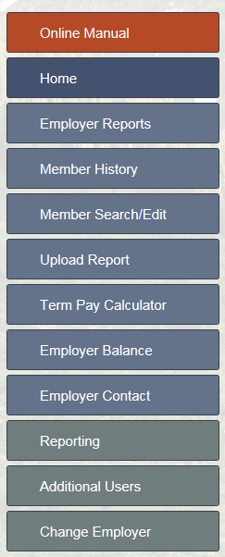
Wage & Contribution Reporting System
Three ways to create a monthly report:
  Upload a report generated from your payroll system [BEST]
        NEW: Adjustment reports can be uploaded
  From Employer Reports menu option:
  Use “Copy Forward” to copy a previous month’s posted report, then edit it as needed
  Or use Add + to create a report from scratch
        Can be used to create Adjustment reports
        Use for $0 Contribution reports if no wages paid
2
3
1

Slide 28
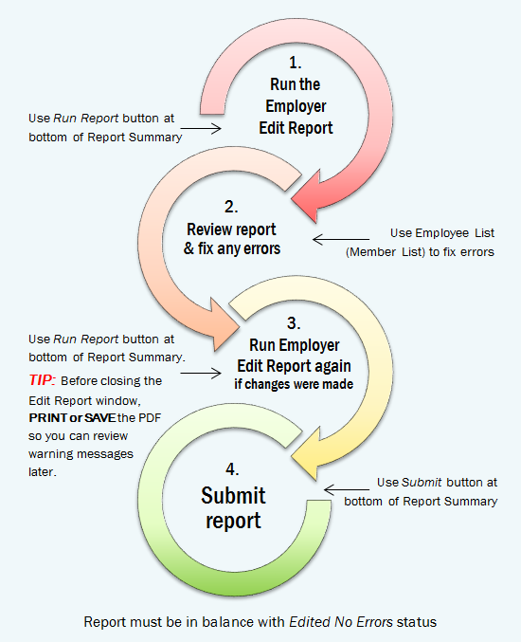
Overview:
Monthly reporting process
After uploading
or creating your report, you must complete ALL of these steps
EXCEPTION:
For a
$0 Contribution report, only Step 4 is required.

Slide 29
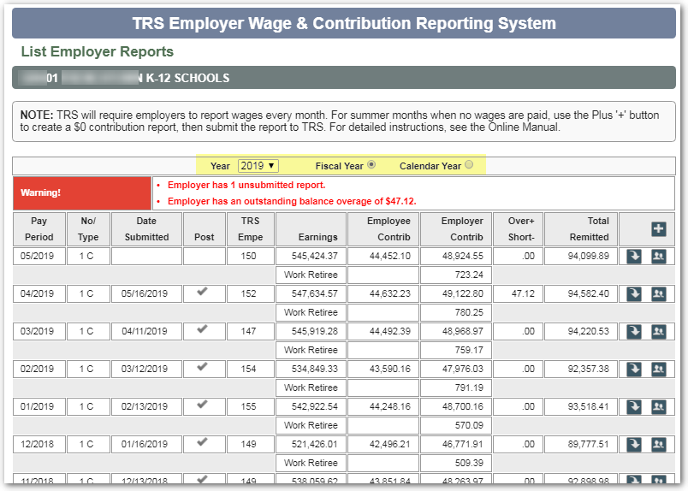
List Employer Reports
View reports by calendar or fiscal year
    Use the arrow to view or edit the Report Summary – such as to change amount remitted for an overage/shortage
  Use the Employee button to view or edit employee data, including error/warning msgs
  Use the Plus (Add) button to create a new report – including $0 Contribution report

Slide 30
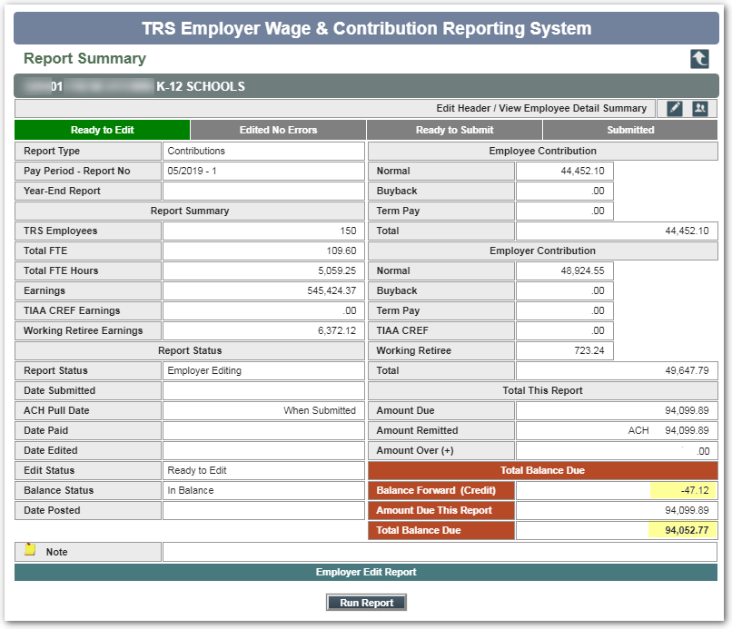
Report Summary
“Progress bar”
across the top tells you the step you are on and which steps remain
Button at bottom indicates the next available action
If you make changes, progress bar resets to “Ready to Edit” status

Slide 31
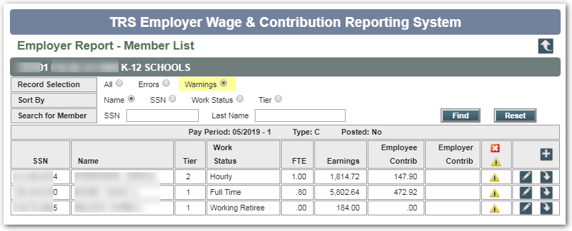
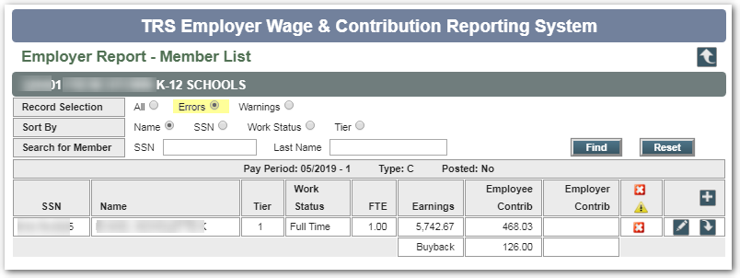
Edit Report: Check data for errors
The edit report checks for errors such as incorrect work status, FTE, or contribution amounts. The system produces a PDF report that you may save or print.
If errors are found, return to Employer Reports, then click the Employees
button to review the Member List. You must resolve errors before proceeding.
You can filter the list by Errors or Warnings:
Click Edit to review/resolve

Slide 32
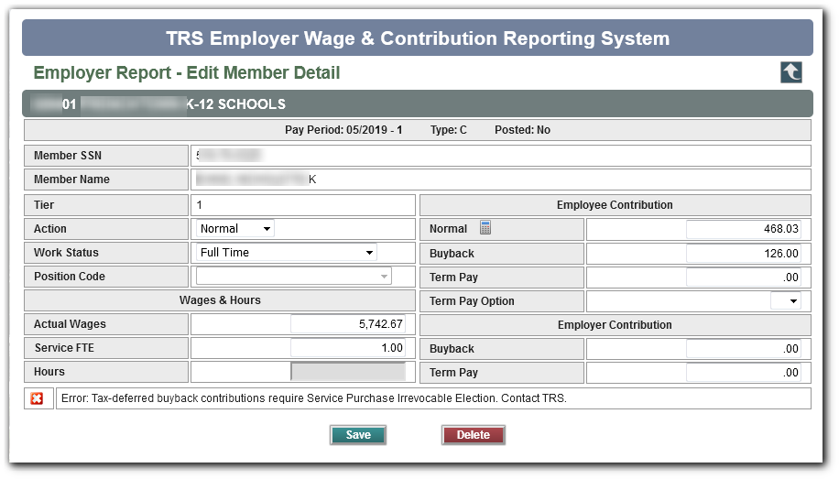
Edit Member Detail: Review & correct problems
The problem identified in the Edit Report is displayed at bottom of Edit Member Detail
Make corrections
  TIP: See the Online Manual for a list of common errors and warnings, or call TRS
After correcting errors,
re-run the Edit Report

Slide 33
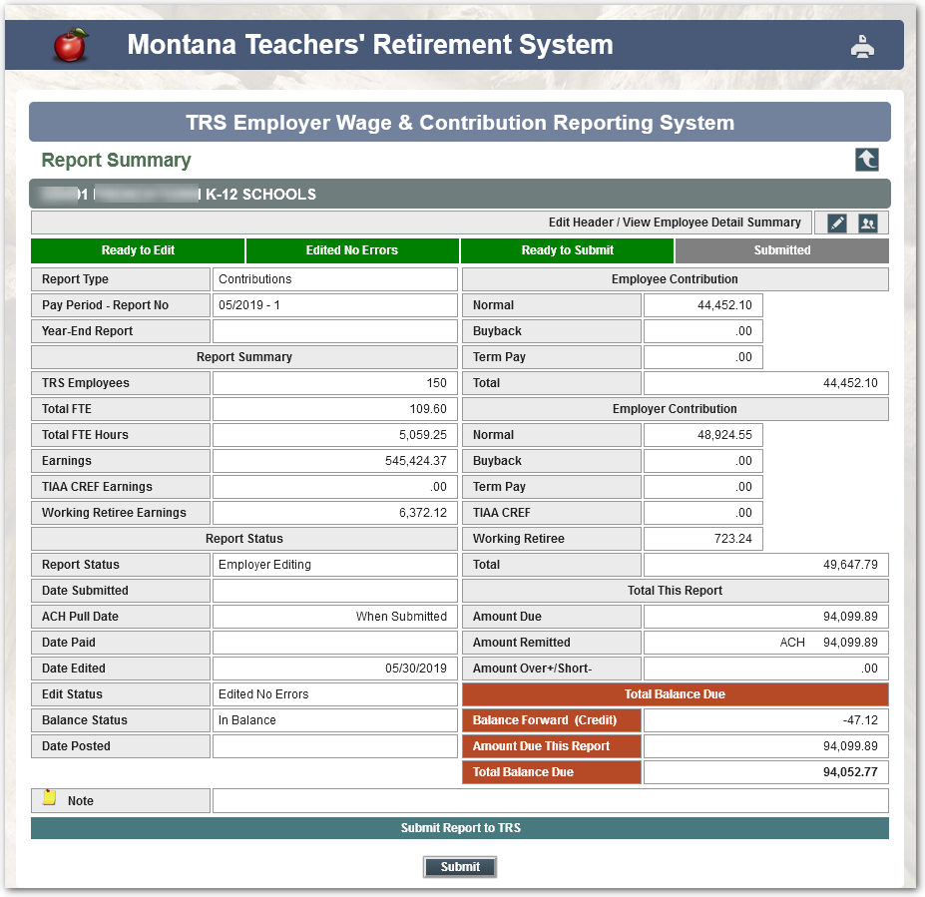
Ready to Submit?
Once the Report Summary shows “Edited No Errors,” you may be ready to submit your report… but:
Pay attention to the red section. Do you need to change the amount remitted first?
  To use a credit balance
  To cover a shortage from a prior report
Click the Edit button to make adjustments…

Slide 34
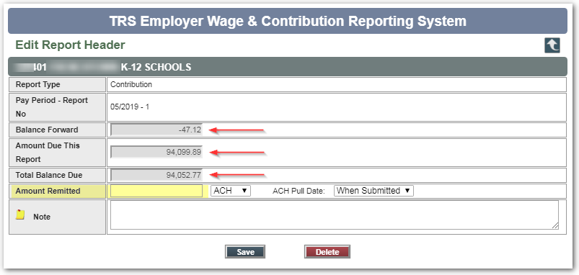
Edit Report Header
The gray fields show the balance forward,
if any, and the balance due
You may change the Amount Remitted field to match
Enter a note about the change, if you like
Click Save… THEN
Submit your report
TIP: The Delete button is used only if you need to completely delete a report and start over
(as long as it hasn’t been submitted)

Slide 35
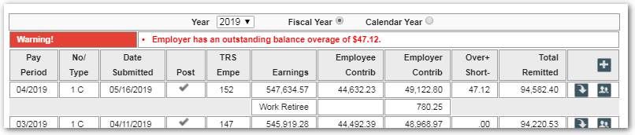
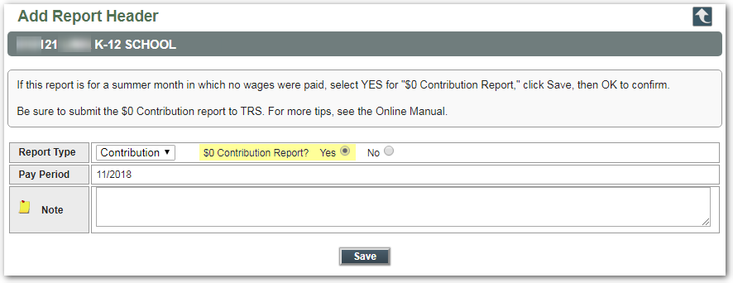
New Requirement: Submit a $0 Contribution report for a month in which no wages were paid
Overview of steps:
  Go to Employer Reports list and click “Add” (+)
  Select “Yes” for $0 Contribution Report
  Click Save – then SUBMIT the report
    It posts immediately!
    You can create another report right away
TIP: More detailed steps can be found in the Online Manual

Slide 36
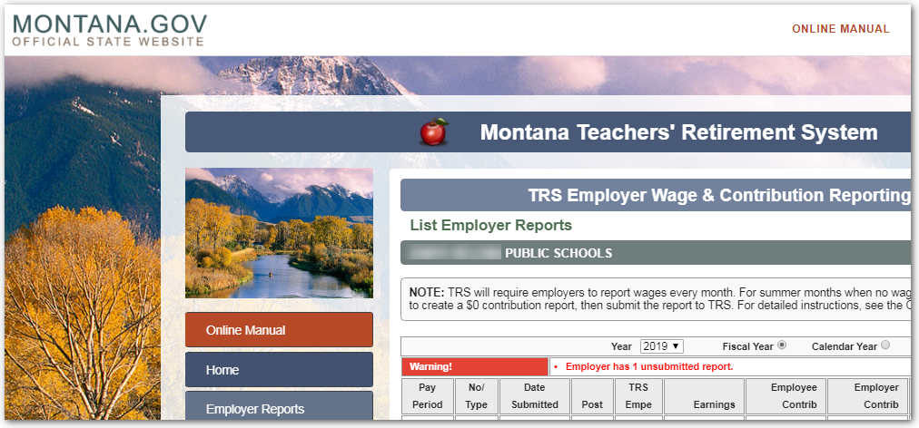
Online Manual
Click either of the red links to open the manual

Slide 37
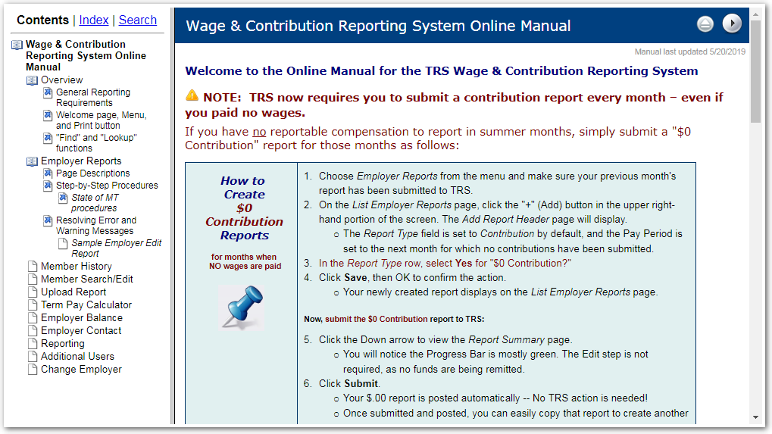
Online Manual
The manual opens in its own small window
  TIP: You can make the window wider
Click on any item in Contents pane
to read that topic

Slide 38
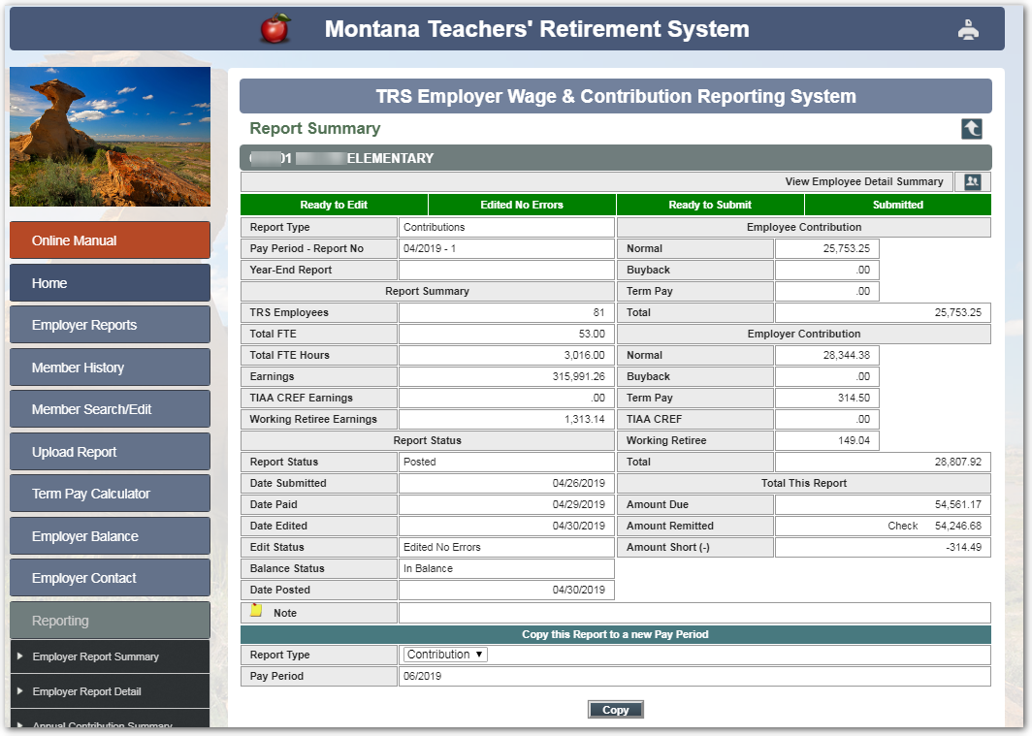
Printing the Report Summary
Two ways:
Use the Printer button (upper right)
  Can use to print any screen in this system
Or, click Reporting > Employer Report Summary to generate a PDF

Slide 39
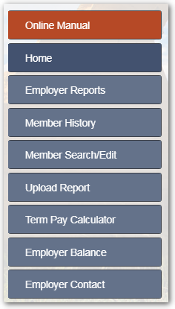
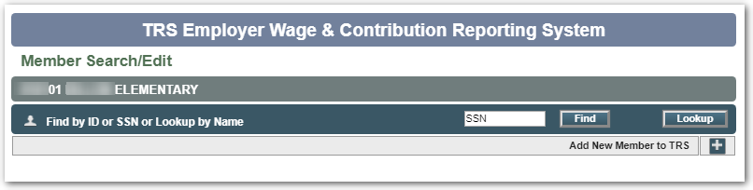
Member Search/Edit: Find by SSN
To find out if a new employee is already a TRS member:
  Enter the SSN and click Find (preferred method); or
  Use Lookup to search by name

Slide 40
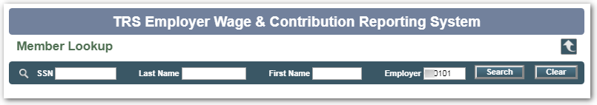
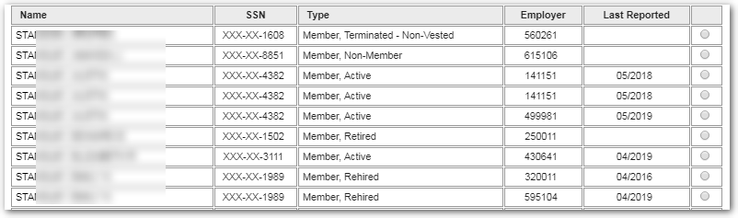
Member Search/Edit: Lookup by name
TIP: Erase your Employer ID to search all of TRS
Many possible matches are listed:
Type column shows status
Common statuses =
  Active, Retired, Terminated, Rehired, “Non-member”(i.e., Montana University System retirement plan member)
Most of the SSN is obscured if the person has never been associated with your school

Slide 41
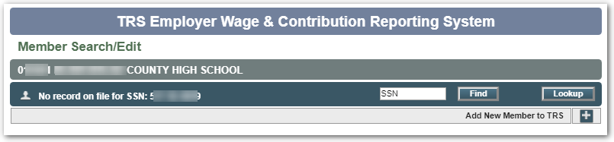
Member Search/Edit: No member found
If you searched by SSN or name and your employee does not have a TRS membership record:
  You can either add them to TRS manually using Add+ button, or
  Your upload file will create a member record automatically
    If gender, DOB, or other required info is missing from upload file, you will need to edit it (we’ll review Edit Member screen later)

Slide 42
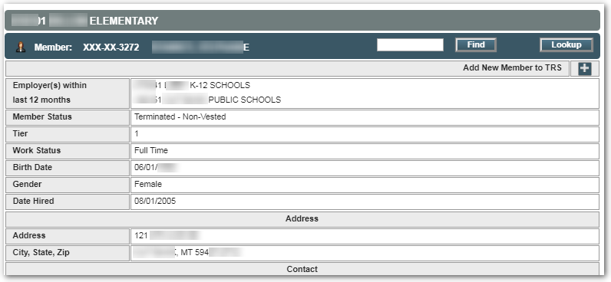
Member Search/Edit: Member found
This person is a terminated (inactive) member of TRS
Do not click the “Add New Member to TRS” button; just report wages
This will notify TRS that the person is an active member again

Slide 43
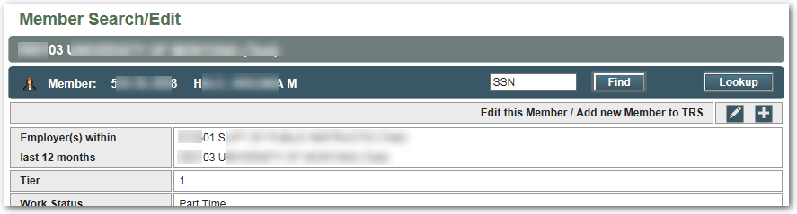
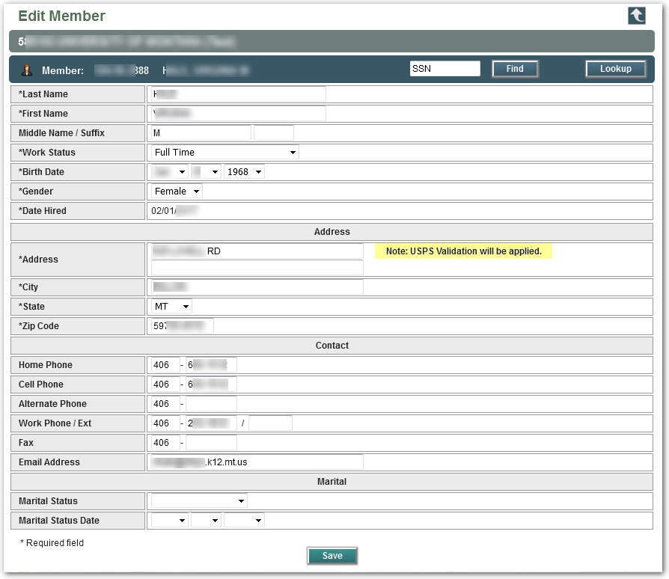
Member Search/Edit: Edit Member
Once you report wages for a new employee, an Edit button is available on Member Search/Edit
  Exception: If employee
  is a TRS retiree/benefit recipient, there is no
  Edit button
Addresses are validated against USPS data automatically

Slide 44
Other Wage & Contribution Reporting System Features
Next, we’ll review a few other features:
  Term Pay Calculator
  Employer Balance (overage or shortage)
  Employer Contact
  Reporting options
Remember: All menu options and system functions are described in the Online Manual

Slide 45
Brief Review of Termination Pay steps
A retiring employee can choose to include termination pay in the calculation of their monthly TRS retirement benefit (this increases average final compensation)
If included in calculation, then employer and employee owe contributions to TRS
  TRS Form 129 Termination Pay Irrevocable Election (a.k.a. TPIEF) allows employer to withhold contributions from employee’s pay on a tax-deferred basis (IRS rule)
TPIEF must be signed at least 90 days prior to last day of work for tax deferral
  Make sure the employee has seen an Estimate of Benefits before signing a TPIEF!
  The employee must understand what the election will cost them in contributions

Slide 46
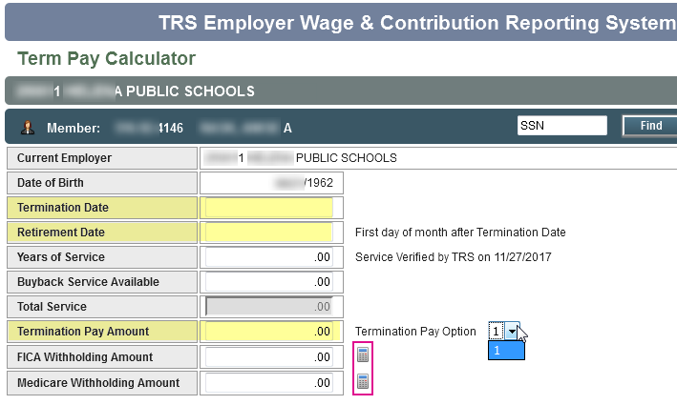
Term Pay Calculator
Example: TRS has a signed TPIEF on file for this employee, who elected Termination Pay Option 1
Enter the Termination Date
Enter the Retirement Date
Enter the Term Pay Amount
Click the FICA and Medicare withholding calculator buttons
Click “Calculate”

Slide 47
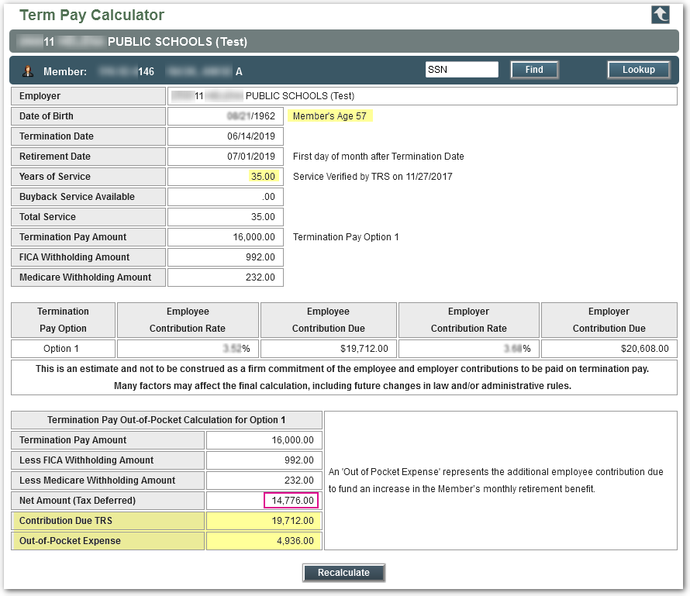
Term Pay Calculator, pg 2
The contributions due TRS for Option 1 are shown
  This employee owes an additional out-of-pocket amount to TRS to fund the lifetime increase in benefits
  Employee must write a personal check to TRS for the difference
  Cannot change their mind – the choice they made on the TPIEF is irrevocable

Slide 48
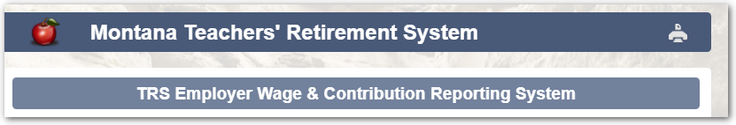
Form 113 Retirement Termination Pay
Print the Term Pay calculation
  use Printer icon at the top of screen
Follow all instructions on TRS Form 113 Retirement Termination Pay
Submit Form 113 to TRS (fax, email, or mail) with the Term Pay Calculator printout one week prior to submitting your Wage & Contribution report
  Otherwise you will get errors
FOR MORE DETAILS
Watch a recorded Termination Pay webinar from
April 2019:
trs.mt.gov/
TrsInfo/Workshops

Slide 49
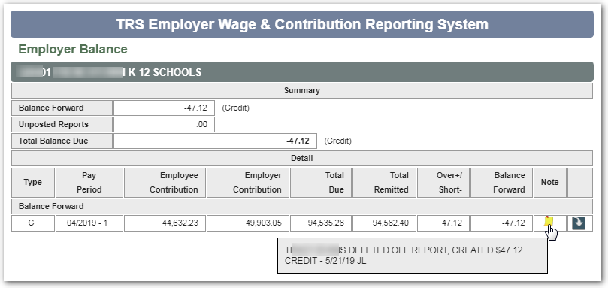
Employer Balance menu option
Shows any submitted and posted reports that contribute to a balance forward
  Example: Credit balance with explanatory note from TRS

Slide 50
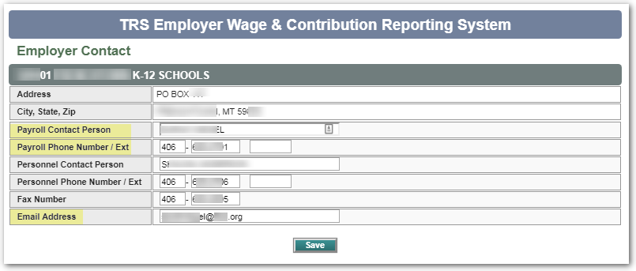
Employer Contact menu option
If you are a new Payroll clerk, please update name, phone, and email!
TRS requires current contact info to distribute important information:
  Contribution rate changes
  System updates
  Reporting deadlines

Slide 51
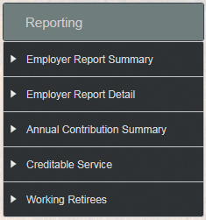
Reporting menu options
Five “Reporting” options allow you to generate PDF reports or summaries anytime:
    Employer Report Summary and
    Employer Report Detail are print-friendly versions of your monthly report
    Working Retirees allows you see if your TRS working retirees are close to reaching their allowable earnings limit
Continued…

Slide 52
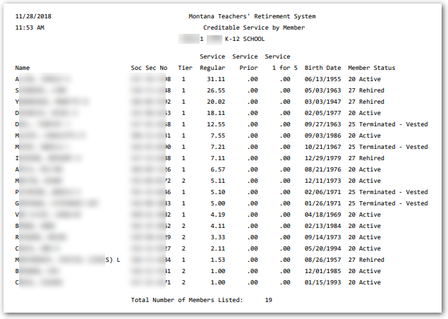
Reporting menu: Two new options
  New as of Dec. 2018:
  Creditable Service
  shows each employee’s TRS membership tier and their posted service credit to date. This can be useful for budgeting.
NEW
NEW
  Annual Contribution Summary shows the wages and contributions that your district reported to TRS for a given school year. This may be useful for auditors.

Slide 53
Reminders
Hourly vs. Full Time employees
  Use the HOURLY work status for any employee who is paid hourly – even if they work the equivalent of full-time hours in a month
  Full Time = full-time contract; Part Time = part-time contract
Hiring a TRS retiree and reporting contributions
  Warning: There are many regulations and requirements involved in hiring a TRS retiree – Please read all related Fact Sheets on the website
  Form 146 must be completed and submitted to TRS at least annually
  If retiree has been returned to Active member status, you must report
  as an Active Member, not a working retiree

trs.mt.gov

Slide 54

Deadlines
15
Wage and contribution reports must be submitted by the 15th
of the following month
Remit payments to TRS by ACH instead of check – Safer, easier, more efficient
  Form 140 to get started
JUNE reports are due by July 15; then TRS must close out the fiscal year
  Same deadline applies to “$0 contribution” reports if no wages were paid
Insurance Deduction System updates must be submitted to TRS on or before the 16th of the month prior to the month affected
  Note: Submit July 1 insurance premium changes by Friday, June 14
Make use of the TRS website!
  Forms, Fact Sheets, rates, retirement prep information, presentations
  and more
trs.mt.gov

Slide 55
Questions?

Q & A
To call TRS during normal business hours:
  Main phone number: (406) 444-3134 / toll free (866) 600-4045
  Always call with questions about termination pay, incentive plans, which positions are reportable to TRS vs. PERS, working retirees, etc.
Wage & Contribution Reporting questions:
  Nolan Brilz (406) 444-3679  Nbrilz@mt.gov
  Joyce Love (406) 444-3323  Jlove@mt.gov
trs.mt.gov

