Slide 1
Infinite Campus Reporting for MAPS Claiming
Claims are due Monthly June 10…Wait that’s today!?!

Slide 2
Do I have access to that in Campus? (You Should, so ask for it)
Login to Campus
Point of Sale
Reports
Edit Check

Slide 3
No need to print -just file it for your review
Select Summary Type: the month
Select Federal Program: NSBP (Breakfast), NSLP (Lunch), After School Snack –choose all that your school is a part of
CTRL Click to select multiple
Select Calendar: Individual School
GENERATE REPORT -save pdf to folder
Repeat for each School

Slide 4
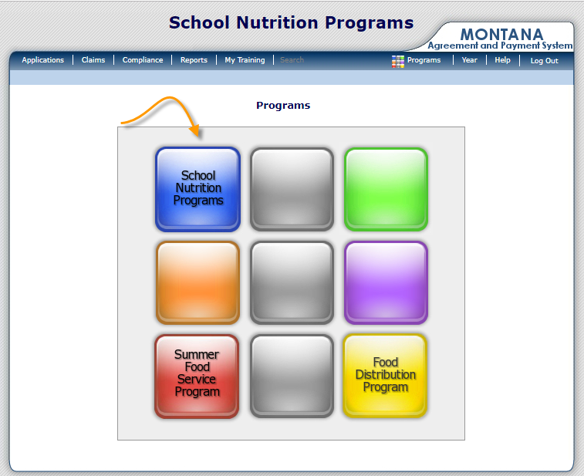
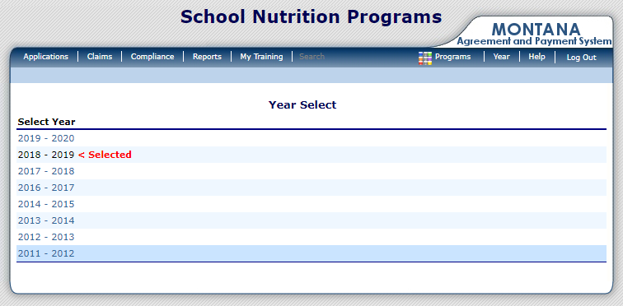
Login to MAPS
Click Claims
Current Year

Slide 5
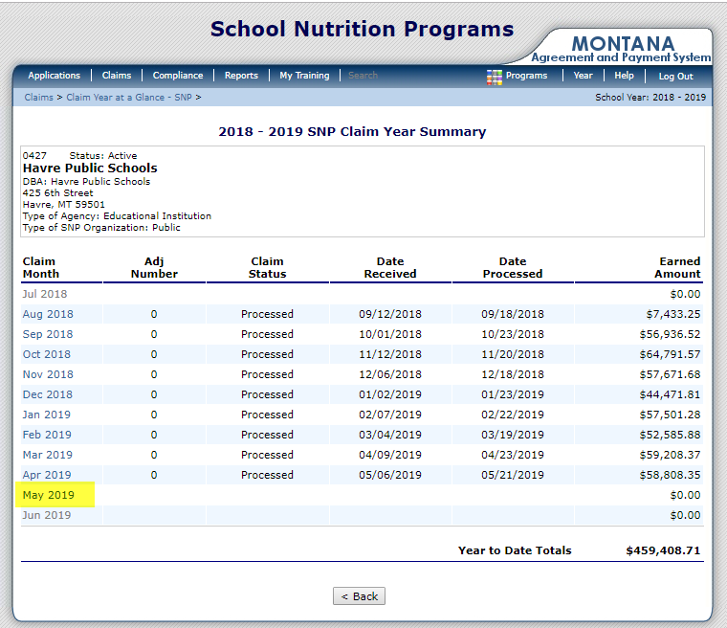
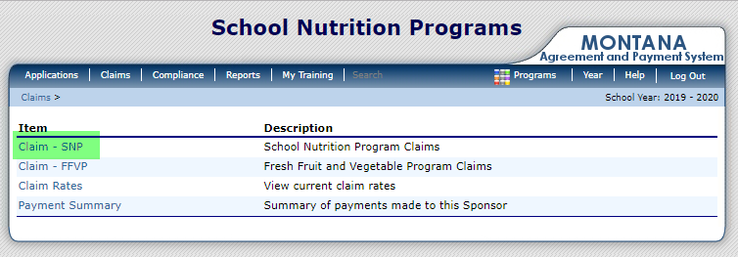
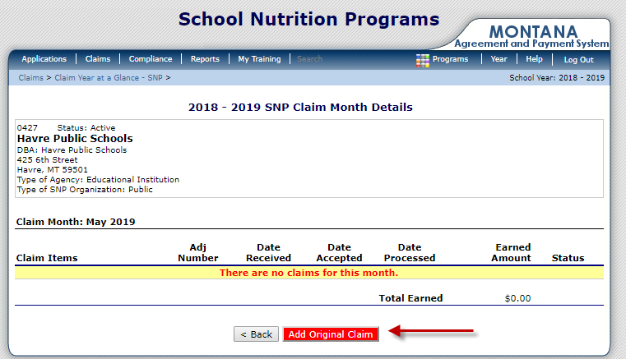
CLAIMS in MAPS
Most Common SNP (School Nutrition Program)
Select the Last Month Completed
Add Original Claim

Slide 6
Add (Select) School

Slide 7
Input information from Campus into MAPS
Infinite Campus
MAPS

Slide 8
Repeat for School Breakfast Program (if applicable)

Slide 9
Same for each school in your program
Common Errors/Warnings: Usually means you have input an incorrect amount from your Campus Report.
ERRORS –need to be fixed for submittal
Free Lunches Served cannot exceed (Number of Children Approved for Free Meals X Number Operating Days)
Number of Operating Days cannot exceed the Days of Operation calculated from the Site Application. (Includes only the days of the week checked on the site applications)
WARNINGS –do not need to be corrected for submital
Reduced Price Lunches Served equals (Number of Children Approved for Reduced Price Meals x Number Operating Days).
Number of Reduced Priced Breakfast is the same as last month

Slide 10
Examples of Errors/Warnings in MAPS

Slide 11
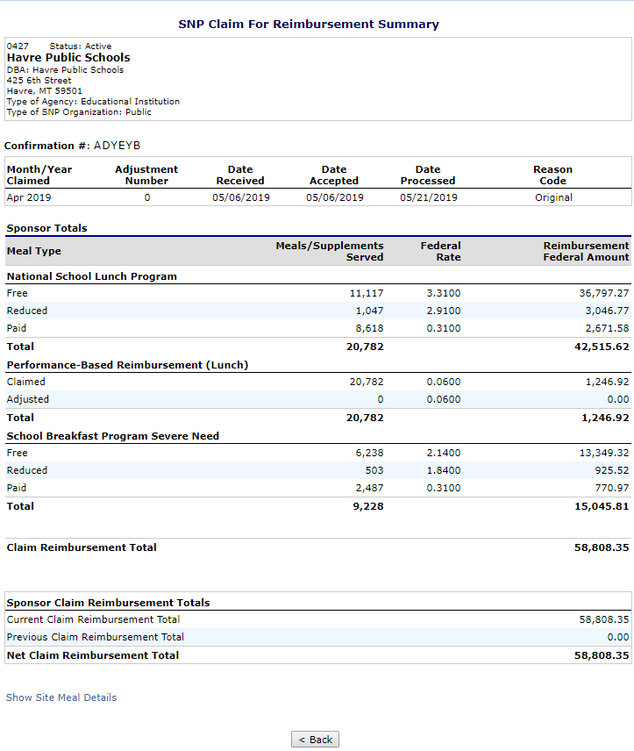
Submit & Save Summary to folder

Slide 12
Things to remember
Keep Infinite Campus Information Accurate
Daily Transaction Summary should be reviewed by Cashier/Manager
Update Eligibility in Campus on a regular basis
Claims submitted to OPI by the 10th of each month are paid around 20th of each month
OPI website https://opi.mt.gov/>Leadership>School Nutrition> Agreements, Claims, &Data for more information.

Slide 13
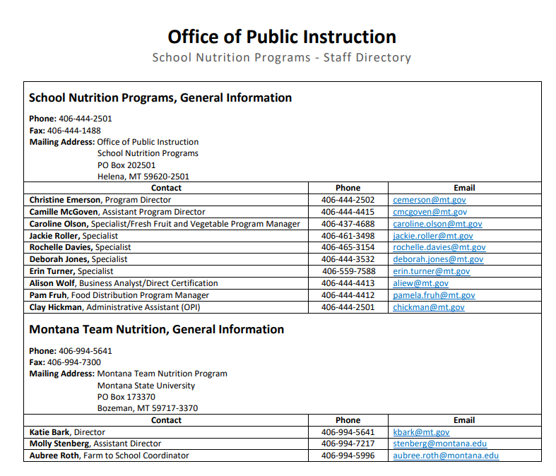
Clay Hickman is the BEST!! They all are!

Slide 14
Questions…

