Slide 1
How to survive Teacher retirement
Presented by:
Shanna Flores, Havre Schools
Jane Knudsen, Malta Schools

Slide 2
Retiree Checklist
Initial Meeting: information for teachers and forms the Clerk needs to sign…
______ 1. Form 129: Termination Pay - Irrevocable Election Form (on file)
______ 2. Ask for Resignation letter
______ 3. Form 144: Member & Employer Certification of Termination of Employment
______ 4. Form 117: Authorization for Deduction of Health Insurance form
______ 5. Form 113: Retirement Termination Pay (aka term pay calculator)
______ 6. Inform teacher of possible out-of-pocket contribution, depending on the option they choose
on Form 113

Slide 3
Forms in Retirement File (date received):
______ 1. Copy of letter from TRS – in receipt of Form 129: Term Pay – Irrevocable Election Form
______ 2. Irrevocable Resignation Form from District (retirement incentive)
______ 3. Copy of Resignation Letter
______ 4. Copy of Signed Form 144: Member & Employer Certification of Termination of Employment
______ 5. Copy of Signed Form 117: Authorization for Deduction of Health Insurance form
______ 6. Copy of Payroll change form from TRS Insurance Deductions
______ 7. Copy of Signed Form 129: Termination Pay – Irrevocable Election Form
______ 8. Letter from TRS that the teacher may have to pay termination pay difference
______ 9. Copy of Termination Pay calculation spreadsheet sent to TRS (optional)
______ 10. Term Pay Calculator from TRS website
______ 11. Copy of Form 113: Retirement Termination Pay with Term Pay Calculator on back
______ 12. Copy of District checks made payable to teacher and any checks from the teacher
______ 13. Copy of letter/documents to teacher informing them of any out of pocket expense

Slide 4
FORM 129 – Termination Pay – Irrevocable Election Form

Slide 6
The employee makes choice – not you!
Termination pay OPTION 1—the total amount of the termination pay received by the member must be used in calculating the member’s retirement benefit by ADDING the total termination pay to the compensation used to calculate the member’s average final compensation (AFC). This option provides the largest monthly benefit increase and will have the highest cost for both the member and the employer. The required employer and employee contributions will be actuarially determined. In many cases, the member’s required contributions on the termination pay will be greater than the termination pay amount.
Termination pay OPTION 2—the total amount of the termination pay received by the member must be used in calculating the member’s retirement benefit by DIVIDING the total amount of termination pay by the member’s total number of years of creditable service to determine an annual amount of termination pay. The annual amount of termination pay is added to each year of compensation used to calculate the member’s AFC. This option provides a smaller monthly benefit increase than option 1. Employer and employee contributions will be calculated based on the total statutory employer (including state supplemental) and member contribution rates then in effect.

Slide 7
TERMINATION PAY IRREVOCABLE ELECTION FORM
TRS recommends that prior to signing an election form, the employee requests an estimate of benefits or utilizes the ‘on-line benefit estimator’ located on the TRS website.
Termination pay is restricted to payments made at the time of termination and retirement.
May elect to have employee contributions deducted from termination.
Pay as a tax-deferred contribution.
This election form must be signed by employee and employer at least 90 calendar days prior to the last pupil instruction day, pupil instruction related day, or termination date.
Signing the election form is NOT a commitment to retire on a specific date.

Slide 8
TP-IEF (continued)
Your employer is required to withhold and remit TRS contributions, tax deferred.
The election is effective on the date the form is signed by you and your employer.
The election is only valid with your current employer.
If you have more than one employer reporting wages, you must sign an irrevocable election with each employer.

Slide 9
TERMINATION PAY DEFINITION Check your Collective Bargaining AGreement
Vacation pay
Sick leave
PERSONaL LEAVE
Severance pay
Early termination incentive plan (request TRS review/determination)
Other payments contingent on terminating employment

Slide 10
FORM 144
–
Member and Employer Certification of Termination of Employment

Slide 11
Form 144 certification of termination of employment (aka prearranged employment agreement)

Slide 12
FORM 117
– Authorization for Deduction of Health Insurance

Slide 13
FORM 108 – Application for Retirement Allowance
This form is included in retiree packet and is returned to TRS by the retiree.

Slide 14
Form 108 Application for retirement allowance
You will be asked for estimated termination pay.

Slide 15
Example of Estimated Term Pay to send to TRS when requested or when you know that you have teachers who are planning to retire.

Slide 16
FORM 113 – Retirement Termination Pay

Slide 17
TERMINATION PAY OPTIONS on form 113 Again: retiree chooses – not you!
If at the time of termination and retirement the employee will receive termination pay, they should have elected one of the following three options:
OPTION 1 - use the total termination pay in the calculation of the employee’s Average Final Compensation (AFC). The employee and employer shall pay the actuarially required contributions to TRS as are determined by the TRS board to fund the monthly retirement benefit increase.
OPTION 2 - divide the termination pay by the total number of years of creditable service to determine a yearly amount.
OPTION 3 - exclude the termination pay from the calculation of the AFC.

Slide 18
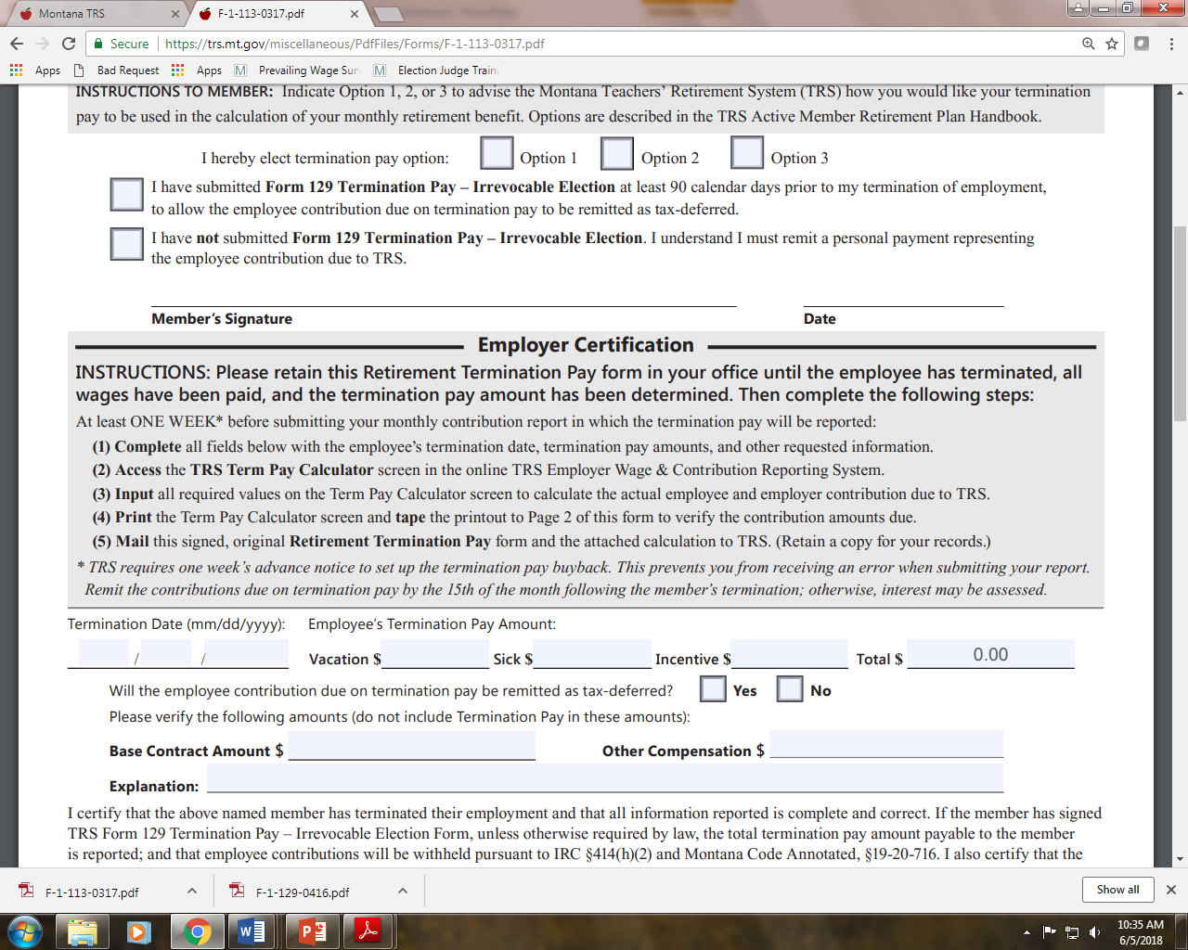
Complete this section with actual (not estimated) final termination pay
SEND ORIGINAL FORM 113 (with Term Pay Calculator on the back) TO TRS ONE WEEK PRIOR TO SUBMITTING YOUR MONTHLY REPORT

Slide 19
TERMINATION PAY – IRREVOCABLE ELECTION CALCULATION FORMULA
Termination pay amount
Less FICA/Medicare (7.65%)
Net amount (tax deferred)
Less Calculated TRS contribution
Either
A balance remaining will be paid to the employee, less the appropriate tax withholding
Or
A balance owing results in an ‘out of pocket’ expense, payable to the TRS by employee personal
check and mailed in along with FORM 113

Slide 20
TERMINATION PAY - IRREVOCABLE ELECTION CALCULATION AGE 60 - EXAMPLE
25 Years 30 Years 35 Years
Term Pay Amount $ 5,000.00 $ 5,000.00 $ 5,000.00
FICA/Medicare 7.65% ($ 382.50) ($ 382.50) ($ 382.50)
Net Amount $ 4,617.50 $ 4,617.50 $ 4,617.50
Contributions Due TRS ($ 4,200.00) ($ 5,040.00) ($ 5,880.00)
Difference $ 417.50** ($ 422.50)*** ($ 1,262.50)***
Monthly Benefit Increase $ 57.87 $ 69.44 $ 81.02
Recovery time 6 months 16 months
** Payable to EMPLOYEE, less federal and Montana state taxes.
***Out of pocket expense payable to the TRS by personal check.

Slide 21
TERMINATION PAY – IRREVOCABLE ELECTION FORM 129 NOT SIGNED
Employee is not precluded from the use of termination pay in the calculation of their average final compensation.
The employee contributions will be taxed (Fed and State).
Employer (you) must remit the net amount of the termination pay directly to employee.
Employer (you) will remit the employee contributions due to the TRS with employee’s personal check.

Slide 22
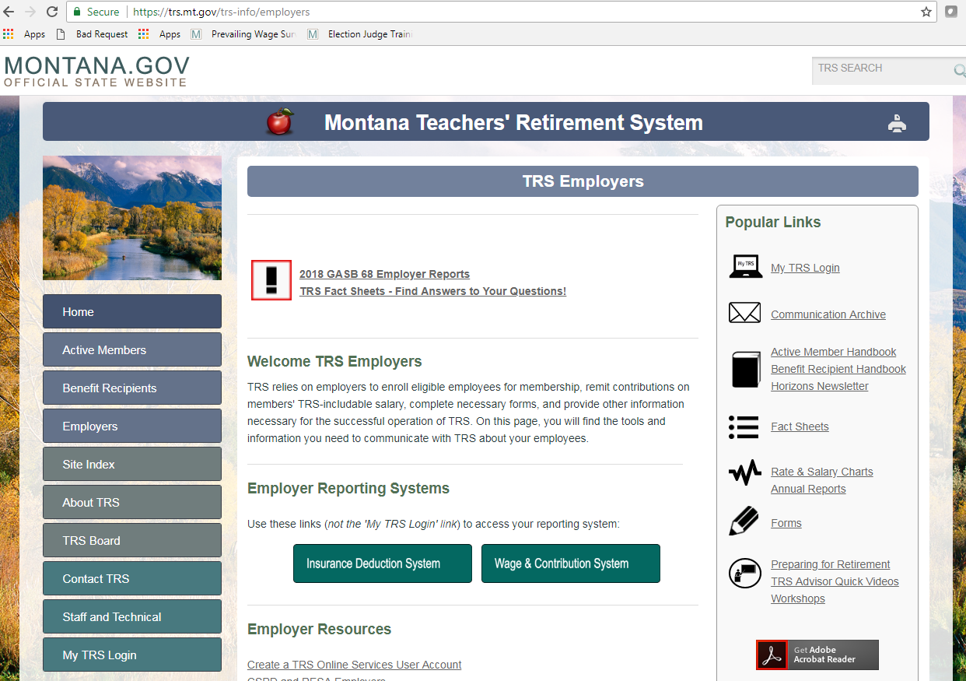
TRS Website – Employers Wage & Contribution System

Slide 23
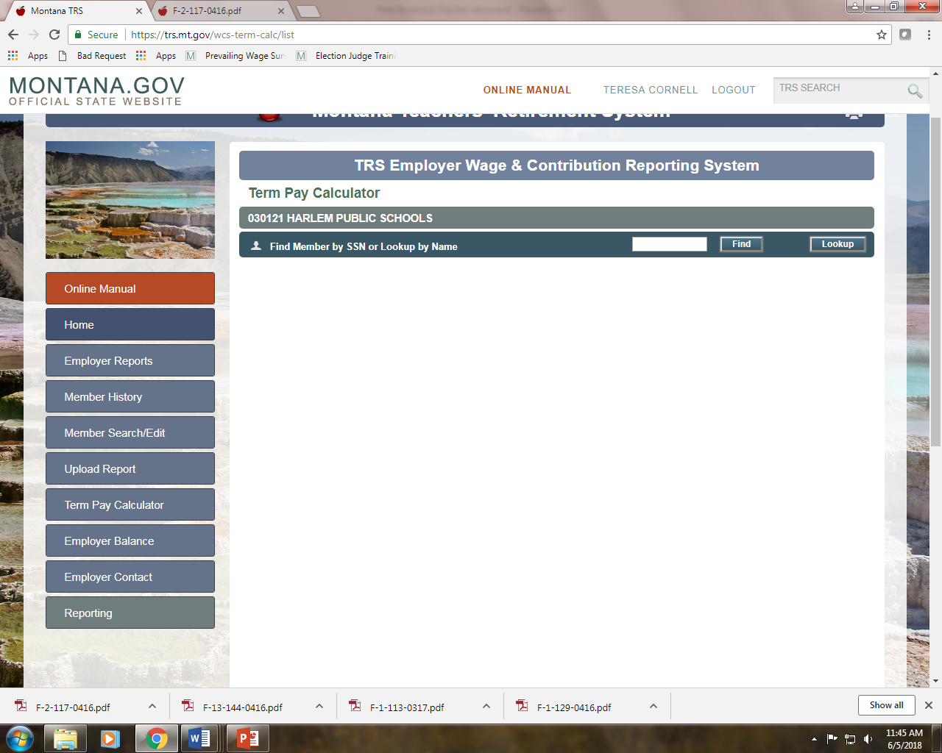
or
TRS Website – Term Pay Calculator

Slide 28
Example Letter of out-of-pocket expense to retiree

Slide 29
Example Letter with no out-of-pocket expense to retiree

Slide 30
Fund 14 – Retirement Fund
Last minute/unexpected retirements and/or retirement incentives can put the squeeze on your retirement fund balance.
Be as fiscally responsible as you can but it is okay to plan for a small cushion in your retirement fund budget.
what’s in your reserves? Don’t be afraid to use them. Make sure you have the budget authority to use – otherwise you will need a budget amendment.

Slide 31
Any questions??? Thank you for coming!!!

