Slide 1
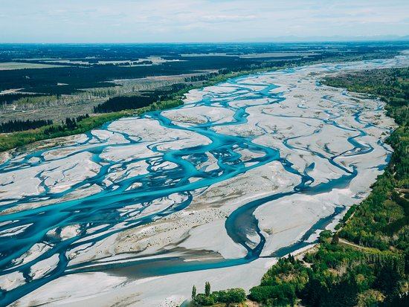
The Building Reserve Fund: A Braided River
MASBO Summer Conference 2019

Slide 2
Disclaimer
Although this presentation covers a majority of changes relating to the building reserve fund between FY 1971 and FY 2020 there are still many details that are either briefly discussed or not covered.

Slide 3
A History of the Building Reserve Fund
The building reserve fund is authorized as a special purpose fund under section 20-9-502, MCA.
The 1971 Legislative session created the first appearance of the building reserve fund.
The language of the fund was touched again in 1975, 1981, 1991, 2001, 2007, 2009, 2017, 2019.
Most significant changes were made in 2001 (SB 390), 2013(SB 348), 2017 (HB 307), 2019(SB 92)(SB 10).
3

Slide 4
2001 (SB 390)
The bill was a proposal to amend the building reserve fund to include a voted transition levy not to exceed a 6 year duration.
4

Slide 5
2013 (SB 348) & 2019 (SB 92) 20-9-236, MCA
Transfers of state or local revenue from any fund, other than the debt service fund or retirement fund, to its building reserve fund.
5

Slide 6
2013 (SB 348) & 2019 (SB 92) 20-9-236, MCA
Planning for improvements to school and student safety, including but not limited to the cost of staffing for or services provided by architects, engineers, school resource officers, counselors, and other staff or consultants assisting the district with improvements to school and student safety and security.
Programs to support school and student safety and security, including but not limited to active shooter training, threat assessments, and restorative justice.
Installing or updating locking mechanisms and ingress and egress systems at access points, including but not limited to systems for exterior egress doors and interior passageways and rooms, using contemporary technologies. Installing or updating bullet-resistant windows and barriers. Installing or updating emergency response systems using contemporary technologies.

Slide 7
2013 (SB 348) (Continued) 20-9-236, MCA
Transfers are not considered expenditures to be applied against budget authority. Any revenue transfers that are not expended or encumbered within 2 full school fiscal years after the funds are transferred must be transferred back to the originating fund.
If transfers of funds are made from any school district fund supported by a nonvoted levy, the district may not increase its nonvoted levy for the purpose of restoring the transferred funds.

Slide 8
2019 (SB 10)
Changed the taxable value used in the calculation of state support for $ per local effort, using the same TV used in all other forms of GTB. 20-9-369, MCA
Additionally, a final sentence was omitted in the bill language in SB 307 (2017) and wasn’t discovered until after the bill became law.

Slide 9
2017 (HB 307)
Split the building reserve into 4 sub-funds:
Voted Levy Sub-Fund
Transition Levy Sub-Fund
Safety Transfers Sub-Fund
Permissive Levy Sub-Fund

Slide 10
Voted Levy Sub-Fund
A voted levy may be imposed with the approval of the qualified electors of the district for the purpose of raising money for the future construction, equipping, or enlarging of school buildings, or for the purpose of purchasing land needed for school purposes in the district or funding of intercap loans.

Slide 11
Voted Levy Sub-Fund (Continued)
The trustees shall pass a resolution that specifies:
The purpose or purposes for which the new building reserve or addition to the building reserve will be used.
The duration of time over which the new building reserve or addition to the building reserve will be raised, in equal annual installments.
The total amount of money that will be raised for the duration of time specified for the levy.
A building reserve tax authorization may not be for more than 20 years.

Slide 12
Transition Levy Sub-Fund
This sub fund is used for transition costs related to opening or closing a school or replacing a school building or consolidating with or annexing to another district.
The total amount the trustees may submit to the electorate for transition costs may not exceed the number of years specified in the proposition times the greater of 5% of the district's maximum general fund budget for the current year or $250 per ANB for the current year.
The duration of the levy for transition costs may not exceed 6 years.

Slide 13
Safety Transfers Sub-Fund
A subfund in the building reserve fund must be created for the funds transferred to the building reserve fund for school safety and security pursuant to 20-9-236, MCA. See slides 5 & 6.

Slide 14
Safety Transfers Sub-Fund SB 92(2019)
A voted levy may be imposed with the approval of the qualified electors of the district to provide funding for improvements to school and student safety and security that meet any of the criteria set forth in Sections 20-9-236(1)(a) through (1)(e), MCA. See Slides 5-7.

Slide 15
Permissive Levy Sub-Fund
A subfund must be created to account for revenue and expenditures for school major maintenance and repairs.
The trustees of a district may authorize and impose a levy of no more than 10 mills for school major maintenance projects.
The amount of money raised by the levy, deposits, transfers and anticipated state aid may not exceed the district's school major maintenance amount.
"school major maintenance amount" means the sum of $15,000 and the product of $100 multiplied by the district's budgeted ANB for the prior fiscal year.

Slide 16
Permissive Levy Sub-Fund 20-9-525, MCA
First, making any repairs categorized as "safety", "damage/wear out", or "codes and standards" in the facilities condition inventory for buildings of the school district as referenced in the K-12 public schools facility condition and needs assessment final report prepared by the Montana department of administration pursuant to Section 1, Chapter 1, Special Laws of December 2005.

Slide 17
Permissive Levy Sub-Fund 20-9-525, MCA
After addressing the repairs outlined on Slide 16, any of the following:
Updating the facility condition inventory as recommended in the final report with the scope and methods of the review to be determined by the trustees, employing experts as the trustees determine necessary.
The first update must be completed by July 1, 2019, and each district shall certify the completion to the Office of Public Instruction no later than October 31, 2019.
Subsequent updates must be certified to the Office of Public Instruction no less than once every 5 years following the first certification.

Slide 18
Permissive Levy Sub-Fund 20-9-525, MCA
Undertaking projects designed to produce operational efficiencies such as utility savings, reduced future maintenance costs, improved utilization of staff, and enhanced learning environments for students, including but not limited to projects addressing:
roofing systems
heating, air-conditioning, and ventilation systems
energy-efficient window and door systems and insulation
plumbing systems; electrical systems and lighting systems
information technology infrastructure
other critical repairs to an existing school facility or facilities

Slide 19
Permissive Levy Sub-Fund 20-9-525, MCA
SB 92 (2019)
School district boards of trustees that have certified to the Office of Public Instruction a current school safety plan or emergency operations plan pursuant to 20-1-401, MCA may, prior to addressing the school facility projects, utilize the proceeds from the permissive levy authorized and any school major maintenance aid for improvements to school and student safety and security as described in §20-9-236(1), MCA. See slide 6.

Slide 20
Permissive Levy Sub-Fund (Continued)
If the imposition of 10 mills is estimated by the trustees to generate an amount less than the maximum levy revenue, the trustees may deposit additional funds from any lawfully available revenue source and may transfer additional funds from any lawfully available fund of the district to the subfund, up to the difference between the revenue estimated to be raised by the imposition of 10 mills and the maximum levy revenue.
The district's local effort for purposes of calculating its eligibility for state school major maintenance aid consists of the combined total of funds raised from the imposition of 10 mills and additional funds raised from deposits and transfers.

Slide 21
State Major Maintenance Aid 2017
2017 these words appear in HB 647 & coordinating language. 20-9-633, MCA
Beginning in fiscal year 2019, the Superintendent of Public Instruction shall annually deposit in the state major maintenance aid account:
$5.8 million in fiscal year 2019;
$6.4 million in fiscal year 2020;
$7.6 million in fiscal year 2021; and
$10 million in fiscal year 2022.

Slide 22
State Major Maintenance Aid 2017
2017 Additional state support for major maintenance with SB 260 and coordinating language.
Creation of the school facilities fund within the coal severance tax trust fund and allocating coal severance tax funds to the school major maintenance aid account.
HB 390 and coordinating language appropriated $2 million to the Office of Public Instruction for major maintenance aid starting in FY 2019.

Slide 23
State Major Maintenance Aid 2017 SS
SB 261 (2017) regular session, level 4, delayed the HB 2 appropriation until FY 2020.
HB 06 (2017 Special session) swept the state major maintenance aid account to the state general fund.

Slide 24
State Major Maintenance Aid 2019
2019 (HB 159)
Clarifies that the legislature intends funding for the natural resources K-12 facilities payment will be a general fund appropriation to support school major maintenance aid in the amounts of:
$6.4 million in FY 2020; $7.6 million in FY 2021; and $10 million in FY 2022 & FY 2023.
These amounts are to be appropriated from the state general fund reduced by the amount of projected earnings from the school facilities fund pursuant to 17-5-703, MCA for that fiscal year.

Slide 25
District Major Maintenance Aid
Major maintenance amount $15,000 + 100 per budget limit ANB we term “Box” size.

Slide 26
District Major Maintenance Aid
Major maintenance amount $15,000 + 100 per budget limit ANB we term “Box” size. Statewide ≈ $22,000,000
$22,000,000

Slide 27
District Major Maintenance Aid
Major maintenance amount $15,000 + 100 per budget limit ANB we term “Box” size. Statewide ≈ $22,000,000
Dollar of local effort ≈ Statewide $12,000,000
Local Effort
$12,000,000
$22,000,000

Slide 28
District Major Maintenance Aid
Major maintenance amount $15,000 + 100 per budget limit ANB we term “Box” size. Statewide ≈ $22,000,000
State Major Maintenance Aid
≈ Statewide $10,000,000
Dollar of local effort ≈ Statewide $12,000,000
State Aid
$10,000,000
Local Effort
$12,000,000
$22,000,000

Slide 29
District Major Maintenance Aid
Major maintenance amount $15,000 + 100 per budget limit ANB we term “Box” size. Statewide ≈ $22,000,000
State Major Maintenance Aid
≈ Statewide $10,000,000
$6,400,000
Dollar of local effort ≈ Statewide $12,000,000
State Aid
$6,400,000
Local Effort
$12,000,000
$22,000,000

Slide 30
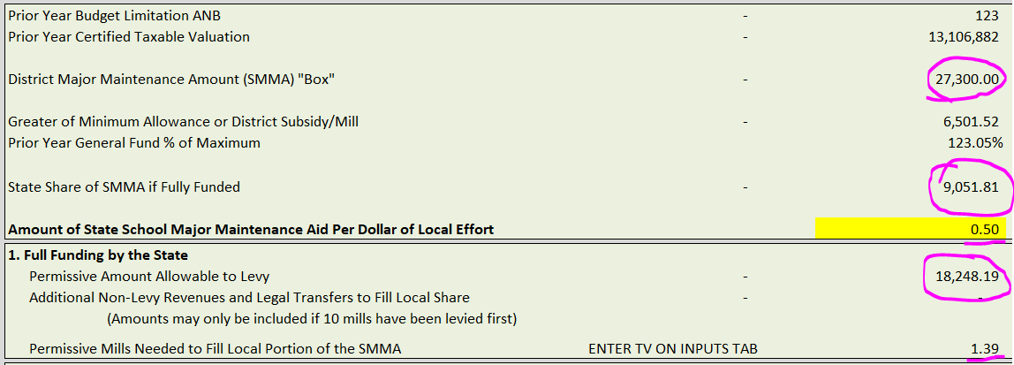
What Does This Mean for My District?
The Image below is from the general fund budget spreadsheet tab BuildReserve

Slide 31
What Does This Mean for My District?
Box = $15,000 + (ANB X 100)

Slide 32
What Does This Mean for My District?
Box = $15,000 + (ANB X 100)
All districts are guaranteed a subsidy calculated with at least 18% of their taxable value

Slide 33
What Does This Mean for My District?
Box = $15,000 + (ANB X 100)
All districts are guaranteed a subsidy calculated with at least 18% of their taxable value
Districts with PY adopted budgets 97% or greater than the PY Maximum GF Budget can receive a greater state subsidy

Slide 34
What Does This Mean for My District?
Box = $15,000 + (ANB X 100)
All districts are guaranteed a subsidy calculated with at least 18% of their taxable value
Districts with PY adopted budgets 97% or greater than the PY Maximum GF Budget can receive a greater state subsidy
District subsidy per $ of local effort (NOT ROUNDED)

Slide 35
What Does This Mean for My District?
Box = $15,000 + (ANB X 100)
All districts are guaranteed a subsidy calculated with at least 18% of their taxable value
Districts with PY adopted budgets 97% or greater than the PY Maximum GF Budget can receive a greater state subsidy
District subsidy per $ of local effort (NOT ROUNDED)
Permissive Levy Amount Not to Exceed 10 Mills

Slide 36
What Does This Mean for My District?
State Aid
$9,051.81
Local Effort
$18,248.19
$27,300,000

Slide 37
What Does This Mean for My District?
Thought 1: If statewide the program needs $10 million and the appropriation is $6.4 million what is the result?
State Aid
$9,051.81
Local Effort
$18,248.19
$27,300,000

Slide 38
What Does This Mean for My District?
Thought 1: If statewide the program needs $10 million and the appropriation is $6.4 million what is the result?
State Aid
PRORATED PAYMENT IN MAY
Local Effort
$18,248.19
$27,300,000

Slide 39
What Does This Mean for My District?
Thought 2: If the appropriation is $6.4 million but is limited to available revenue what if that is less than $6.4 million?
State Aid
PRORATED PAYMENT IN MAY
Local Effort
$18,248.19
$27,300,000

Slide 40
What Does This Mean for My District?
Thought 2: If the appropriation is $6.4 million but is limited to available revenue what if that is less than $6.4 million?
State Aid
PRORATED PAYMENT IN MAY
Local Effort
$18,248.19
$27,300,000

Slide 41
What Does This Mean for My District?
Thought 3: If the statewide program needs $10 million, will all 400 Districts use this program?
State Aid
PRORATED PAYMENT IN MAY
Local Effort
$18,248.19
$27,300,000

Slide 42
What Does This Mean for My District?
Thought 3: If the statewide program needs $10 million, will all 400 Districts use this program?
State Aid
PRORATED PAYMENT IN MAY, BASED ON AVAILABLE REVENUE
Local Effort
$18,248.19
$27,300,000

Slide 43
What Does This Mean for My District?
Thought 4: If I levied to fill the “box” in full in FY 2019 and I do the same this year, how much state $ do I get?
Local Effort
$27,300.00
$27,300,000

Slide 44
What Does This Mean for My District?
Thought 5: If I adjust my levy down to maximize the state funds received will all districts in the state do the same?
State Aid
PRORATED PAYMENT IN MAY, BASED ON AVAILABLE REVENUE
Local Effort
$18,248.19
$27,300,000

Slide 45
What Does This Mean for My District?
Thought 5: If I adjust my levy down to maximize the state funds received will all districts in the state do the same?
State Aid
PRORATED PAYMENT IN MAY, BASED ON AVAILABLE REVENUE
Local Effort
$18,248.19
$27,300,000

Slide 46
What Does This Mean for My District?
Thought 6: What if there is extra revenue left after the total SMMA distribution and total available state revenue is known?
State Aid
PRORATED PAYMENT IN MAY, BASED ON AVAILABLE REVENUE
Local Effort
$18,248.19
$27,300,000

Slide 47
What Does This Mean for My District?
Thought 6: What if there is extra revenue left after the total SMMA distribution and total available state revenue is known?
State Aid
PRORATED PAYMENT IN MAY, BASED ON AVAILABLE REVENUE
Local Effort
$18,248.19
$27,300,000

Slide 48
What Does This Mean for My District?
Thought 6: What if there is extra revenue left after the total SMMA distribution and total available state revenue is known?
State General Appropriation HB2
Coal Sub Trust as per SB260(2017) Termed the School Facilities Fund
Transfer from GF (Clarified in HB159(2019) through HB647(2017))
Transfer from School Facilities (HB390(2017) through SB260(2017))
School Facilities and Technology Account 20-9-516 Receives revenue from: Riverbed rents & Timber
Transfer from School Facilities (HB390(2017) through SB260(2017))
Major Maintenance Aid Account $6.4 Million Appropriated FY 2020
Mutual Spillover
HB647(2017) HB2(2019)
Technology Payment to Schools $1 M comes back in 2020
Debt Service Assistance (DS GTB)
Appropriated $4 Million
SB 307 Major Maintenance Aid Payment to Schools

Slide 49
What Does This Mean for My District?
Thought 6: What if there is extra revenue left after the total SMMA distribution and total available state revenue is known?
State General Appropriation HB2
Coal Sub Trust as per SB260(2017) Termed the School Facilities Fund
Transfer from GF (Clarified in HB159(2019) through HB647(2017))
Transfer from School Facilities (HB390(2017) through SB260(2017))
School Facilities and Technology Account 20-9-516 Receives revenue from: Riverbed rents & Timber
Transfer from School Facilities (HB390(2017) through SB260(2017))
Major Maintenance Aid Account $6.4 Million Appropriated FY 2020
Mutual Spillover
HB647(2017) HB2(2019)
Technology Payment to Schools $1 M comes back in 2020
Debt Service Assistance (DS GTB)
Appropriated $4 Million
SB 307 Major Maintenance Aid Payment to Schools

Slide 50
Facts and Stuff
District Subsidy per local $ of effort ranges between $0.14 and $4
In FY 2019, 196 of the 401 operating LE’s in the state permissively levied to the permissive sub-fund of the building reserve fund.

Slide 51
Facts and Stuff
Only including the districts who levied in FY 2019:
196 LEs Summed SMMA Box = $15,664,100 196 LEs Total Levied = $13,560,467 or 86.6% of “Box”
Statewide from Slide 27: $12 million/$22 million box or 54.5%
State would have paid out
104 LEs filled the “box” completely $0.00
80 districts partially filled the box with a space for state aid if available $1,398,016 to fill the box.
12 districts under-levied the box to a point that would not fill the box $705,617 totaling a loss of state distribution

Slide 52
Resources
The General Fund Budget Worksheet
http://opi.mt.gov/LinkClick.aspx?fileticket=YtwsnATKkPo%3d&portalid=182
Paul Taylor (OPI) 406-444-1257 or ptaylor2@mt.gov

