Slide 1

Please come back to GEMS, there are loads of new tools!
Robin Clausen
Stakeholder Liaison and Research Analyst
Montana Office of Public Instruction
2019 MASBO Technology Workshops

Slide 2


Slide 3
What first steps do researchers take in a study?
They come to research with a question, sometimes ill defined, that defines the scope of the investigations and what data is needed.
It helps, as a second step, to understand the data available to you.
  GEMS is a frequently used data source for district users and the general public.
  School level and Student level data is provided to OPI by schools. GEMS provides that data back to schools in a way that helps you better understand the data available to you.
To get secure access to student level data (district users), email Robin Clausen @ robin.clausen@mt.gov.
If you already have secure access feel free to follow along on your laptop or tablet. https://gems.opi.mt.gov.

Slide 4
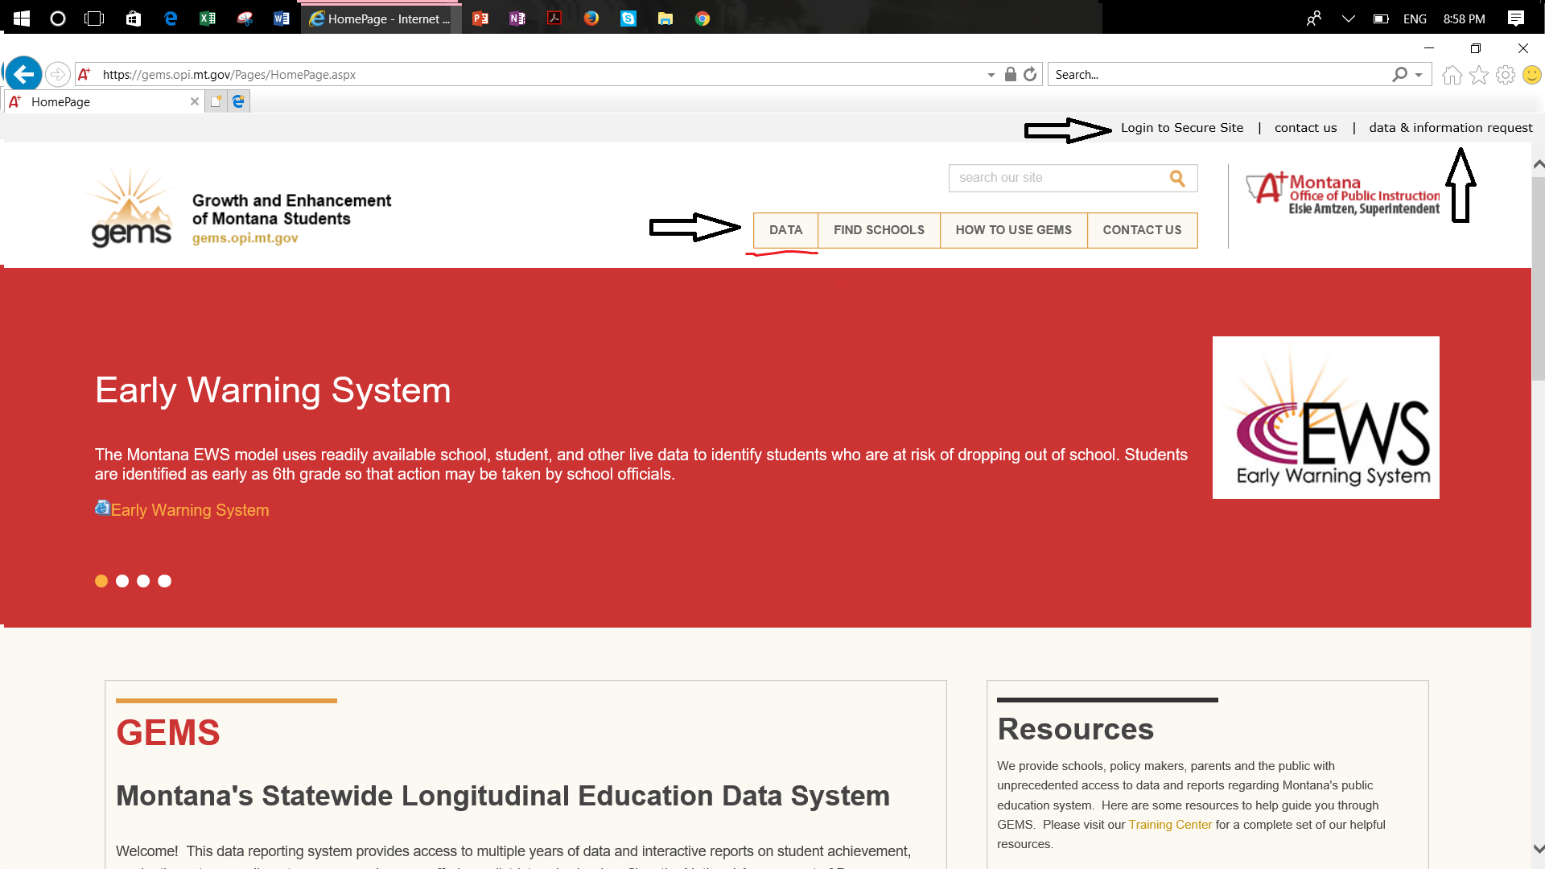
This is the main menu. Select Data to get to each domain’s overview page. Select Find Schools for school profile and comparison tool.

Slide 5
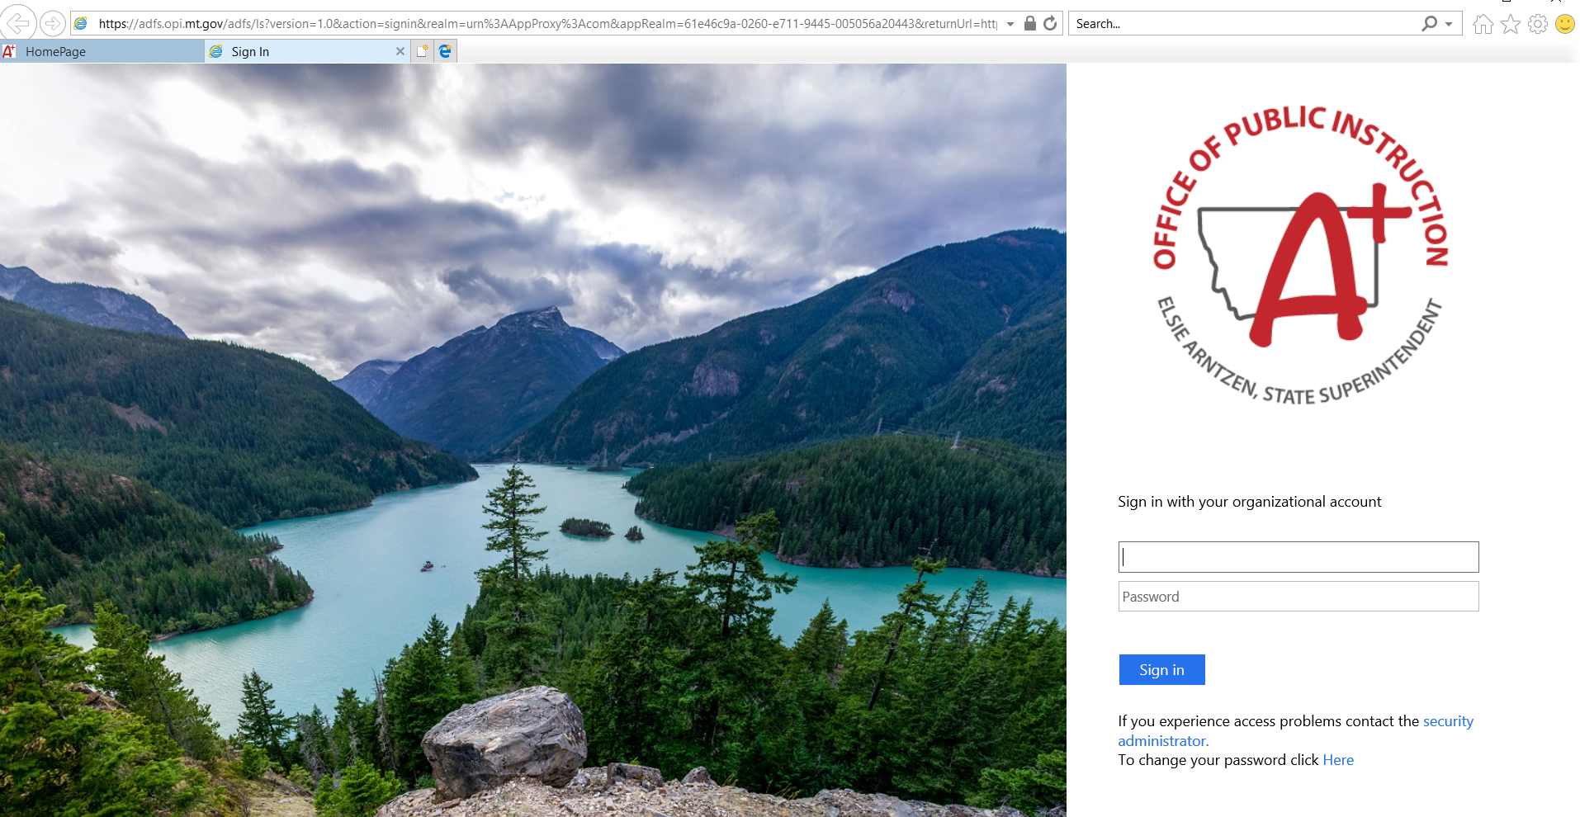
X
x

Slide 6
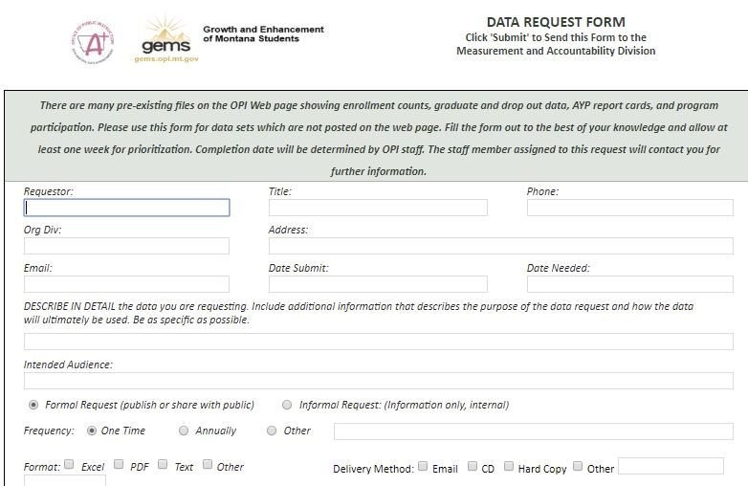

Slide 7
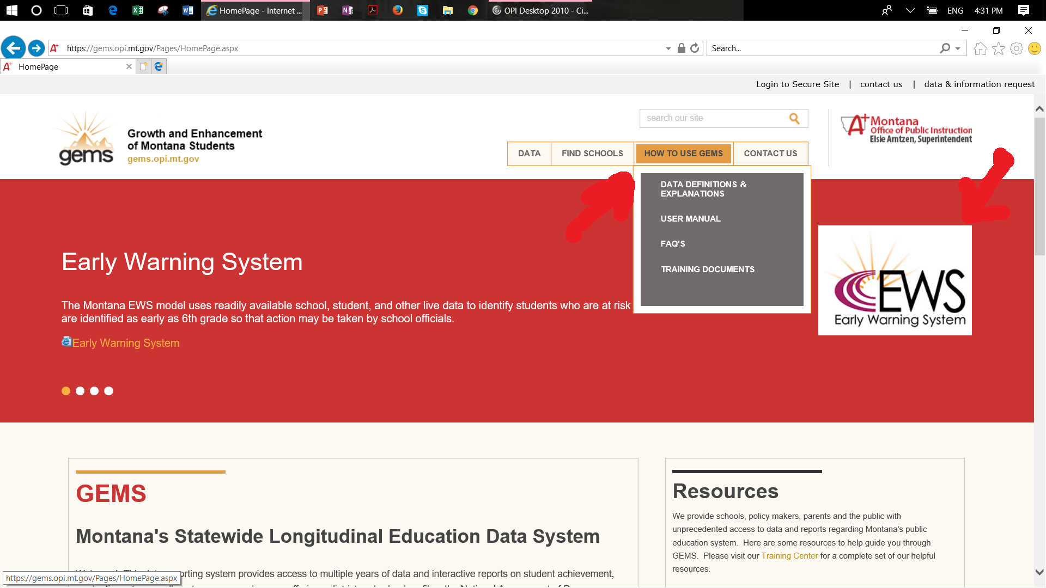

Slide 8
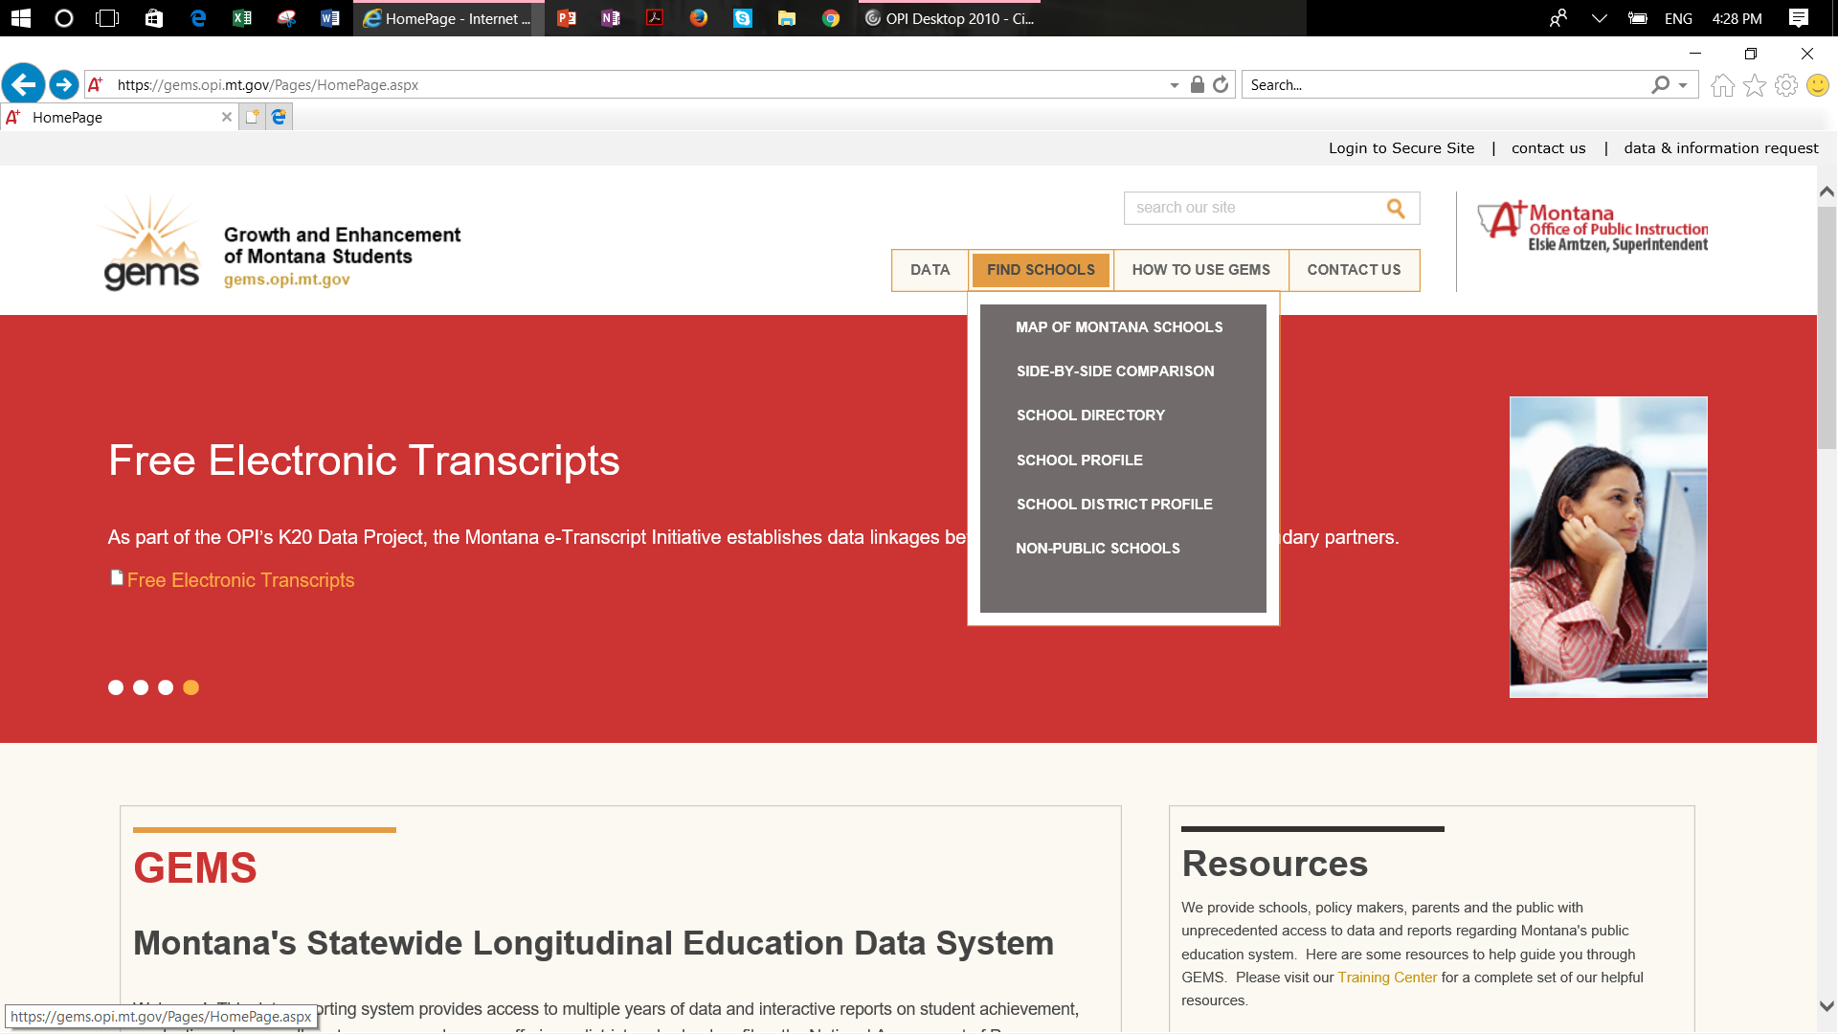

Slide 9
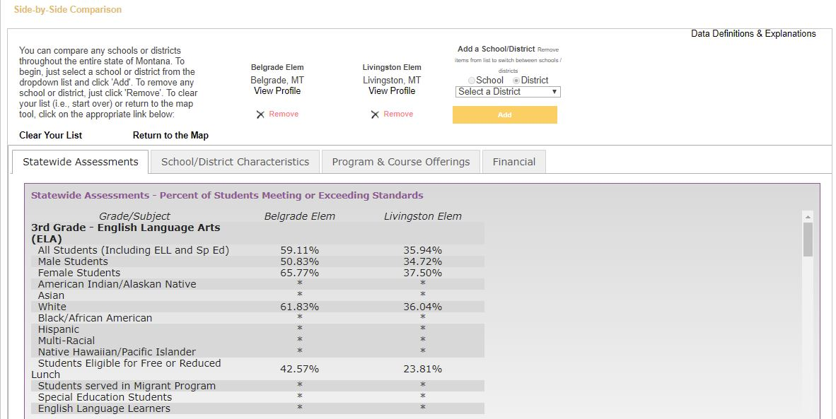

Slide 10
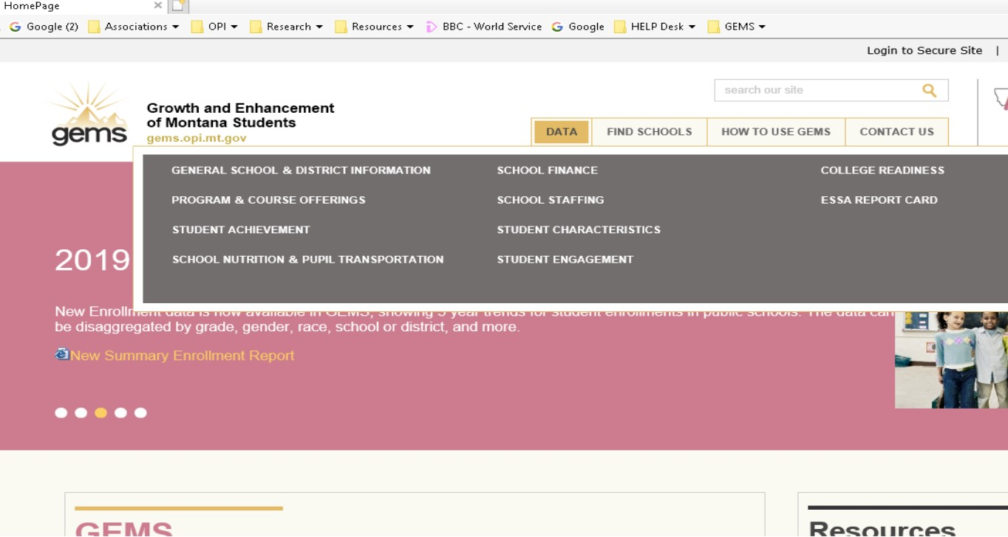

Slide 11
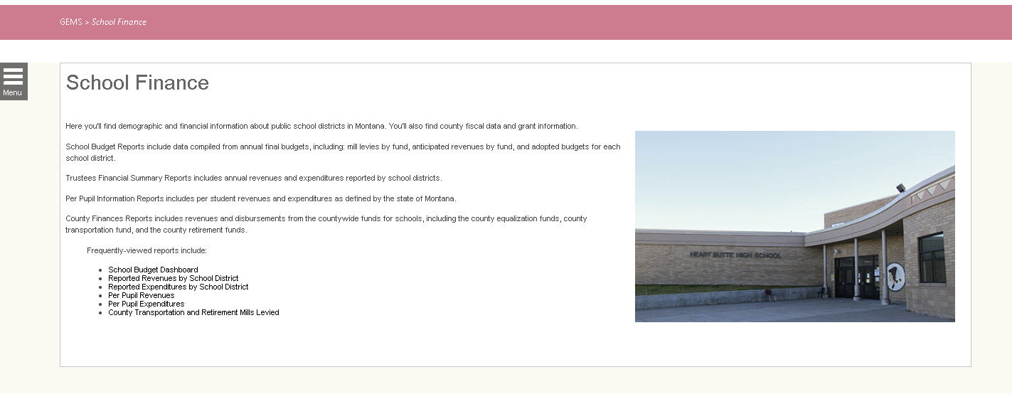
This is the data menu. By selecting the icon you will be given a list of available datasets in the School Finance Domain.

Slide 12
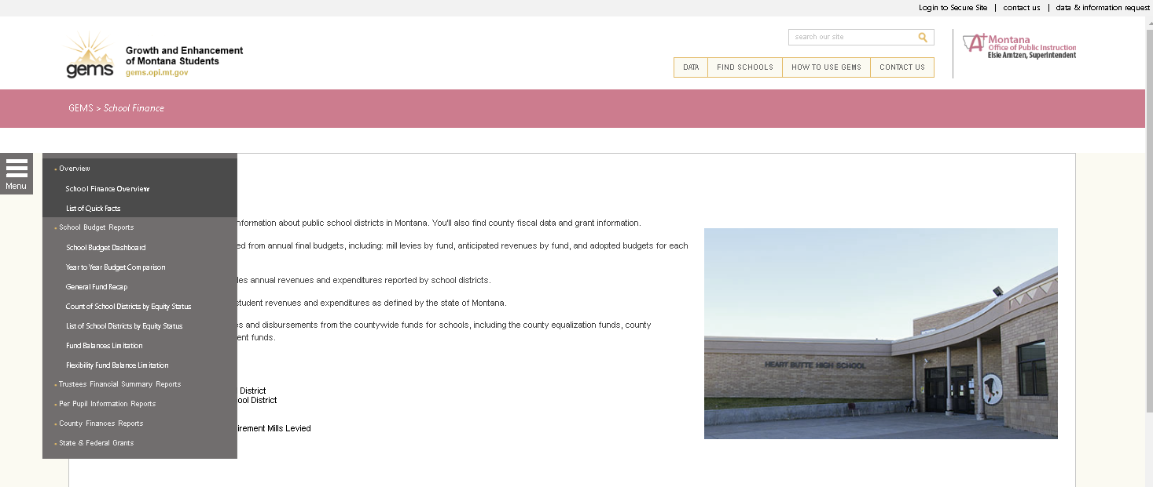
Right – Click On Graph

Slide 13
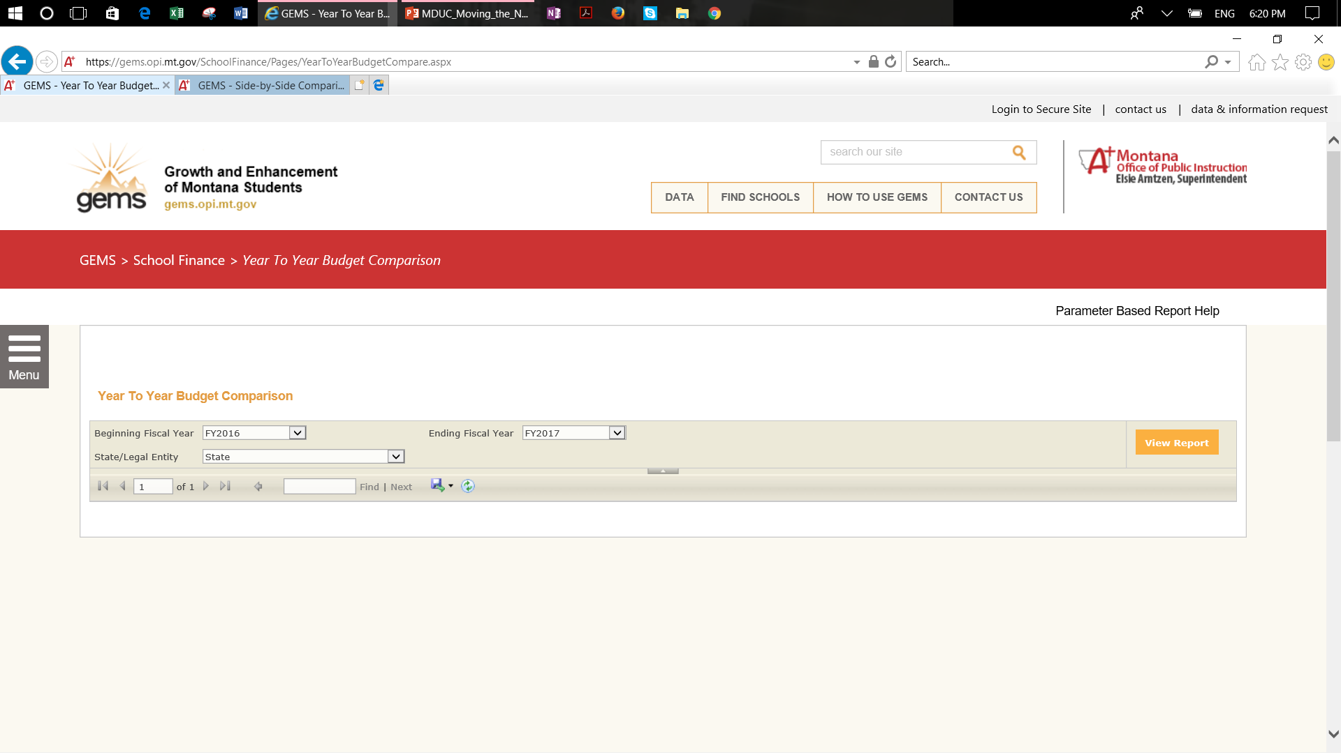
This is the page counter. It helps give you an idea of the size of the dataset.
After selecting the parameters you must press run for the data to display. This applies to each time you select a parameter.
This is the save icon – it looks like a floppy disk. This allows you to save the dataset to pdf, csv, Excel.

Slide 14
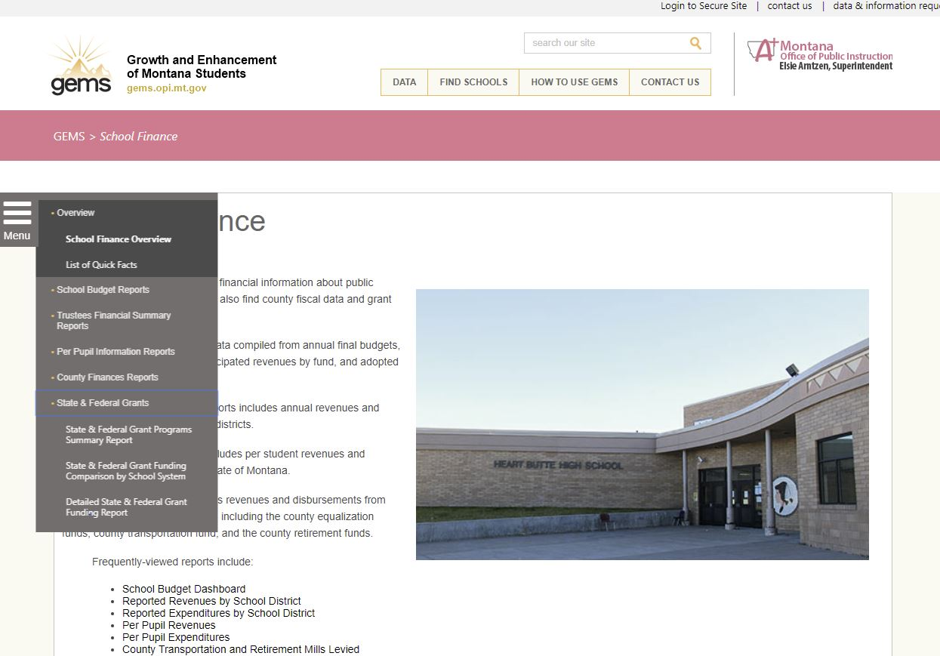

Slide 15
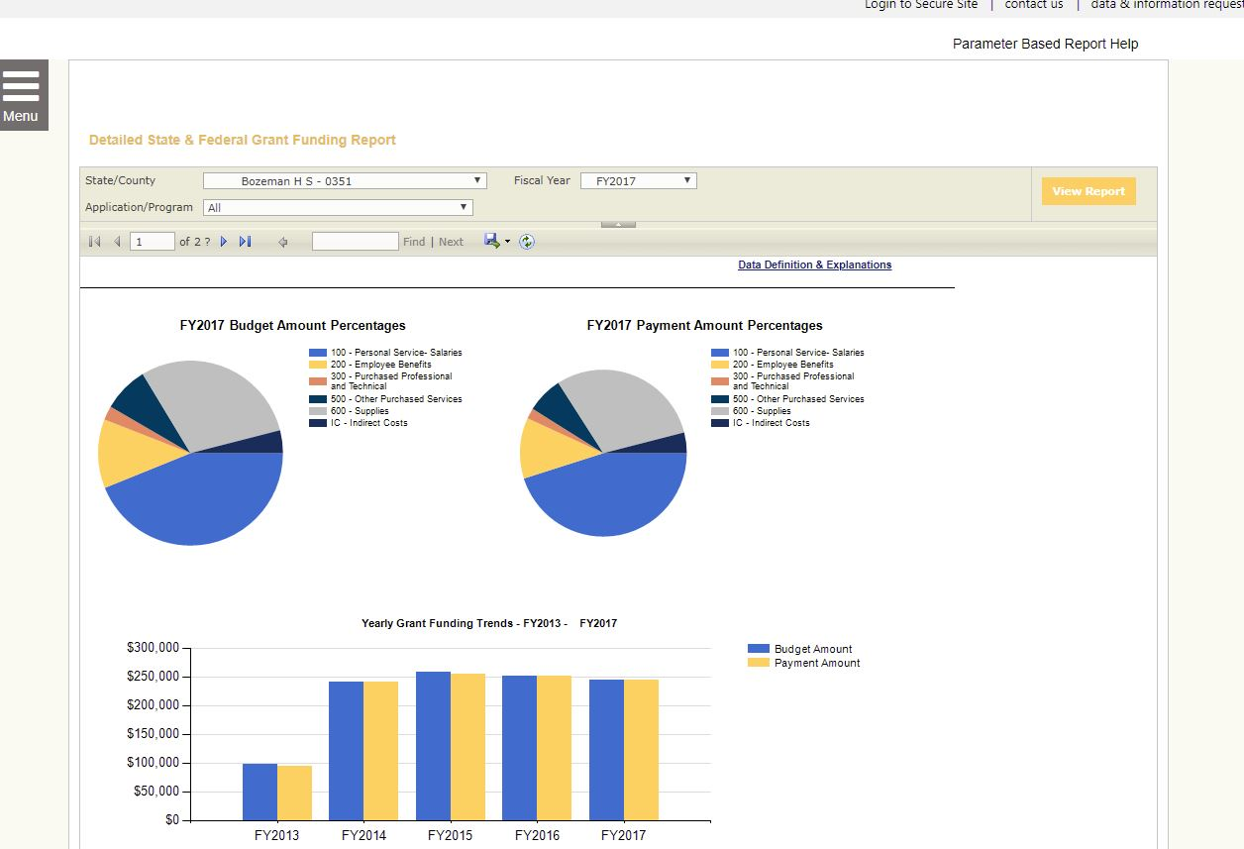

Slide 16
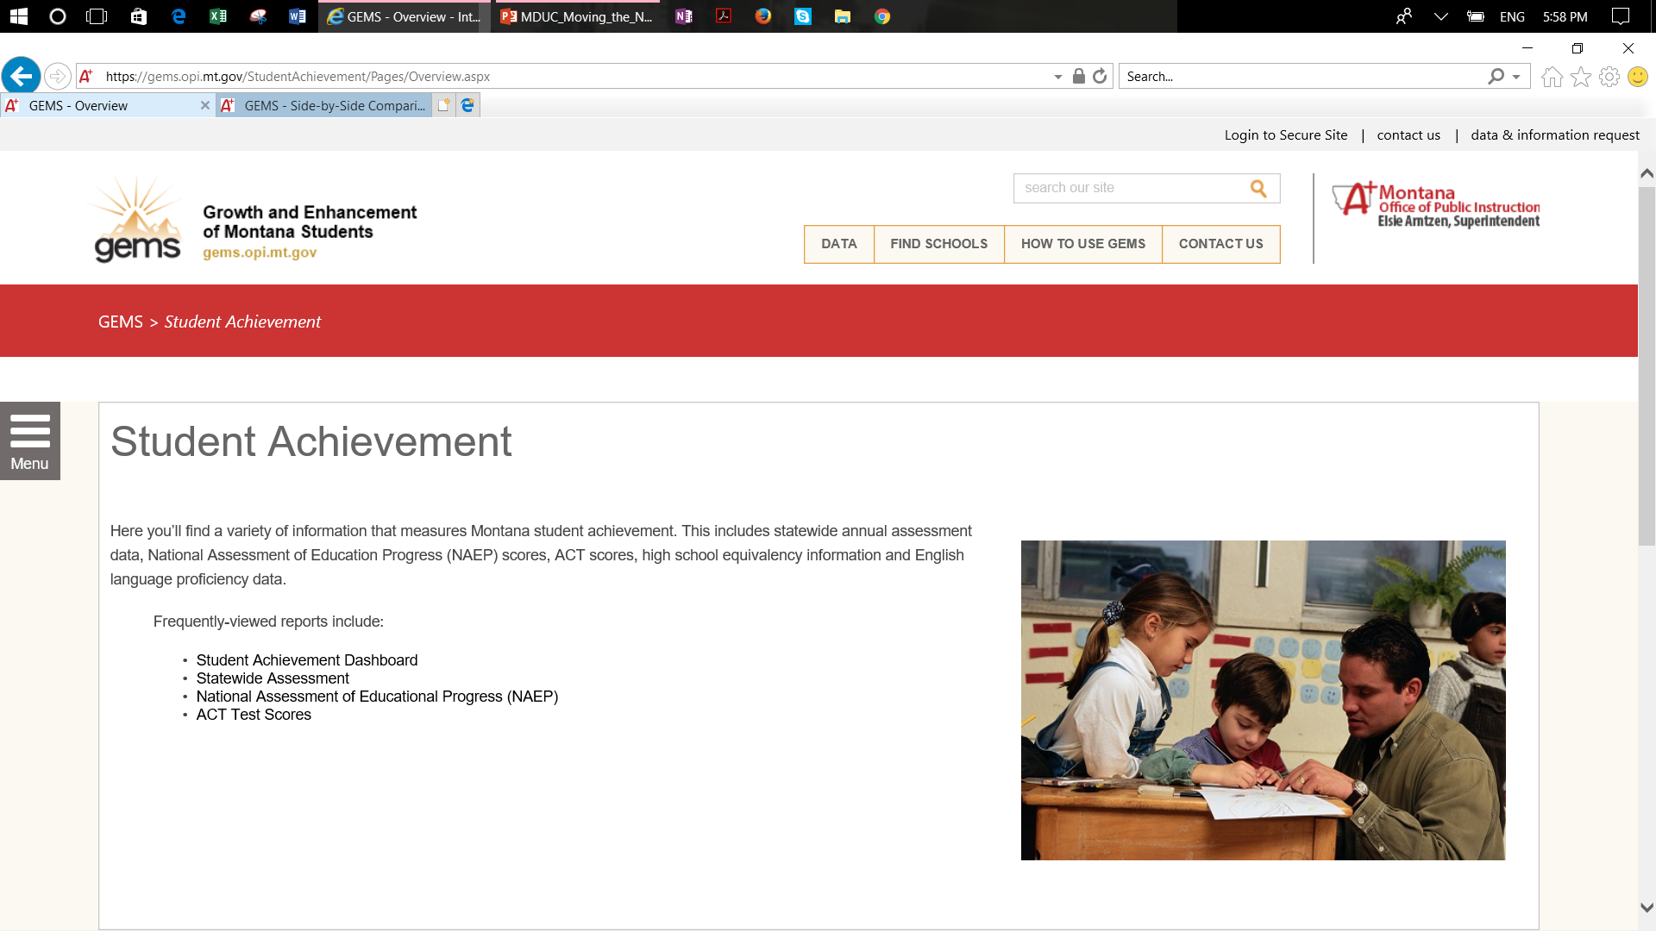

Slide 17
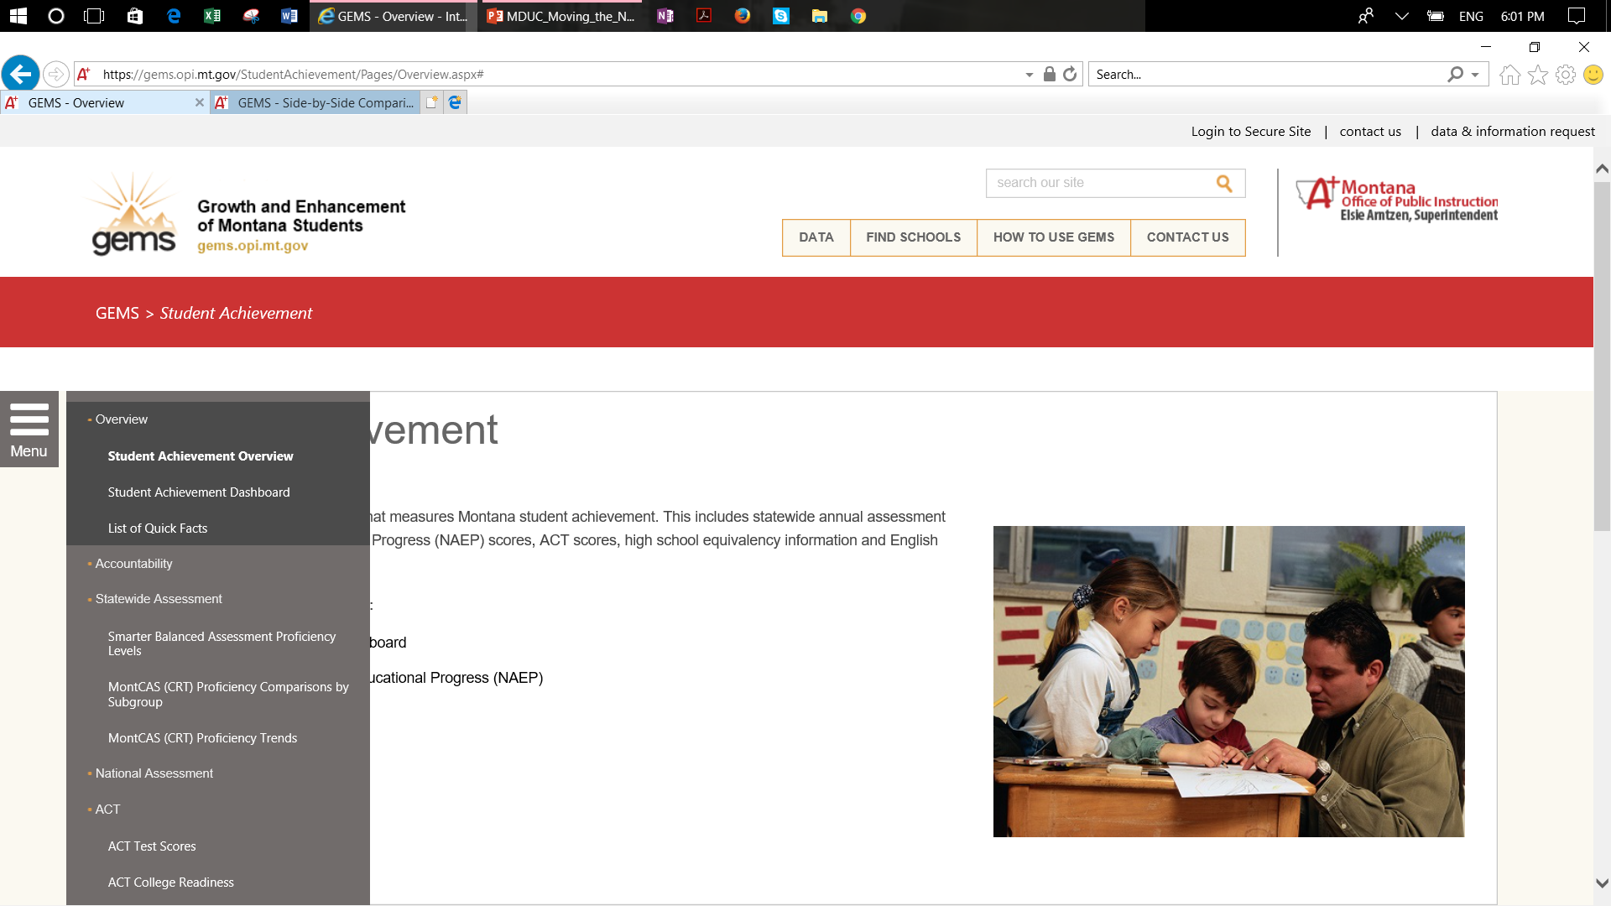

Slide 18
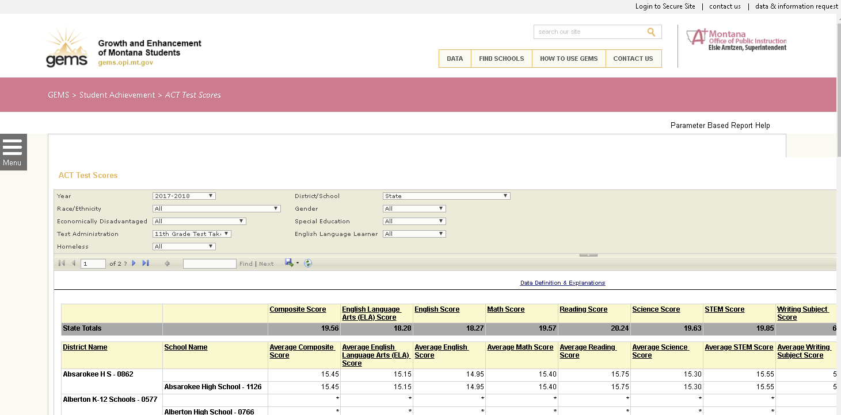
Economic Disadvantage contains data on free and reduced lunch
An asterisk signifies that student data is masked for privacy reasons (< 10 cell count). Data is not masked on secure GEMS.

Slide 19
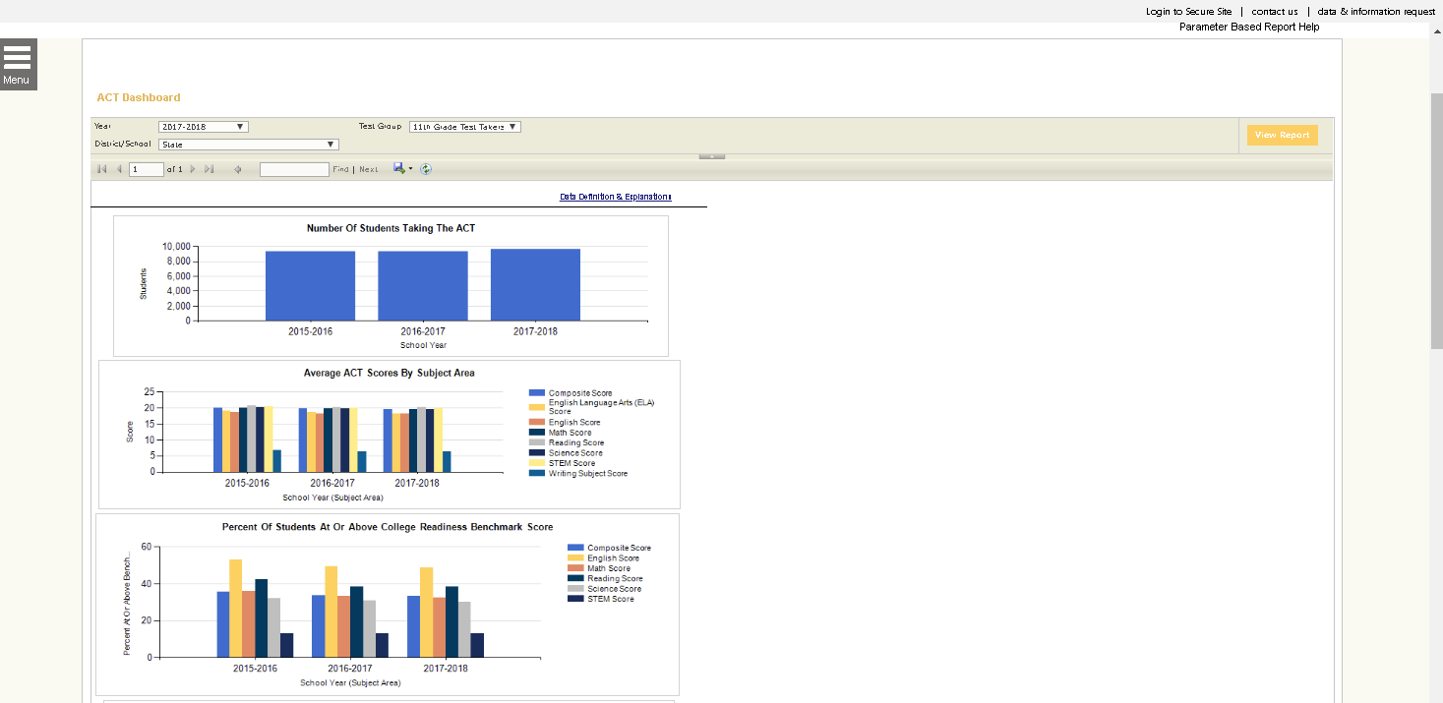

Right Click on Tiny Box

Slide 20
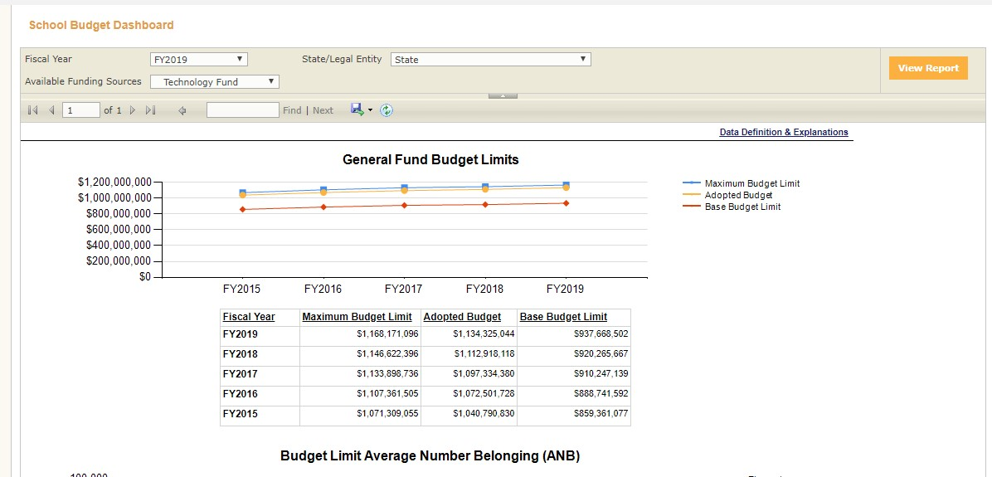

Slide 21
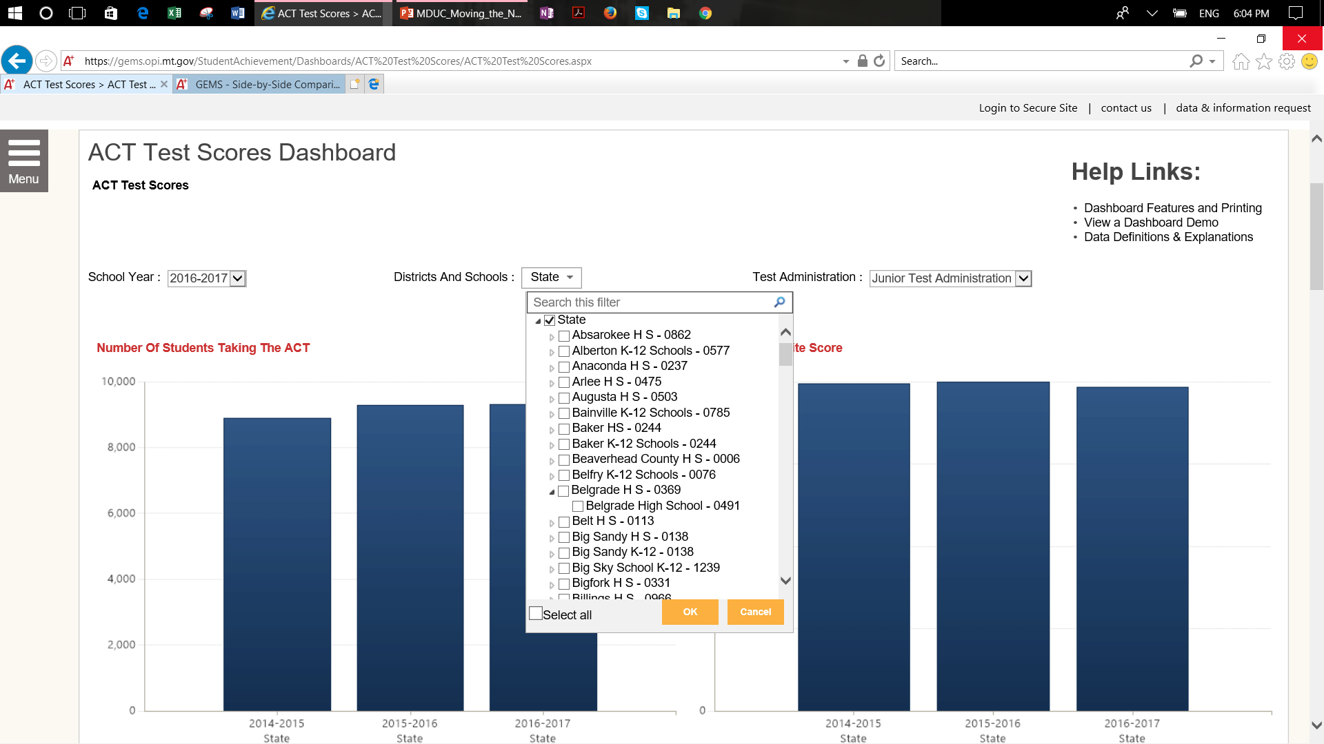
Criteria Selection for Menu Below is by LE (LEA) and School. The number for each are the LE Number and School Code.

Slide 22
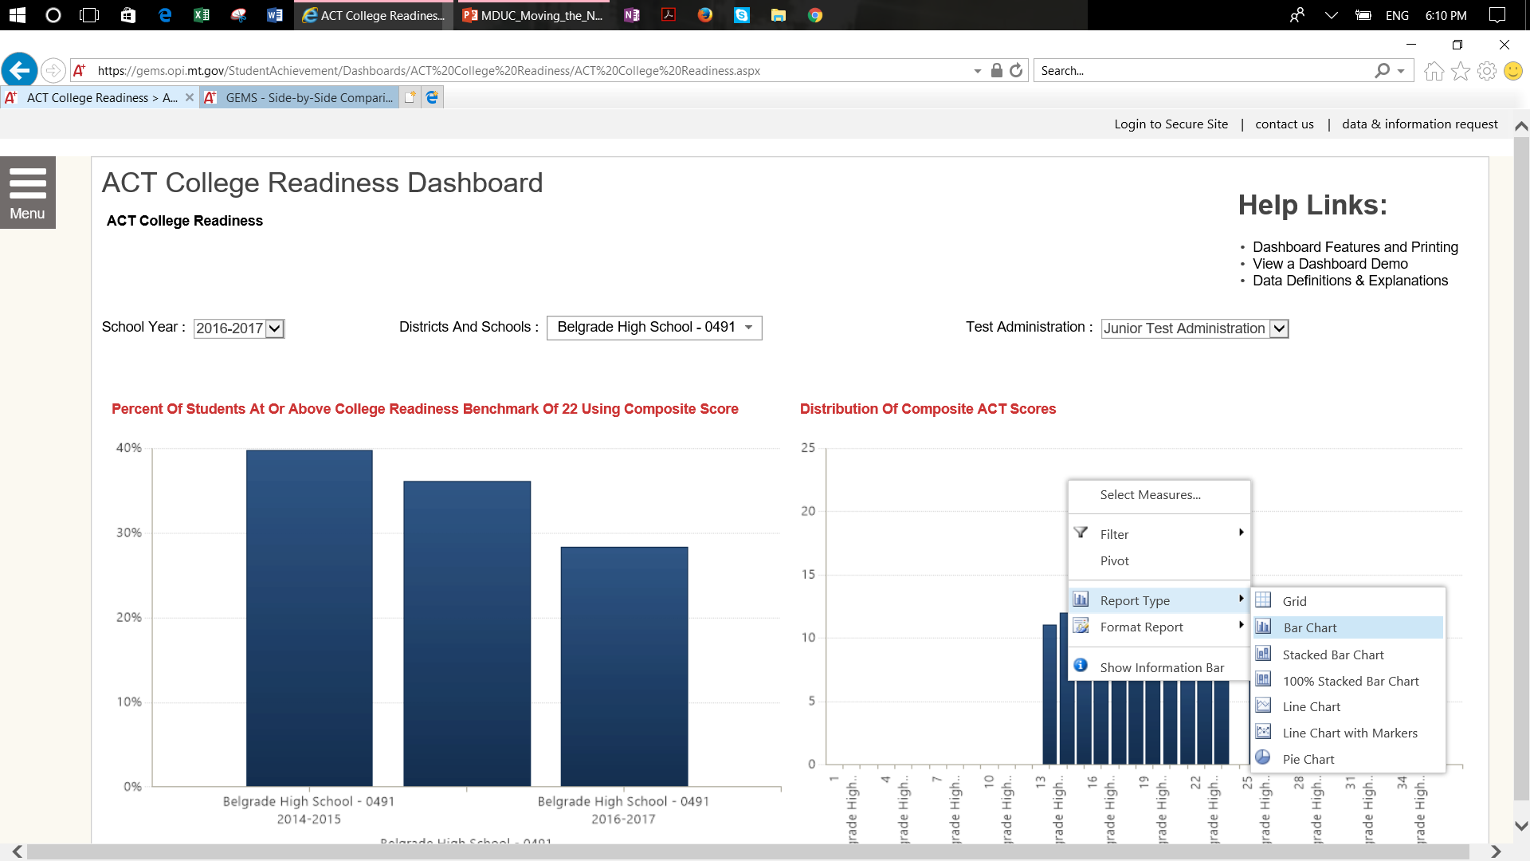
Right – Click On Graph

Slide 23
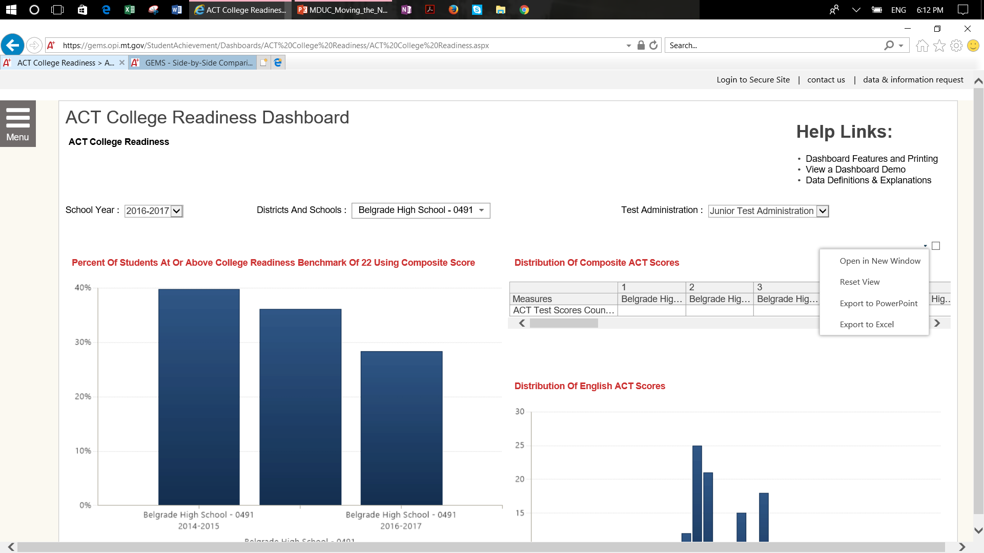
Right Click on Tiny Box

Slide 24
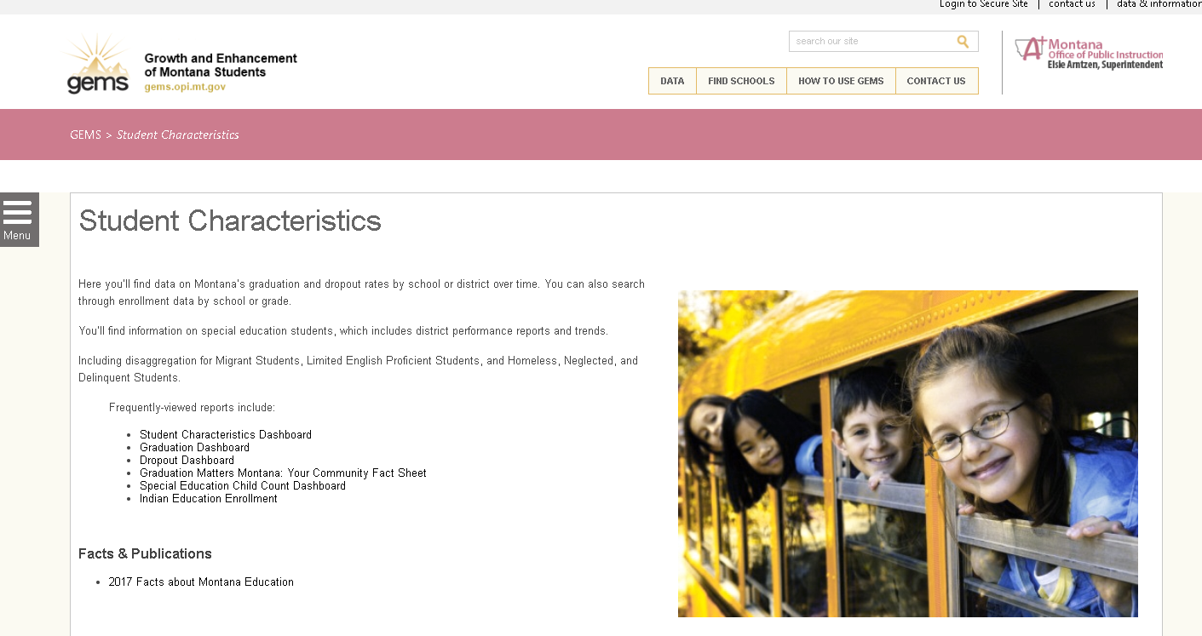

Slide 25
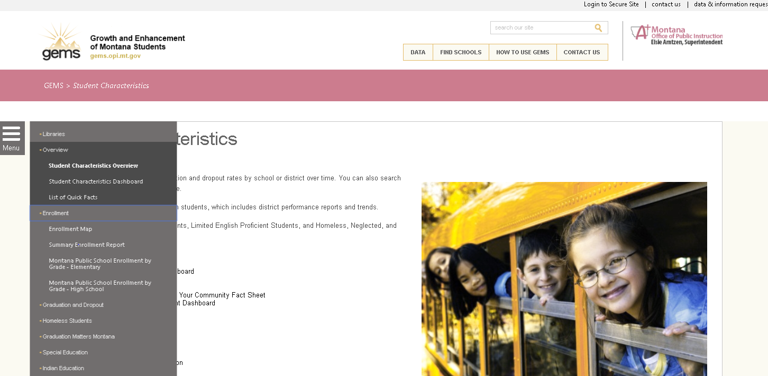

Slide 26
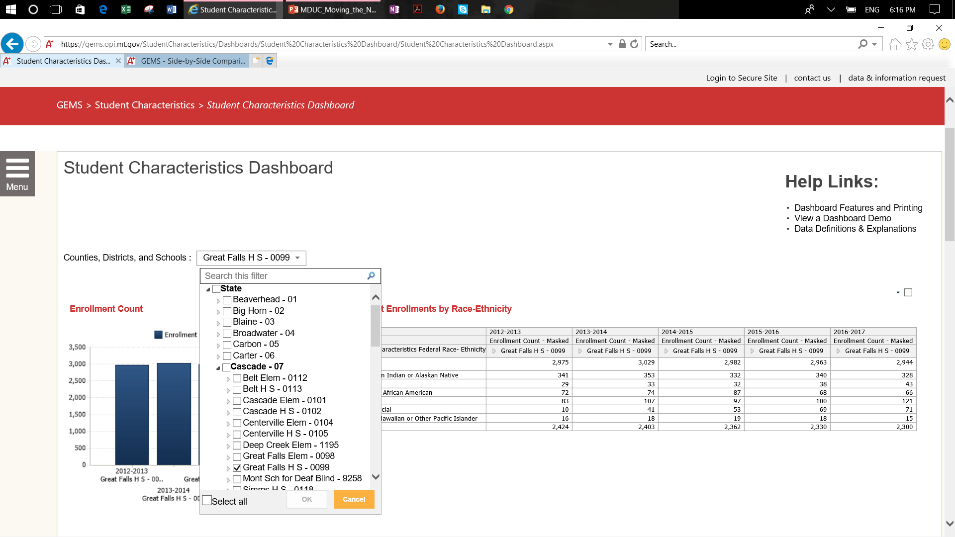

Slide 27
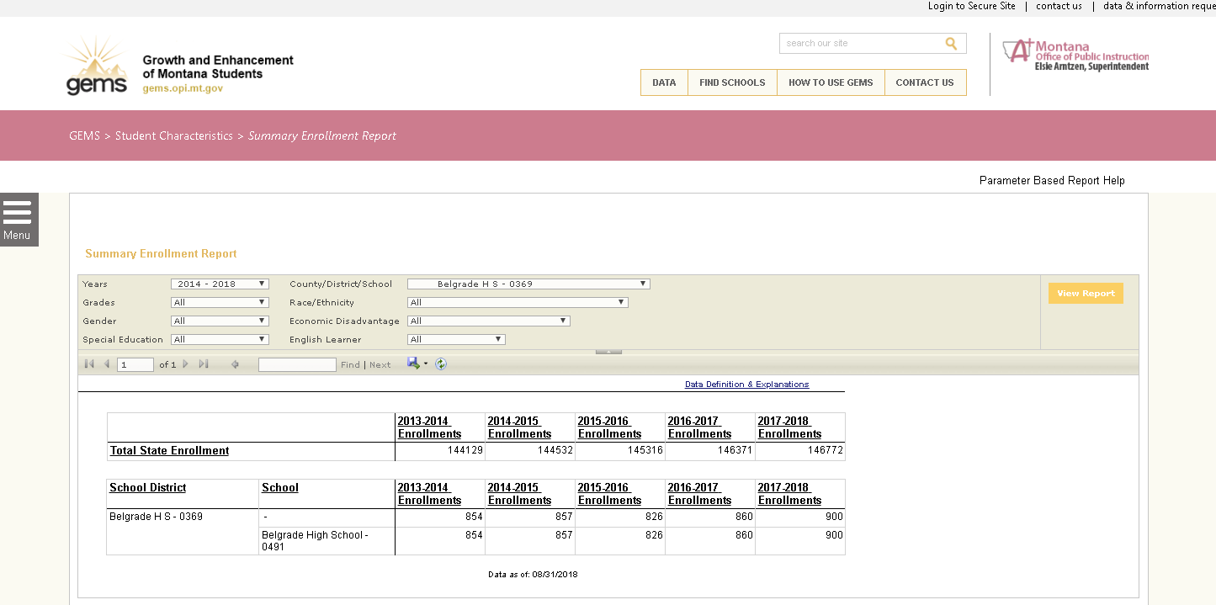

Slide 28
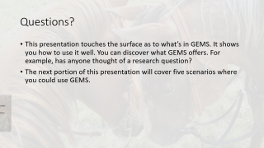

Questions?
This presentation touches the surface as to what’s in GEMS. It shows you how to use it well. You can discover what GEMS offers. For example, has anyone thought of a research question?
The next portion of this presentation will cover five scenarios where you could use GEMS.

Slide 29
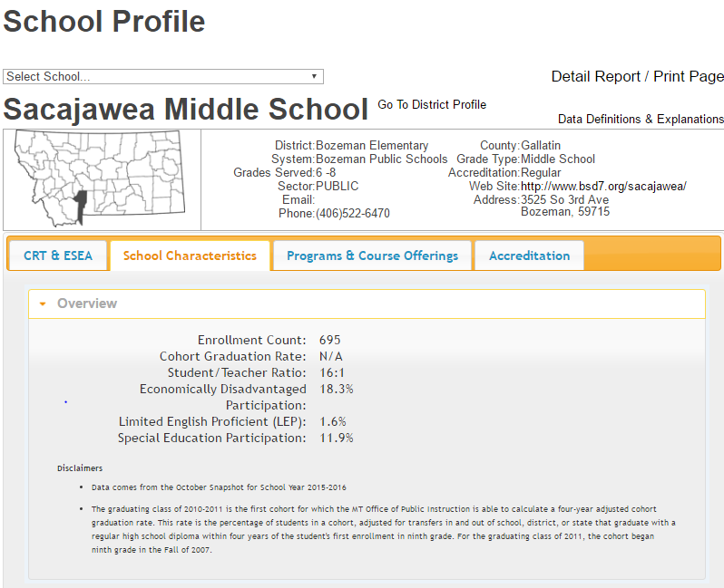
Before you visit, click it!
Know more about the schools you visit and compare them to others.

Slide 30
Lesson: before you visit, click it!
You are teaching in Bozeman High School. Bozeman has a playoff Basketball game with Butte, another AA team. With your class compare the two schools on the basis of the GEMS school profile.
  Which one is the richest/poorest district (most/least % of students in poverty)?
  Which school has the best graduation rate?
  How many students are in each school?
What other data points would you like to see on a school profile?

Slide 31
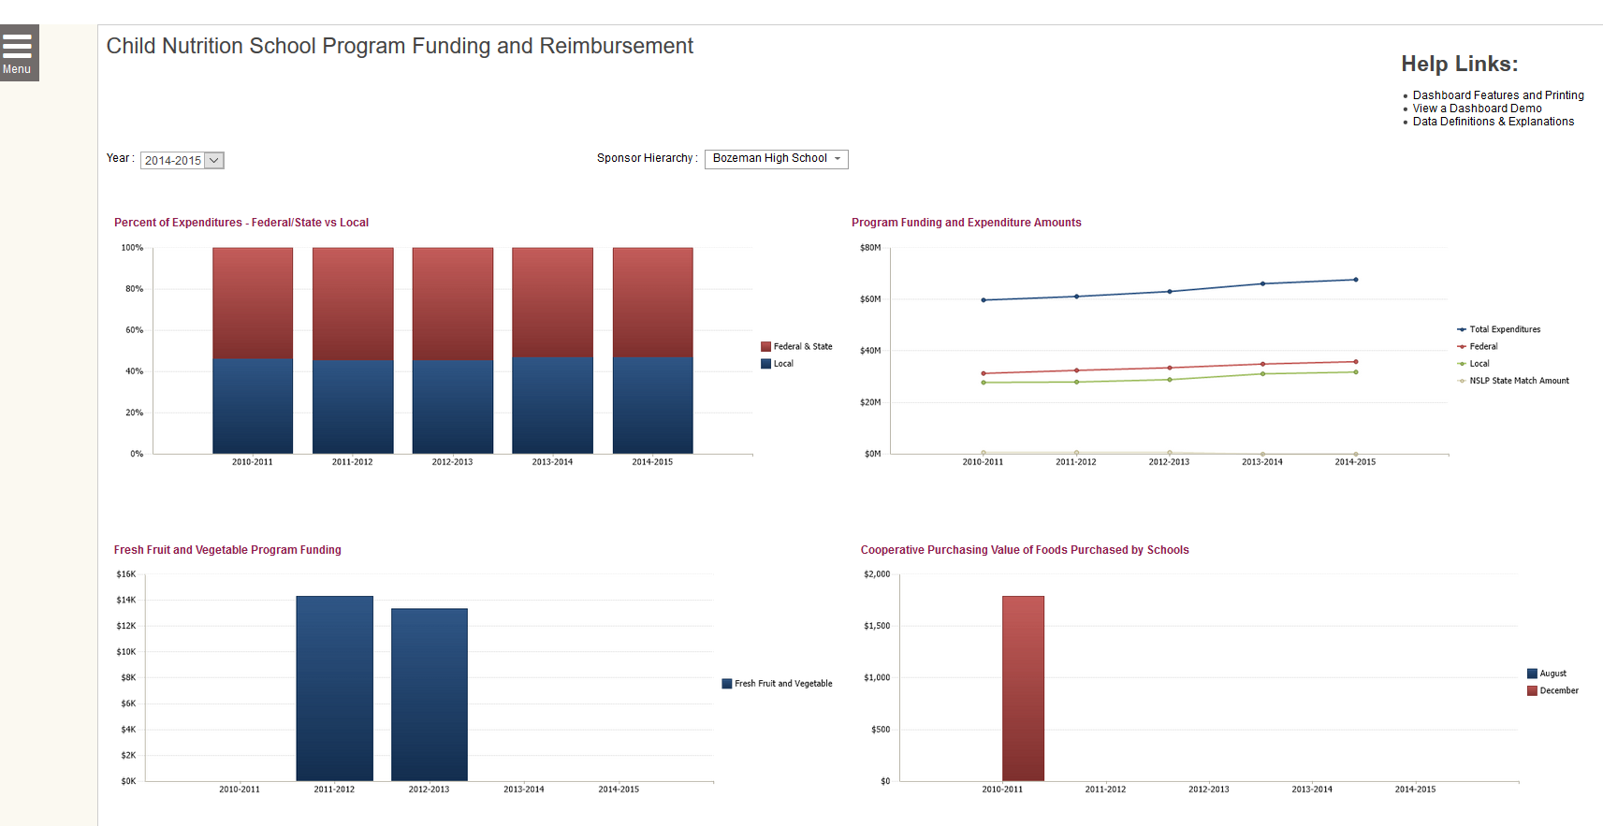
Child nutrition is one of the largest line items in a school district’s budget. How much do the schools you visit spend in comparison to state/federal contributions?

Slide 32
Lesson: how much do the schools you visit spend in comparison to state/federal contributions?
Compare the relationship between the how much the school district, state, and federal government fund the total cost of meal programs.
    How much was spent locally on these meals?
    How many meals (lunch) were served in the high school?

Slide 33
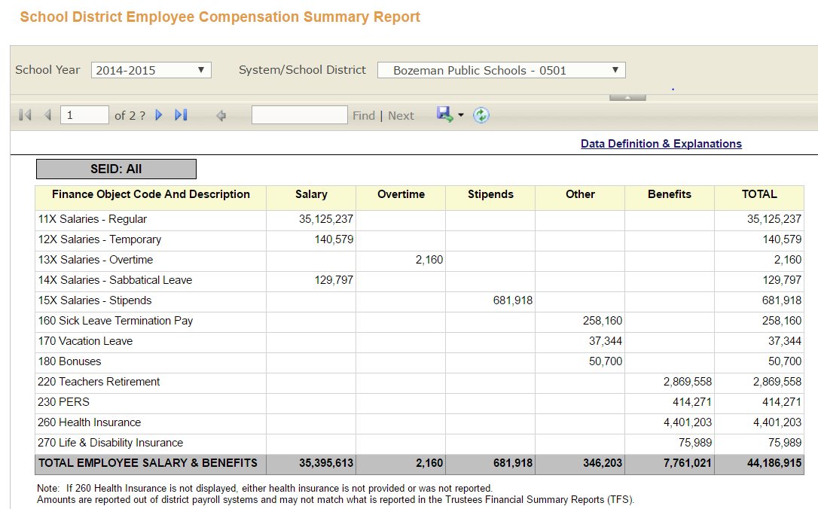
How much does the workforce cost in the schools you visit (Bozeman)?

Slide 34
Lesson: How much does the workforce cost in the schools you visit?
Randomly select 3 Class AA schools with similar student populations (number and economically disadvantaged), which schools spends the most on salaries (per pupil)?
Is there variation in the cost of benefits between schools?

Slide 35
How do you target students at risk of dropping out of high school for services? Use our rigorous Early Warning System.

Slide 36
Lessons: How do you target students at risk of dropping out of high school for services?
The EWS works with student level data for each participating school.
  Investigate how many students in a school should be identified as at-risk of dropping out of high school?
  How does this compare to schools of similar sizes and/or have a similar percentage of students in poverty?
  How would you incorporate the EWS into a 360 degree evaluation of the student’s case?

Slide 37
Please come back to GEMS, there are loads of new tools!
Contact Information
Robin Clausen
Stakeholder Liaison and Research Analyst
Montana Office of Public Instruction
robin.clausen@mt.gov
406-444-3793

