Slide 1
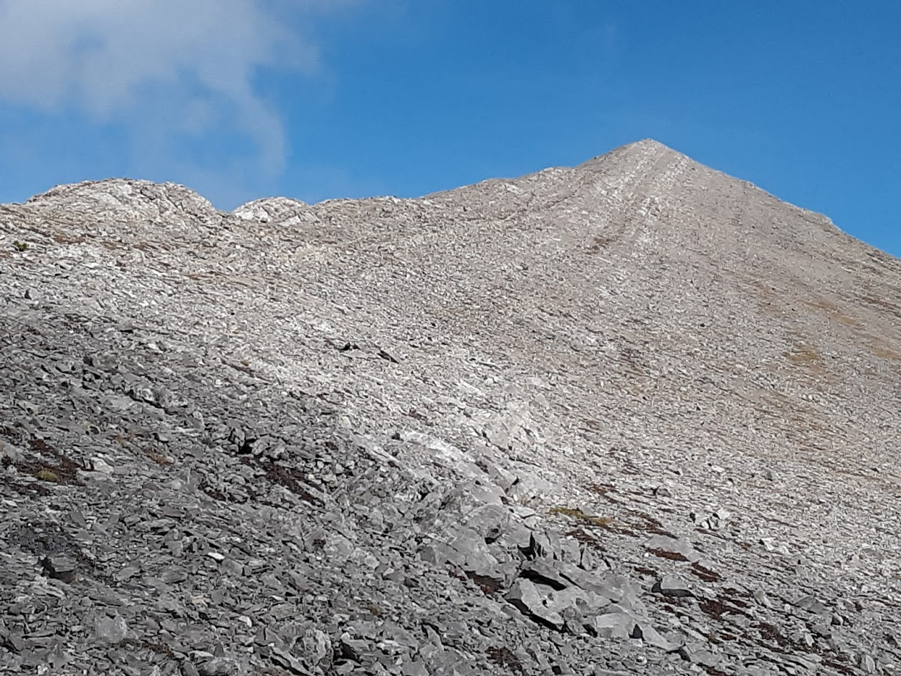
General Fund Budget Spreadsheet
MASBO Technology Workshop 2019

Slide 2
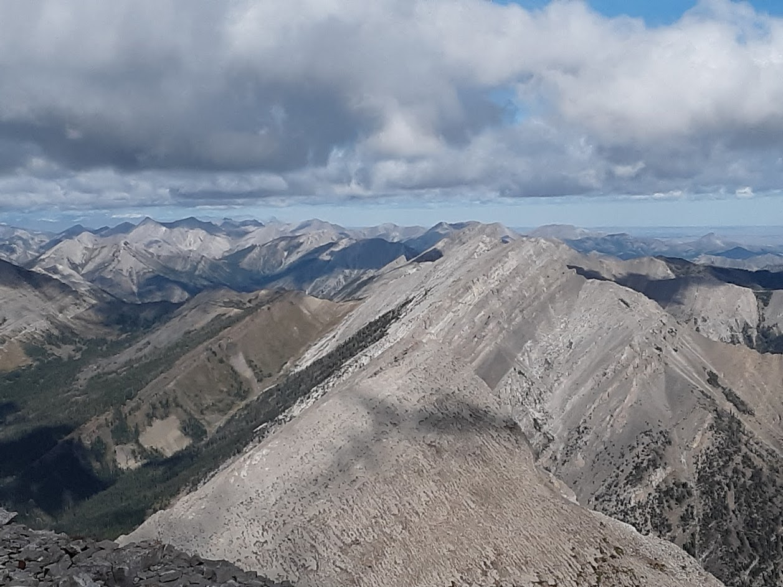
Objectives
What do you use this spreadsheet for?
How can we improve the spreadsheet to make it better?
What items in the spreadsheet are not helpful and need to be removed?
What about the spreadsheet is confusing and could be better presented?

Slide 3
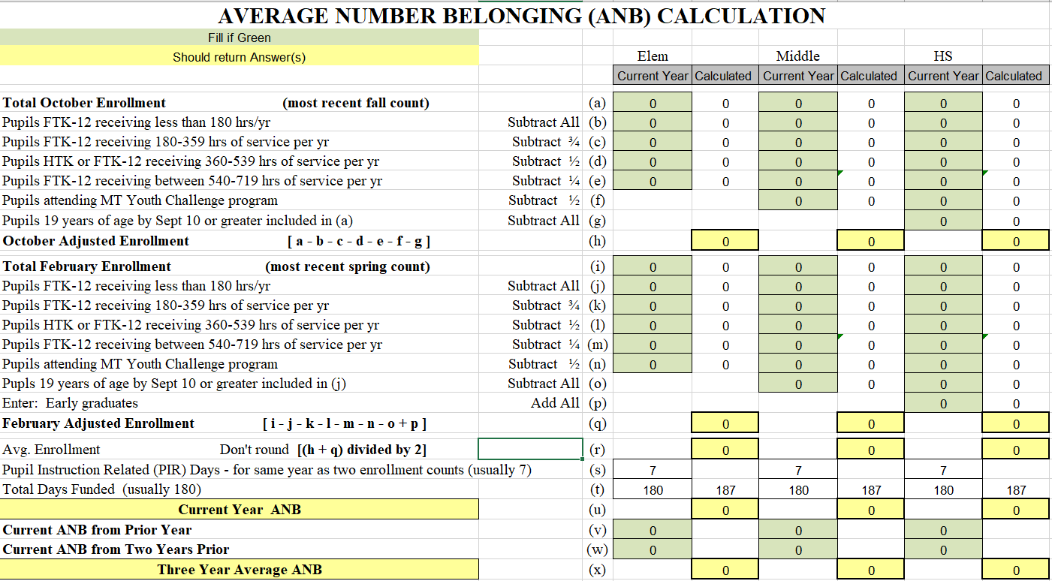
Enrollment to Average Number Belonging
ANB Calculation Sheet http://opi.mt.gov/Leadership/Finance-Grants/School-Finance/Student-Count-ANB

Slide 4
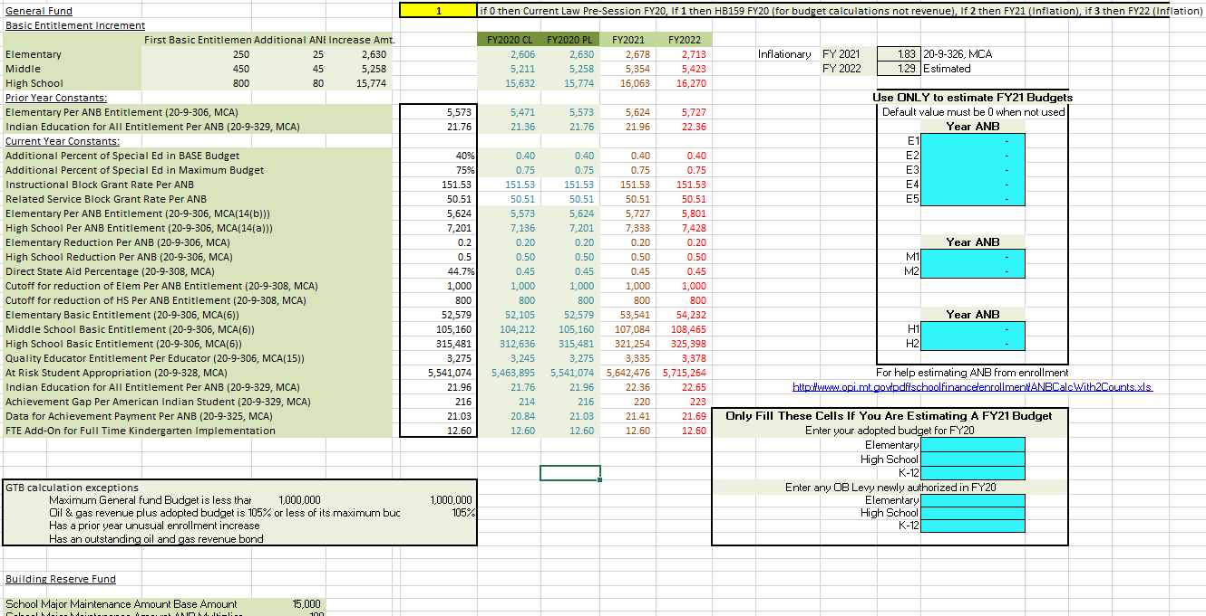

Slide 5
Parameters (PAR) Tab
Inflation toggle “if 0 then Current Law Pre-Session FY20, If 1 then HB159 FY20 (for budget calculations not revenue), If 2 then FY21 (Inflation), if 3 then FY22 (Inflation)”
-This toggle directs the spreadsheet to access the data in differing columns on the PAR tab.
-To extend the estimated inflation to future years enter a 3 here then adjust the estimated inflation rate. Note that the inflation compounds off the adjacent column to the left so there is a change of inaccurate data using this method.
-Inflation initially is determined on the Governors budget as per 20-9-326, MCA. The Legislature then chooses to accept, modify or propose different rates.
This inflation is applied to BASE aid components (Per-student, Basic, Indian Education for All, Quality Educator, Data for Achievement, Achievement Gap, At Risk.

Slide 6
Parameters (PAR) Tab
CL = Current Law & PL = Present Law Adjustment.
-These columns are generally only seen during legislative years so districts can anticipate the potential increases to the BASE aid components.
Entering data to estimate a future year:
-Enter an estimated current year ANB by budget unit in the dark blue CY ANB cells.
-Enter the prior year (PY) adopted budgets. Section 20-9-308, MCA states: The trustees of a district may adopt a general fund budget up to the maximum general fund budget or the previous year's general fund budget, whichever is greater. This allows for the calculation to occur with better accuracy.
-Enter any approved over-BASE (OB) levy in the general fund (GF). Entering this data allows for an adjustment to the 5 year lookback outlined in Section 20-9-308(2)(a), MCA so that proposals for estimated OB levies will be more accurate.

Slide 7
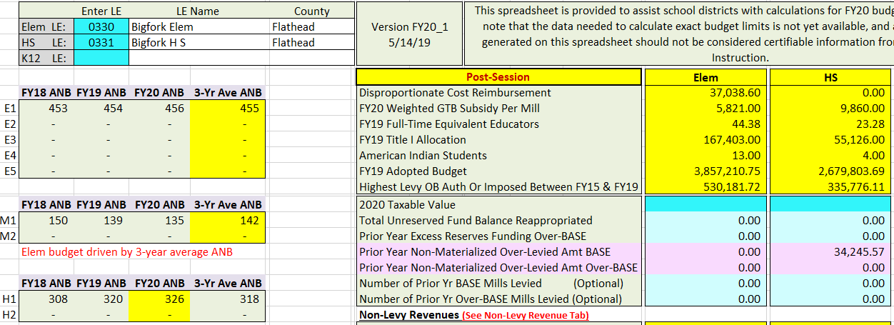
Estimating Future Years Continued
After entering estimated values to the PAR tab, data and information adjusts on the Inputs tab.

Slide 8
Limitations in Estimation
SPED rates for IBG, RSBG and Disproportionate Costs do not adjust. -Affects budget limits and state SPED allowable cost payment along with tax levy (Swings in budget limits are often associated with disproportionate cost changes)
GTB subsidy per BASE mill does not adjust. -Affects General Fund GTB
The number of FTE does not Adjust -Affects QEC payment, budget limits (can be changed on the District Data tab)
Title I amounts received does not adjust -Affects At Risk payment, budget limits (can be changed on the District Data tab)
Inflation is year-over-year and known amounts may not be known for future years. -Could skew resulting estimation
Taxable Values very from assessment to non-assessment years. -Could affect levy, mills, GTB

Slide 9
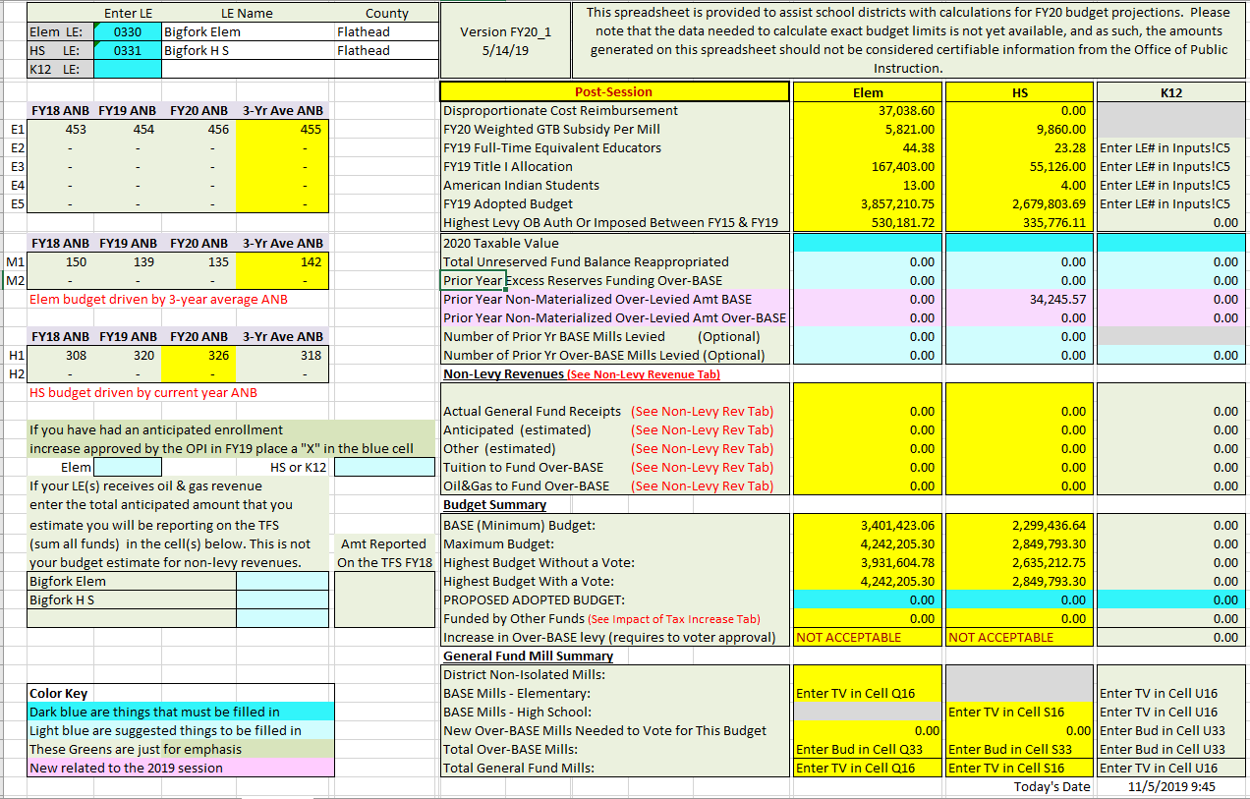

Slide 10
Input Tab
Section 20-9-310, MCA(5)(b)(iii) States that the general fund BASE budget levy must be calculated as though the trustees budgeted 12.5% of the oil and natural gas production taxes received by the district in the prior year to the BASE buget.
The provisions do not apply to the following: -A district that has a maximum general fund budget of less than $1 million. -A district whose oil and natural gas revenue combined with its adopted general fund budget totals 105% or less of its maximum general fund budget. -Has had an approved unusual enrollment increase. -A district that has issued outstanding oil and natural gas revenue bonds.
This section is used to help districts in the situation. The 12.5% if not estimated is levied to the BASE as taxes, and GTB is never paid toward this portion of BASE.

Slide 11
Input Tab
Section 20-9-314(6)(b), MCA state that any over levied amounts resulting from non-materialized anticipated enrollment increases must be used to reduce the BASE or over-BASE budget levy in the ensuing school fiscal year.

Slide 12
Input Tab
Some of the colors on the spreadsheet have meaning.
The date is a formula =NOW(). This is updated every time a change is made. This is important for printing different copies/versions.

Slide 14
Non-Levy Revenue Tab BASE
Actual are estimated revenuers that MUST be anticipated on the ensuing year’s budget, see section 20-9-141, MCA.
Anticipated are revenues that COULD be estimated for the ensuing year but are not required.
Other estimated revenues are revenues received that could be held as excess reserves. The OPI recommends holding these as excess reserves if possible.

Slide 15
Non-Levy Revenue Tab over-BASE

Slide 16
Non-Levy Revenue Tab over-BASE
Tuition is estimated to the over-BASE
Oil & Gas may be estimated in the BASE or over-BASE.

Slide 17
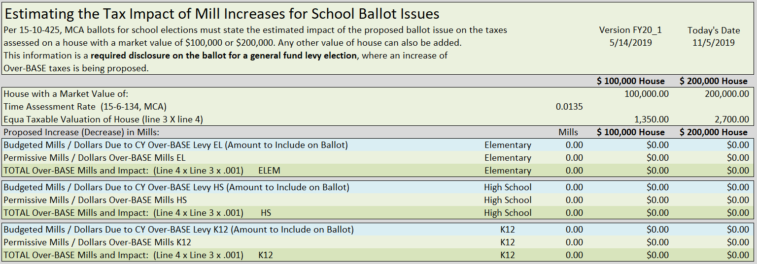
Impact of Tax Impact Tab

Slide 18
Impact of Tax Impact Tab
The blue line is the increase for potential over-BASE levy
The light green line is the permissive OB already in place.
The dark green line is the total of permissive OB levy plus the proposed OB levy increase.

Slide 19
Flexible Non-Voted Levy Authority (FNVLA)
Section 20-9-308, MCA states the trustees of a district may increase the district's over-BASE budget levy without a vote if the board of trustees reduces non-voted property tax levies authorized by law to be imposed by action of the trustees of the district by at least as much as the amount by which the over-BASE budget levy is increased. The ongoing authority for any non-voted increase in the over-BASE budget levy imposed must be decreased in future years to the extent that the trustees of the district impose any increase in other non-voted property tax levies.

Slide 20
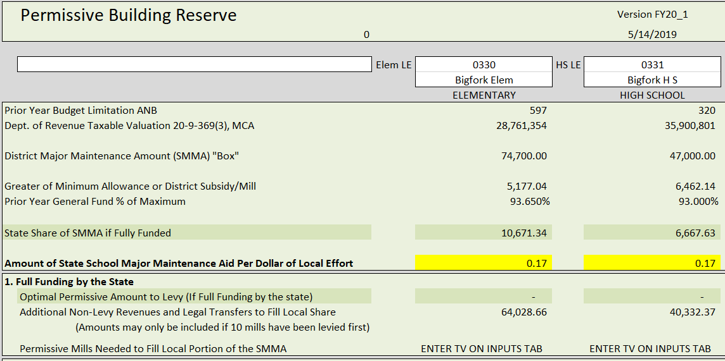

Slide 21
State Major Maintenance Aid (SMMA)
The formula uses the PY budget limitation ANB
The “box” size is 15,000 + (Budget Limit ANB X 100)
The State subsidy per dollar of local effort is the state aid per each dollar to support filling the box.
State share of SMMA if fully funded (appropriation and revenues available for all contributing districts to be full supported in the subsidy contribution).
Optimal Permissive Amount to Levy (the local contribution to maximize the largest amount of state support to completely fill the box)

Slide 22
State Major Maintenance Aid (SMMA)
A district has the following:
5 ANB
$1.5 in state aid per each local $1 of effort.
Box size will be (5 X 100) + 15,000 = 15,500
The following example is adding $1,000 at a time to fill the box.

Slide 23
State Major Maintenance Aid (SMMA)

Slide 24
State Major Maintenance Aid (SMMA)

Slide 25
State Major Maintenance Aid (SMMA)

Slide 26
State Major Maintenance Aid (SMMA)

Slide 27
State Major Maintenance Aid (SMMA)

Slide 28
State Major Maintenance Aid (SMMA)

Slide 29
State Major Maintenance Aid (SMMA)

Slide 30
State Major Maintenance Aid (SMMA)

Slide 31
State Major Maintenance Aid (SMMA)

Slide 32
State Major Maintenance Aid (SMMA)

Slide 33
State Major Maintenance Aid (SMMA)

Slide 34
State Major Maintenance Aid (SMMA)

Slide 35
State Major Maintenance Aid (SMMA)

Slide 36
State Major Maintenance Aid (SMMA)

Slide 37
State Major Maintenance Aid (SMMA)

Slide 38
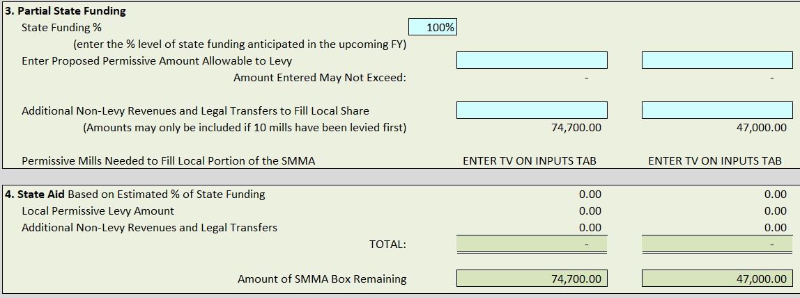
Section 20-9-525, MCA School Major Maintenance Aid Account -- Formula

Slide 39
State Major Maintenance Aid (SMMA)
This toggle is currently set at 100%. If all 400 districts were to levy to maximize the state money and having an appropriation of $7.6 million in FY2021 (if achieving full state revenue) the lowest % a district would receive is estimated at 74.6% (Estimated currently because the DOR TV is not out until December). If you want to estimate a shortage please do not prorate the state % less than the 74.6%.
Not all districts are levying to the permissive sub-fund:
196 LEs in 2019, permissively levying $13,557,527.88
230 LEs in 2020, permissively levying $10,252,355.06

Slide 40
State Major Maintenance Aid (SMMA)

Slide 41
Resolution of intent to increase nonvoted levy
Section 20-9-116, MCA The trustees shall provide notice of intent to impose an increase in a non-voted levy for the ensuing school fiscal year.

Slide 42
Resolution of intent to increase nonvoted levy
adopting a resolution of intent to impose an increase in a nonvoted levy that includes, at a minimum, the estimated number of increased or decreased mills to be imposed and the estimated increased or decreased revenue to be raised compared to nonvoted levies imposed in the current school fiscal year and, based on the district's taxable valuation most recently certified by the department of revenue, the estimated impacts of the increase or decrease on a home valued at $100,000 and a home valued at $200,000.
publishing a copy of the resolution in a newspaper that will give notice to the largest number of people of the district as determined by the trustees and posting a copy of the resolution to the school district's website.

Slide 43
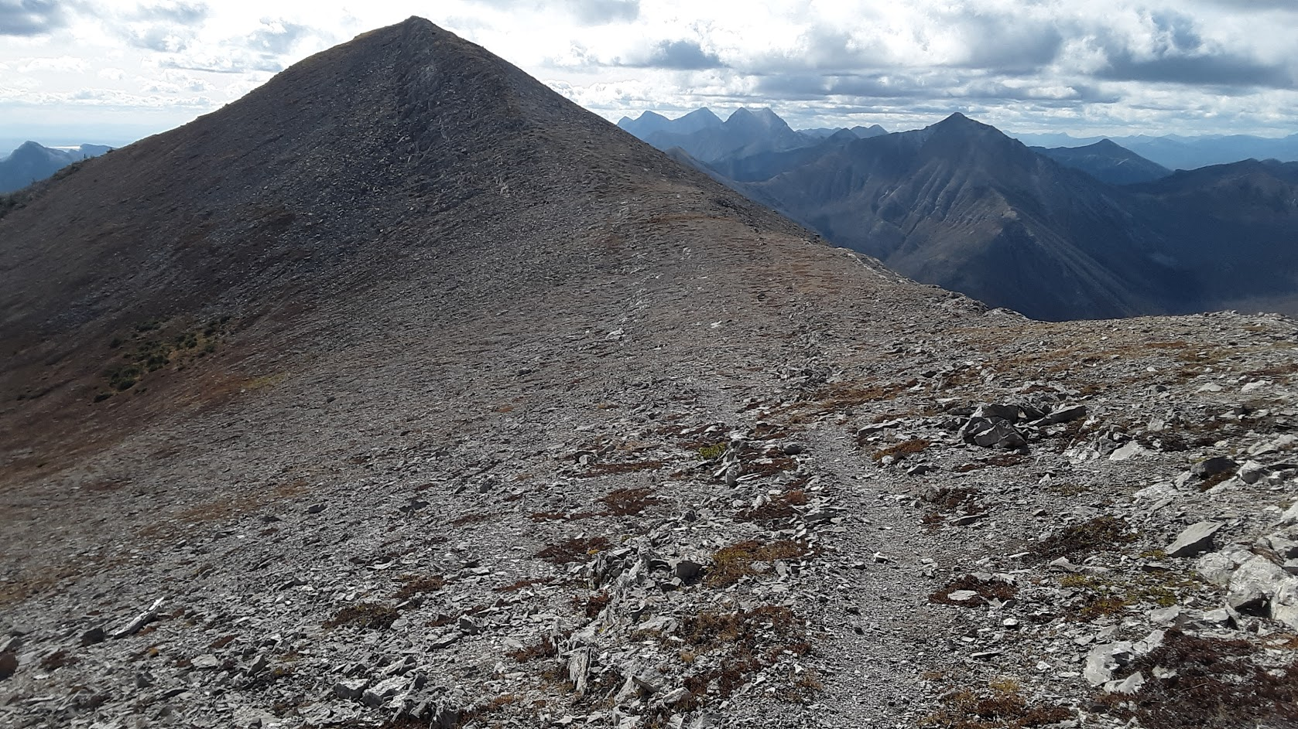
Paul Taylor (OPI)
406-444-1257
ptaylor2@mt.gov

