Slide 1
2019 MASBO Budget Workshops
Mike Waterman, Director of Business Services
Bozeman Public Schools
(406) 522-6097 – work
(406) 589-4027 – cell
mike.waterman@bsd7.org
Denise Williams, Executive Director
Montana Association of School Business Officials
(406) 461-3659
dwilliams@masbo.com

Slide 2
Financing Sources for Budgeted Funds
Factors determining tax requirements
Expenditure Budget
Money carried forward from prior year (“fund balance reappropriated)
YOU CAN
—AND SHOULD—
MANAGE BOTH!!

Slide 3
Understanding Fund Balance
Beginning Fund Balance
+ Revenue
- Expenditures
Ending Fund Balance

Slide 4
Understanding Fund Balance
Beginning Fund Balance
+ Revenue
- Expenditures
Ending Fund Balance
Reserves
(limited as a %
of ensuing
year budget)
Remit to State
(VERY rare)
Fund Balance Reappropriated
+ New Revenue
Ensuing Expenditure Budget

Slide 5
Understanding Fund Balance
Beginning Fund Balance
+ Revenue
- Expenditures
Ending Fund Balance
Reserves
(limited as a %
of ensuing
year budget)
Fund Balance Reappropriated
+ New Revenue
Ensuing Expenditure Budget

Slide 6
Understanding Fund Balance
+
=
Fund | Reserves | + Fund Balance Reappropriated | = Beginning Fund Balance | New Revenue | Adopted Budget

Slide 7
A word about reserves…
Factors determining tax requirements AND RESERVES:
Expenditure Budget
Money carried forward from prior year (“fund balance reappropriated)
YOU CAN
—AND SHOULD—
MANAGE BOTH!!

Slide 8
A word about reserves… Making a Case for Reserves

Slide 9
Understanding Fund Balance General Fund – Bozeman High School
Reserves
+ Fund Balance Reappropriated
Beginning Fund Balance
Reserves | FY19 | FY20 Projected
Adopted Budget | $ 17,684,592.00 | $ 18,264,828.00
Cap: 10% of Budget | $ 1,768,459.20 | $1,826,482.80
Actual Fund Balance | $ 1,762,987.75 | $ 1,482,426.91
Reserves % | 9.97% | 8.12%

Slide 10
Understanding Fund Balance General Fund – Bozeman High School
New Revenue
+ Fund Balance Reappropriated
Expenditure Budget
Reserves | FY19 | FY20 Projected
Adopted Budget | $ 17,684,592.00 | $ 18,264,828.00
Cap: 10% of Budget | $ 1,768,459.20 | $1,826,482.80
Actual Fund Balance | $ 1,762,987.75 | $ 1,482,426.91
Reserves % | 9.97% | 8.12%

Slide 11
Notice of Intent to Increase Non-Voted Levies 20-9-116, MCA
Notice requirements:
Publish in newspaper and on website by March 31
Dollar and mill increases in nonvoted levies in:
Transportation Fund
Bus Depreciation Fund
Tuition Fund
Adult Ed Fund
Building Reserve Fund
Using prior year taxable value
Impact on $100K and $200K home
Nonbinding

Slide 12
Understanding Fund Balance
Methods for estimating
Fund Balance Reappropriated:
Averaging
Trend Analysis
Projecting Actual

Slide 13
Understanding Fund Balance Budget-to-Actual Reports
Reserves | FY19 | FY20 Projected
Adopted Budget | $ 17,684,592.00 | $ 18,264,828.00
Cap: 10% of Budget | $ 1,768,459.20 | $1,826,482.80
Actual Fund Balance | $ 1,762,987.75 | $ 1,482,426.91
Reserves % | 9.97% | 8.12%

Slide 14
Understanding Fund Balance Budget-to-Actual Reports
Reserves | FY19 | FY20 Projected
Adopted Budget | $ 17,684,592.00 | $ 18,264,828.00
Cap: 10% of Budget | $ 1,768,459.20 | $1,826,482.80
Actual Fund Balance | $ 1,762,987.75 | $ 1,482,426.91
Reserves % | 9.97% | 8.12%

Slide 15
Understanding Fund Balance General Fund – Bozeman High School
 | Budget | Actual | Difference
Beginning Fund Balance | $ 1,762,987.75 | $ 1,762,987.75 | -
+ Revenue | 17,684,592.00 | $ 17,404,031.16 | ($ 280,560.84)
- Expenditures | 17,684,592.00 | 17,684,592.00 | -
Ending Fund Balance | $ 1,762,987.75 | $ 1,482,426.91 | ($ 280,560.84)
Reserves | FY19 | FY20 Projected
Adopted Budget | $ 17,684,592.00 | $ 18,264,828.00
Cap: 10% of Budget | $ 1,768,459.20 | $1,826,482.80
Actual Beg. Fund Balance | $ 1,762,987.75 | $ 1,482,426.91
Reserves % | 9.97% | 8.12%

Slide 16
Understanding Fund Balance General Fund – Bozeman High School
 | Budget | Actual | Difference
Beginning Fund Balance | $ 1,762,987.75 | $ 1,762,987.75 | -
+ Revenue | 17,684,592.00 | $ 17,404,031.16 | ($ 280,560.84)
- Expenditures | 17,684,592.00 | 17,684,592.00 | -
Ending Fund Balance | $ 1,762,987.75 | $ 1,482,426.91 | ($ 280,560.84)
Reserves | FY19 | FY20 Projected
Adopted Budget | $ 17,684,592.00 | $ 18,264,828.00
Cap: 10% of Budget | $ 1,768,459.20 | $1,826,482.80
Actual Beg. Fund Balance | $ 1,762,987.75 | $ 1,482,426.91
Reserves % | 9.97% | 8.12%
Maximum Reserves = lesser of:
Legal limit (General Fund: 10% of ensuring year budget)
Beginning Fund Balance

Slide 17
Understanding Fund Balance General Fund – Bozeman High School
 | Budget | Actual | Difference
Beginning Fund Balance | $ 1,762,987.75 | $ 1,762,987.75 | -
+ Revenue | 17,684,592.00 | $ 17,404,031.16 | ($ 280,560.84)
- Expenditures | 17,684,592.00 | 17,684,592.00 | -
Ending Fund Balance | $ 1,762,987.75 | $ 1,482,426.91 | ($ 280,560.84)
Reserves | FY19 | FY20 Projected
Adopted Budget | $ 17,684,592.00 | $ 18,264,828.00
Cap: 10% of Budget | $ 1,768,459.20 | $1,826,482.80
Actual Beg. Fund Balance | $ 1,762,987.75 | $ 1,482,426.91
Reserves % | 9.97% | 8.12%
Reserves % =
Reserves / Ensuing Year Budget

Slide 18
Understanding Fund Balance General Fund – Bozeman High School
 | Budget | Actual | Difference
Beginning Fund Balance | $ 1,762,987.75 | $ 1,762,987.75 | -
+ Revenue | 17,684,592.00 | $ 17,404,031.16 | ($ 280,560.84)
- Expenditures | 17,684,592.00 | 17,684,592.00 | -
Ending Fund Balance | $ 1,762,987.75 | $ 1,482,426.91 | ($ 280,560.84)
No fund balance reappropriated?
New revenue = expenditure budget
Reserves | FY19 | FY20 Projected
Adopted Budget | $ 17,684,592.00 | $ 18,264,828.00
Cap: 10% of Budget | $ 1,768,459.20 | $1,826,482.80
Actual Beg. Fund Balance | $ 1,762,987.75 | $ 1,482,426.91
Reserves % | 9.97% | 8.12%

Slide 19
Understanding Fund Balance General Fund – Bozeman High School
 | Budget | Actual | Difference
Beginning Fund Balance | $ 1,762,987.75 | $ 1,762,987.75 | -
+ Revenue | 17,684,592.00 | $ 17,404,031.16 | ($ 280,560.84)
- Expenditures | 17,684,592.00 | 17,684,592.00 | -
Ending Fund Balance | $ 1,762,987.75 | $ 1,482,426.91 | ($ 280,560.84)
Montana Funding System Design:
Budgets designed such that ending
fund balance equals lesser of:
Beginning fund balance (no fund balance reappropriated), or
Reserve limit (with fund balance reappropriated)
Reserves | FY19 | FY20 Projected
Adopted Budget | $ 17,684,592.00 | $ 18,264,828.00
Cap: 10% of Budget | $ 1,768,459.20 | $1,826,482.80
Actual Beg. Fund Balance | $ 1,762,987.75 | $ 1,482,426.91
Reserves % | 9.97% | 8.12%

Slide 20
State Funding Reductions School General Funds
School District General Fund Reductions in 2017-2019 Biennium:
At-Risk Student Payment: 0.5% reduction
Special Ed Allowable Cost Payment: 0.5% reduction
Data for Achievement Payment: Funding Suspended
**KEY ISSUE: NONE of these funding reductions affected spending authority**

Slide 21
Bozeman Public Schools K-12 Percent of Levied Taxes Collected
(Average?)

Slide 22
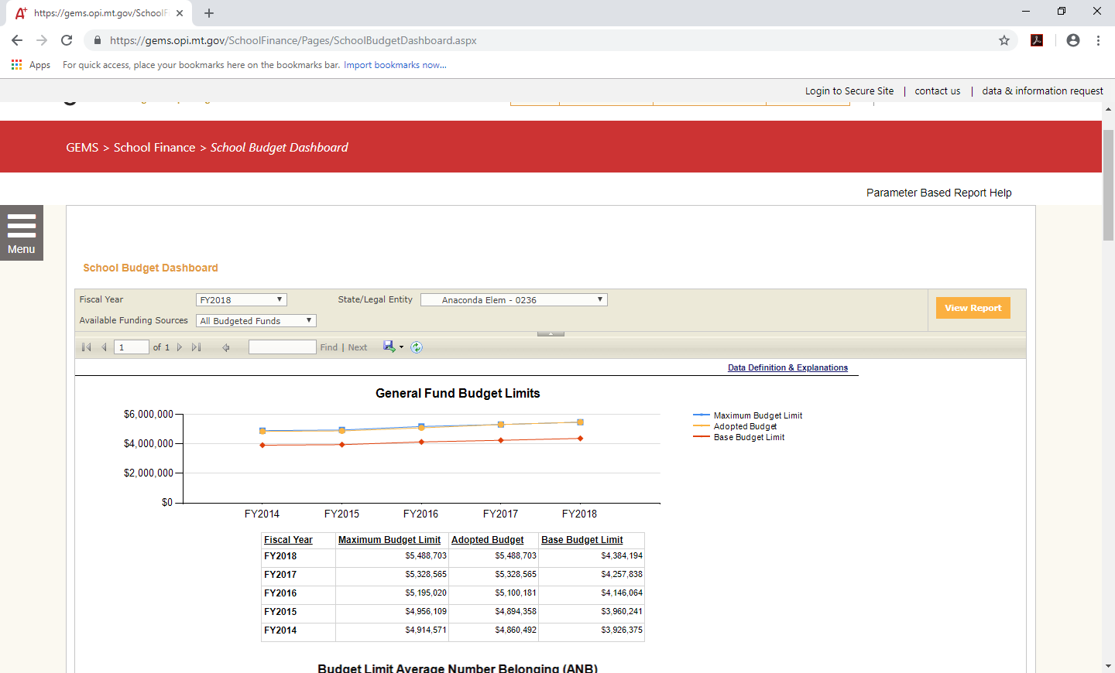
Understanding Fund Balance Calculating Percent of Levied Taxes Collected

Slide 23
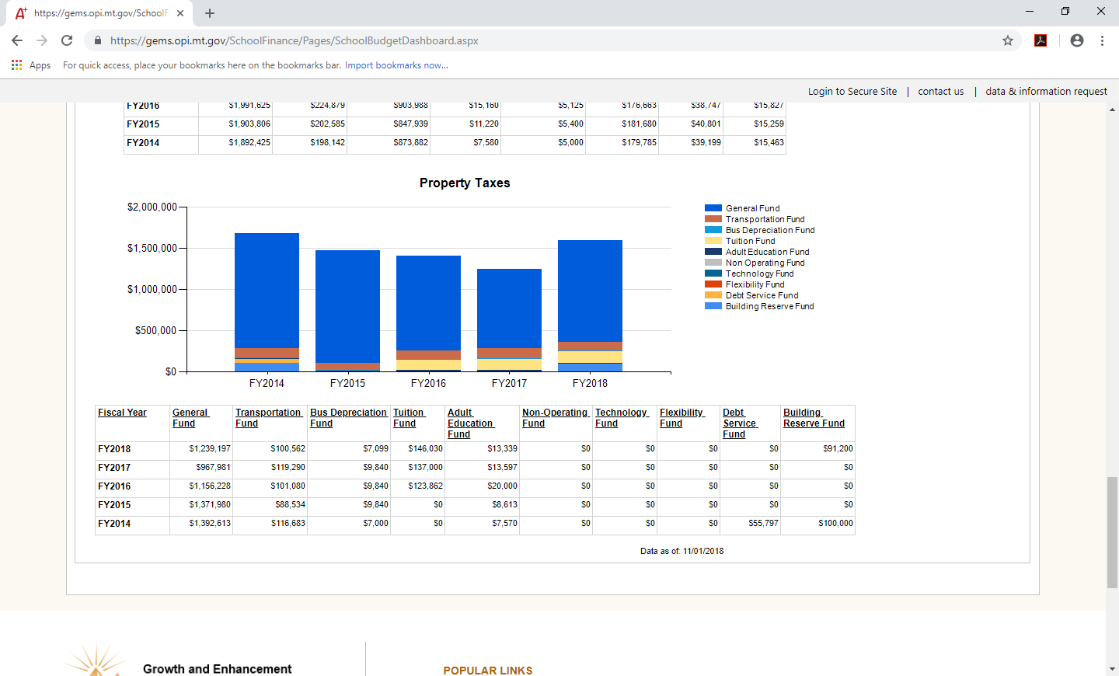
Understanding Fund Balance Calculating Percent of Levied Taxes Collected

Slide 24
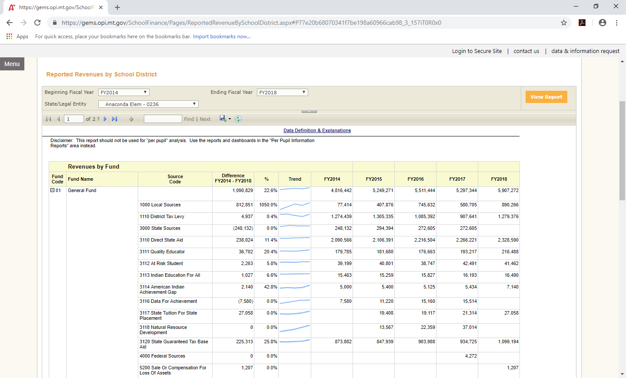
Understanding Fund Balance Calculating Percent of Levied Taxes Collected

Slide 25
Understanding Fund Balance General Fund Revenue – Bozeman High School
Revenue Source | Budget | Actual | Difference
Direct State Aid | $ 7,166,390.72 | $ 7,166,390.72 | -
Quality Educator | 514,400.65 | 514,400.65 | -
At Risk Student | 24,693.80 | 24,693.80 | ($ 123.47)
Indian Ed For All | 49,351.68 | 49,351.68 | -
Amer Indian Ach. Gap | 15,408.00 | 15,408.00 | -
Special Ed Allowable Cost | 500,639.45 | 500,639.45 | ($ 2,503.20)
Data For Achievement | 47,265.12 | 0.00 | ($ 47,265.12)
Guaranteed Tax Base Aid | 1,808,619.12 | 1,808,619.12 | -
Actual Revenue | 68,568.47 | 68,568.47 | -
Anticipated Revenue | 0.00 | 0.00 | -
Local Property Tax Levy | 7,489,254.99 | 7,258,585.94 | ($ 230,669.05)
TOTAL REVENUE | $ 17,684,592.00 | $ 17,404,031.16 | ($ 280,560.84)

Slide 26
Understanding Fund Balance General Fund – Bozeman High School
 | Budget | Actual | Difference
Beginning Fund Balance | $ 1,762,987.75 | $ 1,762,987.75 | -
+ Revenue | 17,684,592.00 | $ 17,404,031.16 | ($ 280,560.84)
- Expenditures | 17,684,592.00 | 17,684,592.00 | -
Ending Fund Balance | $ 1,762,987.75 | $ 1,482,426.91 | ($ 280,560.84)
Reserves | FY19 | FY20 Projected
Adopted Budget | $ 17,684,592.00 | $ 18,264,828.00
Cap: 10% of Budget | $ 1,768,459.20 | $1,826,482.80
Actual Beg. Fund Balance | $ 1,762,987.75 | $ 1,482,426.91
Reserves % | 9.97% | 8.12%
Maximum Reserves = lesser of:
Legal limit (General Fund: 10% of ensuring year budget)
Beginning Fund Balance

Slide 27
Understanding Fund Balance General Fund – Bozeman High School
 | Budget | Actual | Difference
Beginning Fund Balance | $ 1,762,987.75 | $ 1,762,987.75 | -
+ Revenue | 17,684,592.00 | $ 17,404,031.16 | ($ 280,560.84)
- Expenditures | 17,684,592.00 | 17,684,592.00 | -
Ending Fund Balance | $ 1,762,987.75 | $ 1,482,426.91 | ($ 280,560.84)
Reserves | FY19 | FY20 Projected
Adopted Budget | $ 17,684,592.00 | $ 18,264,828.00
Cap: 10% of Budget | $ 1,768,459.20 | $1,826,482.80
Actual Beg. Fund Balance | $ 1,762,987.75 | $ 1,482,426.91
Reserves % | 9.97% | 8.12%
Reserves % =
Reserves / Ensuing Year Budget

Slide 28
Understanding Fund Balance General Fund – Bozeman High School
 | Budget | Actual | Difference
Beginning Fund Balance | $ 1,762,987.75 | $ 1,762,987.75 | -
+ Revenue | 17,684,592.00 | $ 17,404,031.16 | ($ 280,560.84)
- Expenditures | 17,684,592.00 | 17,684,592.00 | -
Ending Fund Balance | $ 1,762,987.75 | $ 1,482,426.91 | ($ 280,560.84)
Reserves | FY19 | FY20 Projected
Adopted Budget | $ 17,684,592.00 | $ 18,264,828.00
Cap: 10% of Budget | $ 1,768,459.20 | $1,826,482.80
Actual Beg. Fund Balance | $ 1,762,987.75 | $ 1,482,426.91
Reserves % | 9.97% | 8.12%
Reserves are a function of:
Ending fund balance
Ensuing year budget amount

Slide 29
Projecting Fund Balances

Slide 30
Projecting Fund Balances Transportation Fund
Revenue and Net Levy Requirements (20-10-144, MCA)
On-Schedule Funding
Anticipated bus route miles at legislatively-determined rates (20-10-141, MCA)
Anticipated individual contracts at legislatively-determined rates (20-10-142, MCA)
Supervised home school & correspondence study
Contingency of greater of 10% of A-C or $100
Over Schedule Funding
All other costs of associated with home-to-school transportation

Slide 31
Projecting Fund Balances Transportation Fund
Revenue and Net Levy Requirements (20-10-144, MCA)
On-Schedule Funding
Anticipated bus route miles at legislatively-determined rates (20-10-141, MCA)
Anticipated individual contracts at legislatively-determined rates (20-10-142, MCA)
Supervised home school & correspondence study
Contingency of greater of 10% of A-C or $100
Over Schedule Funding
All other costs of associated with home-to-school transportation
Budgeted revenue that
you don’t receive
without taking
additional, specific action

Slide 32
Projecting Fund Balances Building Reserve Fund – Major Maintenance (Permissive) Subfund
Annual Funding Cap:
(Greater of 10 mills or
$15,000 + [$100 x ANB])
$
Local taxes
State funding
Most efficient
for local taxpayers;
subfund likely
not fully funded
Ensures max funding;
least efficient
for local taxpayers
POSSIBLE GOAL:
Max funding & efficiency
for local taxpayers

Slide 33
Projecting Fund Balances
Setting realistic timelines
and expectations
for planned expenditures
Why?
Understanding your District’s finances, reserves
Planning
Funding Sources Determine Spending Authority (Budget) | Spending Authority (Budget) Determines Funding Sources
General (01) | Transportation (10)
Bus Depreciation (11) | Tuition (13)
Technology (28) | Retirement (14)
Flexibility (29) | Adult Ed (17)
Building Reserve (61) | Debt Service (50)

Slide 34
Projecting Fund Balances
Why?
Understanding your District’s finances, reserves
Planning
Funding Sources Determine Spending Authority (Budget) | Spending Authority (Budget) Determines Funding Sources
General (01) | Transportation (10)
Bus Depreciation (11) | Tuition (13)
Technology (28) | Retirement (14)
Flexibility (29) | Adult Ed (17)
Building Reserve (61) | Debt Service (50)

Slide 35
Managing Ending Fund Balance Establishing and Implementing District Priorities
Board is responsible for establishing District priorities
Policy is primary tool
Fund Balance Policy regarding fund balance is required by GASB54
District Policy
…but how does the vision become a reality?
Who decides?
When?
And under what authority?

Slide 37
Managing Ending Fund Balance
Tools at your disposal:
Be careful what revenue you anticipate in your budget
Consider where you code revenue receipts during the year
Spend/underspend budget strategically
Move (recode) revenue and expenditures to accomplish District goals

Slide 38
Managing Ending Fund Balance
Common funds:
01 General | 20 Lease Rental
10 Transportation | 21 Compensated Absences
11 Bus Depreciation | 26 Impact Aid
12 School Foods | 28 Technology
13 Tuition | 29 Flexibility
14 Retirement | 50 Debt Service
15 Misc Programs | 60 Building
17 Adult Ed | 61 Building Reserve
18 Drivers’ Ed | 84 Student Activities

Slide 39
Managing Ending Fund Balance Timing of Decision Process
June/July 2019
Sun | Mon | Tues | Wed | Thur | Fri | Sat
23 | 24 | 25 | 26 | 27 | 28 | 29
30 | 1 | 2 | 3 | 4 | 5 | 6
7 | 8 | 9 | 10 | 11 | 12 | 13
14 | 15 | 16 | 17 | 18 | 19 | 20
21 | 22 | 23 | 24 | 25 | 26 | 27
28 | 29 | 30 | 31
August 2019
Sun | Mon | Tues | Wed | Thur | Fri | Sat
 |  |  |  | 1 | 2 | 3
4 | 5 | 6 | 7 | 8 | 9 | 10
11 | 12 | 13 | 14 | 15 | 16 | 17
18 | 19 | 20 | 21 | 22 | 23 | 24
25 | 26 | 27 | 28 | 29 | 30 | 31
Close of fiscal year
Reports due from treasurer
TFS due to County Supt

Slide 40
Managing Ending Fund Balance Interfund Loans
What the…?
A mechanism to move expenditures from one fund to another
Actual transfer of cash on county and district books is postponed
Must be ‘repaid’ in ensuing fiscal year
When?
Anytime, but probably best after June 30 cash is balanced

Slide 41
Managing Ending Fund Balance Interfund Loans vs. Transfers
 | Interfund Loans | Transfers
Primary Purpose | Recode existing expenditures | Repurpose money for the future
Intended Duration | Short term | Permanent
Repayment Required? | Yes | Generally no
Can be used to restore budget authority | Yes | No
Coding requirements | Interfund loan | OPI-required coding

Slide 42
Managing Ending Fund Balance Interfund Loans
How? Two entries.
First in year you are closing out:
Second in ensuing year:
Debit | Credit
Expenditures: New Fund | Due To Other Funds: Old Fund
Due From Other Funds: New Fund | Expenditures: Old Fund
Debit | Credit
Cash: Old Fund | Due From Other Funds: New Fund
Due To Other Funds: Old Fund | Cash: New Fund

Slide 43
Managing Ending Fund Balance Interfund Loans
How? Two entries.
First in year you are closing out:
Second in ensuing year:
Debit | Credit
Expenditures: New Fund | Due To Other Funds: Old Fund
Due From Other Funds: New Fund | Expenditures: Old Fund
Debit | Credit
Cash: Old Fund | Due From Other Funds: New Fund
Due To Other Funds: Old Fund | Cash: New Fund

Slide 44
Managing Ending Fund Balance Interfund Loans
How? Two entries:
Debit | Credit
Expenditures: New Fund (Increase) | Due To Other Funds: Old Fund
Due From Other Funds: New Fund | Expenditures: Old Fund (Decrease)
Cash: Old Fund (Increase) | Due From Other Funds: New Fund
Due To Other Funds: Old Fund | Cash: New Fund (Decrease)
June 30
August 1

Slide 45
Managing Ending Fund Balance Interfund Loans
Year End Balances to Keep in Check
All budgeted fund expenditures may not exceed adopted budget
School Foods Fund (12) ending fund balance < 3 months expenditures
Lease Rental Fund (20) ending cash balance < $10,000 ($20,000 for K-12s)
Compensated Absence Fund (21) cash balance < 30% of liability for XXX
Grants:
Not overspent
Maintenance of Effort managed strategically
Strategically managing fund balance reappropriated

Slide 46
2019 MASBO Budget Workshops THANK YOU FOR COMING!
Mike Waterman, Director of Business Services
Bozeman Public Schools
(406) 522-6097 – work
(406) 589-4027 – cell
mike.waterman@bsd7.org
Denise Williams, Executive Director
Montana Association of School Business Officials
(406) 461-3659
dwilliams@masbo.com

