Slide 1
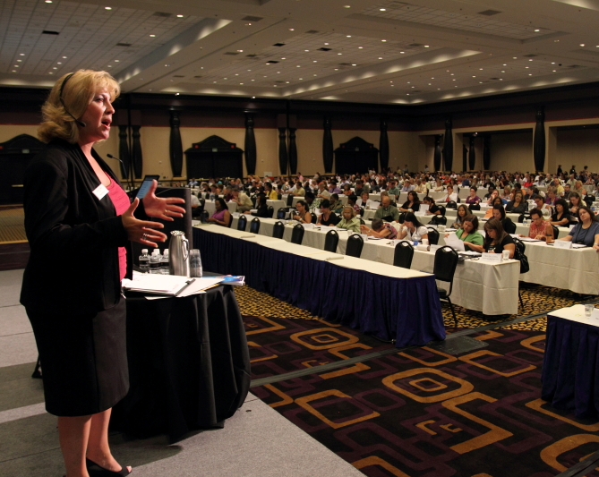
Preparing for an Audit
Trainer: Anthony Gerharz, CPA, Manager
© Wipfli LLP

Slide 2
Materials/Disclaimer
Please note that these materials are incomplete without the accompanying oral comments by the trainer(s).
These materials are informational and educational in nature and represent the speakers' own views. These materials are for the purchasing agency’s use only and not for distribution outside of the agency or publishing on a public website.

Slide 3
Outline
After today’s session you will have a better understanding the following
What an audit is.
How to prepare for an audit and what to expect.
What information will the auditor will ask for.
What final product will be and your responsibilities.
Type of audit opinions.
If there are any findings how severe they are

Slide 4
What is an Audit
“An audit is the examination and verification of the district’s financial statements and records, and their compliance with Generally Accepted Accounting Principles (GAAP)”
– Merriam-Webster Dictionary

Slide 5
What is an Audit - Phases
There are three phases to an audit;
Planning
Get the auditor information in advance so that when they are on sight less work is required on your side. (We will cover what to get them in a bit)
Fieldwork
The auditor is on sight and performing most of the audit and will be looking at the information that they requested you have ready for them.
Wrap-up
The auditor is completing the audit. You may be asked for additional information and to help with any questions that arise after fieldwork.

Slide 6
What to Expect During an Audit
An audit is not a complete examination of the District’s books. Auditors are there to determine if the financial statements are free from material misstatement.
An audit will require additional time and effort, but with proper preparation it will go easily and that time and effort will get you ahead of the game.
Remember, without your assistance auditors cannot do their job and I for one appreciate it.

Slide 7
Ok lets get you prepared!
Information and documentation that may be requested by the auditors and should be provided prior to fieldwork.
Hopefully your auditor send an audit need list.
Trial balance report for the fiscal year.
Ensure that this report includes the revenue and expense accounts as well.
Trustee’s Financial Summary for the fiscal year.
Accounting policies and procedure manual.
A copy of the District’s financial statements and notes (if being prepared by the district).
If the financial statements and notes are not prepared by you then the auditor must prepare themand there are additional steps that will be needed.
A listing of trustee members with contact information and position on board.
A copy of the County Treasures Report for the year end, i.e. June’s report.
A listing of any attorneys used/retained during the year.
Include contact information.
A copy of trustee meeting minutes, if not available online.

Slide 8
Ok lets get you prepared! - continued
A listing of all district warrants written during the fiscal year (July 1, 2016 to June 30, 2017).
A listing of all student activity checks written and all student activity receipts received.
A listing of all warrants written subsequent to year end through date of request.
A listing of all bank accounts held outside of the county.
Most student activity accounts are at a local bank.
The District’s fixed asset schedule.
A detailed listing of asset purchases.
Expenditures coded to XXX-XXX-XXXX-7XX-XXX.
A detailed listing of asset disposals
Including information on whether they were sold, traded, or just disposed.
A listing of all adjusting journal entries made during the year.
Copies of account reconciliations.
Listing of encumbrances outstanding at year end, open purchase orders.

Slide 9
Ok lets get you prepared! - continued
Additional information that may apply.
Schedule of Expenditures of Federal Awards and grant files.
Other Post Employment Benefit Valuation Report (OPEB Report).
Listing of investments held by parties outside the county.
Information pertaining to any new debt and the agreements.
Compensated Absences worksheet
Steps/Lanes Schedule
Information should in general be provided a week or two in advance of the scheduled date of fieldwork. The sooner information is provided the smoother it will go.

Slide 10
You provided all information now what?
After providing the above information you should get the following information back.
Samples that need to be pulled for when the auditor is on site.
Samples that you will generally get prior to fieldwork include:
Check samples, which will require you to provide a copy of the purchase order and supporting invoice.
Payroll samples.
Support for fixed asset additions.
Student activity expenditure and revenue sample.

Slide 11
Audit Fieldwork
The date of audit fieldwork has come, now what?
Auditor will come in and begin their testing this will include:
Looking at the information that you have pulled prior.
Review/testing of account reconciliations and vouching or tracing information to supporting documentation
Analytical tests to test reasonableness of balances.
Expect the auditor to ask questions.
Make time for them.
Expect unpredictability.
All audits are required to add a level of unpredictability to them, so don’t be alarmed if things change from year to year.
Fraud inquiries.

Slide 12
Audit Wrap-Up
Audit wrap-up consists of completing the audit and getting it issued and submitted.
Do you write the financial statements and notes?
If so then you will be waiting on two or three reports from the auditor
The Independent Auditor’s Report.
Independent Auditor’s Report on Internal Control Over Financial Reporting and on Compliance and Other Matters Based on an Audit of Financial Statements performed in Accordance With Government Auditing Standards.
Independent Auditor’s Report on Compliance For Each Major Federal Program and on Internal Control Over Compliance Required by The Uniform Guidance (If the district must have a single audit)
When the district does not prepare the audited financial statements expect,
A draft of the financial statements.
Review the draft and compare amounts to the District’s records.
Other information that will need to be provided to wrap up the audit.
The Management Discussion and Analysis.
Management’s response to any findings.

Slide 13
Audit Opinions
The primary reason for an audit is to express an opinion on the financial statements based on the audit. There are three types of opinions:
Unmodified Opinion: ☺
“In our opinion, the financial statements referred to above present fairly, in all material respects, the respective financial position of the governmental activities, each major fund, and the aggregate remaining fund information of Example School District, as of June 30, 2017, and the respective changes in financial position for the year then ended in accordance with accounting principles generally accepted in the United States.”
Modified Opinion: 😐
“Qualified Opinion on Major Fund(s):
In our opinion, except for the effects, if any, of the matter described in the Basis for Qualified Opinion paragraph on the elementary miscellaneous programs fund and the high school miscellaneous programs fund, the financial statements referred to above present fairly, in all material respects, the respective financial position of the elementary miscellaneous programs fund and the high school miscellaneous programs fund of Example School District, as of June 30, 2017, and the respective changes in financial position thereof for the year then ended in accordance with accounting principles generally accepted in the United States.
Unmodified Opinion on the Governmental Activities, General Fund, Elementary Retirement, and Aggregate Remaining Fund Information:
In our opinion, the financial statements referred to above present fairly, in all material respects, the respective financial position of the governmental activities, general fund, elementary retirement fund and aggregate remaining fund information for Example School District, as of June 30, 2017, and the respective changes in financial position thereof for the year then ended in accordance with accounting principles generally accepted in the United States.”

Slide 14
Audit Opinions - continued
Adverse Opinion: ☹
“In our opinion, because of the significance of the matter discussed in the “Basis for Adverse Opinion on the Financial Statements as a Whole” paragraph, the financial statements referred to above do not present fairly the respective financial position of the governmental activities, each major fund, and the aggregate remaining fund information of Example School District, as of June 30, 2017, and the respective changes in financial position for the year then ended in accordance with accounting principles generally accepted in the United States.”
Disclaimer of Opinion: ☹
Similar to adverse opinion.

Slide 15
Types of Findings
Management Comment: ☺
During the audit, the auditor may identify other deficiencies in internal control that are not significant deficiencies or material weaknesses but that may be of sufficient importance to merit management's attention. AU-C 265.12(b) states that the auditor should communicate other deficiencies in internal control identified during the audit that (a) have not been communicated to management by other parties and (b) in the auditor's professional judgment, are of sufficient importance to merit management's attention.
Findings are not reported on schedule of findings and questioned costs or in the Internal Control or Uniform Guidance reports
Significant Deficiency: 😐
A deficiency, or a combination of deficiencies, in internal control over financial reporting that is less severe than a material weakness, yet important enough to merit attention by those charged with governance.
Findings are disclosed in written communication to management and governance, the schedule of findings and question costs and potentially one or both of the following letters dependent on the type of finding, the Internal Control over financial reporting letter, the Uniform Guidance opinion over major federal programs. Results in having to form a corrective action plan to resolve the finding.
Findings that make the Internal Control over Financial Reporting letter or the Uniform Guidance letter.

Slide 16
Types of Findings - continued
Material Weakness: 😐
A deficiency, or combination of deficiencies, in internal control over financial reporting, such that there is a reasonable possibility that a material misstatement of the entity's financial statements will not be prevented, or detected and corrected on a timely basis. A reasonable possibility exists when the likelihood of an event occurring is either reasonably possible or probable as defined as follows:
Reasonably Possible. The chance of the future event or events occurring is more than remote but less than likely.
Probable. The future event or events are likely to occur.
Findings are disclosed in written communication to management and governance, the schedule of findings and question costs and potentially one or both of the following letters dependent on the type of finding, the Internal Control over financial reporting letter, the Uniform guidance opinion over major federal programs. Results in having to form a corrective action plan to resolve the finding.

Slide 17
Questions?
Contact Information
Anthony B Gerharz, CPA | Manager | Wipfli LLP
Direct: 406.206.3591 | Office: 406.248.1681
Email: tgerharz@wipfli.com

