Slide 1
P-card organization
Shanna Flores, Havre Public Schools

Slide 2
Card Assignment
Who WANTS a Card
Who NEEDS a Card
Who GETS a Card
Who KEEPS a Card

Slide 3
Everybody wants some
All District Employees:
Individual Use Agreement - Signature
Copy of Policy on Back - Signature

Slide 4
Everybody feels the need
Create a Procedure that fits your District
Employees with their own card:
Administrators
Bldg. Secretaries
Tech
Department Heads
Coaches
Advisors
Employees who tend to spend:
Choir/Band Directors
Custodians
Maintenance

Slide 5
But does everybody get one?
Check Out or Sign Out Sheet
Payment Authorization Form
Receipt
Trip Approval Form

Slide 6
And last but not least…. who keeps it?
You decide.

Slide 7
Card flow
The more the merrier
Preauthorization is key
Set procedures you can live by

Slide 8
More Cards=more $$
District Authorized Spenders
Administrators
Building Secretaries
Maintenance
Activity Advisors
Coaches
Or employees in good/long standing rolls

Slide 9
Require Pre authorization
Pre-authorization Form-requires a signature from Administrator or Department Head and a budget line prior to card check out
Travel
Supplies

Slide 10
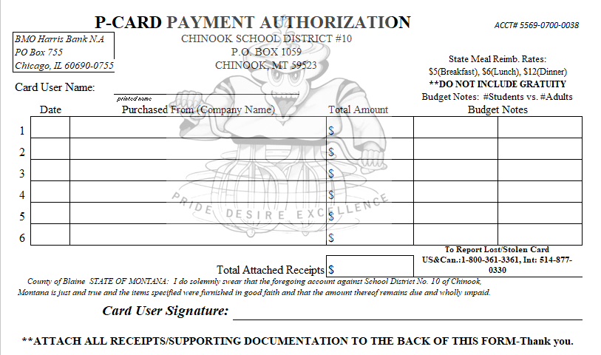

Slide 11
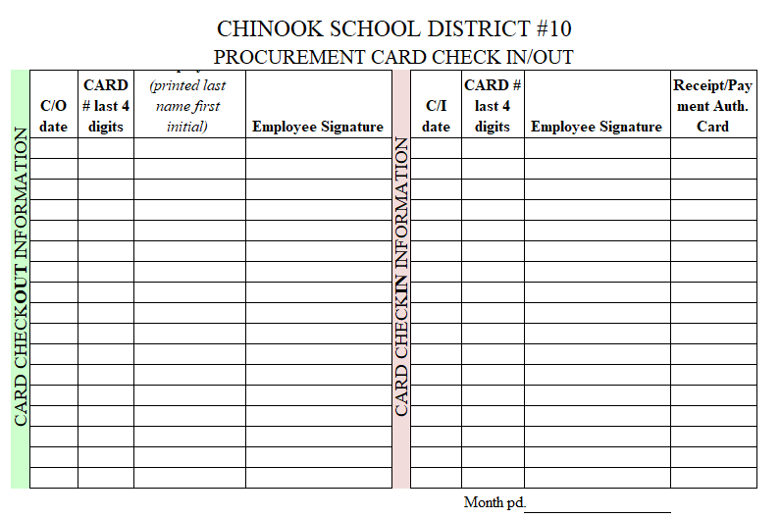

Slide 12
procedures specific to your district
Loose – Everybody gets a card
Happy Medium - Something you can live with
Strict – No one gets a card

Slide 13
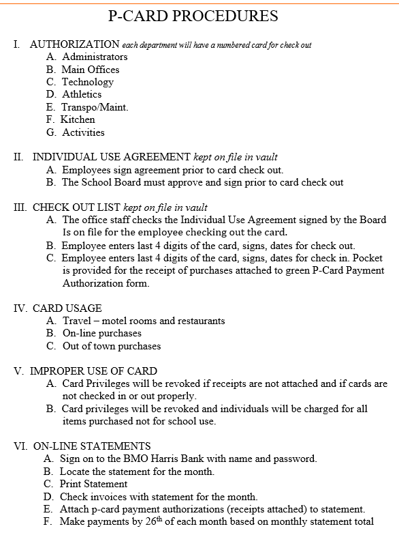

Slide 14
Reconciliation
Spreadsheet Tracking Per Month/Statement
Software Module
Either way pick a date- and stick to it.

Slide 15
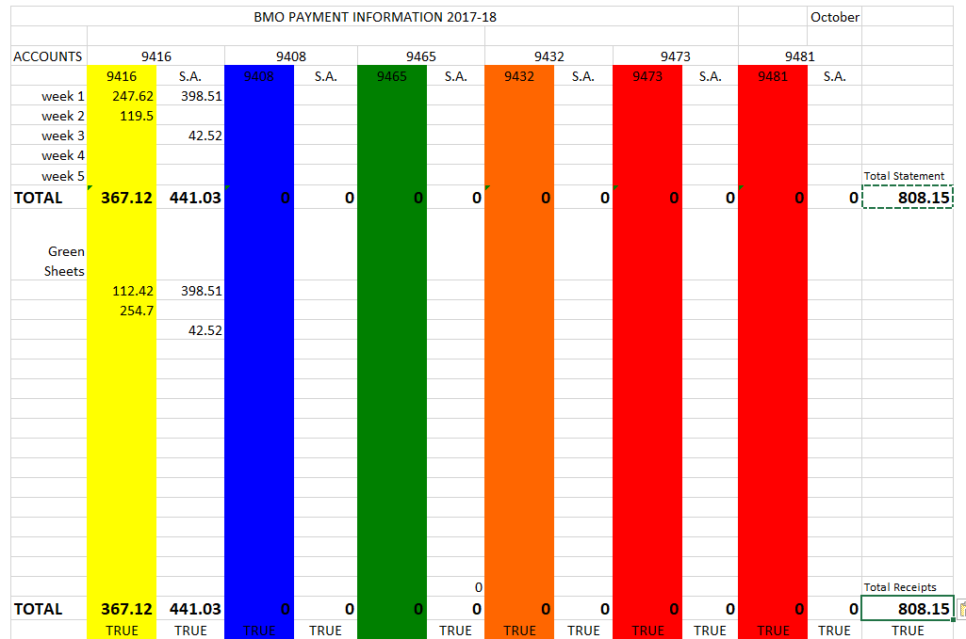

Slide 16
Questions

