Slide 1
MASBO Summer Conference June 13, 2018
Nolan Brilz, Accounting & Fiscal Manager
Montana Teachers’ Retirement System

Slide 2
Part One General Information

Slide 3
Agenda
Overview
TRS, Employers, Members
Contributions
Employers, Members

Slide 4
Overview
TRS
TRS Employers
TRS Members

Slide 5
Teachers’ Retirement System
Established by Montana Legislature in 1937.
Over 19,000 active members
Over 15,000 benefit recipients
Over $3.6 billion in assets managed by Board of Investments
Defined benefit pension plan (401a)
NOT a defined contribution (401k)
TRS Staff
Contact Information on TRS website
www.trs.mt.gov

Slide 6
TRS Employers
Public School Districts
State of Montana
Office of Public Instruction
Board of Public Education
Education Cooperatives
Montana School for the Deaf and Blind
Youth Correctional Facilities
Montana University System
Community Colleges
Any other agency, political subdivision (e.g. county), or instrumentality of the state (e.g. CSPD, educational cooperative)

Slide 7
TRS Members Examples of Some Reportable Positions
Coach
Dean of Students
Guidance Counselor
Librarian
Paraprofessional
PE Instructor
Principal
School Nurse
School Psychologist
Speech Therapist
Substitute Teacher
Study Hall Monitor
Superintendent
Teacher
Teacher’s Aide
Determined by duties, not by title
Contact TRS if you have any questions

Slide 8
Excluded from TRS membership
Bus driver
Cafeteria staff
Custodial staff
Hall monitors
Non-instructional information technology staff
Playground aide
School Clerks
Ticket takers
Contact TRS if you have any questions

Slide 9
Membership Eligibility
Employees must be enrolled in TRS if they
Are employed in a TRS reportable position
Will be employed in the position for at least 30 days or 210 hours in a fiscal year
Anything over 210 hours in a fiscal year is reportable
Anything under 210 hours is not reportable
Full-time
At least 180 days or 140 hours in a fiscal year
Usually contracted full-time teachers
Part-time
Usually contracted part-time teachers
Hourly
No Contract - paid hourly

Slide 10
Membership Eligibility
Substitute Teachers / Part-time Paraprofessional or Teacher’s Aide
On their first day of work, the individual must elect whether or not to participate in TRS
Membership Election (Form 106)
After 210 hours of service during the school year – the individual must be enrolled as a TRS member
TRS recommends that you encourage these individuals to enroll from day one if you believe they will go over the 210 hours

Slide 11
New Hires: Form 107
New members should complete the TRS New Hire Questionnaire (Form 107). Employers will keep this form in their files – do NOT submit to TRS. The individual will indicate if they are
TRS Member: Active or Inactive
Member must report name of current / previous employer
Retired Member
Employer and working retiree must notify TRS within 30 days of employment via Notice of Postretirement Employment (Form 146)
Member of TIAA-CREF
If member is employed in a TIAA-CREF reportable position and is concurrently employed in a TRS reportable position, they cannot become an active member of TRS.

Slide 12
New Hires: Forms 102 & 123
New TRS members MUST fill out:
Record for Membership (Form 102)
Beneficiary Designation (Form 123)
These forms should both be submitted to TRS as soon as possible after the new hire begins.
Both of these forms are on the Forms page of the TRS website in the Employer Forms section.
Please use New Versions of forms from TRS website
If the new hire is already a TRS member coming from another MT school district we do not need new forms.
Unless the member wishes to update their beneficiary info

Slide 13
Contributions to TRS
Employers
Active members

Slide 14
Reportable Earned Compensation
Earned compensation is:
Remuneration paid for the service of a member out of funds controlled by an employer before any pre-tax deductions are deducted from the member’s compensation.
Basically Gross Pay
Earned compensation does not include:
Direct premium payments by employer for medical, pharmaceutical, disability, life, vision, dental or any other insurance
Direct payments by employer for
Professional membership dues, maintenance, housing, day care, automobile, travel, lodging, or entertainment expenses, other forms of maintenance, allowance, or expenses.

Slide 15
Contributions to TRS
Employer Contributions (as of 7/1/2018)
Active Members
School District Employers remit to TRS 8.97% of total earned compensation paid to all active TRS members.
Working Retirees
11.35% - Discussed in later section of presentation.
The employer contribution rate for both active members and working retirees will continue to increase by .1% until July 1, 2023.
Website Resource: Rates & Median Average Salary Charts

Slide 16
Contributions to TRS
Member Contributions
Tier One: became members before July 1, 2013
Employers remit to TRS 8.15% of total earned compensation paid to each active member on behalf of that member
Tier Two: became members on or after July 1, 2013
Employers remit to TRS 8.15% of total earned compensation paid to each active member on behalf of that member
Depending on future funding of TRS, contributions for Tier One and Tier Two members may not always be the same.
Working Retirees
Working retirees do not have employee contributions to TRS.

Slide 17
Part Two TRS Online Reporting System
Insurance Deduction System
Wage & Contribution Reporting System

Slide 18
Agenda
Online Services Overview
Insurance Deduction System
Wage & Contribution Reporting System
Reminders
Resources for TRS Employers

Slide 19
Overview

Slide 20
TRS Online Services (Form 141)
Form 141 - Online Services Roles (one person may be all 3)
Employer Representative
Administrative authority for employer
Assigns Online Administrator
Signs Form 141
Online Administrator
Primary manager of employer access to TRS Online Services system
Fills out Form 141, creates online account
Must create account BEFORE mailing Form 141
Additional Users
Assigned by Online Administrator
Creates online account

Slide 21
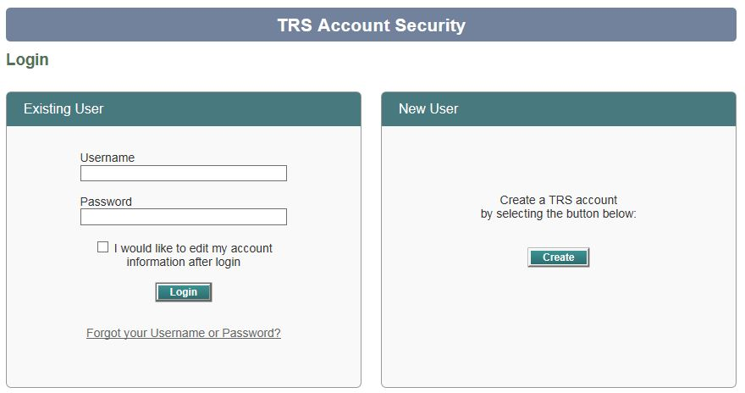
TRS Online Accounts
Online Administrator
Creates Online Services account
Manages Additional Users
Username/Password
Follow instructions on Login page to recover user name and/or password
TRS does not have any record of the password.
TRS can reset your password

Slide 22
Insurance Deduction System

Slide 23
Insurance Deduction System
Montana statute allows TRS benefit recipients to have their employer sponsored health insurance premiums withheld from their monthly TRS benefit payments.
The Employer Insurance Deduction System is designed for employers to record the appropriate insurance deduction amounts for TRS.
After payroll is run each month, the withheld funds are sent directly to the employer for payment of health insurance premiums on behalf of the benefit recipient.

Slide 24
Insurance Deduction System
There is an Online Manual within the system to help you set up and report insurance deductions
If you are interested in more information about Insurance Deduction, contact:
TRS Retired Members & Benefit Recipient Staff
(406) 444-3135: Natalie Chamberlain
(406) 444-3185: Chris Fish

Slide 25
Wage & Contribution Reporting

Slide 26
Wage & Contribution Main Menu
Most of your work is done in this tab.
This is where you will access and create new Employer Reports

Slide 27
List Employer Report
3 ways to create a new report
New report from scratch (use plus button on upper right) creates completely blank report that must be filled in. GOOD FOR ADJUSTMENTS
Copy forward creates exact replica of previous posted report
Report upload is a file generated by an accounting software system such as:
Black Mountain
Foxy Lady
Tyler Technologies
This method is highly recommended by TRS!!!
Be sure you are choosing the correct pay period!

Slide 28
List Employer Report
You can sort your reports by Fiscal or Calendar Year and you can look at any previous year reports
Start a new report from scratch
View/Edit the report summary screen
View/Edit a list of employees included in this report

Slide 29
Report Summary Copy Forward
Go into previously posted report and copy the report forward into the appropriate pay period. Make any changes to wages and hours.
Make sure you have chosen the correct pay period when copying forward

Slide 30
Report Summary Employer Edit Mode
Edit Header: Next Slide
Return to previous screen
Check all amounts before
pressing Run Report
Clear your previous Balance Forward …
… by remitting the Total Balance Due

Slide 31
Report Summary Edit Report Header
You can change:
Report type
Amount remitted
Remittance type
Add Notes
TRS encourages you to use ACH for your monthly contributions. Fill out TRS Form 140 and submit to TRS with your bank info.
You can also delete the report entirely

Slide 32
Report Summary Employer Edit Mode
Once all amounts look correct click Run Report. TRS system will check report and create errors and warnings for your review.

Slide 33
Sample: Employer Edit Report
This report is optional. You can look at your Errors and Warning on the Member List Screen also.
Look in the Online Manual
for a listing and explanation of
all errors and warnings. Call TRS with any questions.

Slide 34
Report Summary Edited with Errors
After you have Run Report you may have errors that must be corrected before submitting. To see the errors click on the Member List.

Slide 35
Member List
Member List – View/Edit a list of employees included in this report. After you Run Report this is where you can see any errors or warnings.

Slide 36
Employer Report Errors and Warnings
You can sort this screen for errors or warnings

Slide 37
Report Summary Employer Edit Mode
You must press the Run Report button each time you make any edits.
The errors/warnings that were corrected will no longer display once you run the report.
Remember: You are not complete until you have clicked the Submit button on this screen!

Slide 38
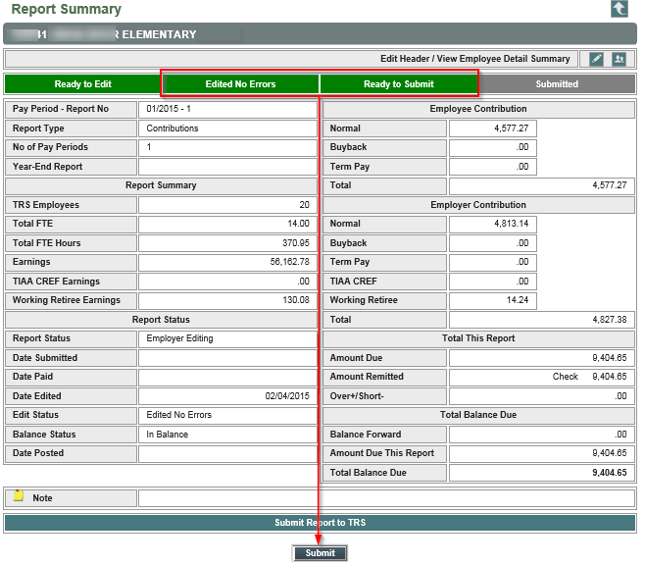
Submit Report

Slide 39
Full Reporting Cycle

Slide 40
Report Summary Unsubmit
You can enter notes here for TRS staff
Use Unsubmit if you make a mistake. You will then start over from “run report”

Slide 41
Print Report / Print Screen
You can print the report from the Report Summary screen by using the Print Screen function in the top right corner.
This print screen function can be used on any screen.

Slide 42
Wage & Contribution Main Menu
Shows the history of TRS contributions for a specific employee. In order to protect privacy, it does not show contribution information from other employers.
You can search the TRS membership database to see if a new employee is already a TRS member.
Once that member is your employee, you can update name, address, etc. If they are not your employee, their private information is protected. (next slide)

Slide 43
Member Search
You can search for a member with the Find button by social security number or press Lookup to search by name.
Reminder
New Members must be entered into the system manually or through the upload process.

Slide 44
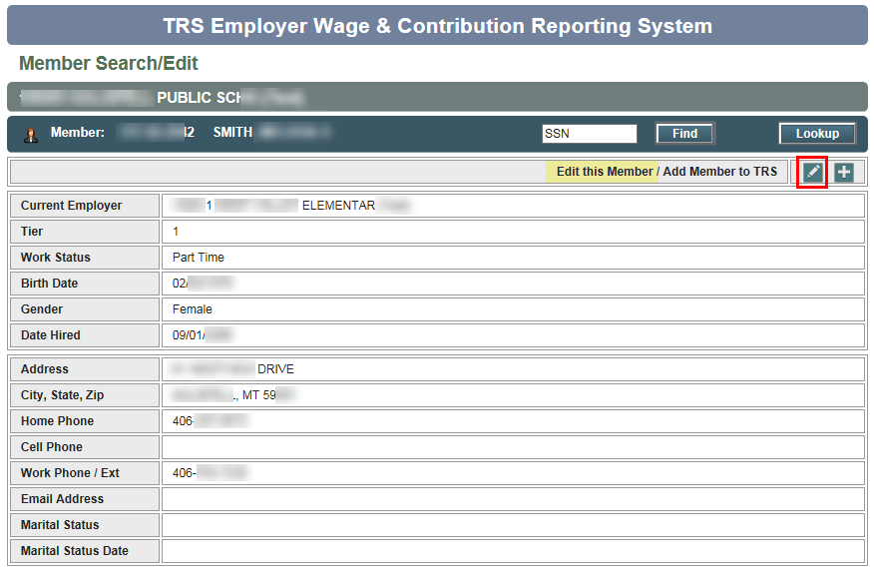
Member Search/Edit
This is a view screen. Pressing the edit icon will bring you to the edit screen (next slide)

Slide 45
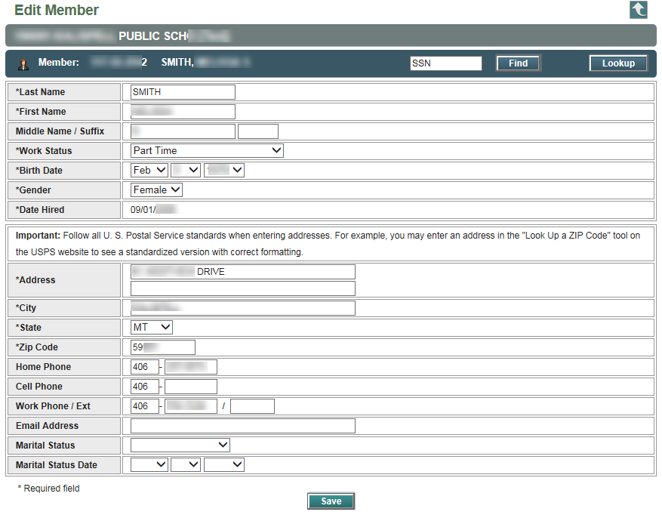
Edit Member
Once all the fields with an asterisk are complete, click on the save button.

Slide 46
Wage & Contribution Main Menu
Upload payroll reports from your accounting system. Easiest way to create a report. If you do not use this function and would like to, let us know if you need help getting set up.

Slide 47
Report Upload
Make sure you have chosen the correct pay period when uploading

Slide 48
Wage & Contribution Main Menu
This is feature which allows you to calculate employer and employee contributions due for termination pay.

Slide 49
Termination Pay Overview:
Termination Pay Irrevocable Election Form – Form 129
At least 90 DAYS prior to last day of work
HAVE MEMBER CALL AND GET ESTIMATE
IRS rule – Allows for tax deferral of term pay
Retirement Termination Pay – Form 113
Filled out at or near termination - TURN IN BEFORE REMITTING
Form used to enter; Term pay option, Amount vacation, Amount sick, Termination date, etc.
Will be used to enter amounts on Term Pay Calculator (Next 4 slides)
Must print Term Pay Calculator and send in with Form 113
All above must be done before Term Pay can be submitted on W&C report

Slide 50
Term Pay Calculator
Date, Amount, and Option from Form 113
DON’T FORGET TO CLICK TAX CALCULATORS

Slide 51
Term Pay Calculator : Result Options 1 & 2

Slide 52
Term Pay Calculator: Input Option 1

Slide 53
Term Pay Calculator: Result Option 1

Slide 54
TERM PAY QUESTIONS
Term Pay Calculator and Term Pay Forms
Cathy Page– 444-3132
Johnelle Sedlock – 444-4113
Brynn Dennehy – 444-3324
Jessie Hill – 444-3091
Reporting Term Pay on W&C Report
Joyce Love – 444-3323
Nolan Brilz – 444-3679

Slide 55
Wage & Contribution Main Menu
It shows a list of any submitted or posted reports that contribute to a balance forward (over/short).
(next slide)
Employer name and contact information for payroll/HR should be updated here whenever necessary. PLEASE UPDATE IF YOU ARE NEW!

Slide 56
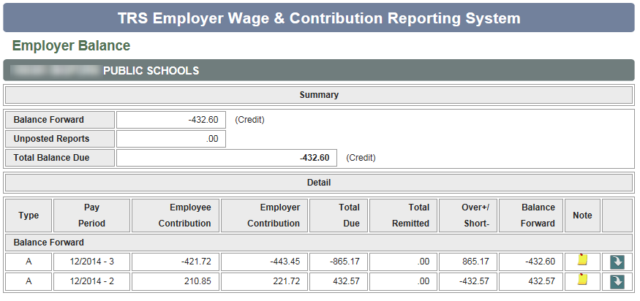
Employer Balance
If the Balance Forward is positive (Employer owes TRS). If Balance Forward is negative (TRS owes Employer).

Slide 57
Wage & Contribution Main Menu
You can run PDF reports anytime and print or save to your computer. The system does not save previously run reports.
Contribution Summary is a PDF version of the Report Summary screen (next slide).
If you pay your contributions by check, rather than EFT/ACH, you will print, sign, and mail this with your check.
Contribution Detail is a PDF version of the Member List screen (Employer Reports section).
Working Retirees is a PDF report of how close your TRS working retiree employees are to their maximum earnings limit.
(two slide)

Slide 58
Report Summary Contribution Report
If you are submitting your contribution via check, you can sign and date this form and enclose with your payment.

Slide 59
Working Retiree Report

Slide 60
Wage & Contribution Main Menu
The Online Administrator will use this selection in order to give access to Additional Users, once they have registered online and submitted their user name (but not password!) to you.

Slide 61
Quick Start Guide
A Quick Start Guide is available on the Wage & Contribution Reporting System web page to help you get started.

Slide 62
Online Manual – Table of Contents
Once you have entered the Wage & Contribution Reporting System, you will have access to the Online Manual.

Slide 63
Reminders

Slide 64
TRS Members
A person employed at least 210 hours during the fiscal year in a position reportable to TRS must become a member of TRS.
TRS membership is not dependent on the job title but on the responsibilities and duties of the position.

Slide 65
TRS Retiree
A TRS member is considered to be retired once they have:
Terminated all employment in positions reportable to TRS, and
Received at least one monthly benefit payment
A TRS member has NOT terminated employment if they have a prearranged agreement to return to work for their pre-retirement employer

Slide 66
Working Retiree Reportable Positions
Working retirees must be reported to TRS if
The performance of duties and functions would require participation in TRS for an active member.
The job title does not determine reportability to TRS, it is the nature of the services, duties, and functions of the position.
Working retirees must be reported if they are
employed by the employer,
an independent contractor,
an employee of a third party, or
If the retiree is a volunteer and does NOT meet the legal definition of a “bona fide volunteer position”

Slide 67
Working Retiree Contributions
Employers pay contributions for TRS working retirees
Employers remit to TRS a percentage of total earned compensation paid to each retired TRS member that they employ. As of July 1, 2017 the rate increases to 11.35%.
If the retiree is a volunteer that does NOT meet the Bona Fide Volunteer Position requirements, the employer must
assign a reasonable value to the time (e.g. per hour rate, sub, rate, or other rate paid employee for similar work) and
contributions must be remitted to TRS by the employer based on the volunteer hours.
More on this - TRS Legislative Update session
If the retiree is an independent consultant or an employee of a third party, contributions must be remitted to TRS by the employer based on the compensation paid for services rendered.

Slide 68
Hiring TRS Retired Members
150 calendar day break in service
Retired TRS members may not return to work in a paid TRS position until 150 calendar days have elapsed.
Rules are different for Bona Fide Volunteer Positions
May substitute teach up to 45 days within the 150 days
Working Retirees
Must comply with break in service and earnings limitations.
Employers must submit contributions for their working retirees.
Independent contractors
Retired TRS members who return to work as an independent contractor must be reported to TRS and must comply with all necessary limitations.

Slide 69
Other Reminders
Sign up for ACH payments
ACH payments are safer and quicker to process
Easy accounting and less cost
Can choose ACH pull date
If remitting checks please send a copy of your contribution report
You can send the Print Screen version or the Contribution Summary Report
Do not skip pay period when creating a report
Please double check to be sure the report you are creating is for the proper pay period
TRS must do several adjustment to move wages and contributions to correct period.
Reports Due by 15th of following month
Please be sure reports are submitted on time
TRS will contact the Superintendent if necessary

Slide 70
Other Reminders
June reports
All June reports must be in by July 15th
TRS will send out reminder emails in June and early July
TRS must close fiscal year in mid July
If June reports are not on time the employer’s Net Pension Liability will be significantly affected.
Update contact information
Please double check your contact information
New clerks!
Warnings and Membership Forms
Please review your warnings and try to eliminate reoccurring issues. Call in with questions.
Please send in new membership forms if you have warnings.

Slide 71
Other Reminders
Be sure to use most recent forms
TRS is still receiving old forms
Check the website for new forms
trs.mt.gov/TrsInfo/Forms
TRS Home Page - Popular Link
Discard old forms

Slide 72
Other Reminders
Warning – Hourly vs Full-Time
You must choose the “Member Status” in the system or it will default to Full-Time.
If an employee is not contracted as a full-time teacher or contracted as a part-time teacher they are probably hourly
If an hourly employee goes over 140 hours in a month our system will give them 1.00 FTE. But you should still just report the hours.
Warning – Retired Member Reporting Contributions
Should they be reported as an Active Member or a Working Retiree?
If TRS has to change the report it will create an overage or shortage.

Slide 73
Resources for TRS Employers

Slide 74
TRS Website
The TRS website is located at: www.trs.mt.gov
Active Members
Benefit Recipients
Employers
Resources
About TRS
TRS Board
Contact TRS

Slide 75
TRS Staff
Our staff members are available to help you with questions or problems that you may have.
Website: trs.mt.gov
Phone: (406) 444-3134 / (866) 600-4045
Email: trswebadmin@mt.gov
The Contact TRS Staff page on the website has information on specific staff members who can help you address specific questions.

Slide 76
Thank You!

