Slide 1
Mindfulness-Based Stress Reduction
MASBO State Meeting
June 14, 2018

Slide 2
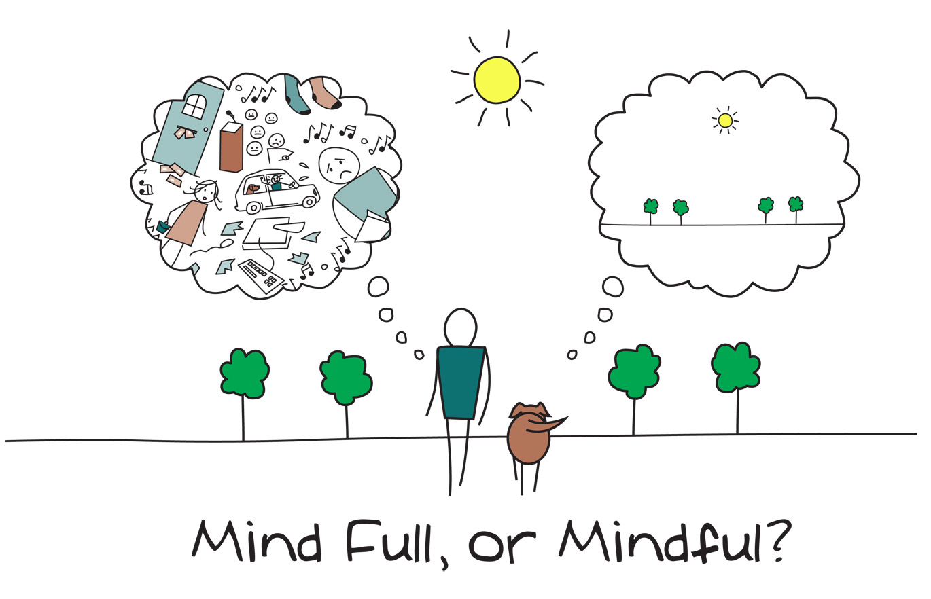
Notes:
If you can start the day without caffeine or pep pills,
If you can be cheerful, ignoring aches and pains,
If you can resist complaining and boring people with your troubles,
If you can eat the same food everyday and be grateful for it,
If you can understand when loved ones are too busy to give you time,
If you can overlook when people take things out on you when, through no fault of yours, something goes wrong,
If you can take criticism and blame without resentment,
If you can face the world without lies and deceit,
If you can conquer tension without medical help,
If you can relax without liquor,
If you can sleep without the aid of drugs,
If you can do all these things,
THEN YOU ARE PROBABLY A DOG!

Slide 3
Stress
“Anything that threatens our sense of well-being – challenges to social status, ego, strongly held beliefs, desire to control things or to have them be a certain way – can trigger the fight or flight reaction to some degree. JKZ
Psychological stress is a transaction between a person and his or her environment that is perceived as taxing or exceeding his or her resources and endangering his or her well-being. Lazarus & Folkman
Notes:
Perceptions create limitations which take away our feelings of power and control in our own lives: shapes our experience of stress, health, and other areas of life
Goal is to introduce a range of formal and informal mindful meditations and their central role in MBSR
Investigate, through interactive dialogue, inquiry, and didactice presentation, the conditional nature of perception
Explore the potential to develop new perspectives on one’s life and resources for wellness

Slide 4
What is your Banana?
Perceptions create limitations which take away our feelings of power and control in our own lives: shapes our experience of stress, health, and other areas of life
Goal is to introduce a range of formal and informal mindful techniques and their central role in MBSR
Investigate, through interactive dialogue, inquiry, and didactic presentation, the conditional nature of perception
Explore the potential to develop new perspectives on one’s life and resources for wellness
Notes:
England colonized India, build golf courses, monkeys would drop out of the trees and steal the golf balls and throw them all over the course. Humane ways to deal with the monkeys:
My health crisis: I Don’t Get Sick: control, burden, trust
What are our perceptions?: can’t ask for help/incompetent, status in community: too much money on clothes, or cars or vacations; we worry that people will judge us for taking medication for depression, that our spouse may be addicted to his pain medication, that our teenage daughter is sexually active. We maxed out another credit card gambling…
Perceptions create the narrative for our behavior

Slide 5
Stress Reaction
SR
SAR
Stimulus → Reaction
→ Awareness
Stimulus → Awareness → Response
A
“In between the stimulus and response there is a space. In that space is our power to choose our response. In our response lies our growth and freedom.” Victor Frankl
Notes:
Introducing conscious process that influences the flow of events that are likely to bring about automatic reactivity.
Building on direct awareness
Hurting a co-workers feelings.

Slide 6
The stress response
The Nervous System when activated for survival
Increased blood pressure
Increased heart rate
Increased vasodilatation to periphery
Increased serum glucose for energy metabolism
Increased free fatty acids for energy metabolism
Increased blood clotting ability
Increased neural activity to muscles (contraction)
Decreased gastric activity
Increased perspiration (to cool body core temp)
Notes:
Analogies: me watching baseball – winning/losing
College football players: game time/test time

Slide 7
Stress and the Immune System
According to the American Psychological Association, chronic stress is linked to the six leading causes of death: heart disease, cancer, lung ailments, accidents, cirrhosis of the liver and suicide. And more than 75 percent of all physician office visits are for stress-related ailments and complaints
7 people die every 2 seconds from stress-related disorders

Slide 8
MB Interventions in Medical Care
Asthma
Cancer
(Breast, prostate)
Transplants
(solid organ, bone marrow)
Pain
(chronic, RA, fibromyalgia)
Cardiovascular (hypertension, myocardial ischemia)
HIV
Diabetes
(Types I & II)
Obesity
Irritable Bowel Syndrome
COPD
Immune Response to autoimmune disorders
Notes:
Hundreds of research articles supporting the use of mindfulness in health care with more coming out each month.

Slide 9
MB Interventions in Psychological Care
Anxiety Disorders
Depression
Suicidality
Personality Disorders
Eating Disorders
Drug Abuse & Addiction
PTSD
Schizophrenia
Notes:
Correlated with less depressive symptoms (Way et al., 2010)
Decreased perceptions of daily hassles, psychological stresses, and nonspecific symptoms (Williams et al., 2001)
Increased empathy for self and others (Shapiro & Izett, 2008)
Enhanced sense of well-being, self-actualization, self-responsibility, and self-directedness (Shapiro et al., 2005)
Reduced:
relapse after treatment for major depression
general psychological distress
Anxiety and panic initially (Kabat-Zinn et al., 1992) and at 3-year follow-up (Miller et al., 1995)
Improved anxiety, depression, self-esteem, and sleep for adolescents (Biegel et al., 2009)

Slide 10
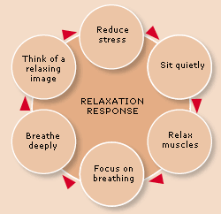
Relaxation Response
“The relaxation response is a physical state of deep rest that changes the physical and emotional response to stress… and the opposite of the fight or flight response.” Dr. Herbert Benson

Slide 11
Mindfulness
It’s Innate: you already have it within you.
It’s Free!
It’s always accessible
It’s Simple (but not always easy)
Through mindfulness, you discover how to live in the present moment rather than worrying about the past or being concerned about the future.

Slide 12
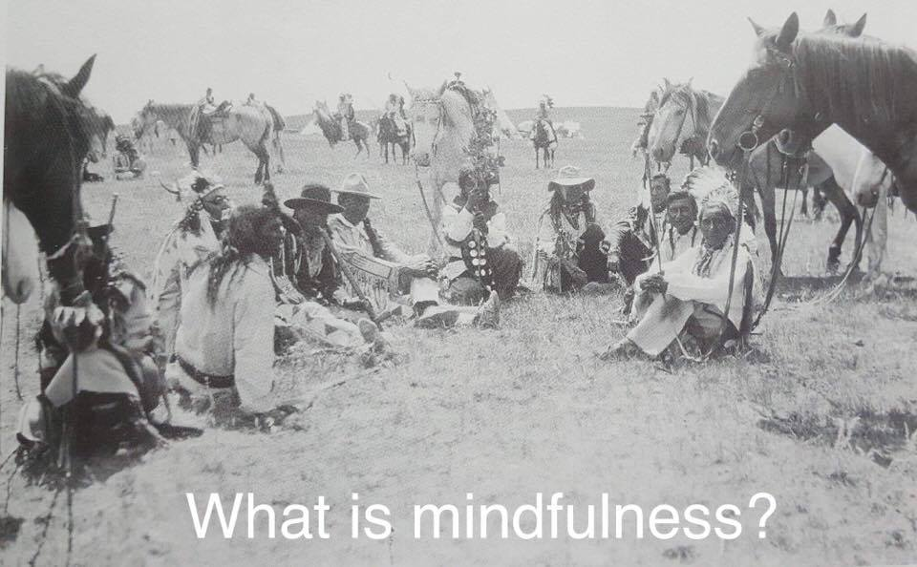
Jon Kabat-Zinn
“Mindfulness is awareness that arises through paying attention, on purpose, in the present moment, non-judgmentally.”
Teach me how to trust my heart, my mind, my intuition, my inner knowing, the senses of my body, the blessings of my spirit. Teach me to trust these things so that I may enter my sacred space and love beyond my fear, and thus walk in balance with the passing of each glorious sun.
Lakota prayer
Notes:
Chiefs, spiritual men, Sundancers, and medicine men smoking and visiting before a celebration, 1930s.

Slide 13
What does mindfulness actually look and feel like?
Attention
Listening, watching, or considering what naturally exists (directing and sustaining attention: breathe, object, emotion…)
Intention
Purposefully increasing awareness of experience
Presence
Being in the moment, here and now
Openness
Being curious, objective and non-judgmental about the experience
Notes:
Mindfulness is awareness that arises through paying attention, on purpose, in the present moment, non-judgmentally

Slide 14
Mindfulness Techniques
Breathing Meditation
Hatha Yoga/Stretching
Body Scan Meditation
Mindful Movement
Mindful Activities of Daily Living

Slide 15
Unconditional
Willing to experience aloneness,
I discover connection everywhere;
Turning to face my fear,
I meet the warrior who lives within;
Opening to my loss,
I gain the embrace of the universe;
Surrendering into emptiness,
I find fullness without end.
Each condition I flee from pursues me,
Each condition I welcome transforms me
And becomes itself transformed
Into its radiant jewel-like essence.
I bow to the one who has made it so,
Who has crafted this Master Game;
To play it is purest delight;
To honor its form – true devotion.
Jennifer Welwood

Slide 16
Books
Benson, H. M. (2010). The Relaxation Revolution. New York, NY: Scrbner.
Collard, P. (2014). Little Book of Mindfulness: 10 minutes a day to less stress, more peace. London, EN: Gaia Books.
Hanh, T. N. (1991). Peace Is Every Step: The Path of Mindfulness in Everyday Life. New York, NY: Bantam Books.
Kabat Zinn, J. P. (1994). Wherever You Go, There You Are: Mindfulness Meditation in Everyday Life. New York, NY: Hyperion.
Kabat Zinn, J. P. (2012). Mindfulness for Beginners: Reclaiming the Present Moment and Your Life. Boulder, CO: Sounds True.
Mate', G. (2003). When the Body Says No: Understanding the Stress-Disease Connection. Hoboken, NJ: Wiley & Sons.
McGonigal, K. (2015). The Upside of Stress: Why Stress is Good for You, and How to Get Good at It. New York, NY: Penguin Random House.
Salzberg, S. (2011). Real Happiness: The Power of Meditation: A 28-Day Program. New York, NY: Workman.
Sapolsky, R. M. (2004). Why Zebras Don't Get Ulcers, 3rd Ed. New York, NY: Holt.
Singer, M. A. (2007). The Untethered Soul: The Journey Beyond Yourself. Oakland, CA: New Harbinger.
Stahl, R., Golstein, E., Santorelli, S., & Kabat Zinn, J. (2010). The Mindfulness-based Stress Reduction Workbook. Oakland, CA: Harbinger.
Williams, M., & Penman, D. (2011). Mindfulness: A Practical Guide to Finding Peace in a Frantic World. Piatkus Books.
Documentaries
The Connection: Mind your Body
HEAL: The most powerful healer is within
Stress: Portrait of a Killer
Apps
Insight Timer
Calm
Headspace
Mindbody
Smiling Mind
Stop, Breathe & Think
10% Happier

