Slide 1


Alternate Ways To Access Care
MASBO Conference 2018

Slide 2

The MANY ways to access care
Why should you care?
Alternative ways to access care and what options are best for you
Discussions with your doctor about cost and quality
Prescriptions
The value of getting a second opinions

Slide 3
Alternate ways to access care and associated costs
WHY SHOULD I CARE?
There are many ways to access care outside of your doctor. Each different way has its own price point and benefits. We always want you to get the best care possible, but you must know your options.
Impacts your out of pocket expenses
Lower costs to your plan
Direct correlation between utilization and premiums

Slide 4

Alternate ways to access care and associated costs
Nurse Line
Virtual Visits
Statewide/Community Health Clinics
Primary Care Provider
Urgent Care
Emergency Room

Slide 5
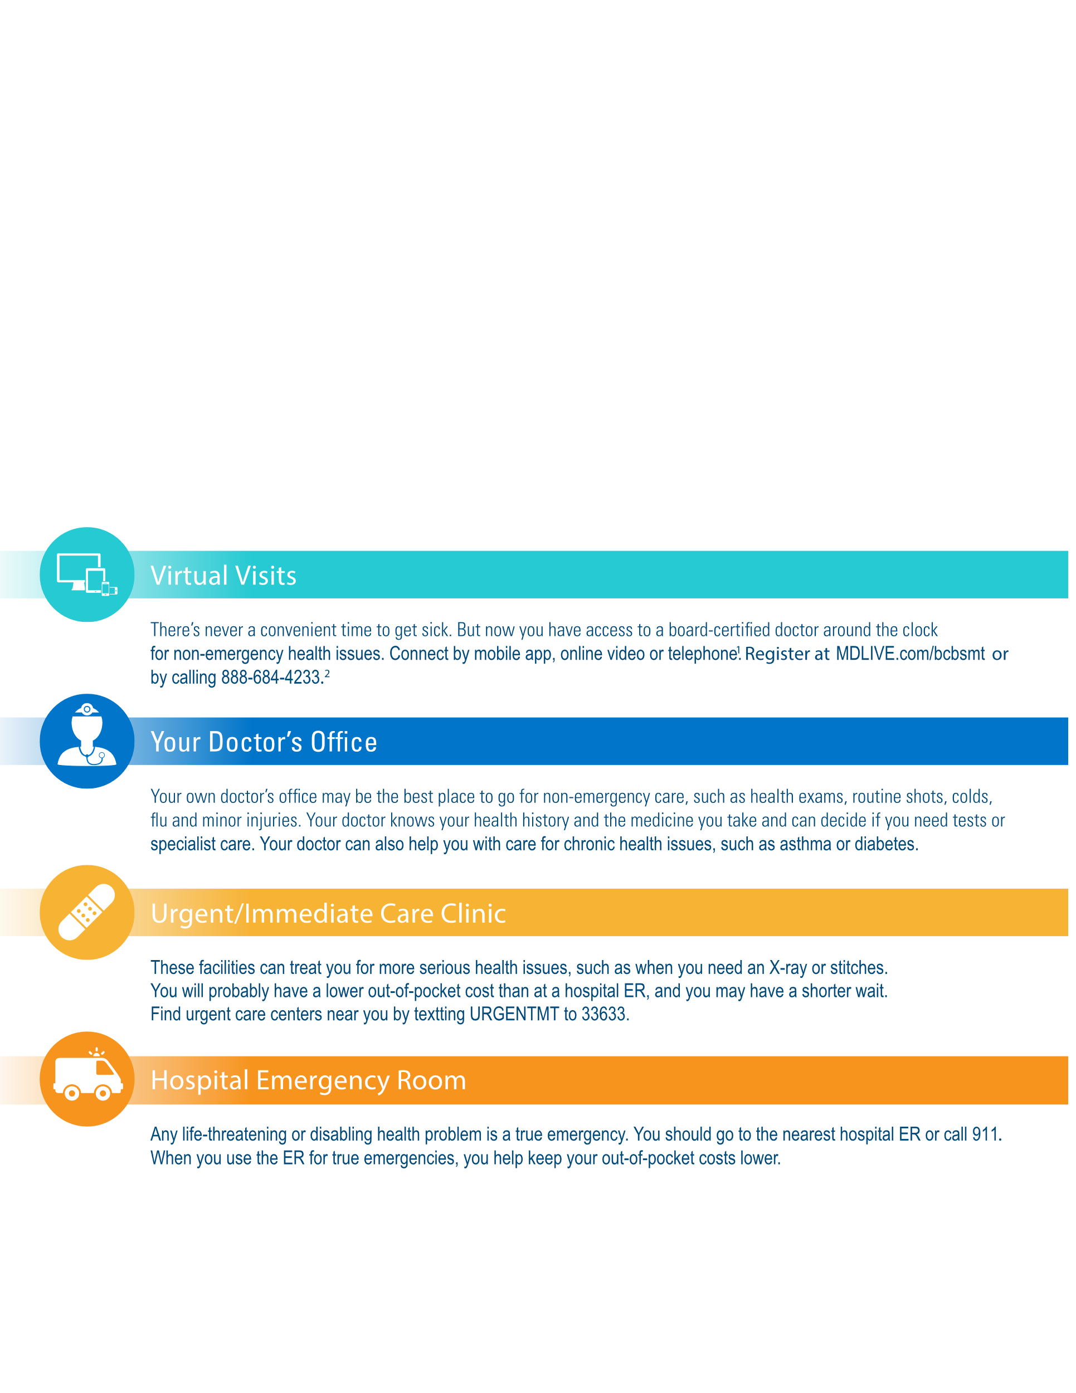
Alternate ways to access care and associated costs
Nurse Line
Nurses can answer your health questions and try to help you decide whether you should go to the emergency room, urgent care center, or make an appointment with your doctor.

Slide 6
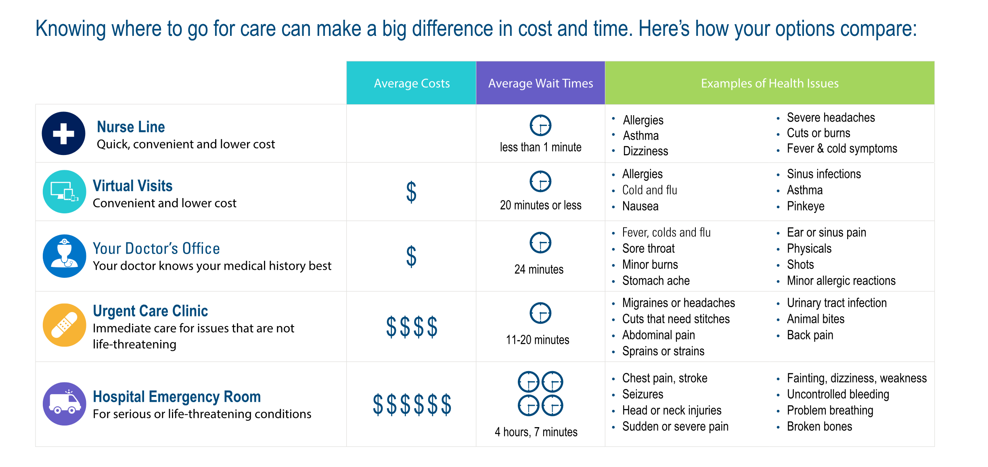
Alternate ways to access care and associated costs

Slide 7

Alternate ways to access care and associated costs
24/7 NURSE LINE
Registered nurses are available when you need them!
Nurses can answer your health questions and try to help you decide whether you should go to the emergency room, urgent care center, or make an appointment with your doctor.
You can also call the Nurse Line whenever you or a covered family member needs answers to health questions about asthma, dizziness or severe headaches, cuts or burns, back pain, fever, cold symptoms, diabetes, a baby’s nonstop crying, and much more!
Plus when you call, you can access an audio library of more than 1,000 health topics – from allergies to surgeries.
Talk to a nurse anytime, 877.213.2565

Slide 8

Alternate ways to access care and associated costs
VIRTUAL VISITS (telehealth)
No matter where you are, a doctor is available
24 hours a day/seven days a week.
You can speak to a doctor immediately or schedule an appointment. This can be a better alternative to the emergency room or urgent care.
These are just some of the conditions doctors can help treat on the phone, computer or tablet:
General Health
Allergies
Asthma
Joint aches
Sinus infections
Pediatric Care
Cold/flu
Ear infections
Pink eye
Behavioral Health
Online counseling
Child behavior/
learning issues
Stress management

Slide 9
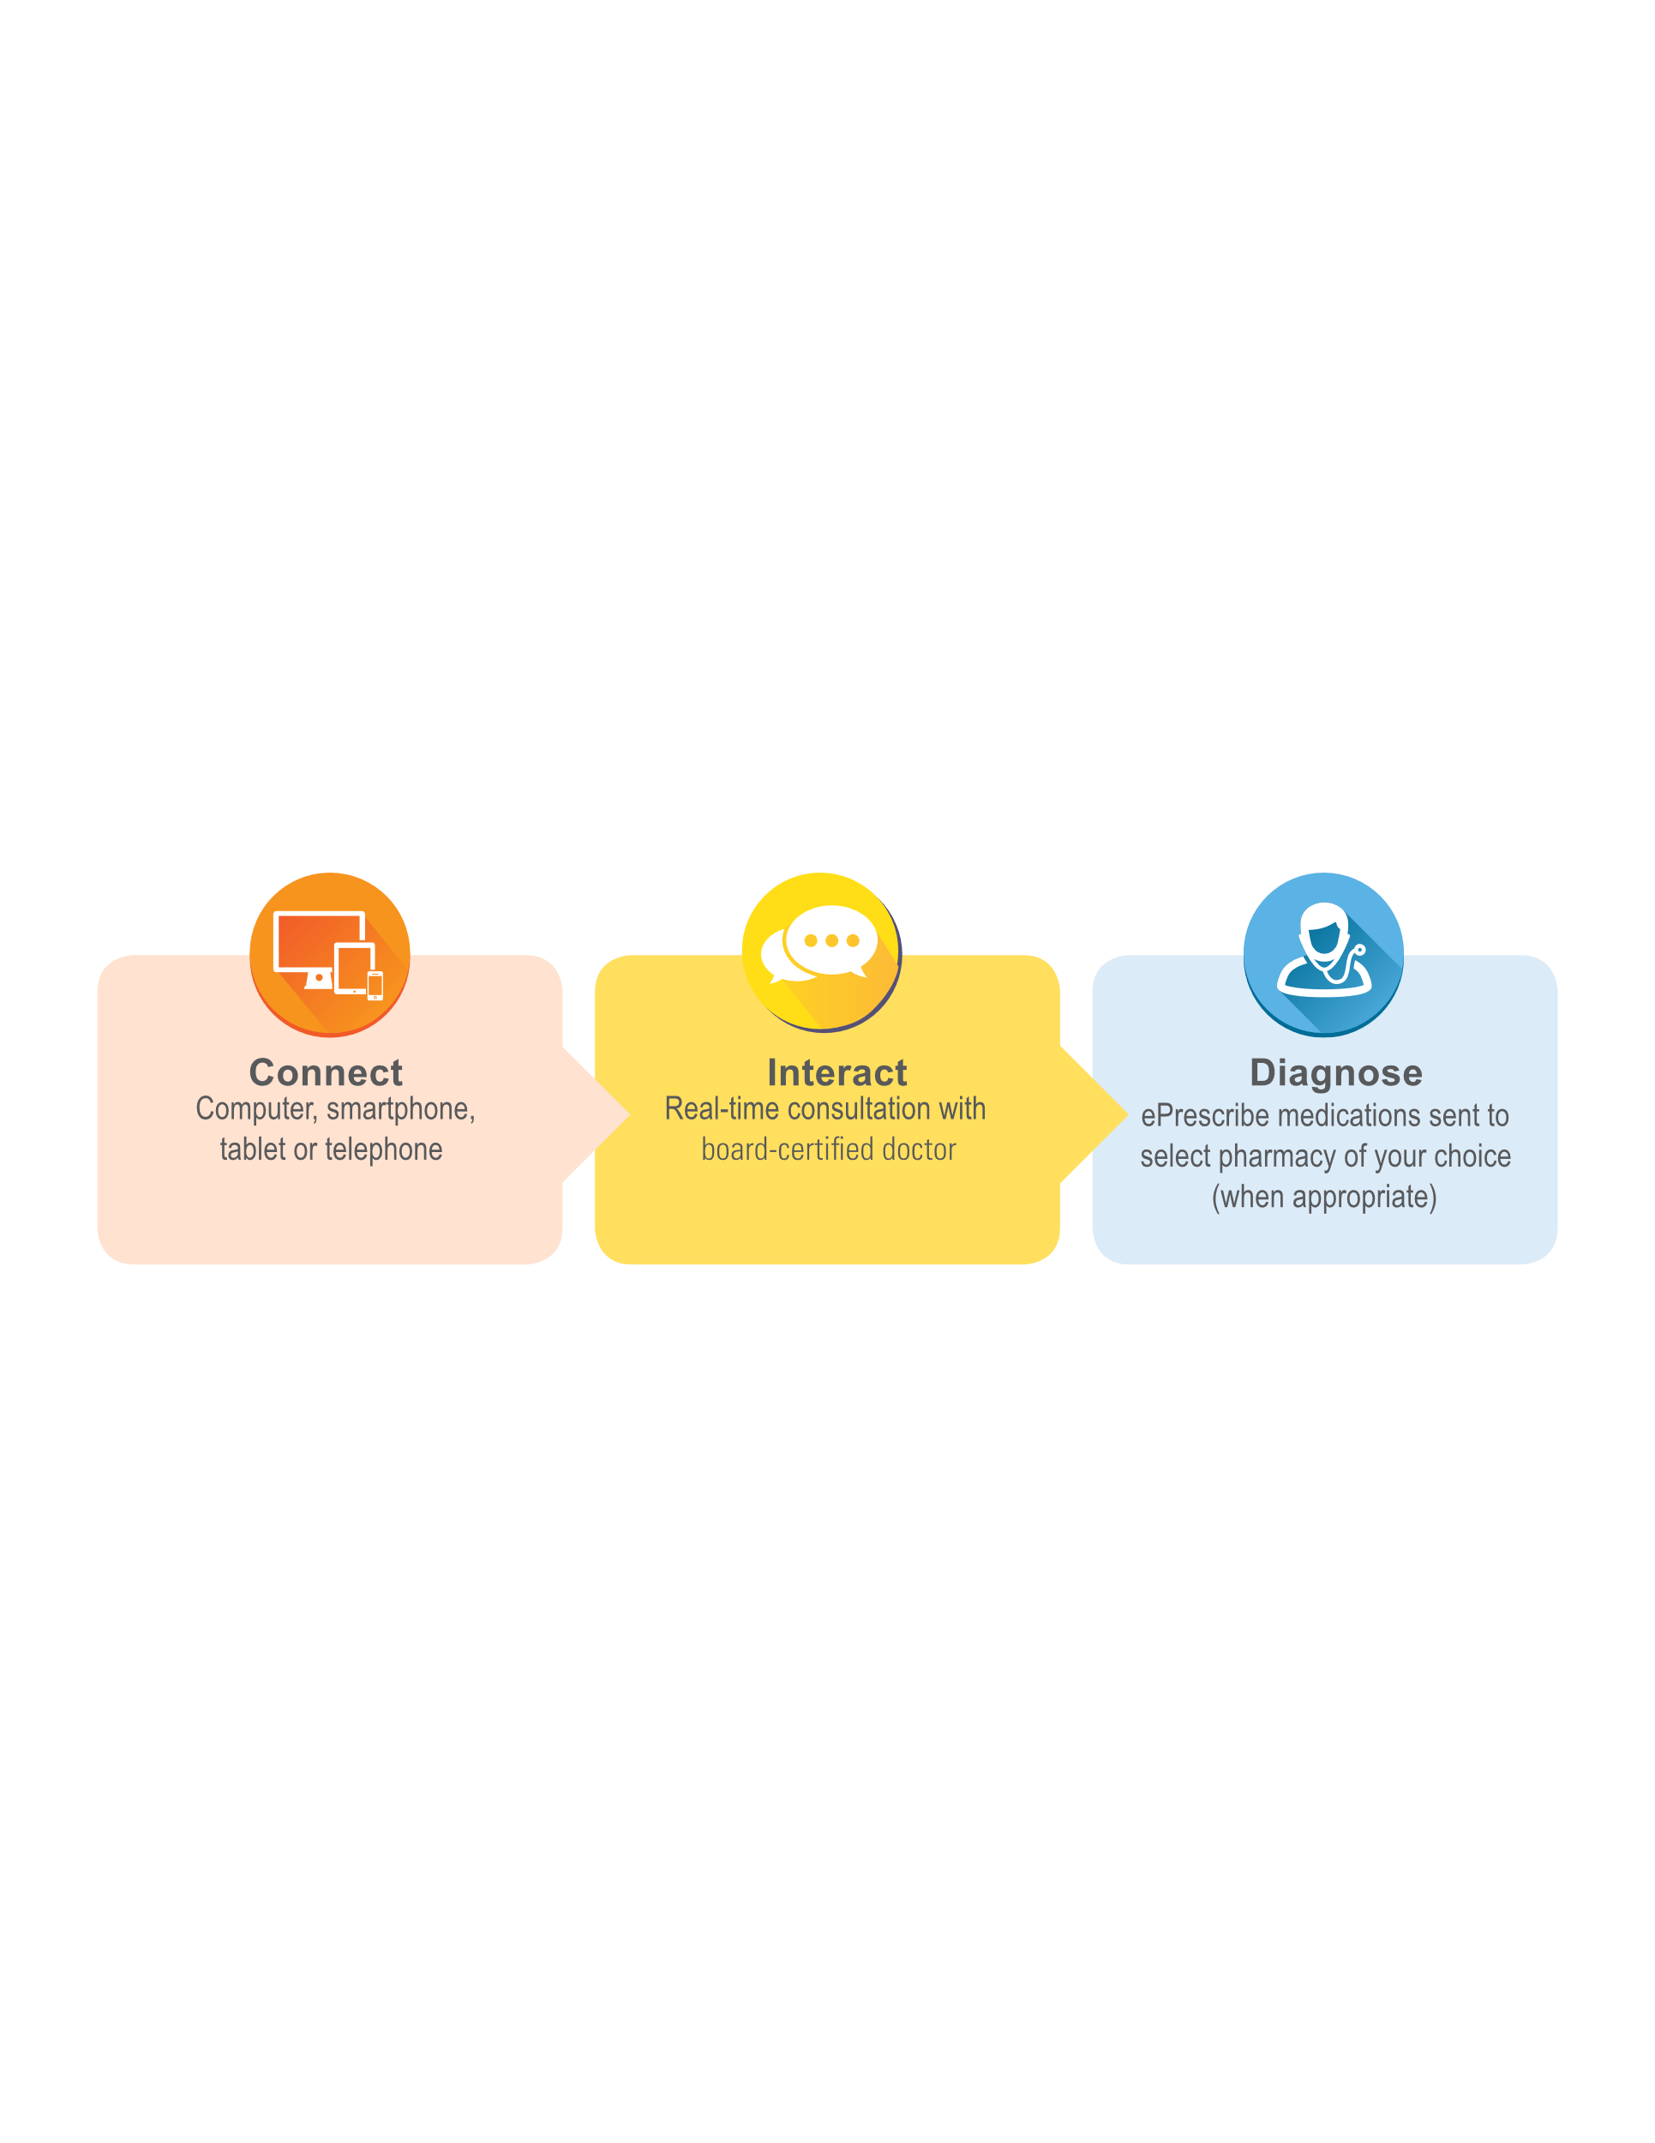
Alternate ways to access care and associated costs
VIRTUAL VISITS (telehealth)
Get connected today!

Slide 10

Alternate ways to access care and associated costs
Community Health Centers and CareHere Health Clinics
Provide an array of services.
Wellness
Nutrition & Health Coaching
Laboratory Work
And more!
It is our goal to remove the barriers that keep people from seeking medical care. Patients book appointments in 20-minute
Increments, and the Centers’ wait times are less than four minutes. Patients are never double booked.

Slide 11

Alternate ways to access care and associated costs
Have a discussion with your doctor on where you can access care for the best cost and quality of care.
Locations- Shop for what works best for you
Inpatient vs. Outpatient care
Utilize health plan’s customer service for assistance in navigating providers, services-ask questions up front.
Take advantage of available transparency pricing tools

Slide 12
Alternate ways to access care and associated costs
Why Shop Smart for Health Care?
Prices for the same-quality medical procedure can vary dramatically depending on the chosen provider–even amongst nearby facilities.
Procedure | Provider A | Provider B | Difference | % Difference
MRI of the Brain | $513 | $4,073 | $3,560 | +794%
Hysterectomy | $7,433 | $35,039 | $27,606 | +471%
Hernia Repair | $3,170 | $10,723 | $7,553 | +338%
Knee Replacement | $17,003 | $61,930 | $44,927 | +364%
Encourage your employees to make more cost-effective choices.

Slide 13
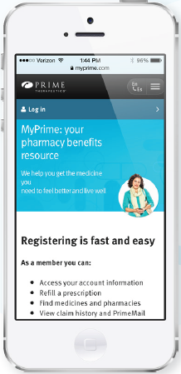
Alternate ways to access care and associated costs
PHARMACY TOOLS
Logged in Pharmacy Tool Members:
Find medicines
Estimate drug costs
Find pharmacies
Many show specific cost to you

Slide 14



Alternate ways to access care and associated costs
PHARMACY PRESCRIPTION OPTIONS
Generic, Brand, Preferred Brand, Specialty Networks or Mail Order
PHARMACY COST ESTIMATOR
View prescription cost estimates for pharmacies in your search area
See out-of-pocket cost for the prescription based on plan design,
drug list status and current personal spending balances
Search medication descriptions, side effects and generic alternatives
SAVINGS ALERT OPPORTUNITIES
Moving to a lower-cost pharmacy
Changing to a generic drug
Consolidating all prescriptions to one pharmacy

Slide 15


Alternate ways to access care
and associated costs
THE BIG PICTURE
PLAN
ENGAGE
MOTIVATE
SUSTAIN
MEASURE

