Slide 1
Making Cents of Wellness

Slide 2
Making Cents of Wellness
Why?
Live Longer
Enjoy Activity
Save Money (premium, medications, doctor costs)

Slide 3
Making Cents of Wellness
How?
Physical Activity and Traditional Thought Process
Gym 5 days/week; restrictive diet
It’s the Small Steps
Eye Exam
Dental Exam
Moderate Physical Activity
Moderate Change in Eating Habits
Mental Wellness

Slide 4
Eye Health
Did
you
know?
Studies have found connections between regular exercise and reducing risks for several common eye ailments such as cataracts, wet age-related macular degeneration and glaucoma.
Vision problems and eye disease stem from high blood pressure and high cholesterol.
A healthy diet and regular exercise are two of the most important steps you can take to lower both.

Slide 5
Eye Health
Annual Eye Exam Benefits
Evaluate visual acuity
Evaluate the complete health of your eyes from front to back—including checking for early signs of serious eye problems
› glaucoma, cataracts, macular degeneration and detached retina
Detect early signs of serious health problems based on the appearance of delicate blood vessels and other structures within the eye
› diabetes, high blood pressure and risk of stroke

Slide 6
Eye Health
1
Strengthen your eyes’ near and far focusing. This exercise strengthens the muscles in your eyes and helps maintain your current vision level.
Sit in a chair or stand in front of a blank wall. Place your thumb about 10 inches in front of your face and focus on it. You can also focus on an object that is five to 10 feet away for 10–15 seconds.
Then, focus on an object that is 10–20 feet in front of you without moving your head. Focus on the object for 10–15 seconds.
After 10–15 seconds, refocus on your thumb. Practice this five times.
Practice zooming with your eyes. This is a good eye focusing exercise, as you have to constantly adjust how well you can focus on an object from certain distances.
Sit in a comfortable position.
Stretch out your arm with your thumb in the hitchhiking position (thumbs up).
Focus on your thumb. Then, bring the thumb closer to you, focusing until your thumb is about 3 inches in front of your face.
Move your thumb away again until your arm is fully outstretched.
Repeat this exercise three more times, once a week.
You can also practice this exercise by holding a pencil in front of you at arm’s length. Then, move your arm slowly to your nose. Follow the pencil with your eyes until you can’t focus on it any longer.
Make a figure eight with your eyes. This is a great exercise to practice controlling the physical movement of your eyes.
Imagine a giant figure eight on the floor, about 10 feet in front of you.
Trace the figure eight with your eyes, slowly.
Trace it one way for a few minutes and then trace it the other way for a few minutes.
Exercising
Your
Eyes
2
3
For more eye exercises visit www.wikihow.com/Exercise-Your-Eyes

Slide 7
Dental Health
5 easy oral hygiene steps to maintain a healthy set of teeth
Brush. Twice a day use soft bristled toothbrush and toothpaste containing fluoride. Wait 30-45 minutes after you eat or drink, so the acids in your mouth drop to normal levels. Brush after breakfast, and again before bed – after you’re done eating and drinking for the day.
Floss. Once a day, use dental floss to clean tight spaces between teeth. Floss before you brush – that way the fluoride in your toothpaste can coat more surface of each tooth. Choose a time of day when you aren’t rushed, taking time and clean each tooth carefully.
Rinse. Talk with your dentist about what kind of mouthwash you should use,
and how often. Some kill bacteria, some contain fluoride, and some do both. After you use mouthwash, don’t eat, drink, or rinse your mouth for 30 minutes.
Chew gum. After you eat, pop in a piece of sugar-free gum sweetened with xylitol. Xylitol kills bacteria causing cavities. Gum in general makes more saliva in your mouth, helping to bring down acid levels. Chew gum for about 20 minutes after you eat.
Rinse again. If you’re out and don’t have gum or a toothbrush, rinse your mouth with water to loosen food particles between teeth and reduce acids in your mouth.
Taking good care of your teeth gives you a nice smile, but it also can keep you in good health.
Poor oral hygiene is linked to heart disease, diabetes, and pregnancy complications.
Tooth loss can make it hard to eat a healthy diet, leading to even more health trouble from poor oral hygiene.
“Healthy Mouth, Healthy Body.” American Dental Association, April 2006. www.ada.org/sections/scienceAndResearch/pdfs/patient_61.pdf Accessed 2013.

Slide 8
Dental Health
Yet another reason to brush at least twice and floss at least once every day.
Researcher shows that periodontal (gum) disease is caused by poor oral hygiene, leading to pain and tooth loss as well as heart disease and stroke.
People with gum disease have nearly double the risk for heart disease as those with healthy gums, according to the American Academy of Periodontology.
Gum infection is more prevalent in people who suffer a certain type of stroke.
While researchers don’t yet know exactly how gum disease affects heart health,
bacteria from infected gums may enter the blood and attach to fatty plaque in the heart’s blood vessels, or
inflammation from gum disease may increase plaque buildup. In heart disease, fatty proteins build up and thicken the walls of the arteries and can lead to restricted blood flow leading to a heart attack or stroke.
“Gum Disease and Heart Disease.” American Academy of Periodontology. http://www.perio.org/consumer/heart_disease Accessed 2013.
Good Dental Hygiene Important for Heart Health

Slide 9
Physical Activity
Benefits of Physical Activity
Manage your weight. Combined with healthy eating, physical activity is key for long-lasting weight control.
Strengthen your heart and lungs. When your heart and lungs work efficiently, you’ll have more energy.
Reduce your heart attack risk. Walking keeps your heart healthy by lowering cholesterol levels.
Control your blood pressure. Walking helps reduce high blood pressure in many cases.
Decrease your risk for diabetes. Walking helps address conditions that create the risk of diabetes. If you already have diabetes, a regular walking program can help lower your blood sugar.
Boost your spirits. Going for a walk is a super way to reduce stress. Regular walking can also help lower feelings of depression and anxiety.
Improve your sleep. Regular physical activity can help you fall asleep more quickly and deepen your sleep. A good night’s sleep can improve your concentration, productivity and mood.
Enhance your mental functioning. Research shows that regular physical activity improves blood flow to the brain, which translates to a better ability to think.
Almost three-quarters of Americans don’t get the recommended 30 minutes of daily physical activity.
Sources: Substance Abuse & Mental Health Services Administration; Mayo Clinic; Johns Hopkins University

Slide 10
Physical Activity
There are ways you can increase your physical activity to maintain a basic level of fitness — without setting aside a big part of your busy day.
Walk up the stairs when possible
Take an after-dinner walk with your family
Choose the farthest parking spot in the lot at work or when shopping
Enjoy your lunch outdoors instead of at your desk
Simple Steps
…it’s that easy!

Slide 11
Physical Activity
Take a look at how changing your thinking can change your life.
Instructions: Although physical activity needs to be a part of our lifestyle, exercise often carries with it thoughts and emotions that stand in the way of us taking action.
Consider any recent thoughts and feelings you may have had about exercise.
Think about what actions you took because of those thoughts and feelings, and what the outcome was.
Revise your thoughts. How could different thinking about same event have resulted in more positive feelings, actions, and a better outcome?
Record these thoughts to create a new feeling.
YOUR
THOUGHTS
I don’t like exercise
REVISED
THOUGHTS
I am still trying new activities to find the right one for me.
Thoughts Influencing Your Actions
Actions: I don’t exercise because I
don’t like it.
Outcome: I am not physically
active at all.
I will try a new activity each week until I find one I like.
I am exercising at least one time a week and discovering
activities that are more rewarding than I thought they would be.
Now try this activity on your own and record your own thoughts.

Slide 12
Physical Activity
Making Physical Activity a Part of Your Family’s Routine
1
SET GOALS
Have your family establish goals that everyone can achieve together. In the first few weeks, you may not achieve every goal, but if you stick with it, physical activity will become a part of your family’s routine.
SCHEDULE YOUR ACTIVITY
Best way to begin increasing your family’s physical activity is to schedule time for it. Start by identifying at least three 30-minute time slots this week for activities like taking a walk, playing sports or doing active chores. Choose times of the day or week when everyone is most likely to stick to the schedule. Creating a calendar can be helpful in tracking your progress and celebrating achievements.
BE FLEXIBLE
If a conflict comes up during physical activity time, reschedule instead of canceling. Find a new time for the activity to replace what you missed.
SHARE IT
To keep the momentum going, share your new ideas, activities and tools with friends, neighbors and relatives. Invite them to join in and get moving too!
REDUCE SCREEN TIME
Parents and caregivers should set rules reducing “screen time” by limiting amount of time children spend on the computer, watching TV and playing video games. Time spent in front of the screen could be better spent being more physically active.
Explain that it’s important to sit less and move more in order to stay healthy.
Health experts suggest no more than 2 hours of computer or television time per day unless it’s related to work or homework. Children 2 and under should be kept away from the TV entirely. Don’t use TV time as reward or punishment; this practice makes TV seem even more important to children.
Exercise Tip
Effective goals are specific, achievable and forgiving. "Exercise more" is a great idea, but "take a 30 minute walk" is more specific and easier to achieve.
2
3
4
5

Slide 13
Physical activity
Family Activities
Play tag, swim, toss a ball, jump rope, hula-hoop, dance to music or even play a dancing video game. It doesn’t have to be sports—just get your family moving!
Walk the dog, go for a jog, go on a bike ride, take the stairs or head to the park and let kids run around for a while.
Celebrate special occasions—like birthdays or anniversaries—with something active, such as a hike, a volleyball or soccer game or playing Frisbee at the park.
Get the whole family involved in household chores like cleaning, vacuuming, and yard work.
Park farther away and count with your children the number of steps from the car to your destination. Write it down and see if you can park even farther away on your next stop.
Train as a family for a charity walk or run.
Make every step you take count toward better health.

Slide 14
Physical Activity
Activity Plan: Tell your story…and create your plan
Writing out your plan is a very important step to achieving your goal. Lives are so busy that finding time, energy and motivation is a challenge.
Think about which days work best for you, what type of exercise you like, and the most convenient place to work out.
Don’t be limited by this individual action plan. Start fresh if the plan one doesn’t meet your needs. Your plan may be to run a half marathon in three months, and if that is the case, your plan may look completely different.
There are many ways to enhance fitness no matter your current fitness level. There are many pathways you can take to reach your fitness goal.
Make this plan your own and don’t be afraid to aim high.

Slide 15
Physical Activity
Goal: Enhance Fitness
My current fitness routine exercise includes:
Example: I don’t exercise routinely but try to take the stairs at work instead of the elevator.
I will begin my exercise program by adding ____ minutes/day(s) of ____.
Examples: “I will begin my exercise program by adding five minutes of walking to the 15 minutes of walking I currently do.”
“I will begin my exercise program by adding one day of strength training to my current exercise routine.”
I will increase my cardiovascular exercise by ____ minutes/day(s) every one to two weeks
Example: “I plan to increase my cardiovascular exercise by five minutes every week.”
In six weeks my goal is to be doing ____ minutes of moderate/vigorous intensity cardiovascular exercise ____ days per week.
Example: “In six weeks my goal is to be doing 60 minutes of moderate intensity exercise three days per week.”
In three months my goal is to be meeting or exceeding the physical activity guidelines by doing ____ minutes of moderate/vigorous intensity cardiovascular exercise ____ days a week and ____ days of strength training a week.
Example: “In three months my goal is to be exceeding the Physical Activity Guidelines by doing 40 minutes of vigorous intensity cardiovascular exercise, three days a week, and three days of strength training a week.”
Tell Your Story
and Create Your Plan

Slide 16
Stress
The Facts About Stress
Called the “health epidemic of the 21st century” by the World Health Organization
Almost ½ of all workers suffer from moderate to severe stress while on the job
Impacts all aspects of life – difficulty with focusing on tasks; responsible for errors and/or missed deadlines; trouble getting along with others; missed work days
Stress causes a variety of health problems
Poor emotional health can weaken immune system, making easier to contract colds and other infections
These health problems can increase work absenteeism, usage of health insurance and work-related accidents
High blood pressure | Upset stomach & ulcers
Headaches | Palpitations
Fatigue & trouble sleeping | Sweating
Weight & appetite changes | Dizziness
Dry mouth | Stiff neck, back pain, muscle aches

Slide 17
Stress
Stress is everywhere and everyone handles it differently. Following these tips may help you begin coping with your stress right away:
Know your limits and be realistic about how much you can do.
Set priorities and focus on what is most important.
Take one thing at a time.
Don’t expect perfection.
Ask for help if you need it.
Have quiet time daily. Relax, even if it is 5-10 minutes.
Take mental vacation. Close your eyes and imagine a place where you feel relaxed and comfortable.
Exercise and stretch.
Develop a hobby and do something you enjoy.
Eat well and get plenty of rest.
Have a support system. Don’t try to cope alone. Let friends and family provide encouragement, motivation, support and guidance.
Stress Stoppers

Slide 18
Nutrition
Poor dietary habits can lead to:
Fatigue
decreased mental effectiveness
irritability
lower energy levels
reduced ability to think clearly
decreased ability to perform your job effectively
higher levels of stress and depression
decreased productivity
Chances are you’ve heard the old adage “you are what you eat.” The idea is that everything you eat affects the way your body functions and how it performs. When you eat healthfully, your body processes the nutrients and maximizes them for optimal energy.
Poor nutrition — often in the form of empty calories — doesn’t give you the energy that you need. Productivity and overall well-being suffer as a result of poor nutrition.
A healthy diet helps you control your weight and lower your cholesterol, but also improve your concentration, alertness, problem-solving skills, and productivity.

Slide 19
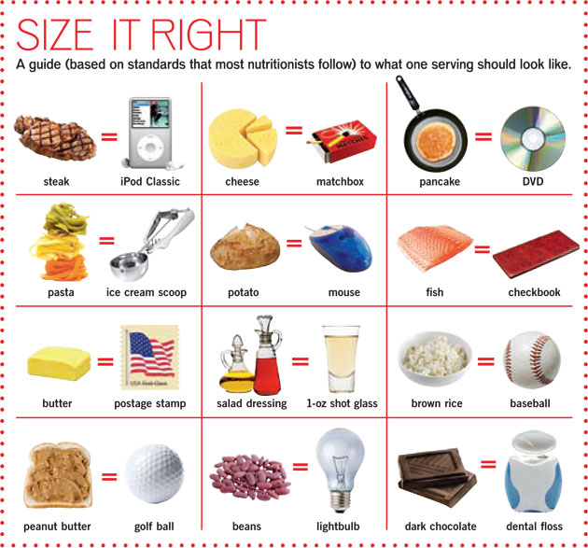
Nutrition
MEASURING UP
Measuring tools are a good way to help control portions, especially at home. Examples of measuring tools include measuring cups, measuring spoons and food scales.
When Measuring:
Measure foods after they are cooked.
Use measuring spoons for oil, margarine and salad dressings. Tableware is inaccurate for measuring.
Use measuring tools to find out how much the cup, glass and other pieces of dishware you use actually hold.

Slide 20
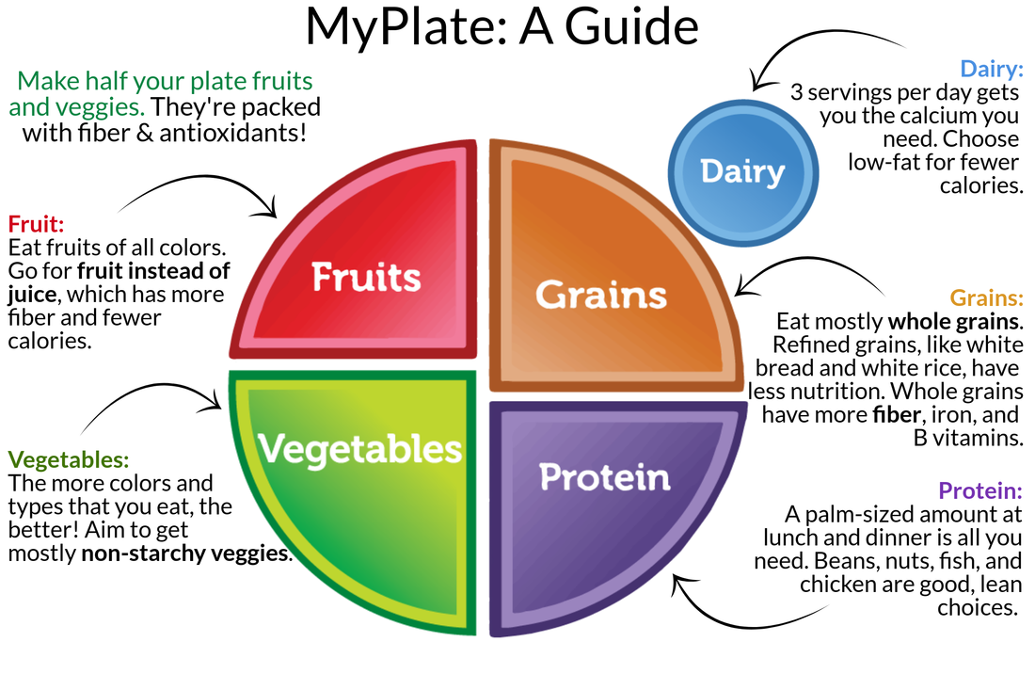
Nutrition
Choose foods and beverages from each food group
Make sure choices are limited in sodium, saturated fat, and added sugars
Start with small changes to make healthier choices you can enjoy.
Go to ChooseMyPlate.gov for more information.

Slide 21
Nutrition
Not sure which produce is in season each month?
Use the list below to help you find when your favorite fruits and vegetables are the freshest.
January – oranges, grapefruit, tangerines, tangelos, lemons, papayas, cabbage, leeks, broccoli, cauliflower
February – oranges, tangelos, grapefruit, lemons, papayas, broccoli, cauliflower
March – pineapples, mangoes, broccoli, lettuce
April – pineapples, mangoes, zucchini, rhubarb, artichokes, asparagus, spring peas, broccoli, lettuce
May – cherries, pineapples, apricots, okra, zucchini, rhubarb, artichokes, asparagus, spring peas, broccoli, lettuce
June – watermelon, strawberries, cantaloupe, cherries, blueberries, peaches, apricots, corn, lettuce
July – watermelon, strawberries, cantaloupe, blueberries, peaches, apricots, kiwi, raspberries, plums, cucumbers, tomatoes, summer squash, corn, green beans, lettuce
August – watermelon, strawberries, cantaloupe, blueberries, peaches, apricots, kiwi, raspberries, plums, cucumbers, corn, eggplant, tomatoes, summer squash, green beans, lettuce
September – grapes, pomegranates, persimmons, eggplants, pumpkins, tomatoes, spinach, lettuce
October – cranberries, apples, pomegranates, grapes, sweet potatoes, pumpkins, winter squash, broccoli, spinach, lettuce
November – cranberries, oranges, tangerines, pears, pomegranates, persimmons, pumpkins, winter squash, sweet potatoes, broccoli, mushrooms, spinach
December – pears, oranges, tangelos, grape fruit, tangerines, papayas, pomegranates, sweet potatoes, mushrooms, broccoli, cauliflower
Refreshing Watermelon Salad
Ingredients
1 cup fresh spring greens
1 cup fresh cilantro
1 cup fresh watermelon, cubed
1/2 cup red grapes, halved
1/4 cup walnuts, chopped
1/4 cup Feta cheese
4 whole-­grain dinner rolls
Directions
In a large salad bowl, mix all ingredients together. Arrange the salad mixture on a platter and serve with whole-­grain dinner rolls.
Visit whatscooking.fns.usda.gov for more great recipes and nutrition information.

Slide 22
Nutrition
ALL ABOUT FIBER
Packed with nutrients, fiber is found in all plant foods including fruits, vegetables and whole grains. There are two types of fiber: soluble and insoluble. Soluble fiber forms a gel in the presence of water—this keeps you fuller for a longer period of time. Soluble fiber has been proven to lower total cholesterol levels and protect against heart disease. Insoluble fiber absorbs water which helps you to feel full after eating. It moves quickly through your intestines, promoting regular bowel movements and aids in preventing constipation.
The daily dietary fiber recommendation is 30-38 grams for men and 21-25 grams for women.
Food Source Soluble Fiber (g) Total Fiber (g)
Barley (1/2 c.) 1 4
Oatmeal (1/2 c.) 1 2 Apples 1 4 Bananas 1 3 Blackberries (1/2 c.) 1 4 Pears 2 4 Black Beans (1/2 c.) 2 5.5 Kidney Beans (1/2 c.) 3 6 Lima Beans (1/2 c.) 3.5 6.5 Northern Beans (1/2 c.) 1.5 5.5 Pinto Beans (1/2 c.) 2 7 Lentils (1/2 c.) 1 8 Chick Peas (1/2 c.) 1 6 Brussels Sprouts (1/2 c.) 3 4.5
PICK UP ON PROTEIN
Protein is necessary for building, repairing and maintaining body tissues. The current daily dietary protein recommendation is 46 grams for women and 56 grams for men. Athletes and most active individuals require a slightly higher protein intake because of the demands of endurance and strength training.
Too much protein may overwork the kidneys, cause calcium loss, raise the risk of heart disease and contribute to obesity.
You can meet your daily protein needs by including a serving of lean animal or vegetable protein and 2-3 servings of dairy. Vegetarians can combine a wide variety of vegetables, beans and nuts to get all the nutrients they need.
3 oz. roasted, skinless chicken breast 26 g.
3 oz. extra lean ground beef 22 g.
3 oz. salmon 22 g.
1 c. skim milk 8 g.
1 oz. low-fat cheese 7 g.
2 T. peanut butter 8 g.
½ c. black beans 8 g.
1 oz. firm tofu 4 g.
½ c. soybeans 14 g.

Slide 23
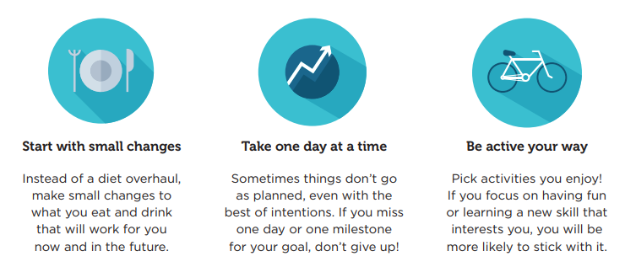
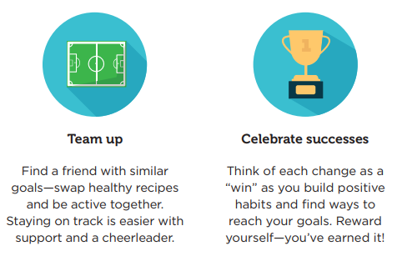
Making Cents of Wellness
Good health is more than just exercise and diet. It’s a point of view and a mental attitude you have about yourself.

Slide 24
Making Cents of Wellness
In summary…
The greatest wealth is health.
It’s the small, everyday steps that can make a big impact.
Wellness is the complete integration of body, mind, and spirit - the realization that everything we do, think, feel, and believe has an effect on our state of well-being.

