Slide 1
Termination Pay
Montana Teachers’ Retirement System
2018 MASBO Spring regional workshops

Slide 2
This presentation will cover:
Which payments qualify as termination (“term”) pay
What options are available for including term pay in calculation of TRS retirement benefits
When to have an employee sign TRS Form 129, Termination Pay Irrevocable Election
When and how to use the Term Pay Calculator to submit with TRS Form 113, Retirement Termination Pay

Slide 3
Termination pay generally includes:
Bona fide vacation leave, sick leave, severance pay
Amounts provided under a window or early retirement incentive plan
Other payments contingent on terminating employment and retiring
Note: If your district’s termination or severance package includes options or benefits other than cash payments, you must contact TRS for a determination before remitting a contribution on a retiring employee’s behalf.
These payments must be made to the employee at the time of termination and retirement to be considered termination pay.

Slide 4
Termination pay does not include:
Amounts that are not wages under Section 3121 of the Internal Revenue Code (IRC)
Amounts payable from a deferred compensation plan under Section 457(f) of the IRC
Amounts that are not actually paid to the employee at the time of termination and retirement
Amounts for which the employee was allowed a choice between a cash payment and another form of payment
Example: District offers the option of either cash or payment of health insurance premiums in lieu of cash

Slide 5
Three options for treatment of termination pay
Term pay options
Term pay gross amount is divided among the years used to calculate Average Final Compensation (AFC)
Term pay gross amount is divided by total years of service credit to determine an annual amount
Term pay is not used in calculation (employee takes cash)

Slide 6
Options 1 and 2 increase the retiree’s monthly benefit
Employer and employee must make contributions to TRS to fund the increase in benefits over the employee’s lifetime
Option 1 = Highest increase in benefits; highest cost
Option 2 = Smaller increase in benefits; lower cost
If the termination pay amount is insufficient to fund the cost of the increase, the employee may owe additional money to TRS (“out of pocket” cost)

Slide 7
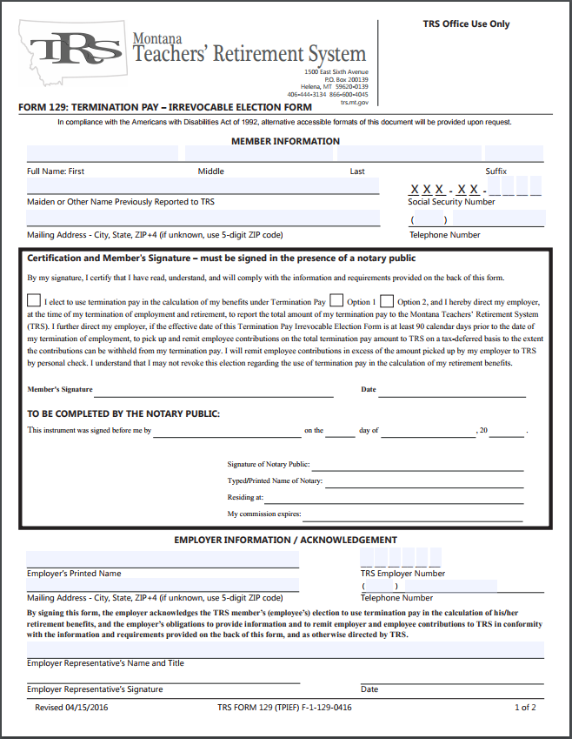
Tax deferral of employee contributions
You and your employee sign TRS Form 129 Termination Pay Irrevocable Election (TPIEF) and file with TRS at least 90 calendar days prior to employee’s termination date for employer to deduct contributions pre-tax
90 days = IRC requirement
If not executed at least 90 calendar days before termination date: Employee may still elect to include term pay in calculation but must pay all employee contributions by personal check

Slide 8
Sign and submit TPIEF at least 90 calendar days ahead – but not too far ahead
TRS strongly recommends you have employees get an estimate of retirement benefits – either from TRS staff or by using the “My TRS” online account system – before they make an irrevocable election
Employees should not lock themselves into a term pay option until they understand how this election will affect them!

Slide 9
Example: Term Pay Option 1
The more years of service, the more it will cost
Hypothetical employee retiring at age 60
Service credit: | 25 Years | 30 Years | 35 Years
Term Pay Amount | $ 5,000.00 | $ 5,000.00 | $ 5,000.00
FICA/Medicare 7.65% | ($ 382.50) | ($ 382.50) | ($ 382.50)
Net Amount | $ 4,617.50 | $ 4,617.50 | $ 4,617.50
Contributions Due TRS | ($ 4,200.00) | ($ 5,040.00) | ($ 5,880.00)
Difference | $ 417.50* | ($ 422.50)** | ($ 1,262.50)**
Monthly Benefit Increase | $ 57.87 | $ 69.44 | $ 81.02
Recovery time | (N/A) | 6 months | 16 months
* Payable to the employee, less federal and Montana state income taxes
** Out-of-pocket expense payable to TRS by personal check to fund the benefit increase

Slide 10
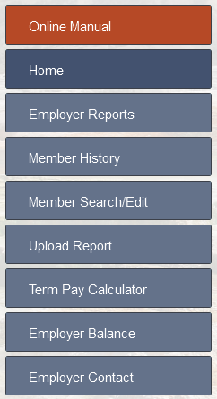
Using the online Term Pay Calculator
Once the employee has terminated and the term pay amount is known:
Log into the TRS Wage & Contribution Reporting System
Select “Term Pay Calculator” from the menu
Look up your employee by name or SSN
TIP: Use the online manual (red button) for more information about using the screen

Slide 11
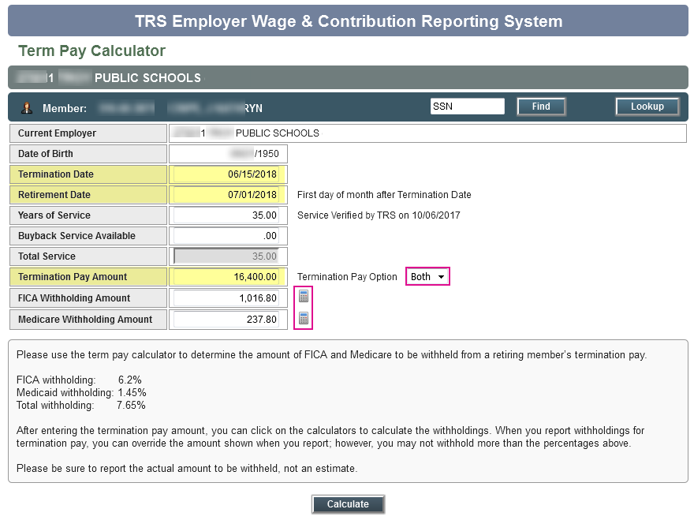
EXAMPLE 1: TRS does not have a TPIEF on file
To use Term Pay Calculator:
Enter the Termination Date
If needed, update Retirement Date
Years of Service will fill in later
Enter Termination Pay amount
You may select “Both” to see contributions due under Options 1 and 2
Click the calculator icons to fill in FICA and Medicare w/h
Click the Calculate button

Slide 12
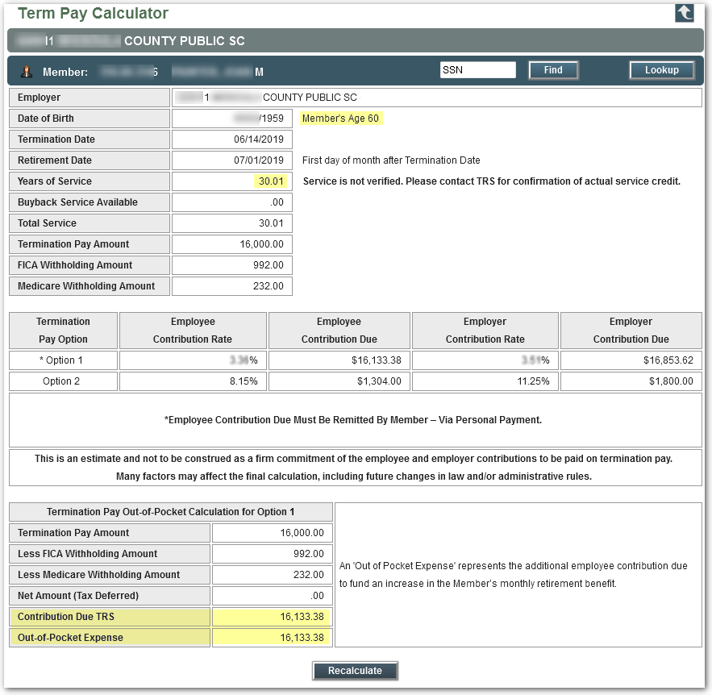
Screen shows contributions due for both options, but no tax-deferred net amount
Click “Recalculate” to start over or modify your entries

Slide 13
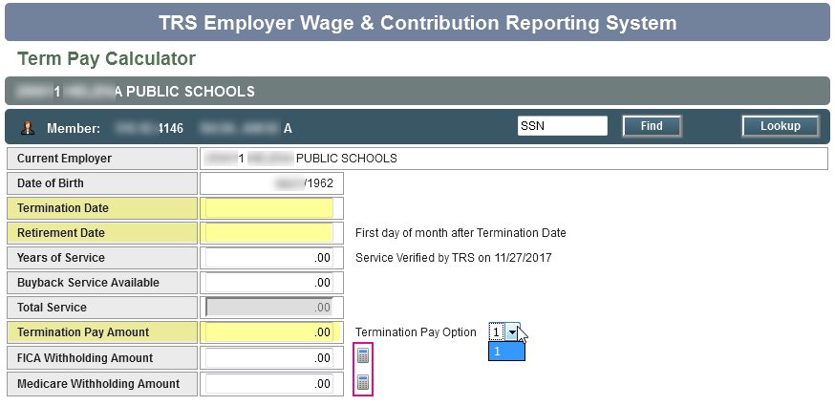
EXAMPLE 2: This employee has made an irrevocable election (Option 1)
Notice the termination pay option cannot be changed.

Slide 14
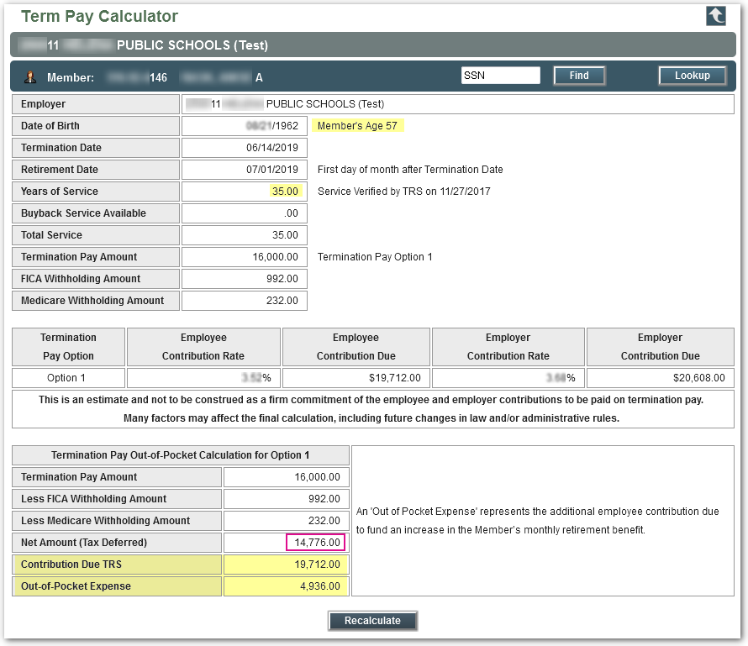
Bottom section shows contributions due, out-of-pocket expense, and the tax-deferred net amount

Slide 15
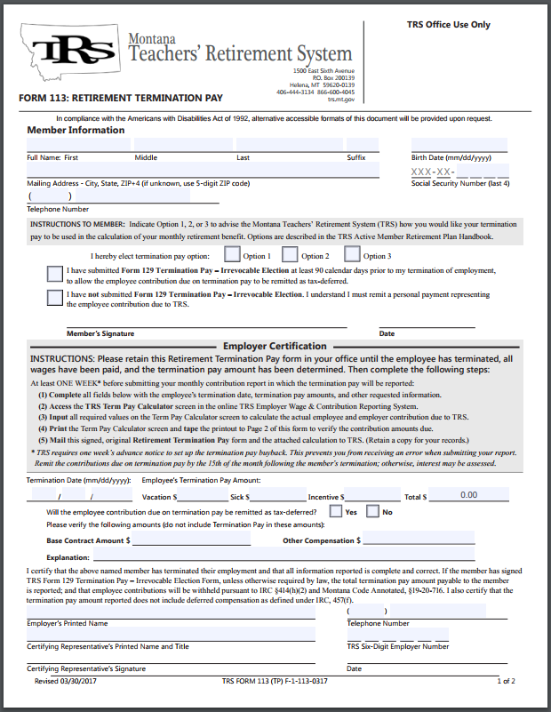
Print calculation and send to TRS with Form 113 – Retirement Termination Pay
You can print the calculation using the Print icon at the top of screen
Follow all instructions on TRS Form 113 Retirement Termination Pay
Submit Form 113 to TRS (fax, email, or mail) with the Term Pay Calculator printout one week prior to submitting your Wage & Contribution report

Slide 16
QUESTIONS?
Questions about Term Pay forms: | Cathy Page | (406) 444-3132 | CPage2@mt.gov
Other TRS Active team members: | Johnelle Sedlock | (406) 444-4113 | jsedlock@mt.gov
 | Brynn Dennehy | (406) 444-3324 | BDennehy2@mt.gov
 | Jessie Hill | (406) 444-3091 | Jessie.Hill@mt.gov
Questions about W&C Reporting: | Nolan Brilz | (406) 444-3679 | NBrilz@mt.gov
 | Joyce Love | (406) 444-3323 | JLove@mt.gov

