Slide 1


AUTO | HOME | LIFE | RETIREMENT
The New Department of Labor (DOL) Fiduciary Rule
Best Practices Workshop
Putting educators first since 1945
^{horacemann.com}
PPT-00175
Notes:
Welcome attendees

Slide 2

Agenda
Department of Labor (DOL) Best Practice Workshop
  The new DOL fiduciary rule
  Possible implications for plan sponsors
  Provider best practice
Notes:
To provide context, who was involved with 403(b) regulation implementation? (Ask for show of hands.)
As you may recall, it placed new requirements on districts as plan sponsors, including:
Plan Document
Ensuring that your plan is operating according to the plan document…., including:
Universal Availability
Annual provision of meaningful opportunity to participate
In summary, the new requirements mean that, as a plan sponsor, your role is no longer hands-off.
The Department of Labor has communicated a new rule that may have implications for you as a plan sponsor. Today we’ll briefly discuss the new fiduciary rule, possible implications for you and your employees, and some best practice questions to ask your providers.

Slide 3
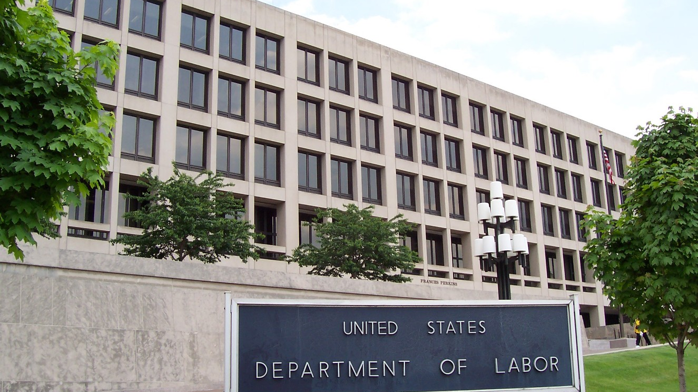
DOL Fiduciary Rule Background
DOL has regulated ERISA retirement plans since 1974
Growing concerns about plans not covered by ERISA, like IRAs
Goal: Protect working Americans’ retirement security
Notes:
First, a bit more background.
The DOL has regulated certain employer retirement plans since 1974 under ERISA, the Employee Retirement Income Security Act.
ERISA does not cover all retirement plans, however. And there have been growing concerns about those plans that are not covered — like IRAs… — The goal of the new rule is to provide protections for more working Americans’ retirement security.

Slide 4

The New Fiduciary Rule
  The DOL final rule:
  Expanded the definition of investment advice as it applies to ERISA retirement plans and individual retirement accounts (IRAs)
  Defined “fiduciary” to include a person or financial institution that provides that investment advice
Notes:
Here’s a summary of the DOL final rule: (Read points.)

Slide 5

The New Fiduciary Rule
Suitability Standard
New Best Interest Standard
Suitability
Best Interest
Representative
Fiduciary
Commission-based compensation
Asset-based compensation
Notes:
The new fiduciary rule sets a higher standard.
These are the key impacts:
As they apply to ERISA plans and IRAs:
Contrast suitability standard vs. best interest standard for each item:
The best interest standard is a higher standard. It requires that the provider’s solution be not only suitable for the client, it must be a solution that is in the best interest of the client.

Slide 6

Standards
Suitability Standard
New Best Interest Standard
  Know the client and the client’s financial situation
  Put client’s best interest before the representative’s financial interest
  Act with the skill, diligence and prudence of a professional
  Avoid misleading statements about fees and conflicts of interest
  Fully disclose conflicts of interest
  Adopt measures to prevent conflicts of interest from causing violations of the best interest standard
  Recommend products that are suitable for client’s situation
Notes:
Here is how the new, higher-level best-interest standard is designed to help protect the investor. (Review points.)

Slide 7


Implications for Plan Sponsors
  Your employees could be affected depending upon how a financial institution implements its business practices:
Suitability Standard
  Non-ERISA 403(b) plans are not subject to the new rule
  IRAs are subject
  to the new rule
Notes:
So, let me ask you all a question: Are you subject to ERISA? (Answer: No, they are exempt as governmental institutions.)
So, if you’re exempt as a governmental institution, what does all this mean to you?
Answer: Depending on how your providers implement their business practices as a result of the new rule, your employees could be affected. Although non-ERISA 403(b) plans are not subject to the new rule, IRAs ARE. A provider could conceivably decide to apply different standards depending on the type of plan: the best interest standard for IRAs and the suitability standard for non-ERISA 403(b)s.
Faced with the dual standard, providers could:
Comply with the new best interest standard only where required and go business-as-usual with non-ERISA 403(b)s.
Withdraw from the 403(b) market entirely, which could cause a disruption for you and your employees.
Work to deliver the higher “best interest” standard for all 403(b) and IRA business, which is what Horace Mann plans to do. We believe this is a best practice in the long-term, and we believe it provides the best value to your employees.

Slide 8
Provider Best Practice
Apply the best interest standard in your plan
Ask your providers:
  How will you respond to the new DOL rule?
    Differentiate between non-ERISA 403(b) and IRA customers, or
    Apply the “best interest” standard for all of your retirement customers
  How will you exercise your best efforts to always act in good faith and in the best interests of your clients?
  How will you address conflicts of interest for your representatives?
  Will you fully disclose your fees?
Notes:
Horace Mann wants to help you help your employees get the best value out of their retirement programs (so they can become retirement-ready), and we want to help you minimize potential disruption in your plan that would distract you from your primary focus: educating children.
So, here are some questions you can ask your providers to understand how they will respond to the new rule:
How will we respond? (Review each and how Horace Mann will respond.)
We will apply the best interest standard to all of our retirement customers.
We will move to a new portfolio of retirement products, paying level asset-based compensation to our representatives for all of those products, to mitigate against any conflicts of interest and ensure we’re acting in the best interest of your employees.
We will fully disclose all of our fees in writing.

Slide 9
For more information, feel free to
contact me.
Mark Major
406-466-3636
Mark.Major@horacemann.com
Putting educators first since 1945
^{horacemann.com}
Notes:
We’re proud and excited about our response to the new DOL rule because we have been putting educators first since the company was founded.
We’re here to help. If you have any questions or would like more information, please contact me.

