Slide 1
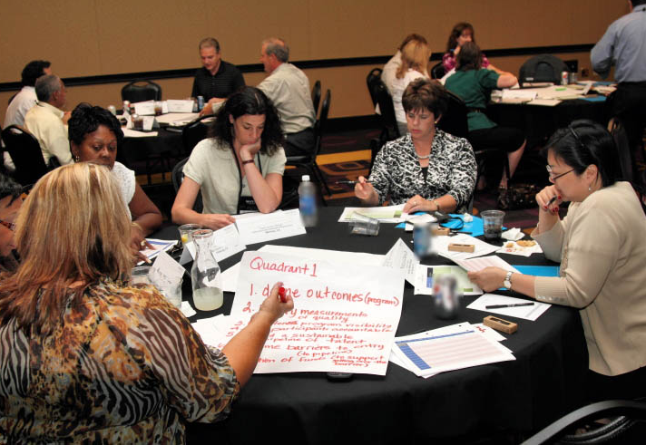
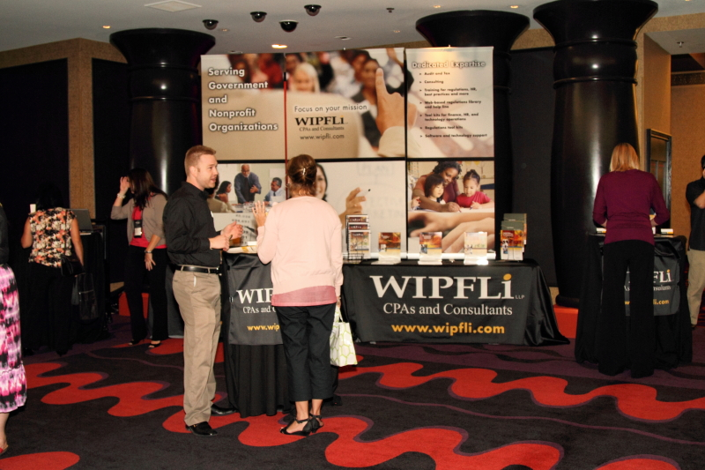
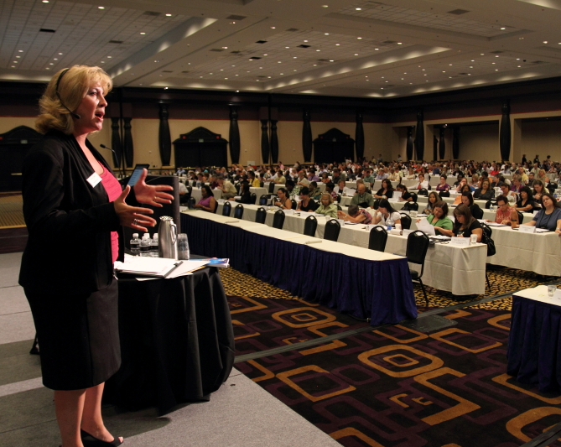
Accounting for Construction Projects
Trainer: Anthony Gerharz, CPA, Manager
© Wipfli LLP

Slide 2
Materials/Disclaimer
Please note that these materials are incomplete without the accompanying oral comments by the trainer(s).
These materials are informational and educational in nature and represent the speakers' own views. These materials are for the purchasing agency’s use only and not for distribution outside of the agency or publishing on a public website.

Slide 3
Outline
After today’s session you will have a better understanding the following
Governmental activity vs. governmental fund accounting for capital projects.
Cost that should be included in capital projects.
The information that should be provided to the auditors.
The accounts and entries that will need to be made.
A walk through of an illustrative example of a project.

Slide 4
Governmental Activities vs. Governmental Funds
Governmental Activities:
Use the economic resources measurement focus and the accrual basis of accounting, and report all of the assets, liabilities, revenues, expenses, and gains and losses of the government.
Capitalize and depreciate fixed asset additions.
Construction in progress is not capitalized until asset is placed in service.
Record long term debt, payments reduce debt by principal.
Same focus that business and enterprise funds will use.
Governmental Funds:
Use the current financial resources measurement focus and the modified accrual basis of accounting.
Bond/debt proceeds recorded as other financing source.
Expend capital asset additions and payments on long term debt.

Slide 5
What to Capitalize
Construction in Progress (CIP): Represents a temporary capitalization of labor, materials, equipment, and overhead of a construction project. Upon completion of construction, accumulated costs are cleared or moved by transfer to another fixed asset classification (e.g., buildings).
Examples of CIP include:
Architecture fees
Engineering fees
Amounts paid to contractors, including the 1% contractor fee
Amounts paid for infrastructure placed in the constructed asset

Slide 6
Documentation to Provide to the Auditor
Capital project
A schedule detailing expenditures on the project.
Copies of invoices to support capital expenditures.
Auditor will give you a list of which ones they will look at.
Copy of board approval of contractor and bids presented.
Copy of the debt agreement.
Copy of the resolution approving the debt agreement.
Including amortization schedule.

Slide 7
Accounting for the Project
Funds to use:
General Fund (01)
Authorized by Section 20-9-301, MCA, for the purpose of financing general maintenance and operational costs of a district not financed by other funds.
Building Fund (60)
Authorized by Section 20-9-508, MCA. It is used primarily to account for the proceeds of bonds sold for the purposes provided in Section 20-9-403, MCA. The fund is also used to account for insurance proceeds for damaged property as provided in 20-6-608, MCA, or the sale or rental of property as provided by 20-6-604 and 607, MCA.
Building Reserve Fund (61)
Authorized by Section 20-9-502, MCA, for the purpose of financing voter approved building or construction projects funded with district mill levies.
Debt Service Fund (50)
Authorized by Section 20-9-438, MCA, for the purpose of paying interest and principal on outstanding bonds and special improvement district assessments. This fund is also used to account for the proceeds of bonds sold for the purposes provided in Section 20-9-403 (c) and (d), MCA.

Slide 8
Accounting for the Project
Funds to use:
Invested in General Fixed Asset Fund (98)
Used to track additions, deletions, and depreciation of fixed (capital) assets, except fixed assets related to fiduciary funds.
General Long Term Liability Fund (99)
Used to track additions and reductions of long-term liabilities, except long-term liabilities related to fiduciary funds.

Slide 9
Accounting for the Project
Balance sheet accounts to use:
For fixed assets:
Land – X98-311-0000-000-000
Land improvements – X98-321-0000-000-000
Building and building improvements – X98-331-0000-000-000
Machinery and equipment – X98-341-0000-000-000
Construction in progress – X98-351-0000-000-000
For debt pertaining to the project
Bonds payable current portion – X99-641-0000-000-000
Notes or loans payable current – X99-650-0000-000-000
Bonds payable/non current – X99-710-0000-000-000
Notes payable/none current – X99-720-0000-000-000

Slide 10
Accounting for the Project
Operating statement accounts to use:
Receipt of bond proceeds (Other financing sources):
Sale of bond – XXX-000-5110-000-000
For the sale of bonds other than refunding bonds are deposited in the Building Fund (60). Premium on bonds sold is that portion of the sale price of the bonds in excess of their par value. The premium represents an adjustment of the interest rate. In the absence of legal authority to include bond premium with the bond proceeds, premium on bonds sold should be credited to the Debt Service Fund (50) and recorded as 1900 Miscellaneous Revenue. Accrued interest paid by the bondholder at the time the bonds are sold should be deposited to the Debt Service Fund (50) and recorded using balance sheet account 656 Accrued Interest Payable. This interest should be returned to the bondholder when the first interest payment is made. See sections 20-9-401, 20-9-435, MCA.
Proceeds from long-term liabilities – XXX-000-5400-000-000
Proceeds from long-term notes made with the Board of Investments as provided by Section 20-9-471, MCA or long-term notes sold in anticipation of federal or state revenue as provided in Section 7-7-109, MCA. Proceeds from capital leases should be recorded using balance sheet account 490 Non-Budgeted Revenues - GAAP Purposes. Proceeds from short-term notes made with the Board of Investments are recorded using balance sheet account 650 Notes or Loans Payable - Current and are not recorded as revenue or as other financing sources.

Slide 11
Accounting for the Project
Operating statement account function to use:
Expenditures on the project (capital outlay and payments on bonds):
Land acquisition services – XXX-000-4100-000-000
Land improvement services – XXX-000-4200-000-000
Architecture and engineering services – XXX-000-4300-000-000
Building acquisition & construction services – XXX-000-4500-000-000
General obligation bonds payments – XXX-000-5100-000-000
Long term notes payments – XXX-000-5200-000-000

Slide 12
Accounting for the Project
Operating statement account object code to use:
Expenditures on the project (capital outlay and payments on bonds):
Land – XXX-000-4X00-710-000
Major construction services – XXX-000-4X00-725-000
General obligation bonds payments principal – XXX-000-5100-840-000
General obligation bonds payments interest – XXX-000-5100-850-000

Slide 13
Accounting for the Project
Operating statement account object code to use:
Expenditures on the project (capital outlay and payments on bonds):
Land – XXX-000-4X00-710-000
Major construction services – XXX-000-4X00-725-000
General obligation bonds payments principal – XXX-000-5100-840-000
General obligation bonds payments interest – XXX-000-5100-850-000

Slide 14
Accounting for Construction Project Case Study
The voters of Wipfli School District approved a $20,000,000 bond for the construction of a new school building. Construction on the new building will begin in Year 1.
During Year 1 the District did the following related to the project:
Received the bond proceeds of $20,000,000.
Purchased land for $2,000,000.
Expended $3,000,000 toward construction of the Building.

Slide 15
Accounting for Construction Project Case Study
Entry for Year 1:
 | Year 1
 | To record receipt of bond/ financing: | DR | CR
160-101-0000-000-000 | Cash | 20,000,000
160-000-5400-000-000 | Other financing sources |  | 20,000,000
 | To record expenditure of funds on construction
160-000-4500-730-000 | Major construction services | 3,000,000
160-000-4100-710-000 | Acquisition of land | 2,000,000
160-101-0000-000-000 | Cash |  | 5,000,000
 | At End of Year 1
 | To record Long term Liability
199-720-0000-000-000 | Bonds payable |  | 20,000,000
199-960-0000-000-000 | Fund balance reserve for non-current assets | 20,000,000
 | To record capital assets
198-351-0000-000-000 | Construction in progress | 3,000,000
198-311-0000-000-000 | Land | 2,000,000
198-960-0000-000-000 | Fund balance reserve for non-current assets |  | 5,000,000

Slide 16
Accounting for Construction Project Case Study
During Year 2 the District did the following related to the project:
Expended $10,000,000 toward construction of the Building.
Entry for Year 2
 | Year 2
 | To record expenditure of funds on construction
160-000-4500-730-000 | Major construction services | 10,000,000
160-101-0000-000-000 | Cash |  | 10,000,000
 | At end of year 2
 | To record capital assets
198-351-0000-000-000 | Construction in progress | 10,000,000
198-960-0000-000-000 | Fund balance reserve for non-current assets |  | 10,000,000

Slide 17
Accounting for Construction Project Case Study
During Year 3 the District did the following related to the project:
Expended $5,000,000 to complete construction of the building.
The first payment on bond is due and the payment is $200,000. Of that $170,000 is principal and the remainder is interest.

Slide 18
Accounting for Construction Project Case Study
Entry for Year 3:
 | Year 3
 | To record expenditure of funds on construction
160-000-4000-730-000 | Capital outlay | 5,000,000
160-101-0000-000-000 | Cash |  | 5,000,000
 | To record repayment of note
150-000-5200-840-000 | Principal on debt | 170,000
150-000-5200-850-000 | Interest on debt | 30,000
150-101-0000-000-000 | Cash |  | 200,000
 | End of Year 3
 | To record capital asset and transfer asset to use
198-331-0000-000-000 | Building and building improvements | 18,000,000
198-351-0000-000-000 | Construction in progress |  | 13,000,000
198-960-0000-000-000 | Fund balance reserve for non-current assets |  | 5,000,000
 | To record payments on long term debt
199-720-0000-000-000 | Bonds payable | 170,000
199-960-0000-000-000 | Fund balance reserve for non-current assets |  | 170,000.00
 | To record current portion of long term debt
199-650-0000-000-000 | Bonds payable current | 170,000
199-720-0000-000-000 | Bonds payable |  | 170,000

Slide 19
Questions?
Contact Information
Anthony B Gerharz, CPA | Manager | Wipfli LLP
Direct: 406.206.3591 | Office: 406.248.1681
Email: tgerharz@wipfli.com

