Slide 1

School bond overview
How to make your District’s Facilities Plan a Reality
October 21, 2016

Slide 2





Participants
Mike Waterman, Director of Business Services
Bozeman Public Schools
Lora Tauck, Business Manager
Ekalaka Public Schools
Bridget Ekstrom, Senior Vice President, Public Finance
D.A. Davidson & Co.
Dan Semmens, Bond Counsel
Dorsey & Whitney LLP
Denise Williams, Executive Director
MASBO

Slide 3
Building Blocks for a Successful Project and Financing
V. Post-Financing Phase
IV. Construction Phase
III. Financing Phase
II. Election Phase
I. Capital Improvement Planning Phase
Phases of Project Completion

Slide 4

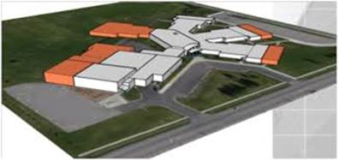
Keys to Success and Pitfalls to Avoid
~Mike Waterman, bozeman Public Schools~
Keys
  You gotta spend money to make money
  Let those with strong backs do the heavy lifting
  Under promise, over deliver
Mike Waterman | (406) 522-6097 | mike.waterman@bsd7.org

Slide 5
Keys to Success and Pitfalls to Avoid
~Lora Tauck, Ekalaka k-12 School district~
Keys
  A School Board that is unified on the bond issue
    If the entire board can’t support the issue, it is difficult for a community to support it!
  Positive downstream conditioning in the Community!
    Necessary to pass the bond, necessary to stifle the rumors before, during and after construction
    Identify your supporters and let them help you
  Prepare for being unprepared
    You don’t know what you don’t know
    Call on those who do!
Pitfalls
  Positive downstream conditioning is positively exhausting
  Unforeseen events drain your brain & your contingency fund
Lora Tauck | (406) 775-8602 | lorat@ekalaka.k12.mt.us

Slide 6
Keys to Success and Pitfalls to Avoid
~dan semmens, dorsey & whitney llp~
Keys
  Allow a lot of time
  Focus on what the District needs now or in the short term
  If you can’t say it simply, maybe you shouldn’t say it at all
Bozeman Elementary Sample Ballot Question
Ekalaka Elementary Sample Ballot Question
Dan Semmens | (406) 721-6025 | semmens.daniel@dorsey.com

Slide 7
Keys to Success and Pitfalls to Avoid
~bridget ekstrom, d.a. davidson & co.~
Keys
  Strive for a favorable union
    Marry the District’s (i) needs/wants with (ii) taxpayer impact estimates
    Know the numbers but keep communications simple
    Understand formulas for taxes and how the bonds impact the District’s taxpayers
  Clean house in advance
    Work on items now that will help your chance of passing the bond and also obtaining a favorable rating
Pitfalls
  Plan for a potential project budget gap
    Retain Project/Budget Flexibility. Use conservative estimates
  Don’t procrastinate
    Start planning at least 6 months before you call an election and possibly longer (see “Clean House” above)
Bridget Ekstrom | (406) 556-6965 | bekstrom@dadco.com

Slide 8
Sample school Debt limitation
Manhattan School Districts General Obligation Bonds
GREATER OF CALCULATION 1 OR 2: | Elementary | High School
CALCULATION 1:
100% of Taxable Valuation | $7,152,270 | $11,135,219
CALCULATION 2:
2016/17 Statewide Average Taxable Valuation Per ANB | $33,670 | $82,390
X School District’s ANB for 2016/17 | 427 | 227
Total | $14,377,090 | $18,702,530
X Debt Limit Rate of 100% | 1.00 | 1.00
Maximum Debt Capacity | $14,377,090 | $18,702,530
DEBT CAPACITY USING CALCULATION 2:
Less: Outstanding Loans/Bonds | $1,884,529 | $604,948
Remaining Debt Capacity | $12,492,561 | $18,097,582
2016 Bond Election | $7,300,000 | $12,400,000
Net Debt Capacity Remaining | $5,192,561 | $5,697,582
Calculation 2 provides the greater debt capacity and is used for Manhattan Schools

Slide 9
Sample bond issue mill levy impact

Slide 10
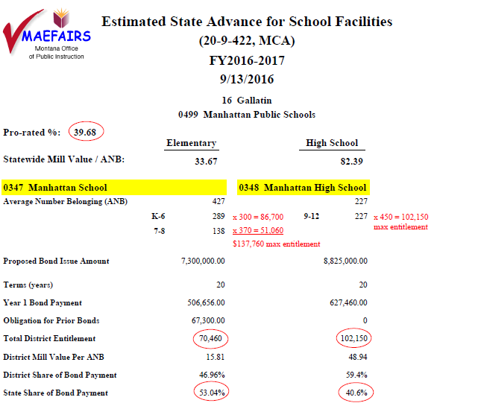
Sample state aid for debt service
This estimate remains preliminary until the bond election is passed and the debt service budget is prepared. The district’s share of the bond payment is the ratio of the district mill value per ANB to the Statewide mill value per ANB. District’s whose mill value per ANB exceeds the statewide mill value do not qualify for Debt Service GTB state funding. The Pro-rate % is the percentage of state funding provided in the previous year.
Source: Montana Office of Public Instruction

Slide 11
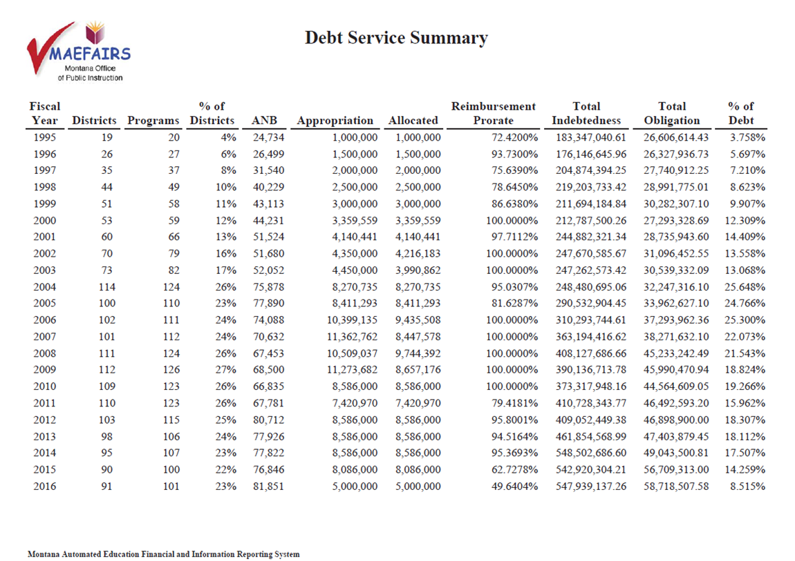
TRends in state aid for debt service

Slide 12
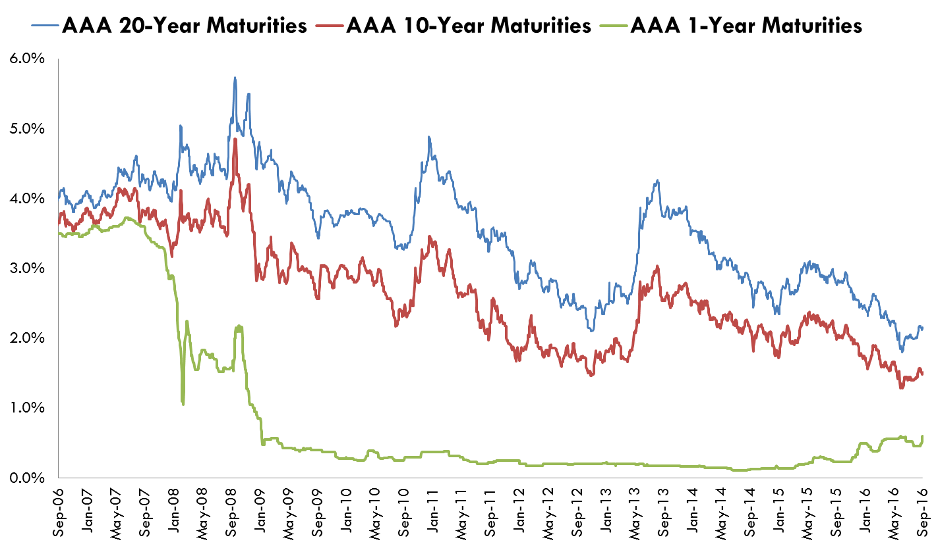
Municipal Bond market update
“AAA” Municipal Trends for 20-year Maturity, 10-Year Maturity, 1-Year Maturity
2.16%
1.51%
0.78%
Source: Thomson Reuters.

Slide 13
Sample municipal bond market rates based on rating
Municipal Market Data Benchmark Information – September 30, 2016
 |  | "AAA" | INSURED | "AA" | "A" | "BAA"
1 | 2017 | 0.78 | 0.88 | 0.82 | 0.95 | 1.20
2 | 2018 | 0.82 | 0.94 | 0.89 | 1.03 | 1.30
3 | 2019 | 0.88 | 1.05 | 0.96 | 1.13 | 1.43
4 | 2020 | 0.94 | 1.16 | 1.04 | 1.26 | 1.56
5 | 2021 | 1.02 | 1.29 | 1.13 | 1.38 | 1.68
6 | 2022 | 1.1 | 1.41 | 1.23 | 1.50 | 1.78
7 | 2023 | 1.19 | 1.53 | 1.35 | 1.62 | 1.91
8 | 2024 | 1.3 | 1.72 | 1.50 | 1.81 | 2.08
9 | 2025 | 1.41 | 1.85 | 1.63 | 1.94 | 2.21
10 | 2026 | 1.51 | 1.95 | 1.74 | 2.04 | 2.32
11 | 2027 | 1.6 | 2.06 | 1.84 | 2.15 | 2.42
12 | 2028 | 1.7 | 2.17 | 1.95 | 2.26 | 2.51
13 | 2029 | 1.79 | 2.27 | 2.04 | 2.36 | 2.60
14 | 2030 | 1.85 | 2.33 | 2.10 | 2.42 | 2.66
15 | 2031 | 1.91 | 2.39 | 2.16 | 2.48 | 2.72
16 | 2032 | 1.97 | 2.45 | 2.22 | 2.54 | 2.78
17 | 2033 | 2.02 | 2.50 | 2.27 | 2.59 | 2.82
18 | 2034 | 2.07 | 2.55 | 2.32 | 2.64 | 2.87
19 | 2035 | 2.12 | 2.59 | 2.37 | 2.68 | 2.91
20 | 2036 | 2.16 | 2.63 | 2.41 | 2.72 | 2.92
Sample Yield Curves
Sample Credit Spreads

Slide 14

School funding interim commission
Summary of Notable School
Facility Developments
Denise Williams | (406) 461-3659 | dwilliams@masbo.com

Slide 15
School funding interim commission
School Facilities – Findings
  Identified 3 “tiers” of facility needs:
    Tier 1: Operations and regular maintenance (O&M)
    Tier 2: Major maintenance
    Tier 3: New construction
  State support of Quality Schools Facility Grant Program (QSFGP) has been inconsistent
  Revenue stream for Debt Service GTB has decreased, leading to reduced reimbursement levels
  Local effort in facilities (a.k.a. “skin in the game”) helps ensure prudent planning and ongoing maintenance
  Capital improvements planning is more effective when:
    districts are provided greater budgetary flexibility
    state support for school facilities is consistent
    state programs are flexible
    districts have a long-term facilities plan based on an updated facility condition inventory
State should help fund these tiers

Slide 16
School funding interim commission
School Facilities - Recommendations
State policy needs to encourage local effort and long-range planning in managing and maintaining school district facilities
  LC ICAP – minor changes to the INTERCAP loan program
  LC EFBT – allow transfers from GF to Building Reserve
  LC GRT1 – replacing QSFGP with formula facility grant program requiring updated facility inventory and plan and local match
  LC GRT2 – revising QSFGP to require updated facility inventory and plan and local match

Slide 17
School funding interim commission
LC ICAP – minor changes to the INTERCAP loan program
  Can use to finance:
    Construction of buildings used primarily for the storage and maintenance of vehicles and equipment
    Cost of nonpermanent modular classrooms necessary for student instruction
  Allows an approved building reserve levy to be used to repay a loan up to 15 years only for projects authorized by voters
  Allows repayment from “an applicable budgeted fund of the district”

Slide 18
School funding interim commission
LC EFBT – allow transfers from General Fund to Building Reserve Fund
  Similar to transfers to Compensated Absences Fund
  For major maintenance projects
    Roofing systems
    Heating, a/c and ventilation systems
    Energy-efficient window and door systems and insulation
    Plumbing systems
    Electrical and lighting systems
    Information technology infrastructure, including internet

Slide 19
School funding interim commission
LC GRT1 – replacing QSFGP with formula facility grant program
  Eliminate School Facility and Technology Account
  Deposit riverbed and timber revenues in Guarantee Account (about $5 million)
  Guarantee Account pays $1 million technology payment to schools
  Guarantee Account sends the greater of $10 million of 20% of interest and income to new Facility Grant Program account
    All districts get “credit” that flows with local planning and effort
    Credit sits in a separate (new) account until claimed by district
  Debt Service GTB is paid from the State General Fund

Slide 20
School funding interim commission
LC GRT2 – revising QSFGP to require updated facility inventory and plan and local match
  Eliminates Facility and Technology Account
  Deposit riverbed and timber revenues in Guarantee Account (about $5 million)
  Guarantee Account pays $1 million technology payment to schools
  Creates School Debt Service Assistance Account
    Funded with lottery net revenue (about $12 million)
    Pays Debt Service GTB (about $10 million)
  Creates Major Maintenance Grant Program Account
    Intended funding is $10 million total from:
- Overflow from SDSAA (about $2 million) | - 95 mills revenue captured from TIFDs (About $2 million)
- Workers comp dividends (amount unknown) | - Transfer from Guarantee Account to bring to $10 million

Slide 21
School funding interim commission
LC GRT2 (continued)
ESTIMATED IMPACT ON STATE GENERAL FUND
 | Gains/Savings | (Losses)
Loss of lottery net revenue |  | $ 12 million
Eliminates NRD payment | $ 5 million
Repeals STEM scholarship program | $ 0.4 million
“Captured” 95 mills from TIFDs | $ 2 - $3 million
Additional needed to replace lost revenue to Guarantee Account |  | $ 2 million

