Slide 1

SECTION I: PAYROLL YEAR END
THINGS TO REVIEW AND RECORD

Slide 2
Do you have all payroll completed?
When is your county’s deadline? Allow enough time.
Did you check balances in grants and code?
Classified/Supt-Sick/Vacation can use Fund 21
Salaries should be Paid in Fiscal Year Earned…
Set a deadline and stick with it!

Slide 3
Quarterly Reports and Taxes
SUCH AS Fica/Medicare, State, TRS, PERS, Annuities, etc.
RECOMMEND COMPLETING BEFORE COUNTY DEADLINE so clears your Payroll Clearing Fund!
IF NOT – must Records what is to be paid in July as an Accrual in your TFS
JV in your accounting system
Salaries and Benefits Payable Account 661

Slide 5
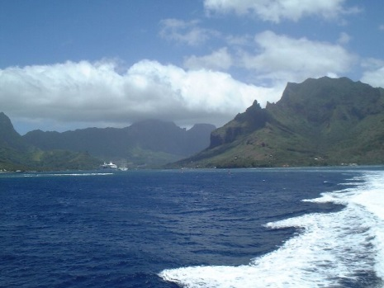
CHECK PAYROLL CODING
Run a Payroll Accounting Report – Does everything look ok?
Pay close attention to Program 280 – Special Ed State Reversion And Medicare Match
Did you ‘spend/code out all payroll grant salaries?
  Remember Fed. Grants –
  Fund X14 (County Retirement Fund) cannot pay employer benefits
Do you need to do a JV to correct Coding?
      Do as much as possible in Payroll !
      Why? OPI Compensation Expenditure Report…
    Must be within a reasonable amount 10%
    http://opi.mt.gov/LinkClick.aspx?fileticket=TOmoVQEAmZA%3d&portalid=182

Slide 6
NOTIFY THE COUNTY WHEN CORRECTING BETWEEN FUNDS
Grants (15) recoded to General or visa versa
Be sure to do by County deadline to hit their June Books
  NO system transfers after County deadline –
  Make sure clearing fund transfers show your corrections
Verify that your transfer is allowable – OPI Transfer Grid
http://opi.mt.gov/Leadership/Finance-Grants/School-Finance/School-Finance-Accounting

Slide 7

Questions?

Slide 8
TFS – PAYROLL COMPENSATED
LONG TERM LIABILTIES
WHAT ARE LONG TERM PAYROLL COMPENSATED LIABILITIES?
Section 1350.0 OPI Accounting Manual Definition:
“Compensated absences” are absences from employment
because of illness, holiday, vacation, or other ‘reasons” for which the employer pays the employee.
Purpose is to provide full disclosure of all obligations of
the district as required by GAAP. “
DOES NOT INCLUDE TERMINATION PAY PAID OUT IN CURRENT FISCAL YEAR.
NOT ENTERED IN YOUR ACCOUNTING SYSTEM BUT RETAINED FOR TFS PURPOSES ONLY!

Slide 9

TFS-PAYROLL
LONG TERM LIABILITIES
TWO TYPES: Current and Projected
1) CURRENT LIABILITIES
COMPENSATION OWED DISTRICT CURRENT EMPLOYEES- *The cost of Employer payouts of Sick/Vacation
and/or personal days to ALL staff
*Check the Collective Bargaining Agreements
*Use current FY salaries (not next year)
Includes Employer Taxes -
Fica(social security)/Medicare, TRS/PERS, WC and UI

Slide 10
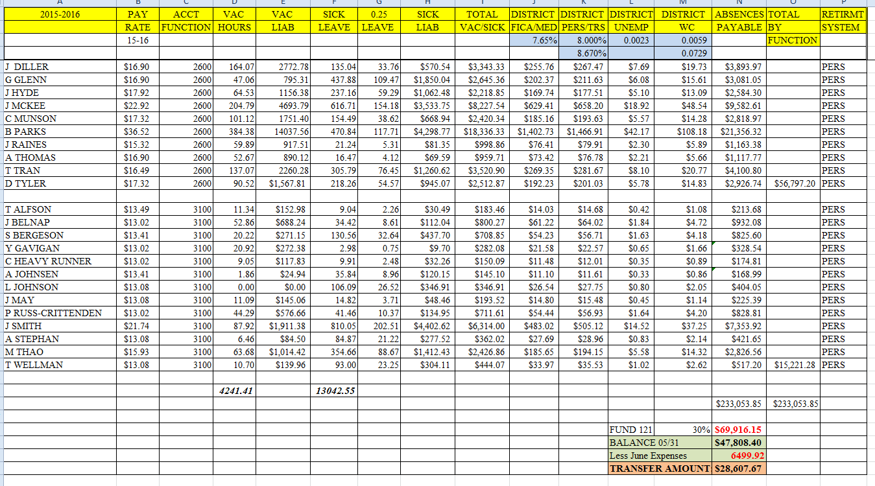

Slide 11
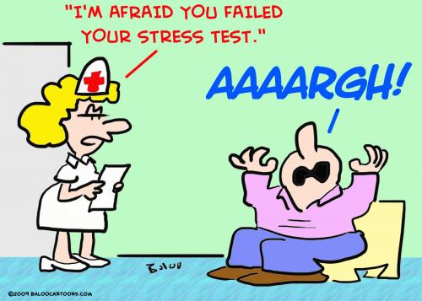
TFS - PAYROLL
LONG TERM LIABILITIES
2) PROJECTED LIABILITIES
RETIREES –DISTRICT RETIREMENT INCENTIVES
DEFINED AS RETIREMENT AGREEMENTS ENTERED INTO WHICH OBLIGATES THE DISTRICT TO MAKE PAYMENTS IN FUTURE FISCAL YEARS.
*Cost of incentives per year is a reportable liability
* Includes any payouts and/or insurance or other
benefits as part of agreement

Slide 12
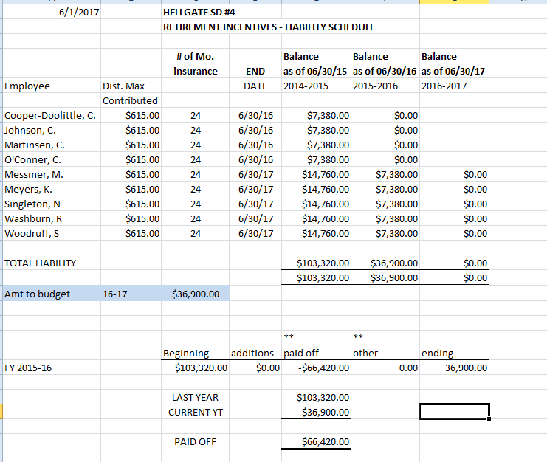

Slide 13
TFS – PAYROLL
LONG TERM LIABILITIES
3) GASB68 – TRS AND PERS LIABILITIES
*Amount to be provided by TRS/PERS – as of June 30th
*Available on MPERA/TRS Website – e-mail notification
*More info available PERS/TRS website/OPI Summer Workshop and your auditors

Slide 14
GASB 75 – POST EMPLOYMENT BENEFITS (OPEB)
GASB 75 – The actuarial cost to the district long term of the district health insurance – Retirees and current
RETAIN for input in the TFS- do not put in your software
Most districts hire a firm to complete

Slide 15
GASB 75 - OPEB

Slide 16
2. Calculate Compensated Transfer -
  Transfer 30% from GF to Fund 21
- - Classified and Superintendent
Only *
Use LT Liability Spreadsheet …..

Slide 17
2. Calculate Compensated
Absences Fund 21
a. Include Employer Taxes
•
•
•
•
•
•
b. Assign & Total by Function/District
Calculate 30% per District
Calculate amount to Transfer to Fund
21 from General Fund
Enter transfer in system
Inform County of the Transfer by County Deadline

Slide 18
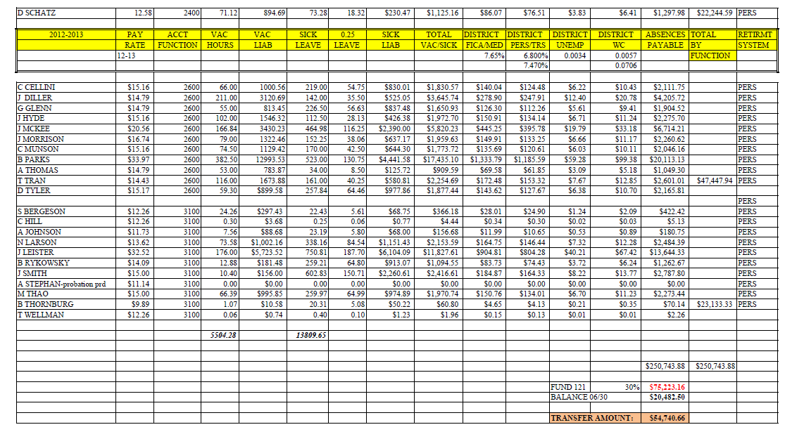

Slide 19
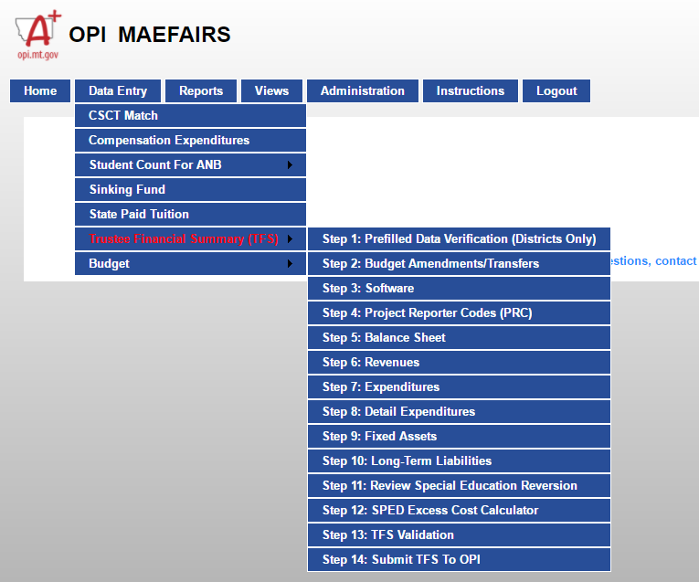
MAEFAIRS-TFS PAYROLL INPUTS

Slide 20
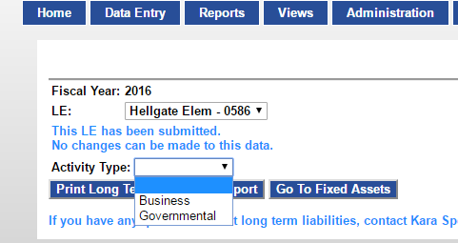
MAEFAIRS-TFS PAYROLL INPUTS

Slide 21
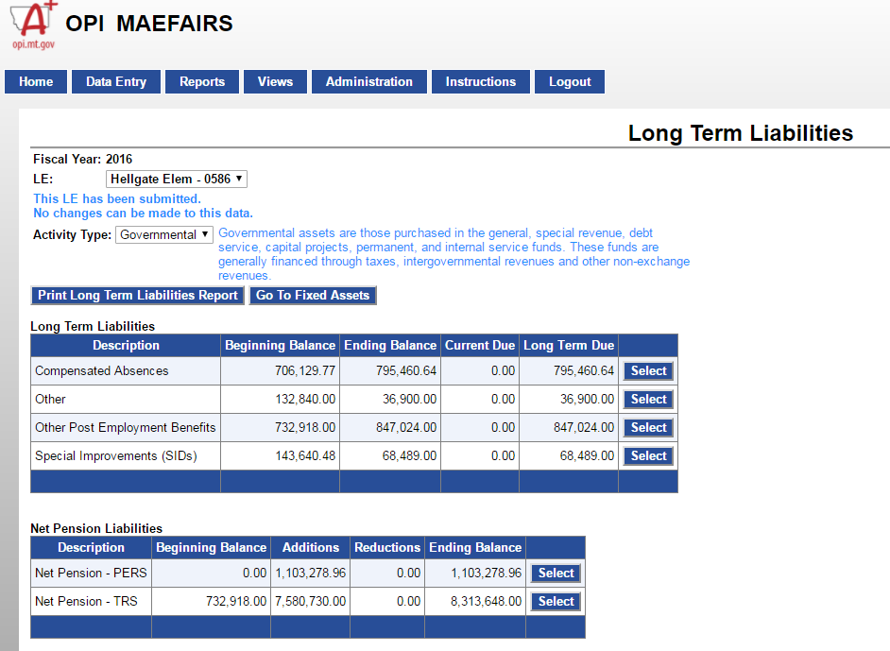
MAEFAIRS-TFS PAYROLL INPUTS

Slide 22

TFS – PAYROLL
WRAP UP - Be sure you’ve transferred all work in Payroll to FINANCE – and POSTED!
Check your Payroll JV’s
Q&A?

Slide 23


Slide 24
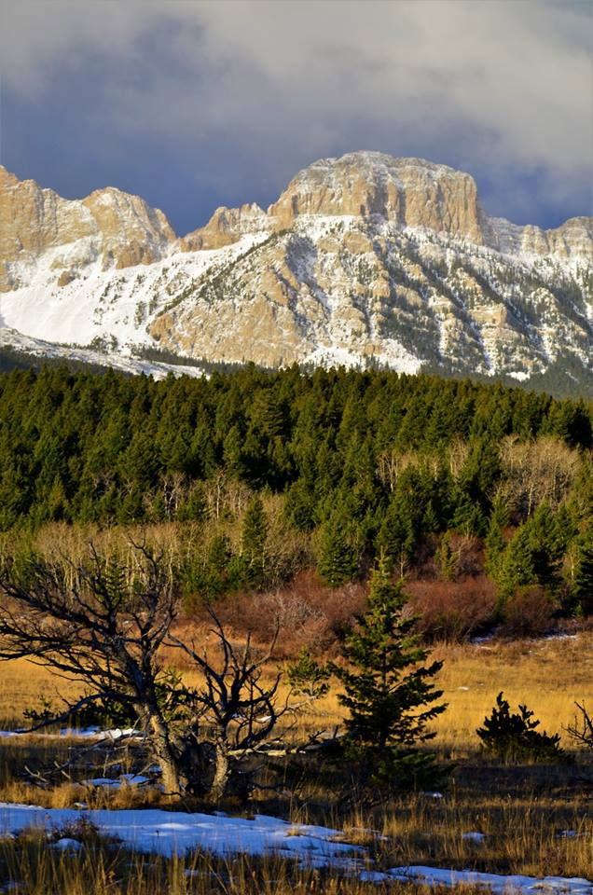
SECTION II
TFS –REVENUES AND EXPENDITURES

Slide 25
TFS –
REVENUES AND EXPENDITURES
Helpful Hints…………
Throughout the Fiscal Year:
Reconcile each Month with the County Treasurer’s Statement
1. This Includes Fund 15 Projects
2. Make sure Revenue are coded correctly to GAAP and
balance against OPI payment notices
… Revenue missing? Call County Treasurer
3. Fix errors now-WILL SAVE YOU TIME at the end of year
If not sure how, call a mentor/area clerk, software vendor, your auditor, or OPI or check OPI Accounting Manual

Slide 26

TFS – REVENUES
RECONCILING REVENUES
  1. State Payments – OPI Year to Date Report
    Correct Source Code used?
    Prefilled on MAEFAIRS -
    http://opi.mt.gov/Administrators/Payments-to-School-Co-ops

Slide 27
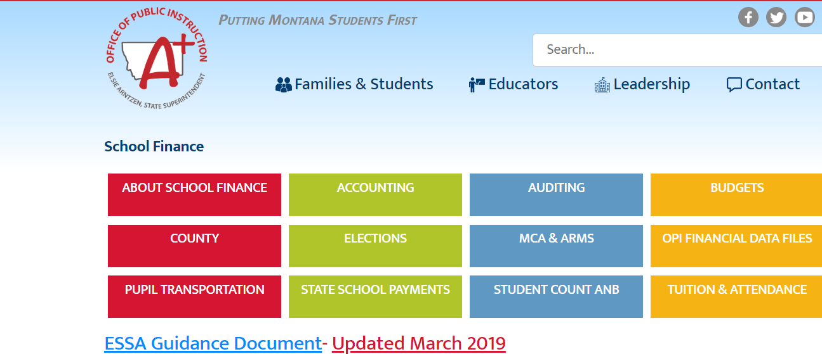

Slide 28
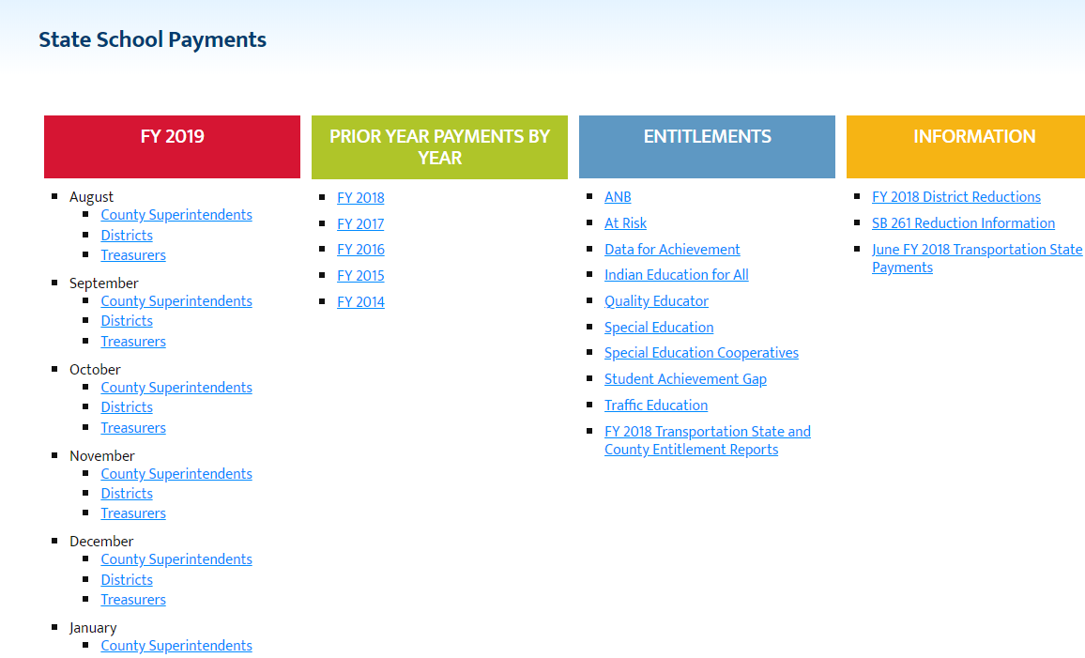

Slide 29
TFS - REVENUES
TAXES AND SPECIAL REVENUES:
General Fund District Taxes –
  1110-1115 – Are they Close to Budget?
  Lower – Could be Protested or not received Tax Payments - Cash Shortfall
  Higher – Could be received Protested/Delinquent Payments –
    Recode to 1117 (Protested/Delinquent Taxes) in a JV – Excess Reserves
    (Carries over to MAEFAIRS Budget)

Slide 31
TFS – REVENUES
WHAT TO DO:
Run a Revenue Report from your Accounting System and compare
Verify all Tax Revenues are coded correctly
Call County Treasurer to find out if there were protested tax payments received/shorted
Make a JV if needed for adjustments – Ask Auditor
    Due From - Late tax payments (won’t hit county books till next year)
    Extra received - Recode to 1117
    May need to do a fund adjustment to next year Budget – let who does this know

Slide 32

TFS - REVENUES
INFLOWS AND OUTFLOWS:
Revenues that are either owed to the district or need to be remitted to others as of June 30th.
Have not been received/or
sent at the county

Slide 33

TFS - REVENUES
EXAMPLES OF INFLOW REVENUES
CODING - XXX (Fund)–180 (acct)
  State Hot Lunch Match Payment
  Drivers Education Payment
  Grants
  Tuition Receivables

Slide 34
TFS-REVENUES
FEDERAL GRANTS AND TFS
(Title I, Title II, IDEA and other
Federal/State Grants)
Total Revenues=Expenditures
  Even if Grant carries over to next Fiscal Year
  New 14-15 IDEA Part B ends September
    If receive from a Coop, check with them on how they are handling this…

Slide 35
TFS - REVENUES
GRANTS…..
* If not all revenue received, enter amount as a “InFlow-Due From)” in System and TFS
* If grant not 100% expended,
Enter amount as a “Outflow-Do To” in system and TFS

Slide 36
17-18 | GRANT / PROJECT RECAP WORKSHEET
OVERALL YEAR END CASH BALANCE |  |  |  |  |  | School: |  | Hellgate Elementary
 |  |  | County Treasurer's Balance | 687879.02 |  | Todays Date: |  | 8/20/18
 |  |  | Clerk's fund 15 Balance | 687879.02 |  | BALANCES
 |  |  | Difference | 0.00 |  | AS OF : |  | June 30, 2018
Project Reporter Code (enter here) | Title of Program |  | Clerk's Beg. Cash Balance | Total Receipts | EXPENSES | Clerk's Ending Cash Balance | DUE FROMS | Notes RE reconcilement:
118 | Title II Part A 17-18 |  | 0.00 | 65,532.00 | 65,532.00 | 0.00
121 | Title I Academic Achievmt Award |  | 11,794.00 |  |  | 11,794.00
129 | FUTP60 6-8 16-17 |  | 262.14 |  |  | 262.14
133 | FUTP60 17-18 |  | 0.00 | 1,330.00 | 1,330.00
200 | Hellgate Hawks Kids Fund |  | 4,700.90 | 3,754.37 | 3,342.79 | 5,112.48
212 | OLWEUS-Bully Prevention Program |  | 0.00 | 526.89 | 1,642.85 | -1,115.96
213 | PTA Donations-Reimbursements |  | 3,212.74 | 0.00 | 4,967.79 | -1,755.05 | ** Due From PTA
215 | Town Pump Grant K-2 |  | 923.11 |  |  | 923.11
221 | Msla Bone&Joint-Mt of Champs |  | 2,733.24 | 2,500.00 | 2,306.49 | 2,926.75
222 | Medicaid-Misc |  | 337,915.82 | 430,846.76 | 110,826.00 | 657,936.58
223 | ASC 1st Grd Science Coach Award |  | 305.01 |  |  | 305.01
251 | Missoula Electric Coop (MEC) |  | 1,722.85 | 1,500.00 | 1,885.16 | 1,337.69
252 | Wells Fargo Found.Ed.Program |  | 892.40 |  |  | 892.40
269 | Missoula Writing Collab-MS |  | 374.27 |  |  | 374.27
271 | OneClass at a Time-Kpax |  | 170.49 | 250.00 | 251.98 | 168.51
351/353 | Medicaid - CSCT |  | 45,528.96 | 494,348.67 | 528,344.38 | 11,533.25
366 | State Gifted/Talented |  | 0.00 | 5,209.00 | 1,500.00 | 3,709.00
415 | Education In the Arts-Airport Pgm |  | 5,140.29 |  |  | 5,140.29
420 | Title I Migrant Summer Program |  | 0.00 | 0.00 | 12,370.93 | -12,370.93 | ** Due From
431 | Title III-MCPS Consortium 17-18 |  | -4,841.32 | 4,841.32 | 3,029.00 | -3,029.00 | ** Due From
462 | Wellness Council Fund |  | 221.48 |  |  | 221.48
465 | HUSSAC Mini Grant-FS |  | 490.95 |  |  | 490.95
551 | Rotary Club Student Award |  | 104.50 |  | 104.50 | 0.00
570 | All Star Education-3rd Grade |  | 66.82 |  |  | 66.82
572 | Target MS Ed Award |  | 942.45 | 0.00 | 0.00 | 942.45
573 | Target 3-5 Ed Award |  | 56.05 | 0.00 | 0.00 | 56.05
574 | Target K-2 Ed Award |  | 748.55 | 0.00 | 0.00 | 748.55
598 | Exxon/Deno's Math/Science Grant |  | 500.00 |  |  | 500.00
599 | ExxonMobil Ed. Alliance |  | 107.33 |  |  | 107.33
617 | Title I Part A 16-17 |  | -12,370.93 | 12,370.93 |  | 0.00
618 | Title I Part A 17-18 |  | 0.00 | 312,600.00 | 312,600.00 | 0.00
718 | IDEA Part B 17-18 |  | 0.00 | 274,323.00 | 274,323.00 | 0.00 |  | ends 9/30/18
721 | Walmart Foundation |  | 694.85 |  | 94.00 | 600.85
728 | IDEA Part B Preschool 17-18 |  | 0.00 | 11,412.00 | 11,412.00 | 0.00
890 | Misc Local Donations |  | 0.00 |  |  | 0.00
 |  |  | 402,396.95 | 1,621,344.94 | 1,335,862.87 | 687,879.02 | 0.00
 |  |  |  |  | Clerk Balance | 687,879.02

Slide 39
TAXES RECEIVABLES
*Taxes Receivables are Taxes still to be collected by the County as of June 30th –
County will provide amounts
Balance Sheet Accounts 120-150.
Offset is 680 – deferred outflow
Enter in JV – Reverse JV Entries in July

Slide 40

TFS - REVENUES
See OPI Accounting Manual
Section 5-200.0 For more information and accounting codes

Slide 41
TFS - EXPENDITURES
Outstanding Purchase Orders/
Encumbrances*
a. Purchase Orders Total by Fund
b. Outstanding PO’s=Encumbrances (Trial Balance Accounts 803 and 953)
c. Retain List for Auditors

Slide 42
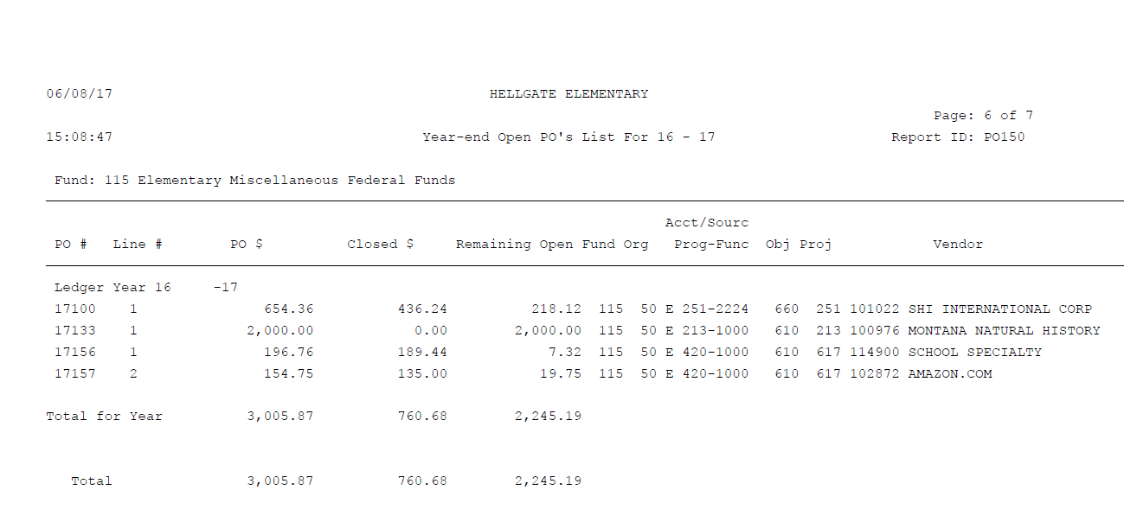

Slide 43
TFS- EXPENDITURES
Close Prior Year Purchase Orders – Goes to 1900
  Will close to 9999 revenue in BM
    JV and move to 1900 OR SPEND!
    Watch amount for GF – carries over to next fiscal year as a budgeted revenue source

Slide 44
TFS - EXPENDITURES
CREDIT CARD PAYABLES – Credit Card charges incurred before July 1st but not paid on credit card bill by June 30th.
Make a list of outstanding credit card charges by fund/accounting code. Keep and enter in your system as a Accounts Payable entry.
Example:

Slide 46
TFS - EXPENDITURES
RECORD YOUR OUTFLOWS (Payables):
*Revenues Owed to other agencies/districts
Record as a Outflow – Due From
  Expenditure record XXX-XXX-XXXX-910-971 (object)
    Record in Balance Sheets XXX - 601-770 (Acct)
Examples of Outflow Revenues:
* Tuition Payable
* Payments to Coops
* June Utilities, other expenses

Slide 47

TFS - EXPENDITURES
OTHER CODING TO CHECK:
  Program 280 – Special Education expenditures
  Object 7XX – Major Equipment/Improvements
  If find coding error, fix in JUNE books….. JV it!
    Avoid “recoding” your warrant/claim/PO unless its in the same fund
    Can cause problems with Fund Balances at County

Slide 48
TFS - EXPENDITURES
Fund 50 Debt Service Payments/Fees
* Usually Paid by County Treasurer
Most bonds paid in two installments:
1st – interest ( 150-100-5100-850)
2nd – principal( 150-100-5100-840)
( Nov/Dec – May/June
Bank Fees – annual or semi-annual
(150-100-5100-860)

Slide 49

TFS – REVENUES & EXPENDITURES
Q&A

Slide 50

5. Fixed Assets Update – GASB34*
•
a. Refer to your previous year TFS
Object 7xx expenditure
•
b. See OPI Website for Excel spreadsheet and Information *(OPI)
•
•
c. Update Your Asset List (manual or software)
•

Slide 51
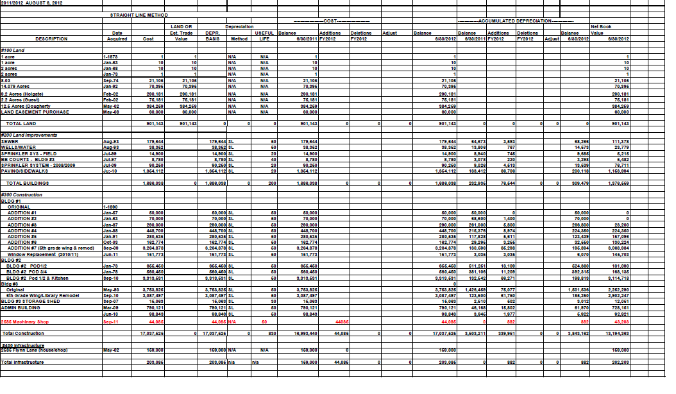

Slide 52
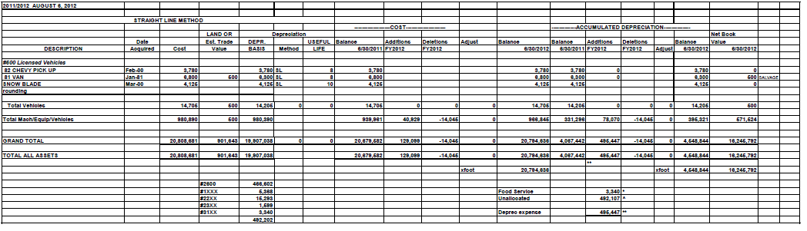

Slide 53
10. Student Activity Account
Balances – Fund 84*
a. Refer to Previous TFS –
(ending compared to current year
beginning balances)
b. Total Revenues and Expenditures
c. Record on TFS input sheet/system

Slide 54
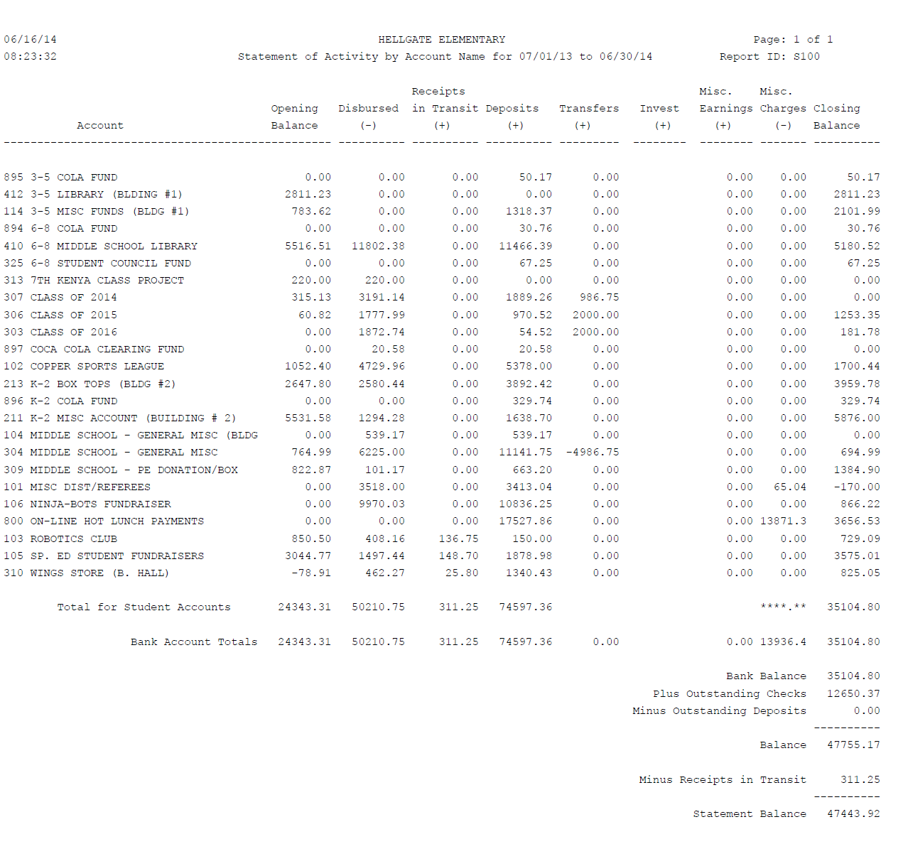

Slide 55

REMEMBER – ALWAYS ASK FOR HELP!
Your MASBO Mentor –
OPI Staff
Your neighbor school

Slide 56

THANK YOU FOR COMING!
Noreen Anderson, Hellgate SD4
nanderson@hellgate.k12.mt.us
(406) 532-4021
Lorie Carey, Jefferson County High School
Lorie.Carey@jhs.k12.mt.us
(406) 225-3740

